Slide 1
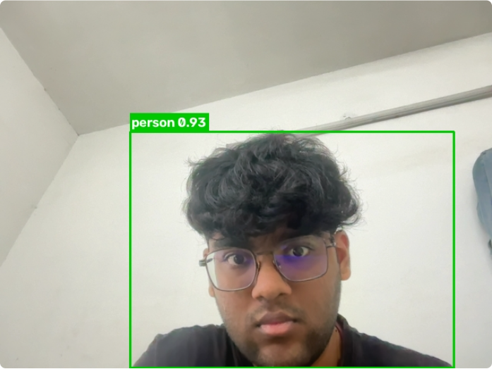
IMAGE PROCESSING AND COMPUTER VISION
Real-Time Object Detection using YOLO
Webcam → OpenCV → pretrained YOLO11n → Streamlit
Yogesh Dixit · Sumitabh Ahirwar
Smit Thakkar · Vishal Prabhu
Notes:
Our project is a real-time object detection system. The laptop webcam is read with OpenCV, every frame goes through a pretrained YOLO11n model, and the result is shown in a simple Streamlit page. The picture on the right is a real frame from our app.

Slide 2

TEAM
Team Members
Yogesh Dixit
Sumitabh Ahirwar
Smit Thakkar
Vishal Prabhu
Roll No. 20233362
Roll No. 20233280
Roll No. 20233570
Roll No. 20233582
Course: Image Processing and Computer Vision
Notes:
These are the four team members and their roll numbers. The project was done for the Image Processing and Computer Vision course.

Slide 3




PROBLEM
Problem Statement
Automatically find and name everyday objects in live webcam video, and show the result instantly with a confidence score.
Fast
A webcam delivers up to ~30 frames per second
Varied scenes
Objects change in size, position and lighting
We do not invent a new detection algorithm. We build a small, reliable system around a pretrained detector and test it.
Normal hardware
Must run on a student laptop without a GPU
Easy to read
Output must be clear to non-programmers
Notes:
The problem is to identify and locate common objects in a live video stream and show the result immediately. The difficulties are speed, varied scenes, ordinary hardware without a GPU, and a result that anyone can understand.

Slide 4
OBJECTIVES
Objectives
1
2
3
Capture live webcam frames with OpenCV
Detect objects with a pretrained, lightweight YOLO model
Draw bounding boxes, class names and confidence scores
4
5
6
Show the live result in a simple Streamlit page
Measure the real FPS and count objects per frame
Handle errors and report test results honestly
Notes:
Our six objectives: capture frames, detect with a pretrained YOLO model, draw the results, show them in Streamlit, measure real FPS and counts, and handle errors while reporting results honestly.

Slide 5
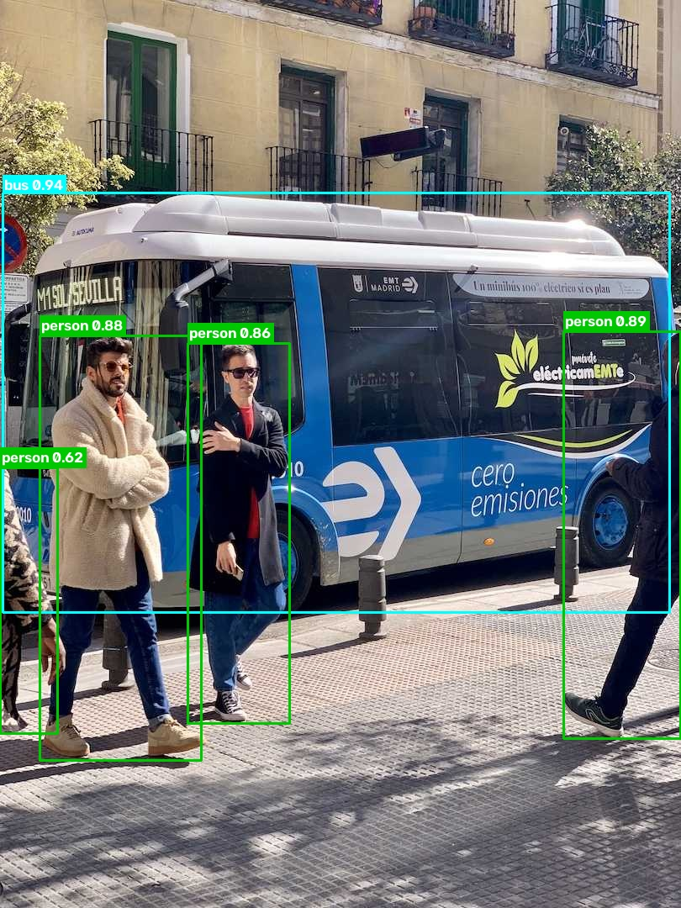
BACKGROUND
What is Object Detection?
Object detection answers two questions: what objects are in the image, and where are they?
Bounding box: a rectangle (x1, y1, x2, y2) around each object
Class label: the object's name, e.g. “bus” or “person”
Confidence score: how sure the model is, from 0 to 1
Classification = one label per image · Detection = box per object · Segmentation = label per pixel
Notes:
Object detection gives a box, a class label and a confidence score for every object. This is different from classification, which gives one label for the whole image, and from segmentation, which labels every pixel. The image is our app's real output on a sample image: one bus and four people.

Slide 6
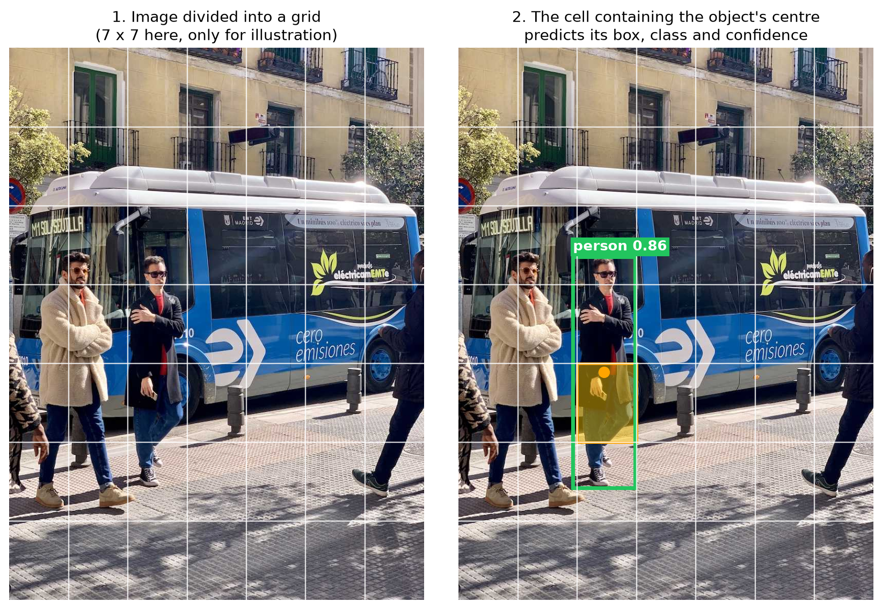
MODEL
YOLO: You Only Look Once
One pass
One CNN looks at the whole image once and predicts all boxes together
Grid idea
The cell containing an object's centre predicts its box, class and confidence
Clean-up
Non-Maximum Suppression removes duplicate boxes (IoU > 0.7)
Pretrained
Ultralytics trained YOLO11n on COCO. We did not train it.
YOLO11n · 2.6 M parameters · 5.4 MB weights · 80 COCO classes · 39.5 mAP50-95 (reported by Ultralytics)
Notes:
YOLO is a single-stage detector: one network, one pass. In the original paper the image is split into a grid, and the cell containing an object's centre predicts it. NMS removes duplicate boxes. We use the pretrained YOLO11n nano model from Ultralytics. It has 2.6 million parameters and was trained by Ultralytics on the COCO dataset.

Slide 7
ARCHITECTURE
System Architecture
Webcam
Streamlit UI
OpenCV Capture
Pretrained YOLO
Object Detection
Boxes + Labels + Confidence
Streamlit Display
laptop camera
toggle + threshold slider
VideoCapture, 640x480 BGR
yolo11n.pt, COCO
boxes, classes, scores, NMS
cv2.rectangle / putText
BGR → RGB, st.image
repeat for every frame until detection is switched off
Everything runs locally on the laptop: no backend server, no database, no cloud. Streamlit is the only UI framework.
Notes:
This is the complete pipeline. The webcam is controlled from the Streamlit UI. OpenCV captures a frame, YOLO detects objects, we draw the boxes, labels and scores, and Streamlit displays the frame. Then the loop repeats for the next frame.

Slide 8
METHOD
Methodology: One Loop per Frame
1
2
3
4
5
Capture
Detect
Draw
Measure
Display
cap.read()
model(frame, conf=t)
cv2.rectangle, cv2.putText
FPS = 1 / Δt
cvtColor BGR→RGB
BGR frame, 640x480
boxes, classes, scores
“person 0.92”
Counter(labels) per frame
st.image in a placeholder
Before the loop: model loaded once (@st.cache_resource), camera opened (error message if it fails)
After the loop: switching the toggle off stops the script and cap.release() frees the webcam
Notes:
For every frame we do five steps: capture, detect, draw, measure FPS and counts, and display. FPS is calculated from the real time of one loop. Before the loop the model is loaded once. When the user switches detection off, the camera is released.

Slide 9



TOOLS
Technologies Used
Python 3.11
OpenCV 5.0
Programming language for the whole project
Webcam capture, drawing boxes and text, BGR→RGB conversion
Ultralytics 8.4
Streamlit 1.64
Loads the pretrained YOLO11n model and downloads its weights
Very basic web UI written only in Python
Also: PyTorch 2.14 runs the network (installed with Ultralytics), NumPy decodes uploaded images.
Not used: FastAPI/Flask, databases, React, Docker, cloud services, model training.
Notes:
We used four main tools: Python, OpenCV, Ultralytics YOLO and Streamlit. PyTorch runs the network in the background. We kept the stack minimal: no backend, no database and no training.

Slide 10
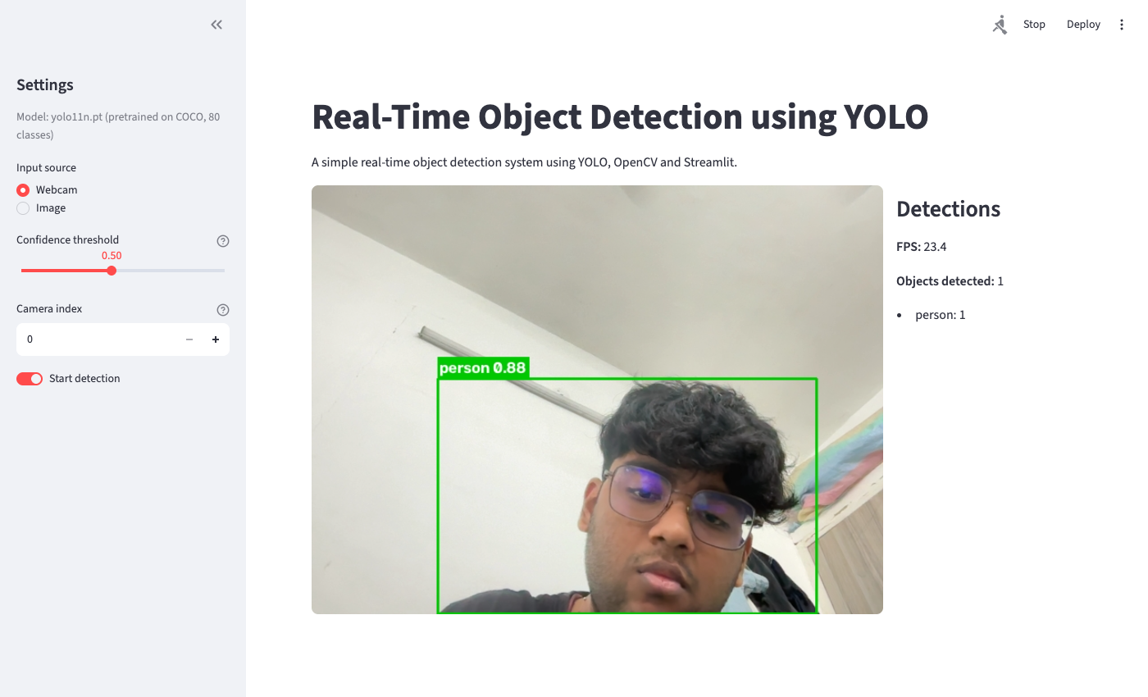
IMPLEMENTATION
Implementation and User Interface
app.py
Streamlit page, controls, webcam loop
src/detector.py
loads YOLO11n, detect() → list of boxes
src/utils.py
draw boxes, format labels, FPS, count
About 310 lines of Python in total
Controls: input source, confidence slider, camera index, start/stop toggle
Notes:
The screenshot is from our live test: the person is detected with 0.88 confidence at 23.4 FPS. The code is split into three files: app.py for the UI and loop, detector.py for YOLO, and utils.py for drawing, FPS and counting.

Slide 11
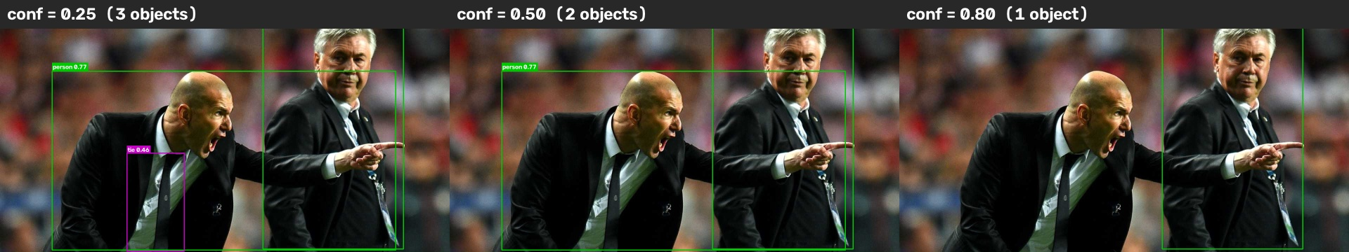
RESULTS
Results (measured on our laptop)
22–24
31 ms
0.77–0.94
FPS in the live app
YOLO11n per frame
person confidence
one browser tab, CPU only
640x480, mean of 50 runs
52 saved live frames
Confidence threshold 0.25 / 0.50 / 0.80 → 3 / 2 / 1 detections (tie 0.46 only appears at 0.25)
MacBook Air, Apple M3, 8 GB RAM, no separate GPU. With two browser tabs running detection at the same time, FPS fell to about 10–14.
Notes:
These are real measurements from our laptop. The app ran at 22 to 24 FPS, the model needs about 31 ms per frame, and the person in front of the camera was detected with 0.77 to 0.94 confidence. The images show the effect of the threshold: lower values show more, but weaker, detections.

Slide 12
TESTING
Testing
Test | How | Result | Status
Webcam opens | live | video shown at 22–24 FPS | Pass
One object | live | person 0.88, count = 1 | Pass
Multiple objects / classes | image mode | bus + 4 persons; tie, clock | Pass
Different distances | live + simulated | nothing found at 1/8 scale | Pass*
Different lighting | simulated | bus missed at 5% brightness | Pass*
Empty scene | image mode | 0 objects, app keeps running | Pass
Confidence threshold | image + live | 3 → 2 → 1 detections | Pass
Webcam unavailable | no camera permission | clear error message, no crash | Pass
Stop detection | toggle off | loop stops, camera released | Pass
* limit found. Lighting and distance were simulated with OpenCV. Multi-object and multi-person cases used sample images.
Notes:
We tested the main cases. Live tests used the webcam. Multiple objects and people were tested with sample images, and lighting and distance with OpenCV simulations, and we mark them clearly. All tests passed. The simulations show where the model reaches its limits.

Slide 13


OUTLOOK
Limitations and Future Scope
Limitations
Future Scope
Speed depends on the laptop's CPU
Low light and small or far objects reduce accuracy
Only the 80 COCO classes (a watch was once labelled “bottle”)
Per-frame count only, no tracking
Webcam must be on the computer running the app
Bigger models (YOLO11s/m) or a GPU
Custom training for new object types
Object tracking with IDs across frames
Mobile or edge devices (Raspberry Pi, Jetson)
ONNX export and other speed optimisations
Notes:
The main limitations are hardware-dependent speed, sensitivity to lighting and object size, the fixed set of 80 classes, and no tracking. Future work could use bigger models, custom training, tracking, or deployment on small devices.

Slide 14
CONCLUSION
Conclusion
Working real-time detector: webcam → OpenCV → YOLO11n → Streamlit at about 22–24 FPS on a laptop CPU.
Honest scope: the YOLO model is pretrained by Ultralytics. Our work is the integration, testing and documentation.
Easy to explain: 3 small Python files, about 310 lines, only 4 packages.
Thank you. Questions?
Notes:
To conclude: we built a working real-time object detector with a pretrained YOLO11n model, OpenCV and Streamlit. It runs at about 22 to 24 FPS on a normal laptop. Our work was integrating and testing the model, not training it. Thank you, we are happy to take questions.

