Slide 1




SMART INDIA HACKATHON 2026
Problem Statement ID – SIH 26164
Problem Statement Title- Enterprise Cryptographic Discovery & Analysis Tool (ECDAT)
Theme- Blockchain & Cybersecurity
PS Category- Software
Team ID-
Team Name- Mudrita

Slide 2
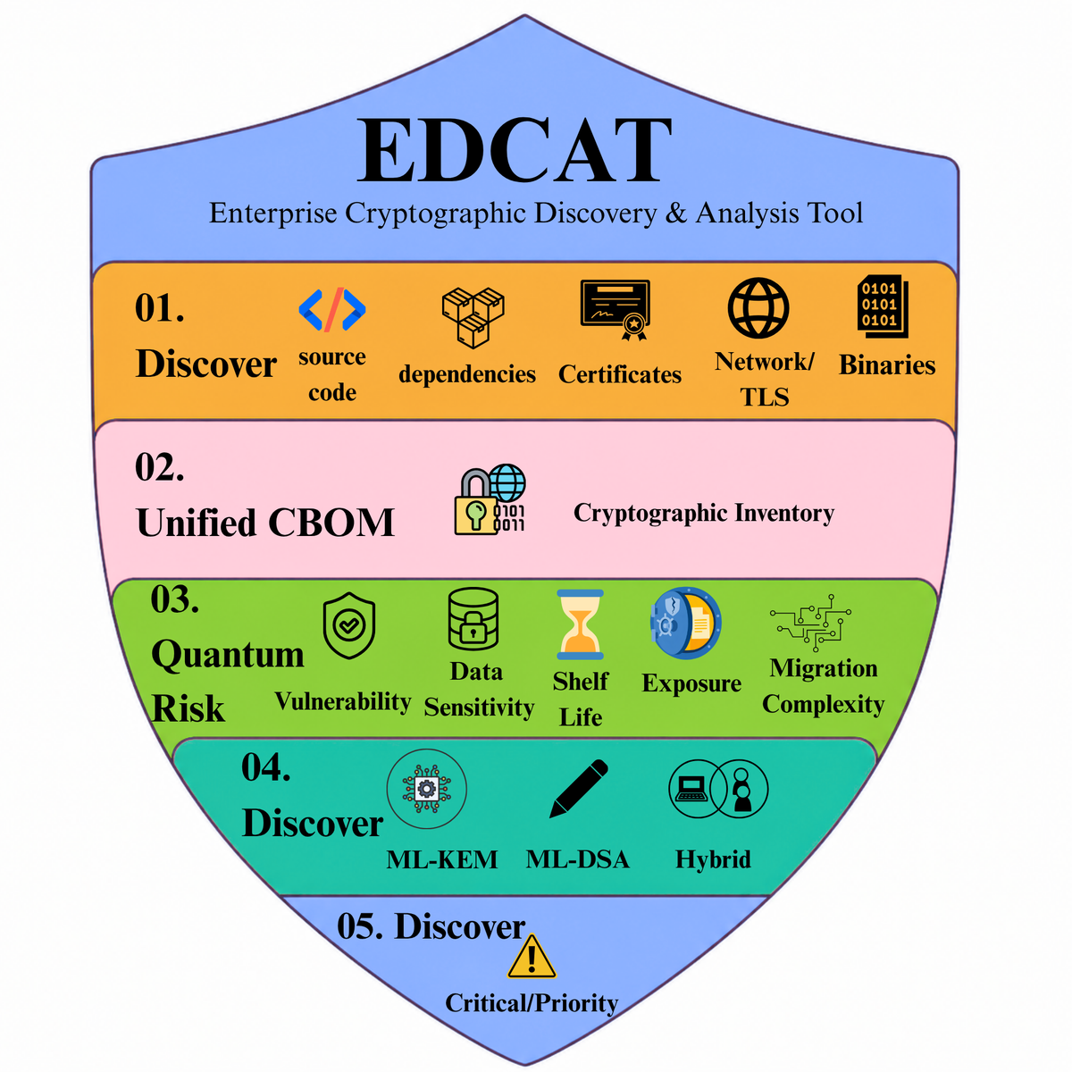

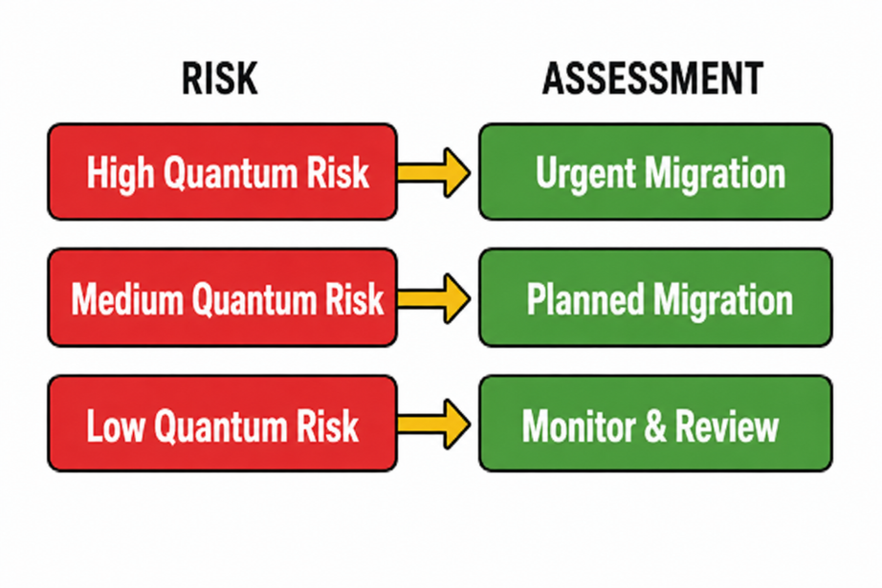
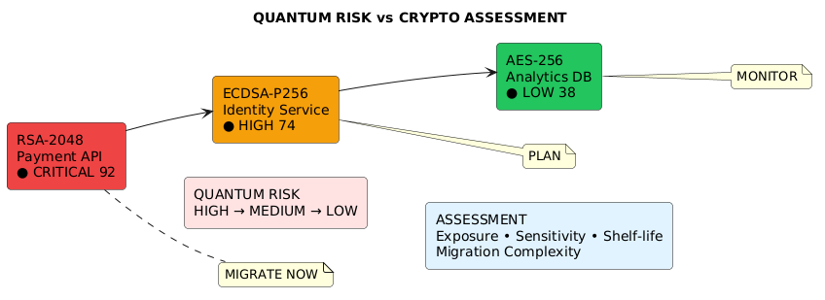


Enterprise Cryptographic Discovery & Analysis Tool (ECDAT)
The problem: Crypto is scattered across enterprise systems.
No unified visibility or migration priority.
VS
Why It Matters?:Quantum-vulnerable crypto threatens long-lived sensitive data.
Limited migration time increases future exposure.
The Solution :ECDAT discovers and analyzes enterprise cryptography.
It scores risk, recommends PQC, and prioritizes migration
Click here
Link
Prototype
@SIH Idea submission- Template
‹#›

Slide 3
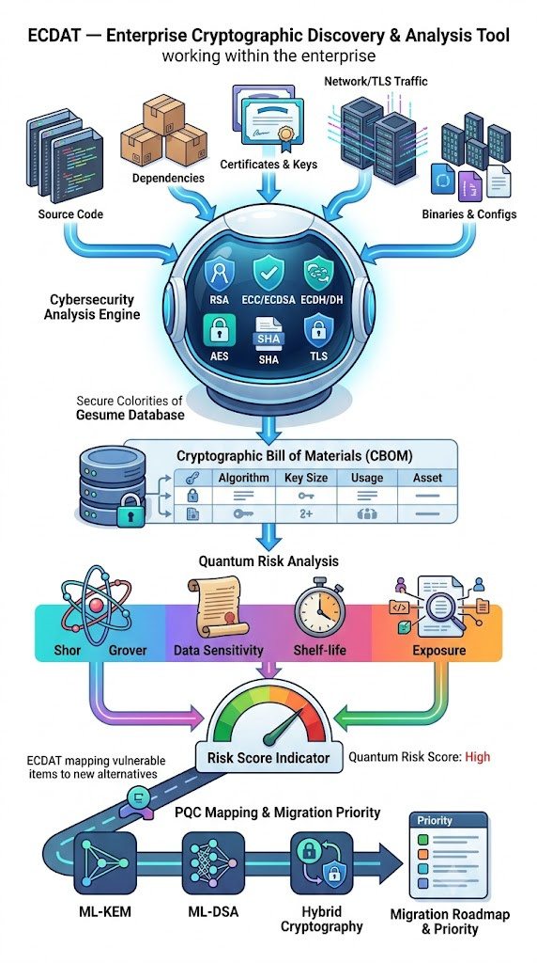
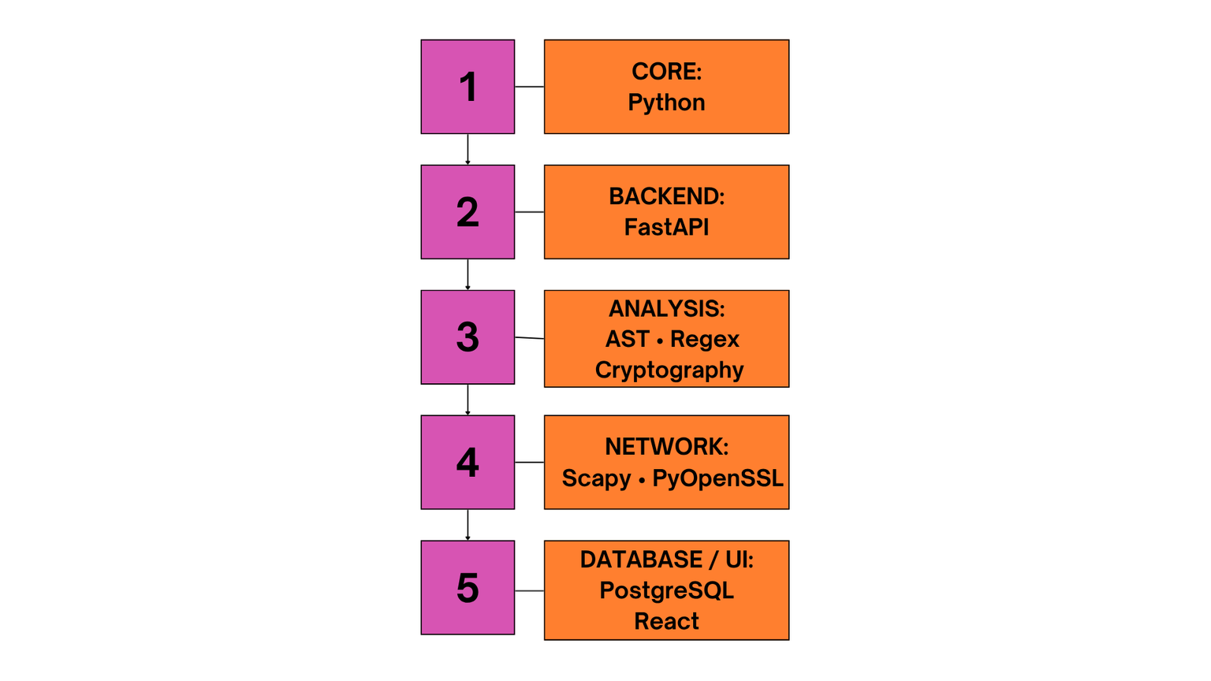
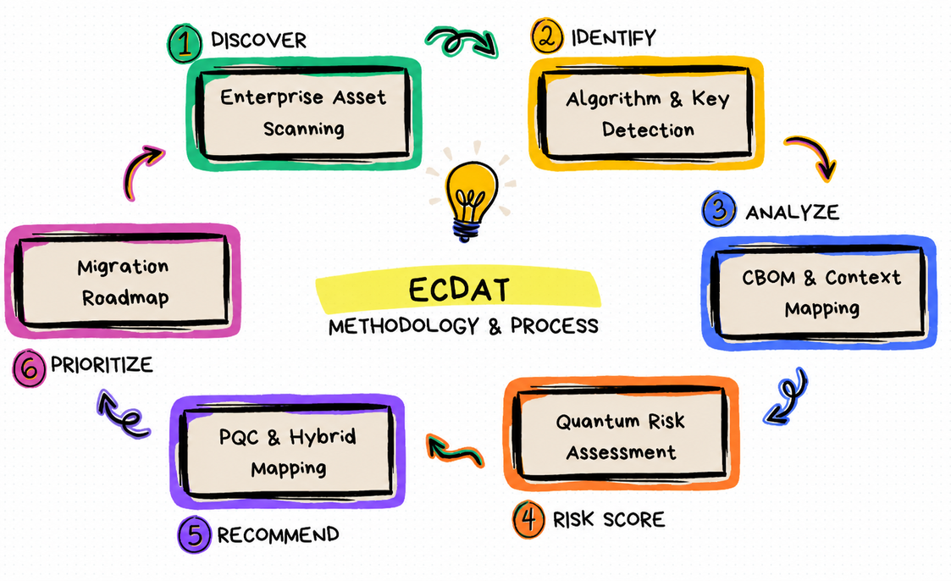
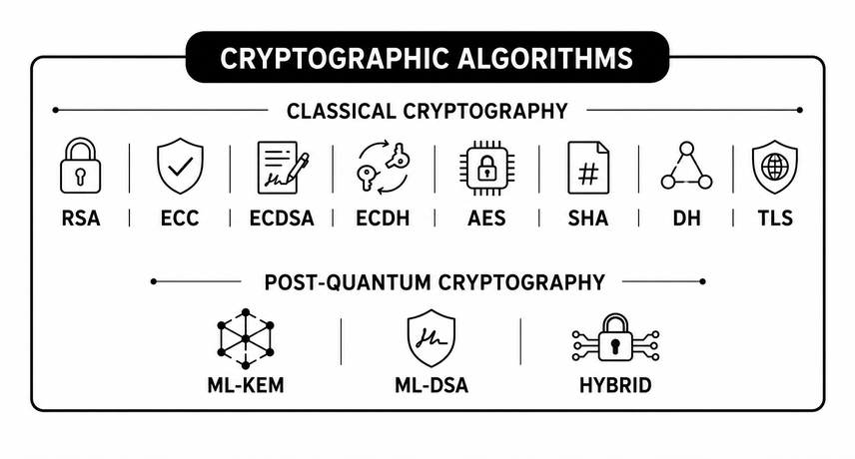
Mudrita
TECHNICAL APPROACH
Detailed Report
GITHUB REPORT
‹#›
‹#›

Slide 4
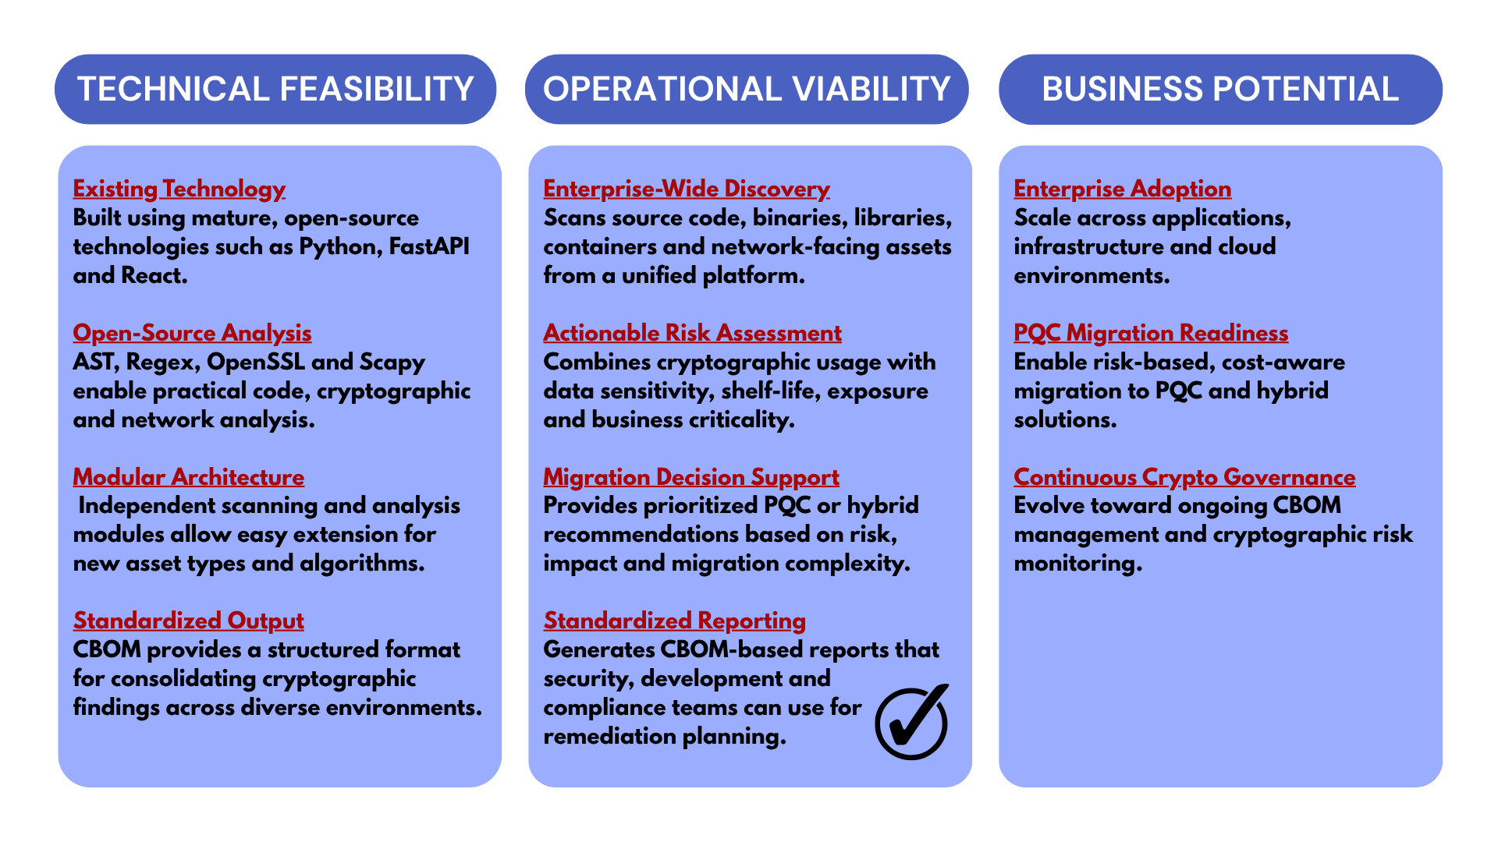

Mudrita
FEASIBILITY AND VIABILITY
‹#›

Slide 5
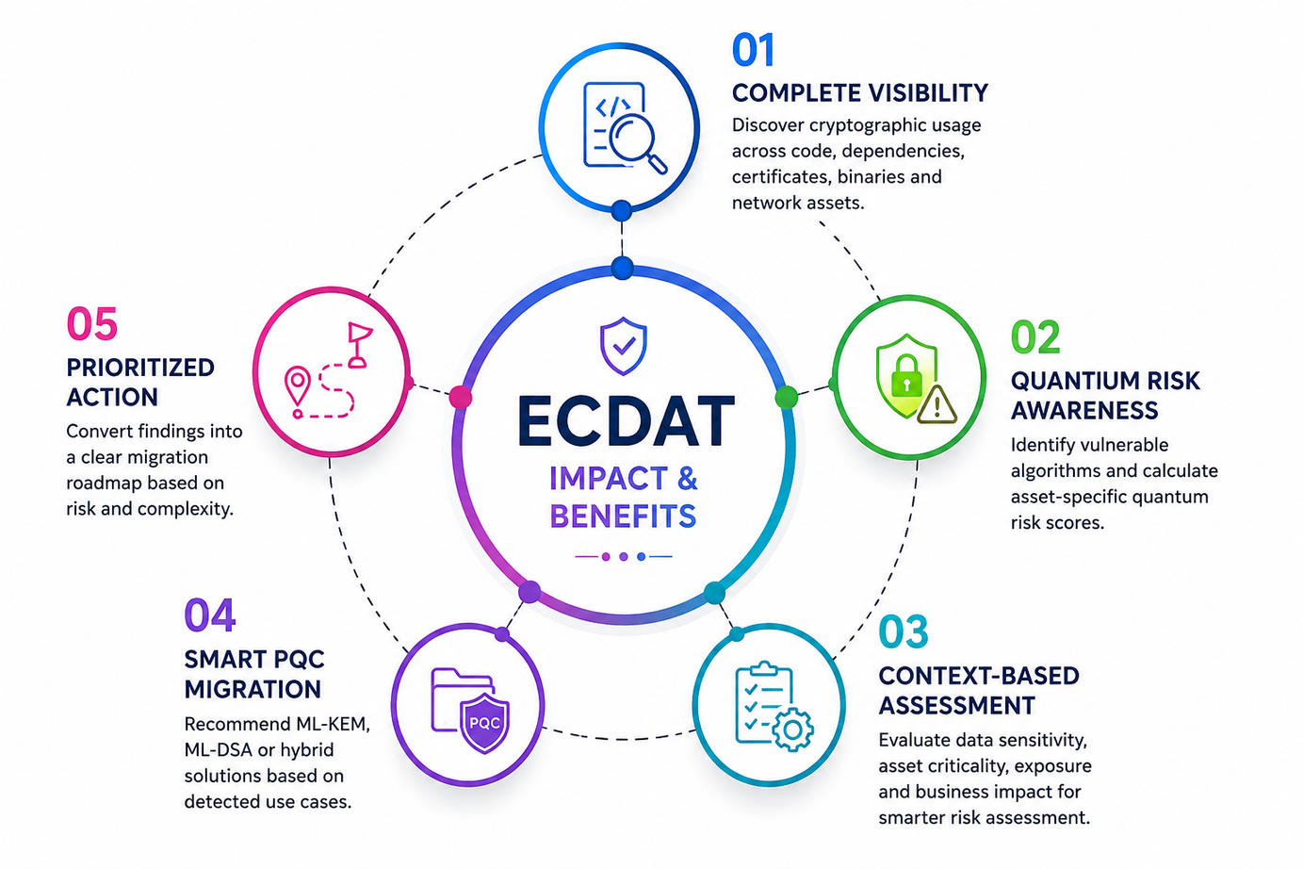
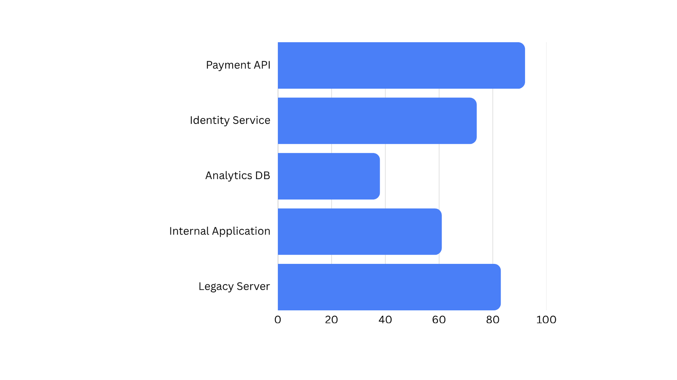
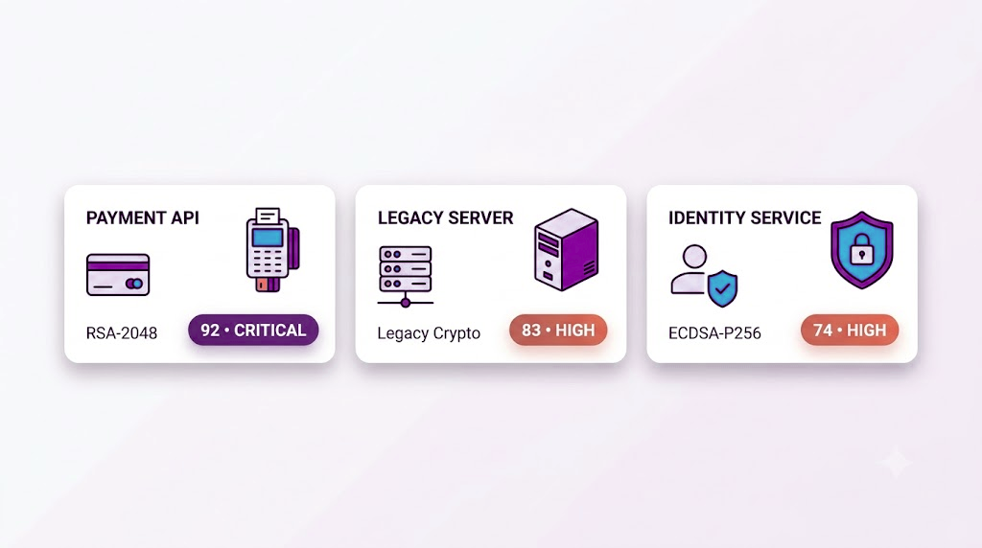
Mudrita
IMPACT AND BENEFITS
QUANTUM RISK–BASED PRIORITIZATION
‹#›
‹#›

Slide 6

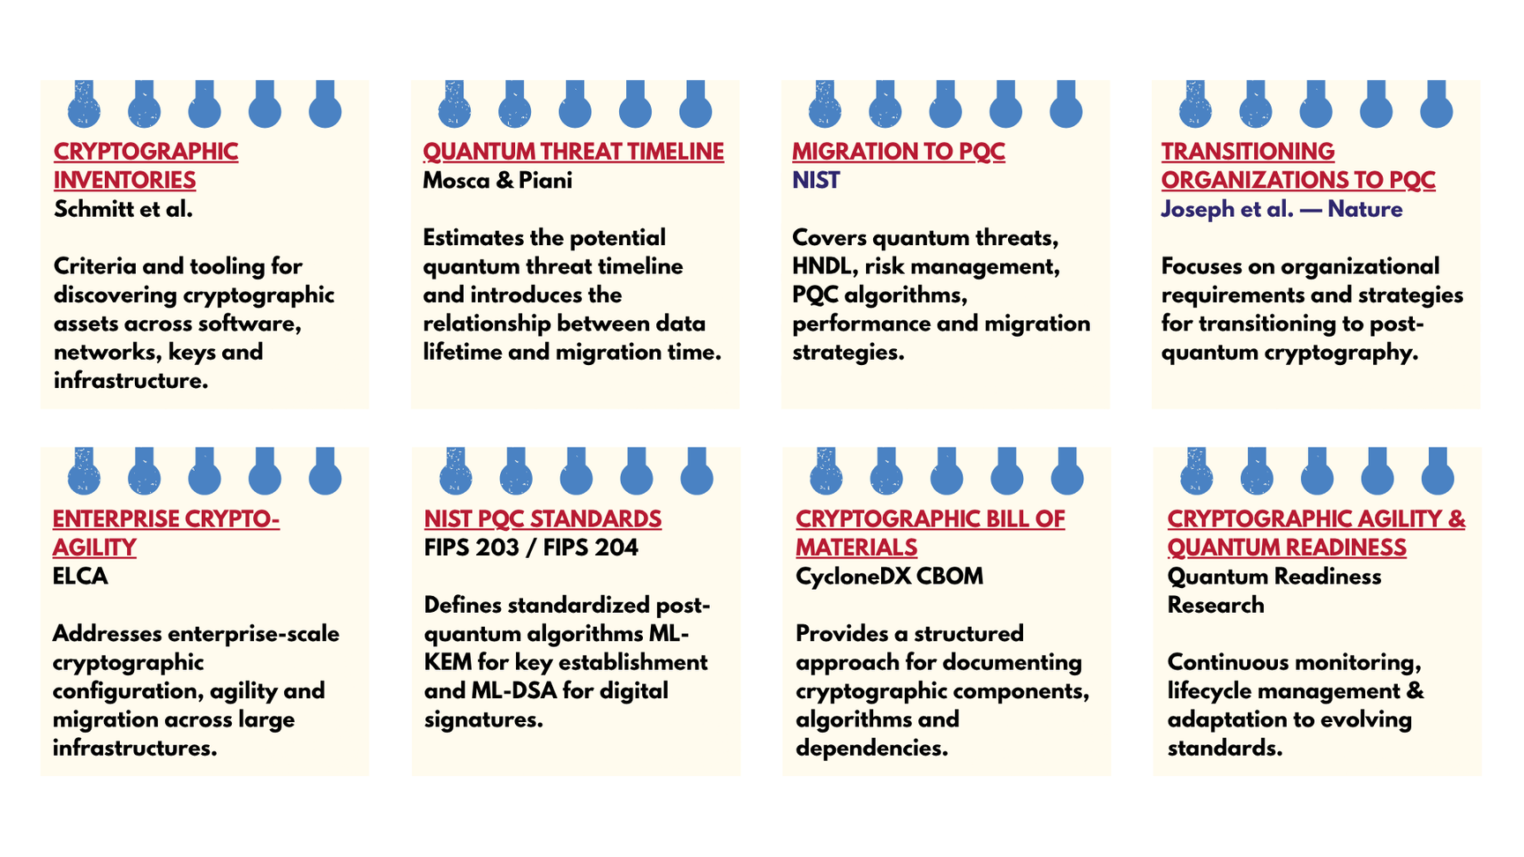


Mudrita
RESEARCH AND REFERENCES
COMPLETE RESEARCH & REFERENCES →
View all papers, standards and sources
‹#›

