Slide 1

Fork and Potato: The RPG
Group 37
Nick Milton
Stephanie Reed
Simon Chen
Adam Hsu
Sean Miyaoka

Slide 2
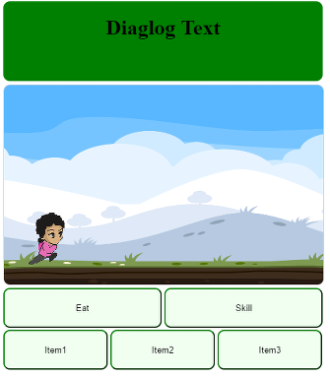
Educational RPG
Automatic sidescroller where you choose a variety of food saving attacks or use items to prevent food going bad that you encounter.
Defeat bosses by answering food waste questions.
Web app
Target audience Children 8-12

Slide 3
Weekly Challenge - Affiliates page
Fully Complete
Made use of the shared google doc
Had to change our site map, created a link from the home page that goes to a new affiliate page
<insert affiliate page here>

Slide 4
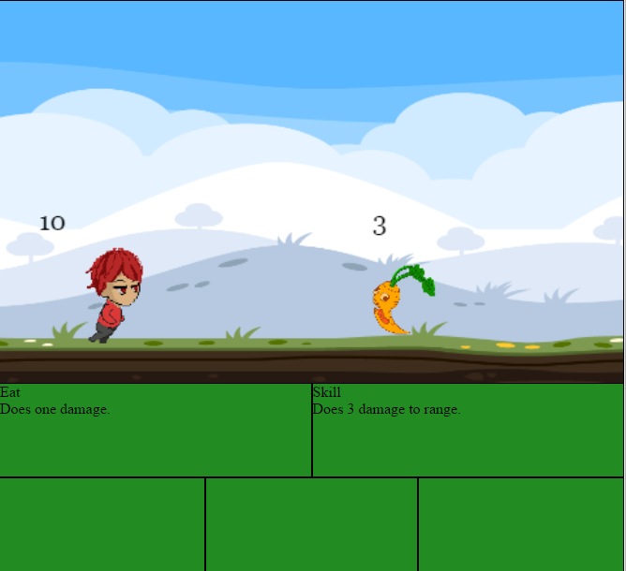
Artwork – Tasks Completed
1st level artwork finished
Implement full player artwork
Implement full enemy artwork

Slide 5
Artwork – Tasks not COmpleted
Artwork not implemented
Implement full defeat artwork
Implement full character selection artwork
Implement full start screen artwork
Implement full main menu artwork
Implement full registration artwork
Implement full login artwork
Challenges
Animations had to be separated into frames

Slide 6
Gameplay – Tasks Completed
Gameplay mechanics implemented
Basic functions for combat system
Auto attack, items and skills added
Added core gameplay loop
Collision mechanic added
Added boss and quiz section
Placeholder level is fully functional

Slide 7
Gameplay - Tasks not Completed
Mechanics not implemented yet
Defeat Overlay javascript functionality
Gameplay dialogue functions
Gameplay dialogue implemented with placeholder
Challenges
Not enough detail on gameplay mechanics description
Needed to write a gameplay design document
Changed to a collision based mechanic

Slide 8
Database – Tasks Completed
A database with a sufficient number of trivia questions
Researched and created 25 questions
Formatted questions into multiple choice
Created a JSON file and imported the questions to firebase
Database functions
Worked out how to save and retrieve data
Enough functionality to enable game mechanics

Slide 9
Database – Tasks not Complete
Level data
Enter enemy stats in database
Setup character level progress and item objects
Account registration and login
Code javascript for user registration page to firebase
Javascript for user login
Challenges
New to firebase
Need to use the correct version of the firebase library

Slide 10
Adjustments to Sprint 2
Take forward incomplete tasks
Change from database login to facebook login
Make viewing on mobile a priority
Sidescrolling speed may differ depending on display settings

Slide 11
Demonstration
http://students.bcitdev.com/A00863917/G37/index.html

Slide 12
Fork and Potato: The RPG
Questions?
Group 37
Nick Milton
Stephanie Reed
Simon Chen
Adam Shu
Sean Miyaoka

