Slide 1

Fork and Potato: The RPG
Group 37
Nick Milton
Stephanie Reed
Simon Chen
Adam Hsu
Sean Miyaoka

Slide 2
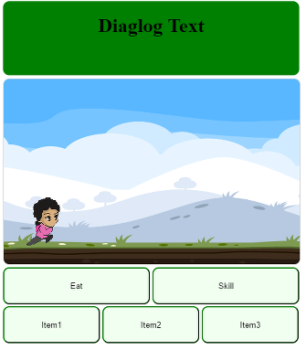
Educational RPG
Automatic sidescroller where you choose a variety of food saving attacks or use items to prevent food going bad that you encounter.
Defeat bosses by answering food waste questions.
Web app
Target audience Children 8-12

Slide 3
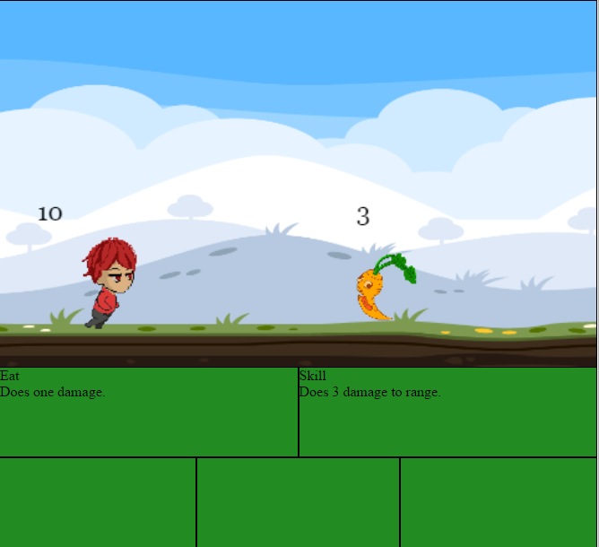
Artwork and UI – Tasks Completed
1st level artwork finished
Full player artwork
Full enemy artwork
Background artwork
Implemented login and create account overlay

Slide 4
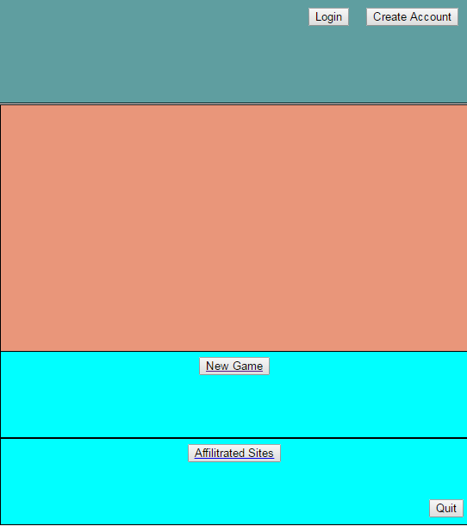
Artwork and UI – Tasks not Completed
Artwork not implemented
Menu screens
Level background needs to look like a perfect loop
UI not implemented
Full character selection
Color scheme not fully implemented
Buttons and fonts need styling
Challenges
Animations had to be separated into frames
Animation issues with displaying running character

Slide 5
Gameplay – Tasks Completed
Core Mechanics
Basic functions for combat system
Auto attack, items and skills added
Added core gameplay loop
Collision mechanic added
Added boss and quiz section
Placeholder level is fully functional

Slide 6
Gameplay - Tasks not Completed
Mechanics not implemented yet
Defeat/Victory Overlay
No pause menu
No exit from gameplay
Gameplay dialogue functions
Challenges
Not enough detail on gameplay mechanics document
Changed to a collision based mechanic

Slide 7
Database – Tasks Completed
A database with a sufficient number of trivia questions
Researched and created 25 questions
Formatted questions into multiple choice
Created a JSON file and imported the questions to firebase
Database functions
Worked out how to save and retrieve data
Enough functionality to enable game mechanics

Slide 8
Database – Tasks not Complete
Level data
Enter enemy stats in database
Setup character level progress and item objects
Account registration and login
Challenges
New to firebase
Connection problems solved with correct version of the firebase library

Slide 9
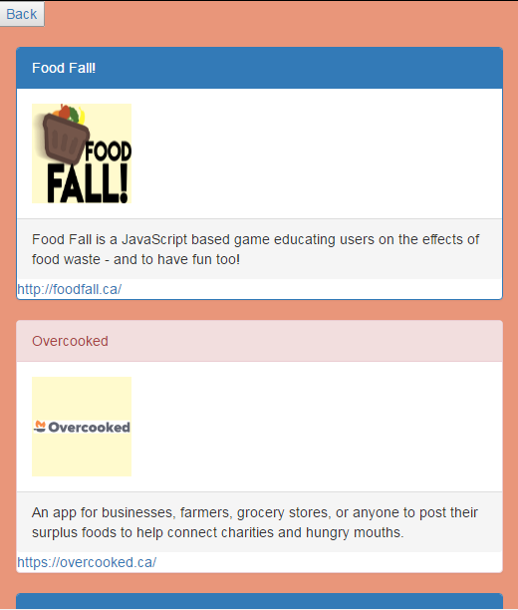
Weekly Challenge - Affiliates page
Fully Complete
Made use of the shared google doc
Had to change our site map, created a link from the home page that goes to a new affiliate page

Slide 10
Adjustments to Sprint 2
Take forward incomplete tasks
Gameplay UI
Dialogue system
Make viewing on mobile number 1 priority
Sidescrolling speed may differ depending on display settings
Reconsider character animation method
Consider facebook login as option

Slide 11
Fork and Potato: The RPG
Demo & Questions
Group 37
Nick Milton
Stephanie Reed
Simon Chen
Adam Shu
Sean Miyaoka

