Slide 1
Fork and Potato: The RPG
Group 37
Nick Milton
Stephanie Reed
Simon Chen
Adam Shu
Sean Miyaoka

Slide 2
Primary Target User: Elementary School Children
Accessibility
Using parent’s smartphone or touchpad
Will have small hands and device will be heavy to them
May hold with one hand and touch with the other
May use a smartphone in two hands
Drawn to graphics rather than excessive text content
Lots of free time

Slide 3
Primary Target User: Elementary School Children
Habits/Characteristics
Will mostly play games or watch videos
Learns quickly and highly susceptible to messages
Will nag parents if they want something
Ages 6 to 8 will take messages literally
Ages 8 to 12 will have started to develop a sense of identity

Slide 4
Orientation and Screen size

Slide 5
Layout

Slide 6
Controls and Navigation

Slide 7
Color Scheme

Slide 8
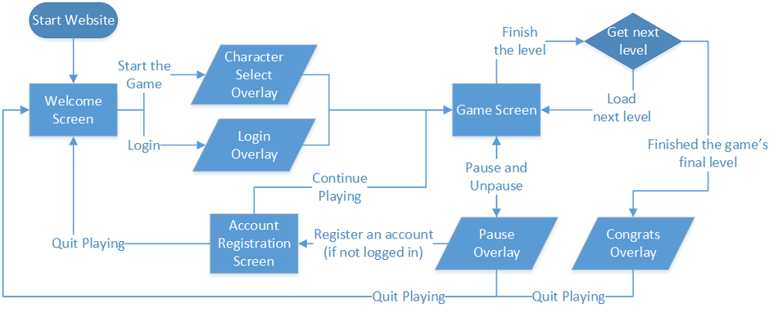
Site Map

Slide 9
Slide Design

Slide 10
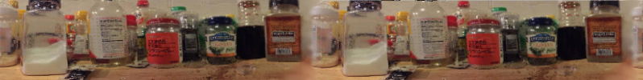


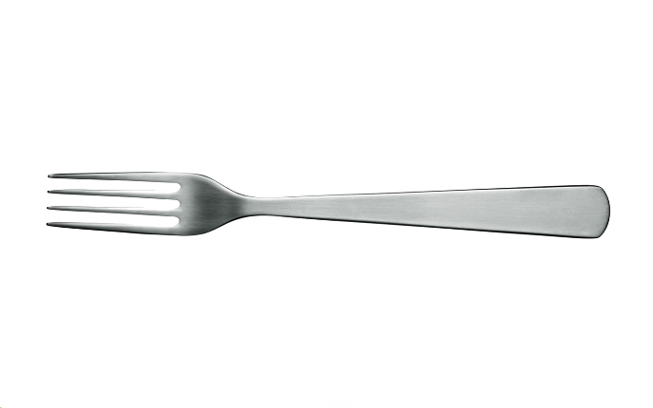
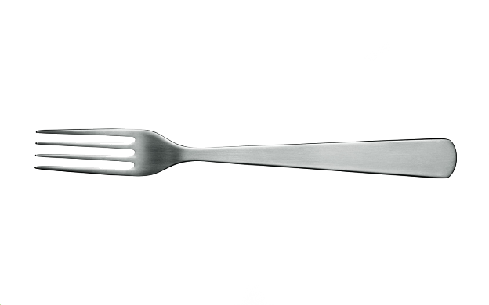
How do you PEREVENT potatoes to sprout ??
So as YOU !
Because you don’t know the following question!
HAHAHAHA，I’m Master Potato.
No one can stop us to be come a tree!!!
Put it into water, keep it wet.
Put it in a dark place, keep it wet.
Put it on newspaper, keep it dry.
Put it into your mouth, keep it ever.

