Slide 1

Fork and Potato: The RPG
Group 37
Nick Milton
Stephanie Reed
Simon Chen
Adam Hsu
Sean Miyaoka
Notes:
Nick -- Good morning. Thank you all for coming out to see the culmination of 5 weeks of hard work of all the groups presenting today.
My name is Nick. This is Steph, Sean, Simon and Adam.
We worked on a web app to educate children on zero food waste. Back at the start of the 5 weeks we came up with an initial idea for this app. This was our 30second pitch.

Slide 2
30 second pitch
https://youtu.be/PmBImuXe5l4

Slide 3
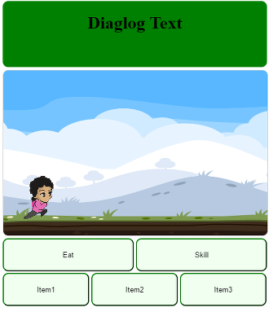
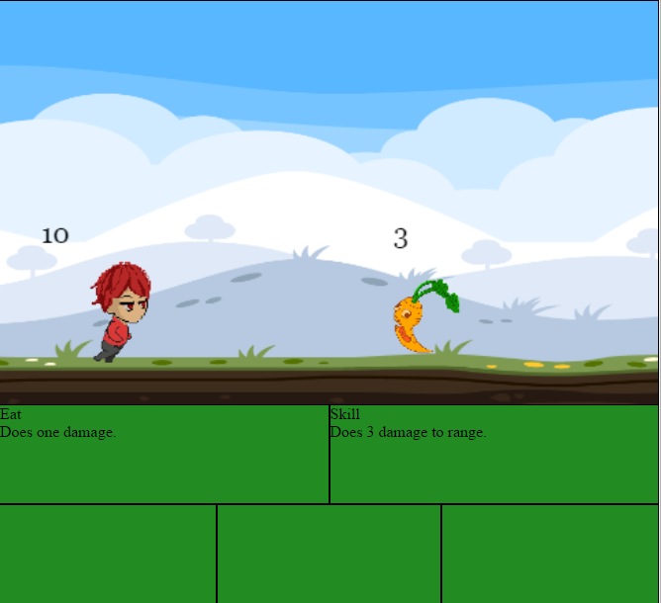
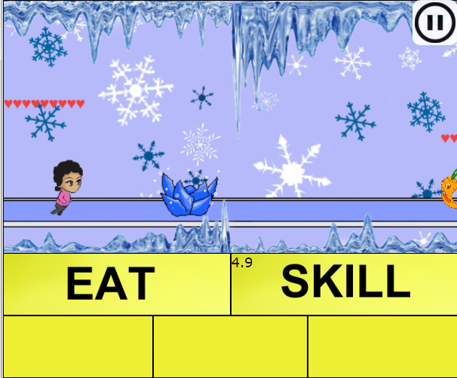
App development
Notes:
Steph -- So our app turned out very different from the initial idea as the project evolved over several weeks and we adapted to the challenges that came up.
Our first idea was a zero food waste trivia game for teenagers and young adults, where you answer as many questions as possible for sixty seconds.
However, upon receiving feedback, we learned that a trivia game would not appeal to these demographics.
What really moved our idea forward was changing our target audience to children. Apps marketed at adults may not be compelling enough to effect any significant change in food use behavior. However, children’s behavior can be influenced to form good habits that they will discuss with their parents and maintain as they get older.
Sean -- Then we struck upon the idea of making a fun game with a narrative about food waste. Where the user would play a character that proceeds through level, saving bad food, by taking actions to preserve food and prevent food waste. At the end of each level, the character would face a boss that can only be defeated with knowledge of zero food waste. That way we could incorporate a quiz, and learning, with a sense of fun.

Slide 4




Technologies
Notes:
Sean -- The requirements for the project are that it would be a web based app. So we would have to use HTML and CSS.
JavaScript was the go to language that can handle a web based game and it is where we created the game mechanics.
Simon -- To keep the coding and delivery simple, we used firebase for the backend. That way we could use JavaScript to access it. And firebase offers a real-time database and authentication functions. It also offers a way to login using social media which came in handy later on.
As well as the coding languages, it must be noted that one of our group members created a lot of original artwork for our game. The animations were particularly challenging but we are very pleased with the result.

Slide 5
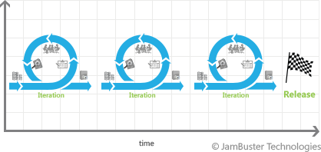
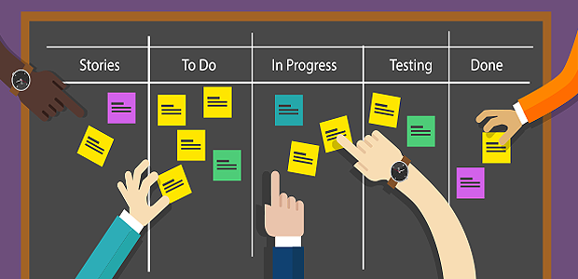
Agile Management
Notes:
Sean -- We used an agile as a project management method. We would create tasks with a certain priority and each iteration, group members would complete those tasks in order of priority. With agile, our morning scrums for each meeting became very important. The pace was fast and tasks were ticked off quickly, or some tasks needed more focus due to unforeseen challenges. An example of this was that our initial plan for animations was to use animated gifs for characters. However the animations were not displayed on the JavaScript canvas. So each frame had to be displayed and an animated with JavaScript.
Nick -- We would present plans for tasks for the week to our peers, other groups and our instructors. Then the week would close with another presentation on our achievements and challenges. This was really helpful as our fellow classmates ask insightful questions or gave us helpful feedback on our process. We found this incredibly helpful as it gave us great perspective on our project.
We will now go through our app.

Slide 6
Fork and Potato: The RPG
Demo
Group 37
Nick Milton
Stephanie Reed
Simon Chen
Adam Shu
Sean Miyaoka
Notes:
Adam --

