Slide 1

Fork and Potato: The RPG
Group 37
Nick Milton
Stephanie Reed
Simon Chen
Adam Hsu
Sean Miyaoka

Slide 2
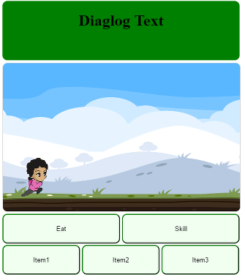
Educational RPG
Automatic sidescroller where you choose a variety of food saving attacks or use items to prevent food going bad that you encounter.
Defeat bosses by answering food waste questions.
Web app
Target audience Children 8-12

Slide 3
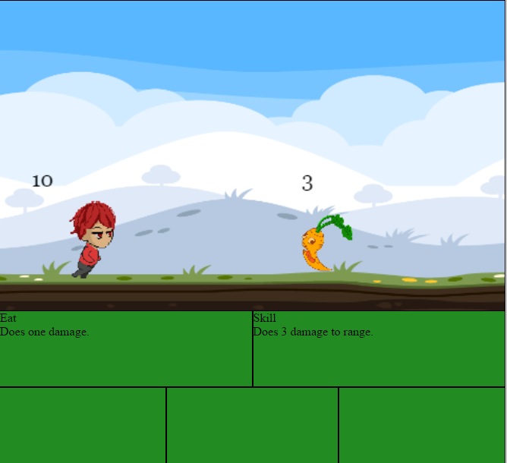
Accomplishments so far
Created a playable game
Linked firebase to pull game data
Created an appealing aesthetic and character

Slide 4
What we will do differently to sprint 1
Previous week we focused on desktop implementation, this week test implementation on mobile
Increase from 2 to 4 hours working as a group/pair programming

Slide 5
Artwork and UI
Implement all art on menu screens
Make the Level background a perfect loop
Implement Full character selection screen
Finalize styling and CSS on all menu screens
Solve the character animation glitches

Slide 6
Gameplay
Features to be created
Game Over / Level Complete Overlay
Pause menu
Gameplay dialogue functions
Randomize questions pulled
Level design and playtesting
Consider designing multiple levels

Slide 7
Database
Enter enemy stats in database
Setup character level progress and item objects
Enter level narrative
Add account registration and login functionality
Implement RegEx
Explore the feasibility of facebook login
Create more questions

Slide 8
Member focus
Simon- Database and login
Steph – Gameplay
Nick – CSS and menu UI
Adam – Artwork and animation
Sean – Character select, UI overlays, affiliate art sites

Slide 9
Weekly Challenge – Easter Egg
All enemies change into Easter eggs upon holding pause button
Require several members to collaborate on art and gameplay
Reduce number of affiliate sites from 4 to 3
Add site URL and logo to google docs spreadsheet

Slide 10
Fork and Potato: The RPG
Questions
Group 37
Nick Milton
Stephanie Reed
Simon Chen
Adam Hsu
Sean Miyaoka

