Slide 1
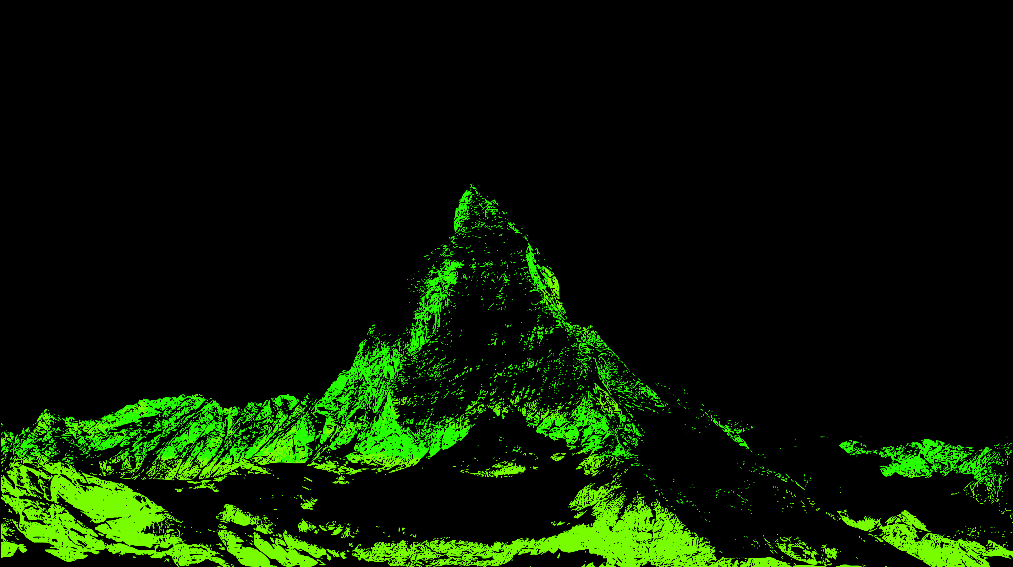
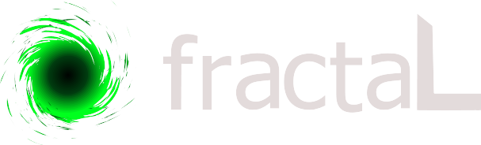
[ A TOOL FOR DIGITAL LITERACY AND ECOLOGICAL thinking ]
Art
Ecology
Technology
[Fernando Daguanno | Saulo Jacques | Fabian Sguiglia]

Slide 2
[ current context ]
{ FACT }
{ PROBLEMATIC }
{ CONSEQUENCES }
}
ANTHROPOCENE
MASSIVE DATA
TECHNOLOGICAL SOCIETY
ENVIRONMENTAL CRISIS
NOISE & CONFUSION
LACK OF TECHNOLOGICAL KNOWLEDGE AND PARTICIPATION ON PRODUCTION
PASSIVE CONDITION &
NO MOBILIZATION TO OVERCOME
THIS SYSTEMATIC CRISIS

Slide 3
[ current context ]
{ FACT }
QUESTIONS
ANTHROPOCENE
MASSIVE DATA
TECHNOLOGICAL SOCIETY
WHAT ARE THE TOOLS TO UNDERSTAND THE PROBLEMS THROUGH CRITICAL THINKING?
HOW TO DEAL WITH A MASSIVE AMOUNT OF DATA?
COULD DIGITAL LITERACY REACH BEYOND TRAINING AND PROMOTE A REAL INCLUSIVE PROCESS?

Slide 4
[ current context ]
{ FACT }
QUESTIONS
{ fractaL }
ANTHROPOCENE
MASSIVE DATA
TECHNOLOGICAL SOCIETY
WHAT ARE THE TOOLS TO UNDERSTAND THE PROBLEMS THROUGH CRITICAL THINKING?
HOW TO DEAL WITH A MASSIVE AMOUNT OF DATA?
COULD DIGITAL LITERACY REACH BEYOND TRAINING AND PROMOTE A REAL INCLUSIVE PROCESS?
EVALUATE THE ECOLOGICAL ISSUE AND FACILITATE THE DEBATE AND KNOWLEDGE PROCESSES.
DATA AS A SOURCE FOR LEARNING AND CREATION THROUGH SOUNDS & IMAGES
OPEN TECHNOLOGY AND OPEN SCIENCE PROMOTING PARTICIPATION AND SKILL IMPROVEMENT

Slide 5

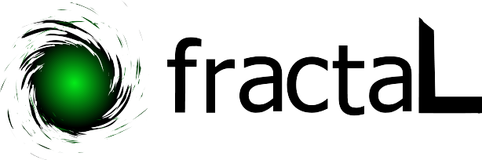
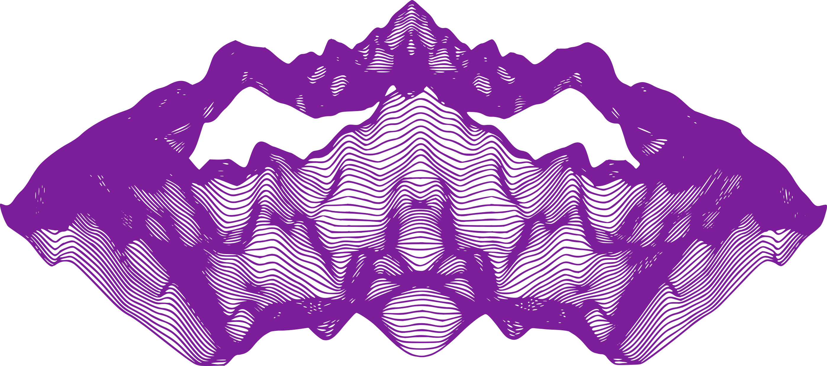
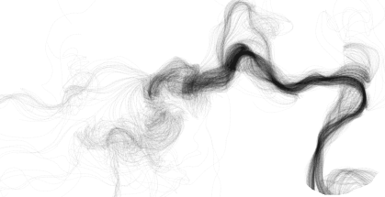
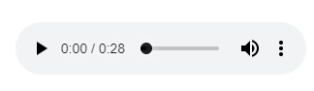
[What is fractaL?]
The Colors of Waterflow
The Shape of Biodiversity
The Shape of Biodiversity

Slide 6
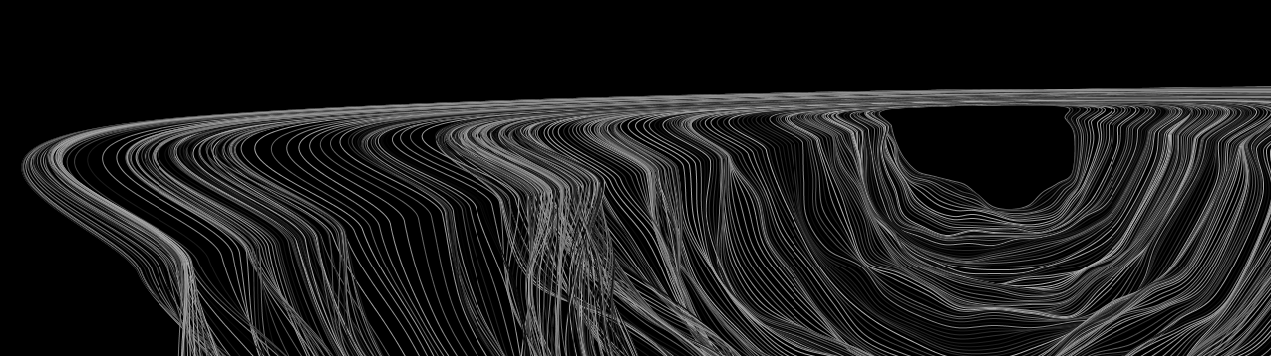
[What is fractaL?]
A 10 months educational program that helps young people learning python language
using and transforming environmental data
into SOUNDS & IMAGES

Slide 7
[WE USE]
Technology
{ we develope fractaL CODE as a tool for learning and studing }
{ beginners friendly }
Art
{ we traduce the code into synestetic rapresentations of images and sounds}
Ecology
{ we use as a base environmental data set and evolutions e.g.: AMAZON }

Slide 8
[WE USE]
Education
{ Our workshops and classes are thought to transmit strong skills on programming language and scientific thought }
Participation
{ interactive classes and art, participatory process of society in doing science}

Slide 9
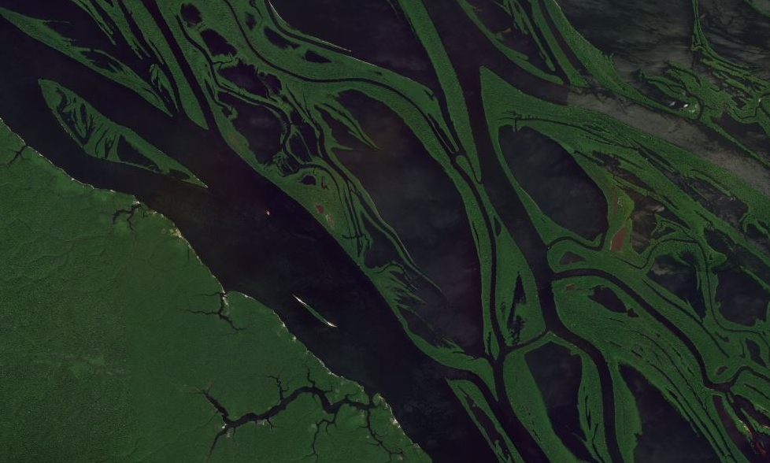
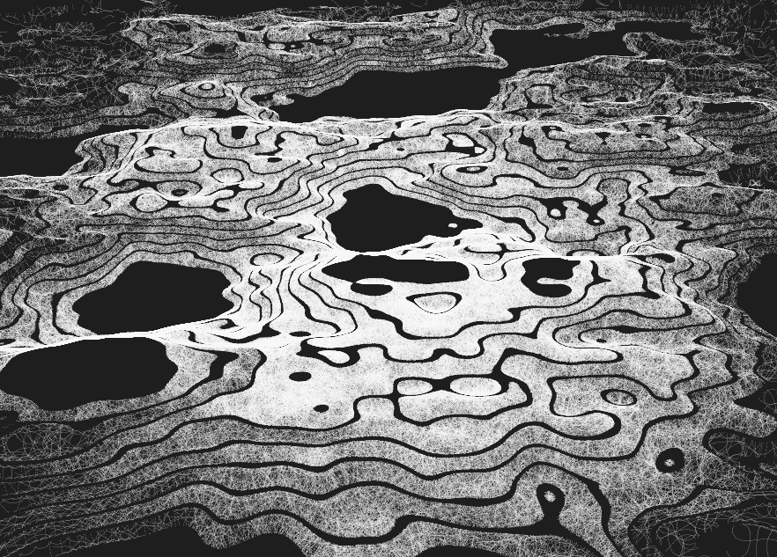
[WE USE]
[ FRACTAL & synesthesia ]
Fractal Geometry is a way of measuring the degree of roughness or brokenness or irregularity in an object. Contrary to triangles, squares, circles, rectangles, the shapes in Fractal Geometry are not regular at all.
The principles of Fractal Geometry are broadly used to generate computer graphics and create digital worlds, or in ecological research as a way to better understand the natural patterns around us.
Amazon Archipelago
Simulation using fractal geometry

Slide 10
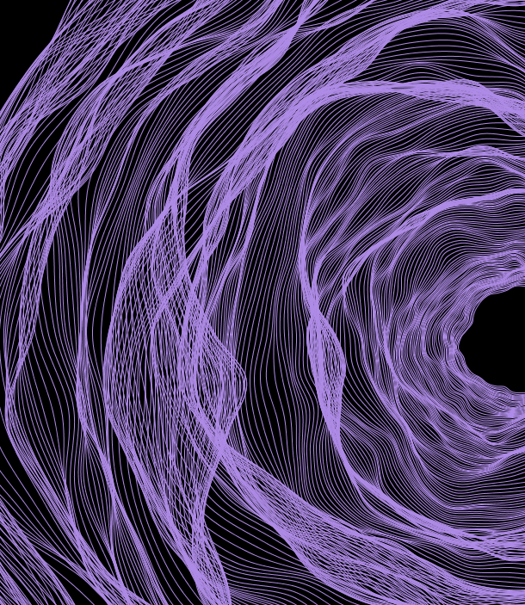
[WE USE]
[ FRACTAL & synesthesia ]
Synesthesia is a phenomenon in which stimulation of one sensory or cognitive pathway leads to experiences in a second sensory or cognitive pathway.
In fractaL synesthesia is used to produce sounds and images. Environmental variables that usually can be felt or smelled will be seen and heard.

Slide 11
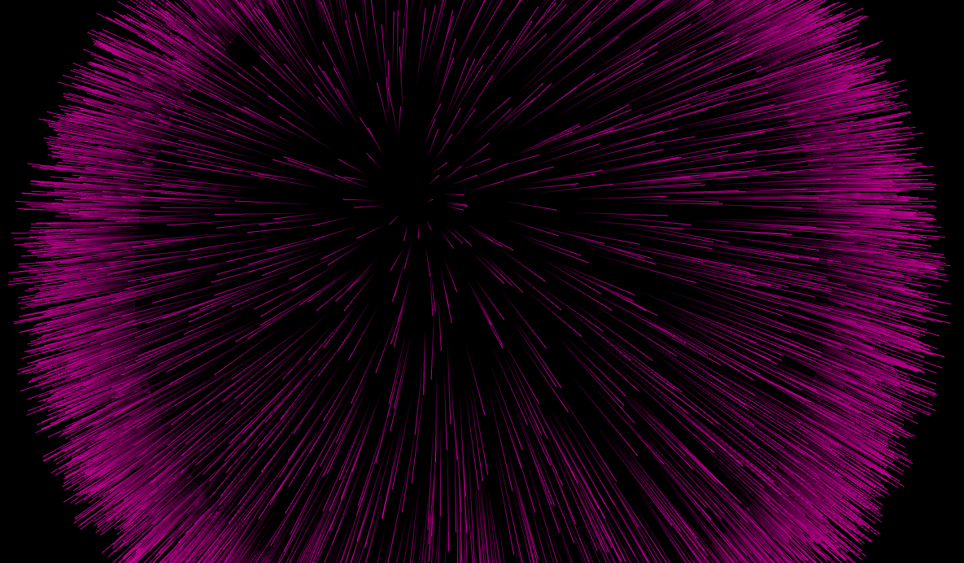
[ how we make it possible ]
[release & promotion]
June 2019

Slide 12
[ how we make it possible ]
[release & promotion]
June 2019
{Exhibitions} cultural | artistic | civic | free technology centers performances short workshop educators | broad audience
{Urban Installation} squares | urban spaces | schools or sport areas projections on building walls music 14-18 years old
OTHER PARTNERS {Local communities and partners} associations | civic centers | network of members and collaborators
{Public schools and teachers}
{Communication support} {Where}
website content | digital media and networks | local offline & online media & newspapers.
Barcelona, Quilmes, Sao Paulo, Rio de Janeiro

Slide 13
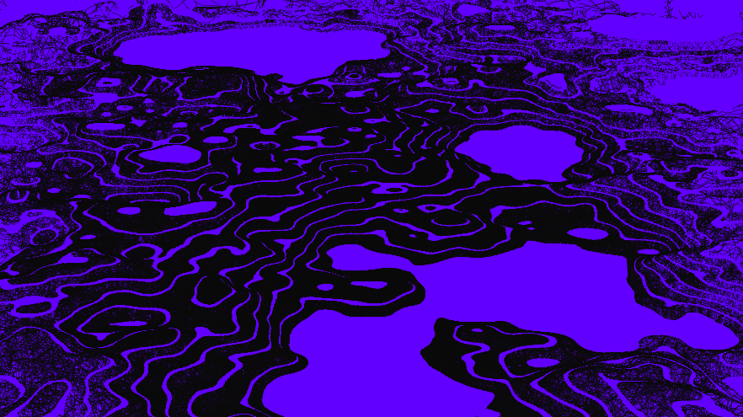
[ how we make it possible]
[TOOLS & steps]
June 2019
October 2019 -------------------------------------- April 2020

Slide 14
[ how we make it possible]
[TOOLS & steps]
June 2019
October 2019 -------------------------------------- April 2020
{final selection of students}
{fractaL Educational Program}
Where
Barcelona, Quilmes, Sao Paulo, Rio de Janeiro
Young people between 14-18 years old
Understanding of Python package and application ecosystem |
Learn Python Syntax through practice on manipulating data | Experiment with the code and development of a project based on fractaL
5 classes of 4 hours (20h in total per course)
Who
What

Slide 15
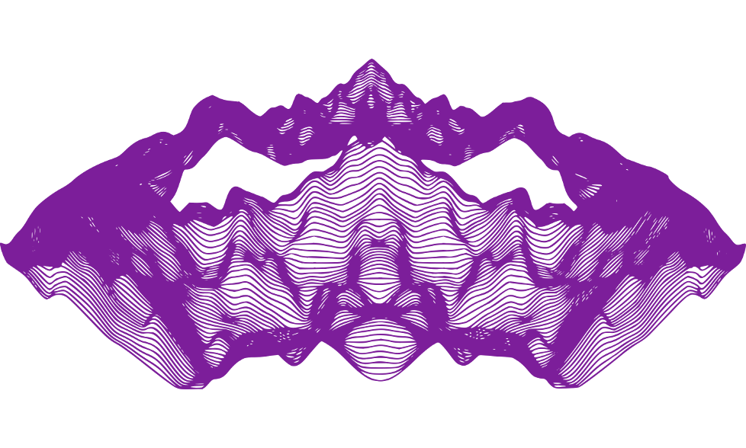
[ how we make it possible]
[TOOLS & steps]
June 2019
October 2019 -------------------------------------- April 2020
May 2020

Slide 16
[ how we make it possible]
[TOOLS & steps]
June 2019
October 2019 -------------------------------------- April 2020
May 2020
{Hackaton & Final Event}
Barcelona + Virtual Connection with Quilmes, Sao Paulo, Rio de Janeiro
General audience | teachers and educators | participants of the Hackaton | 14-18 years old people | partners
Hackaton, presentation of fractaL development, the final projects presentations, the new year program development 2020
2 days
Where
Who
What

Slide 17
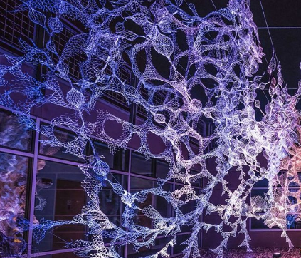
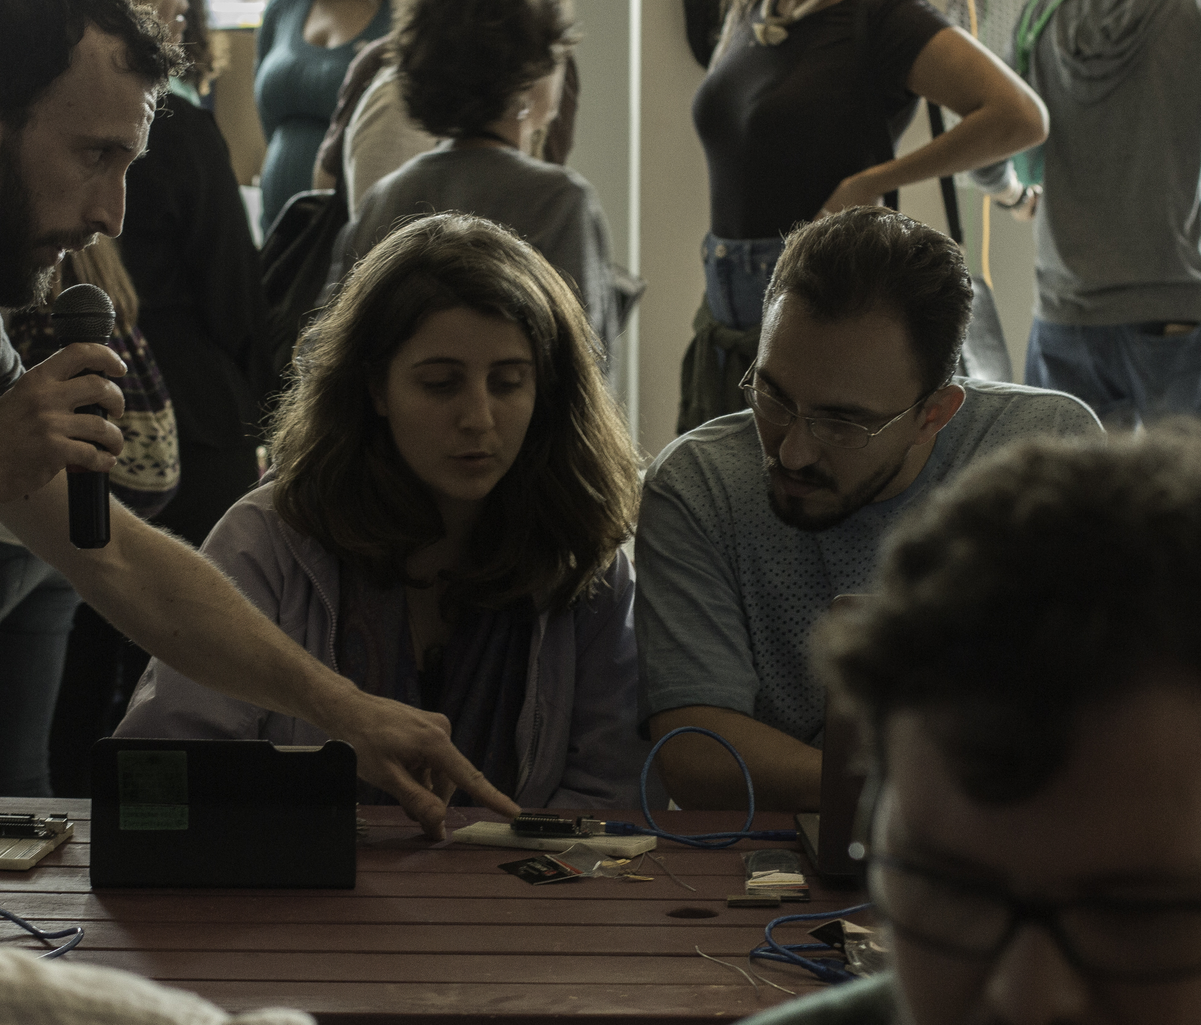
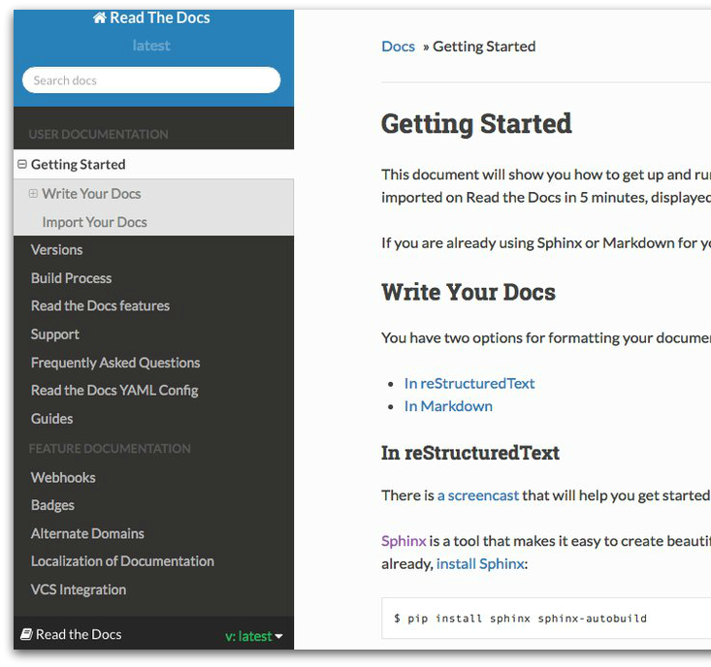
[… to be continued]
{the didactic material}
{the fractaL Didactic Program Community}
to find useful information and new
opportunities to learn
will be shared using open
source platforms
All the digital audiovisual material
created in the classes will become gradually part of
{artistic exhibitions}

Slide 18
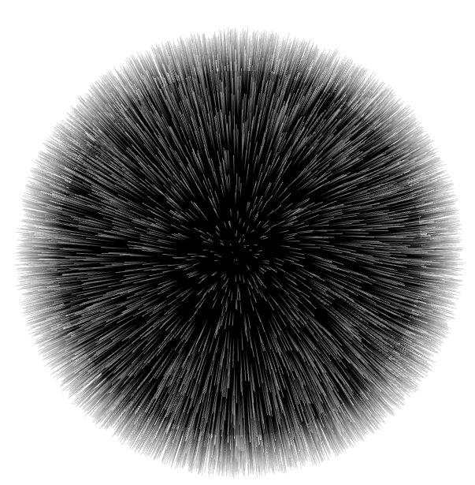
[… to be continued]
{from local
communities to a global network}
quilmes
barcelona
to keep in touch,
create, collaborate
rio de janero
granollers
sao paulo
vitoria gasteiz
zaragoza

Slide 19


OUR TARGET
PRIMARY TARGET: {14-18 years old youths}
CHARACTERISTICS: international and diverse audience
SELECTION CRITERIA: gender equity, local-regional community and social inclusion. A priority focus will be given to students from public schools and areas at risk of social exclusion.
Those criteria will be assured by an external group composed by members committed to the principles of Python Foundation.
SECONDARY TARGET: {educators, teachers, broad audience}

Slide 20
[ aims & BENEFITS ] COUNTABLE
> 350
Young people reached
Workshop hours
> 60
Teaching hours
> 50
3
Countries
5
4
Public Space Exhibition
Cities

Slide 21
[ aims & BENEFITS ] uncountable
{significant & beautiful representation of data}
{technological
literacy}
{participation &
collaboration}
{python language
promotion}
{local
focus}
{global
integration}
{diversity & inclusivity}
{interdisciplinarity}
{environmental
sensitivity}
{openness &
freedom}

Slide 22


[ budgets* ]
$30,014
Proposal 1 – Development, Workshops, Hackathon and Other Events
$18,385
Proposal 2 – Partial Development, Workshops and Other Events
$10,275
Proposal 2 – Partial Development and Workshops
*The detailed budget can be found in the spreadsheet sent attached to the application]

Slide 23
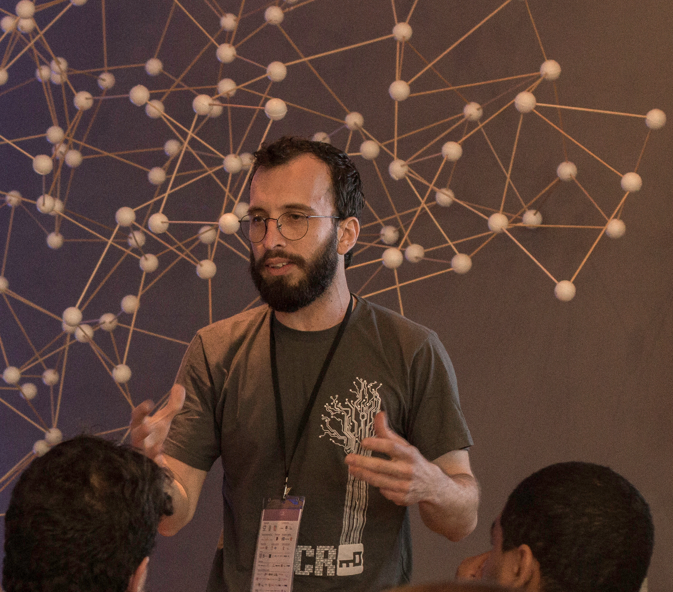
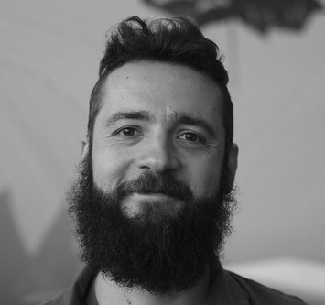
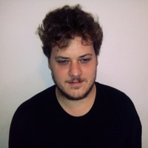
The team & why
Saulo Jacques, PhD
Ecological Education &
Open Technology
Fernando Daguanno
Open Hardware Art
Fabian Sguiglia, PhD
Sound Art Research & Interactive Systems

Slide 24
[ THANKS FOR MAKING ]
A REALITY
ecofractal.gitlab.io
twitter.com/eco_fractaL
gitlab.com/ecofractal/fractal

