Slide 1
Venetian Blinds Simulation Progress and Optimization
James Rogers
1/19/23
jroger87@vols.utk.edu
Determining optimal parameters for VB array, optimizing for neutron Time-of-Flight in HIBEAM ESS beam design

Slide 2
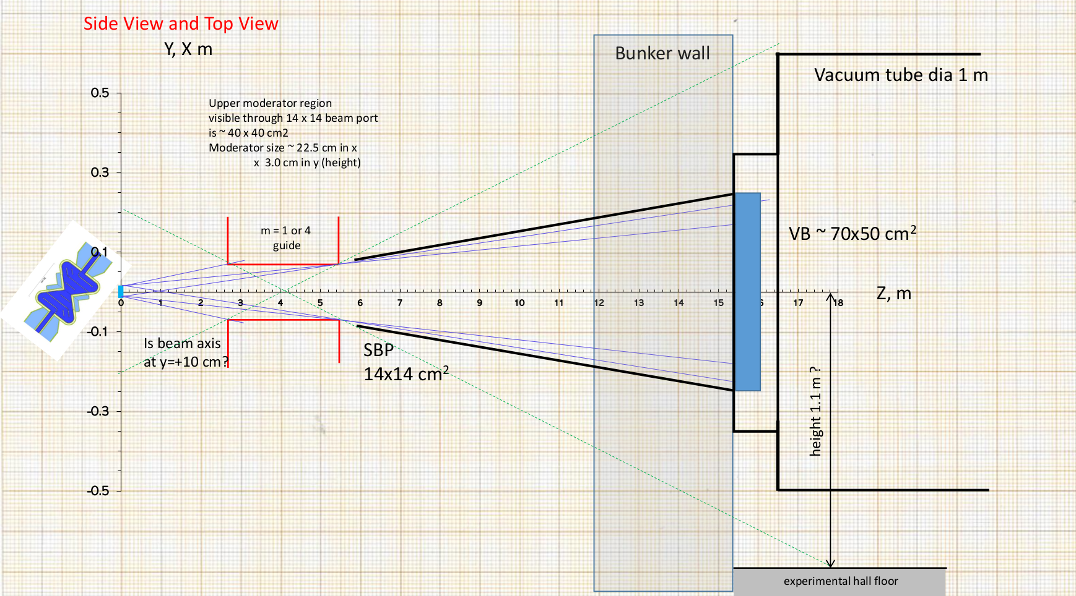
HIBEAM Current design
(Kamyshkov’s Drawing)
Detector @75m

Slide 3
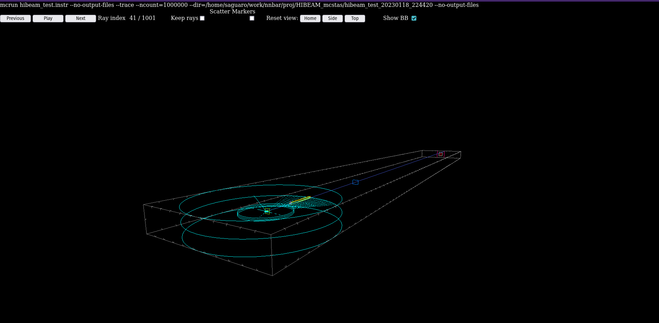
Results without Venetian Blinds
Detector position @75m
Ghost detector @15m
(position of VB)
(no effect)
*following data simulated using singular 2 MW pulse
Beam guide (m=4)
ESS sector E beamline 5
Cold fraction=0.7
λmin=0.1Å
λmax=20Å
1 pulse, 2MW

Slide 4
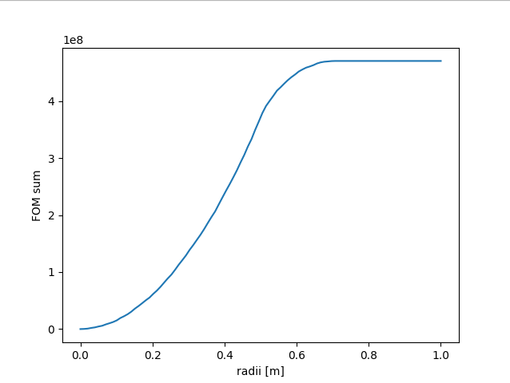
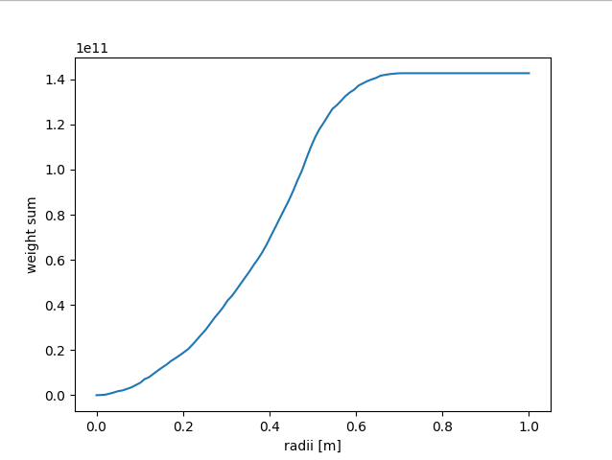


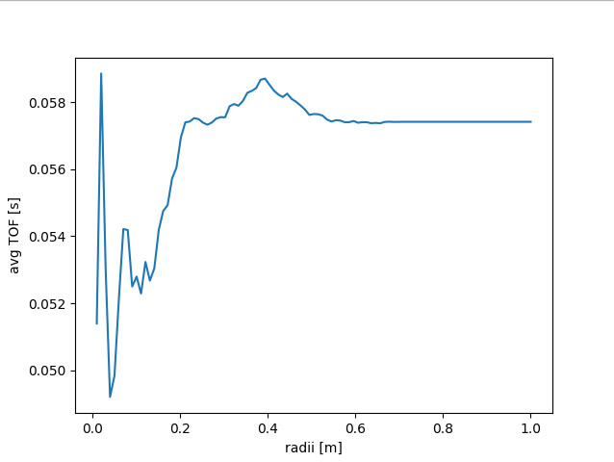
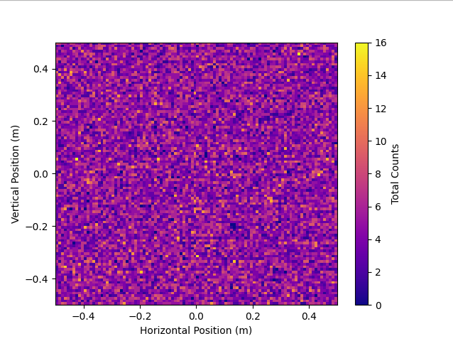

No VB
Φ vs radius
1.4e11
F.O.M. vs radius
4.7e8
*No gravity
T.O.F. avg vs radius
Detector Image
Max ~15 counts/cm^2
0.058s

Slide 5
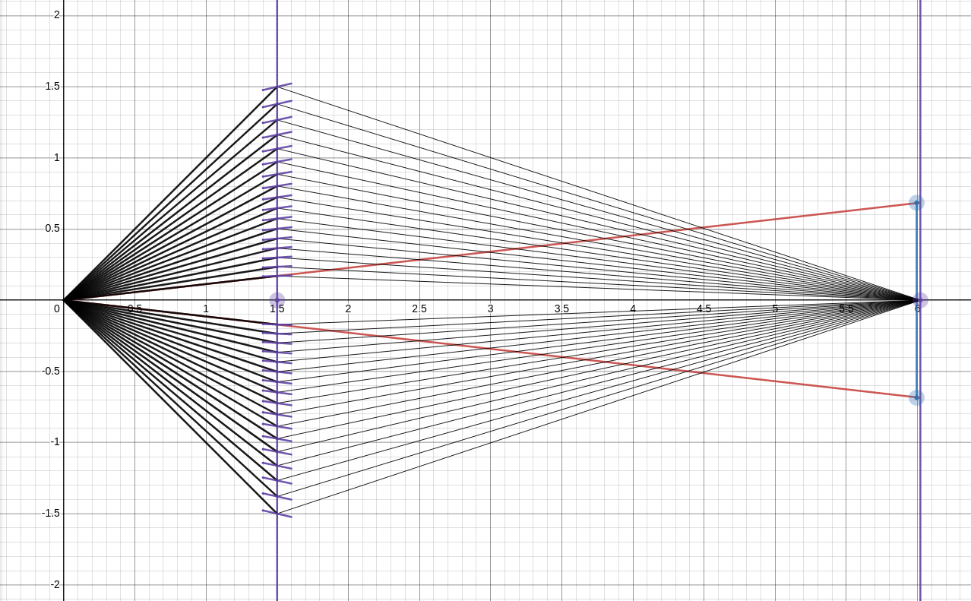
Example of Venetian Blinds (2d)
Params for Simulation:
* N: [1] (1/2) number of blades
* zvb: [m] z position of vb
* zdet: [m] z position of detector
* len: [m] blade length (z)
* thickness: [m] thickness of 'dead zone' substrate (y)
* hvb: [m] (1/2) height of vb array (y)
* wvb: [m] (1/2) width of vb array (x)
* hdet: [m] (1/2) height of detector (y)
* mi: [1] m value of material

Slide 6
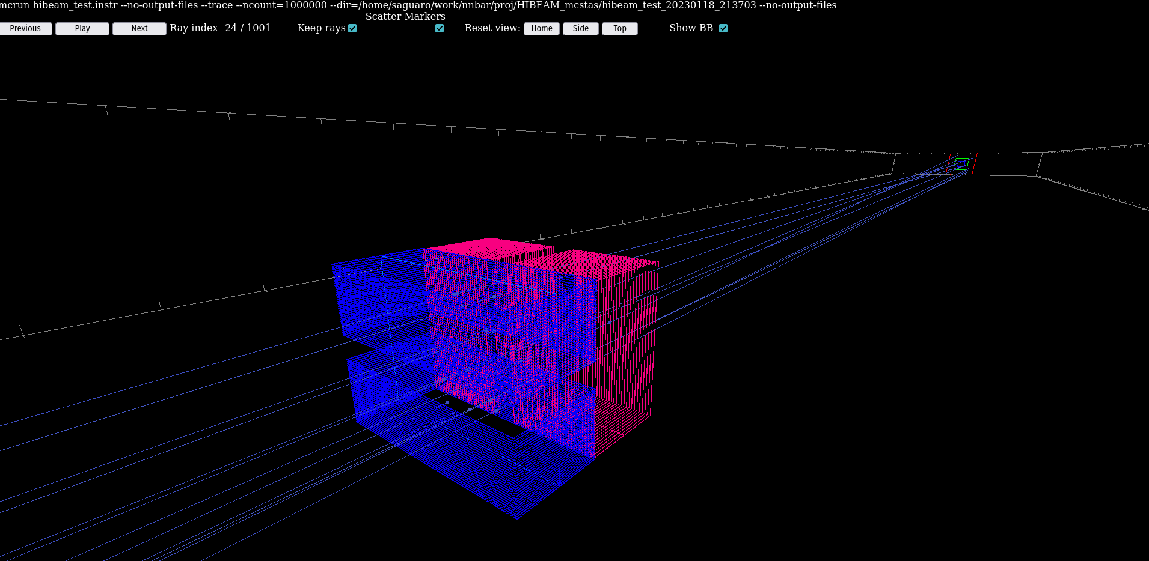
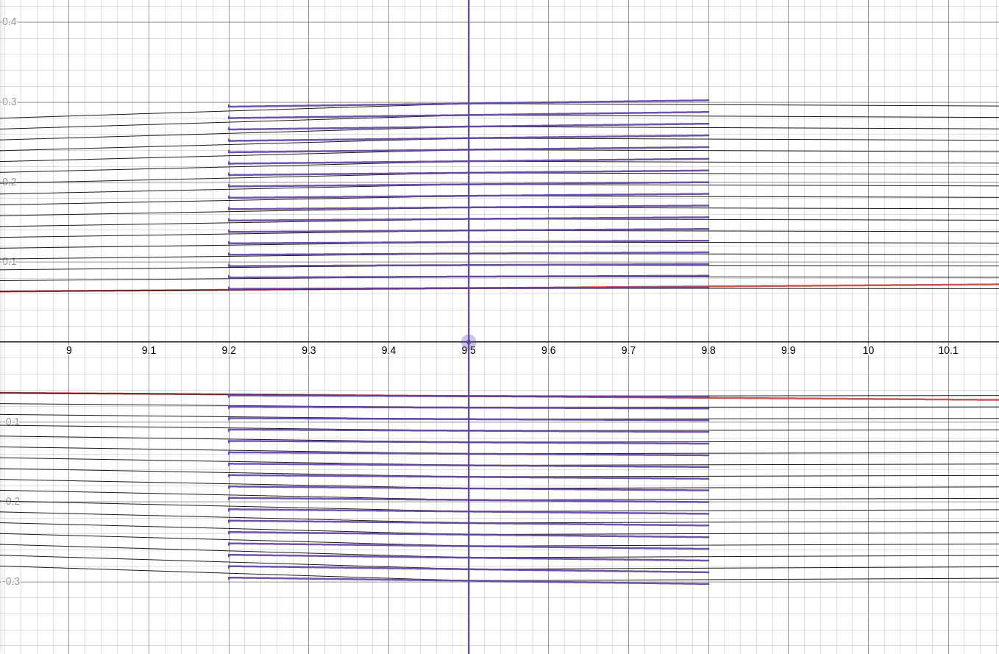
Results with length=60cm
y-z projection
(only y deflectors shown)
60cm
3d visualization
*webGl rendering shows only outline of plates

Slide 7
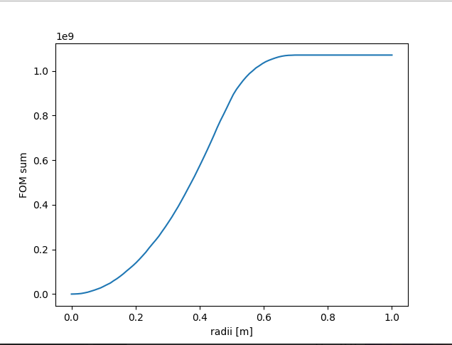
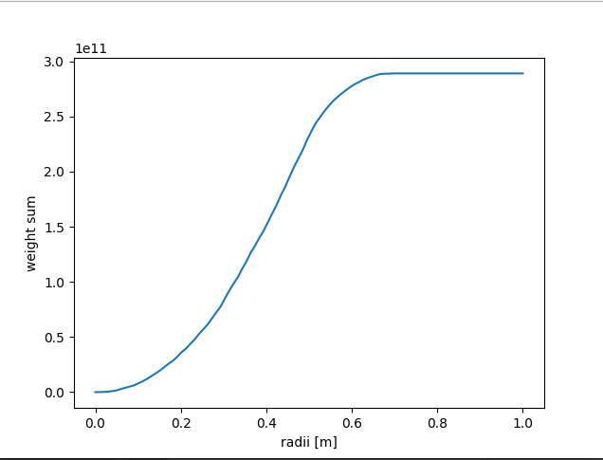
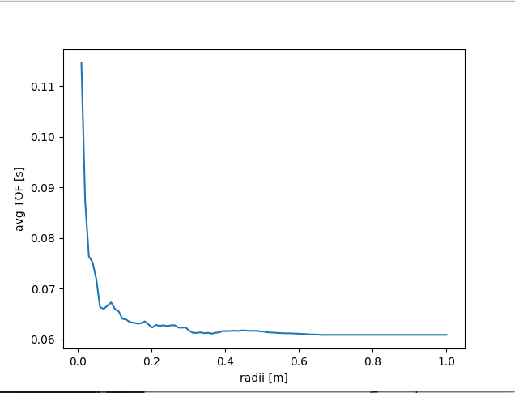
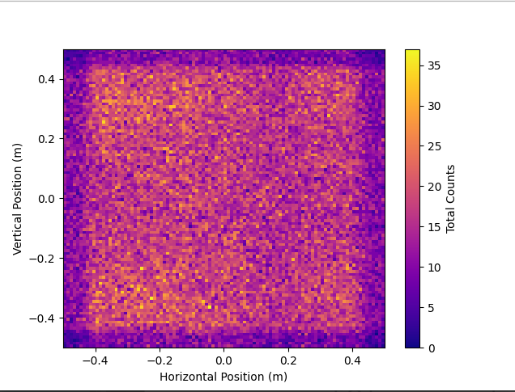
l=60cm
F.O.M. vs radius
1.1e9
Φ vs radius
2.8e11
*No gravity
T.O.F. avg vs radius
Detector Image
Max ~35 counts/cm^2
0.070s

Slide 8
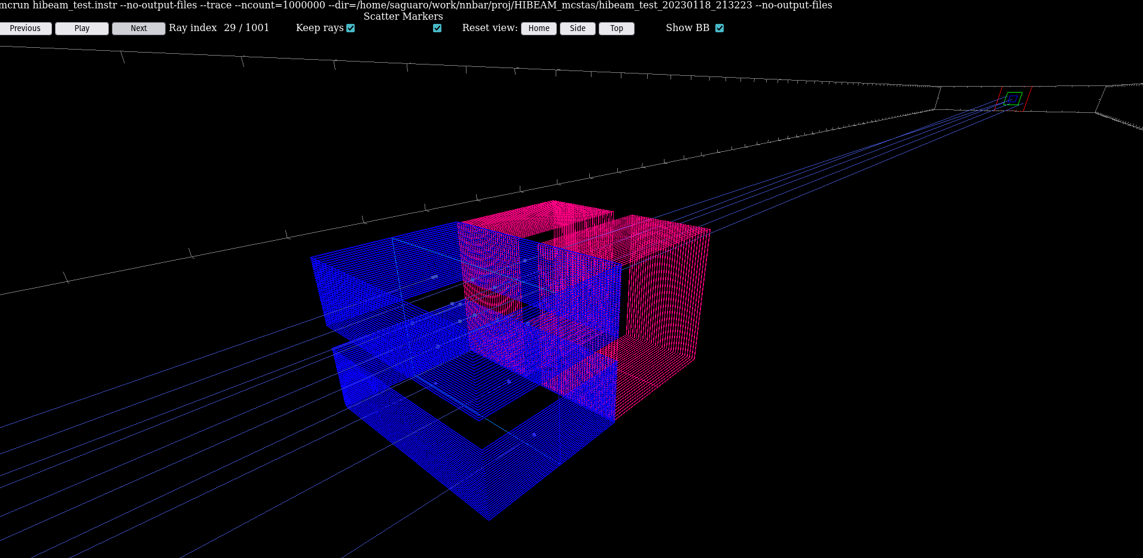
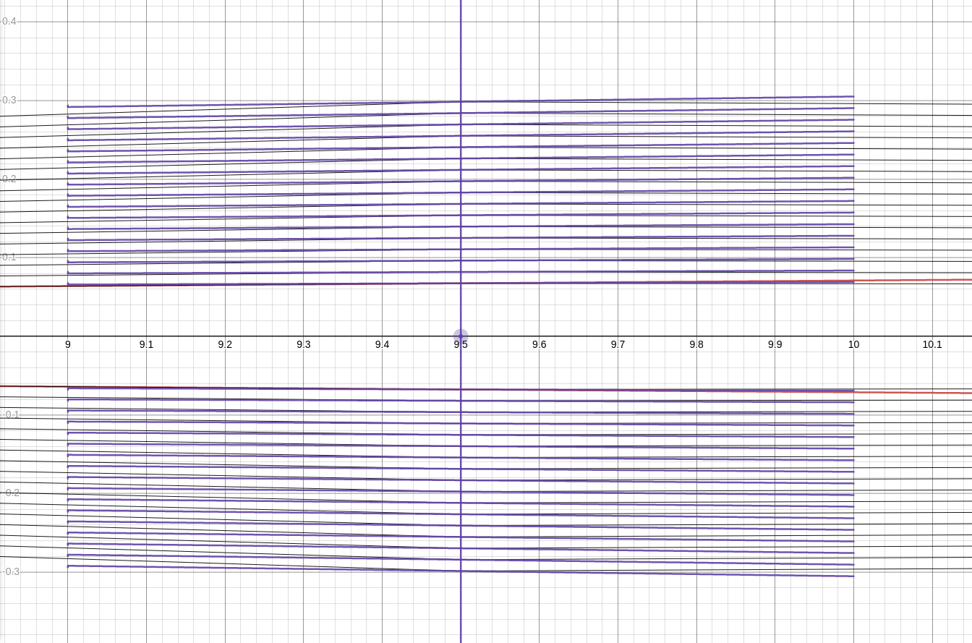
Results with length=1m
y-z projection
(only y deflectors shown)
1m
3d visualization

Slide 9
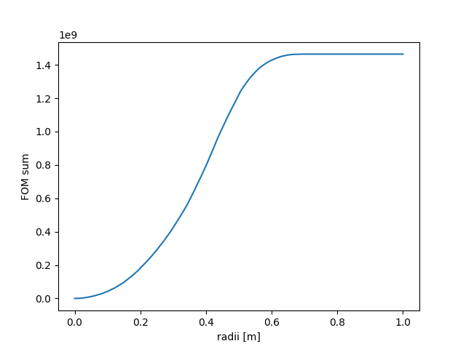

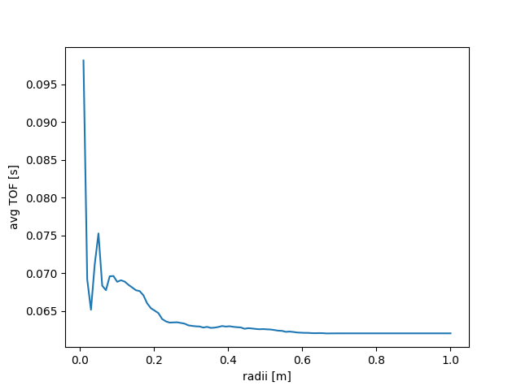
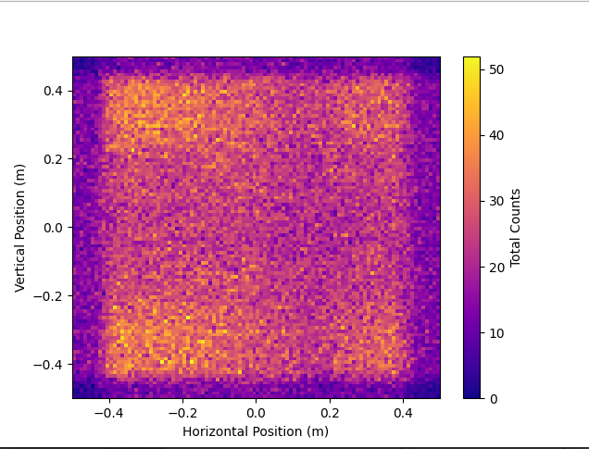
l=1m
F.O.M. vs radius
Φ vs radius
3.8e11
1.5e9
  Greater neutron Φ
*No gravity
T.O.F. avg vs radius
Detector Image
Max ~50 counts/cm^2
0.070s
Higher avg TOF for r=(0.05,0.2)
Higher avg TOF for r=(0.05,0.2)
Higher avg TOF for r=(0.05,0.2)

Slide 10
Conclusions/ Continuation
Slightly higher flux at detector with longer blades
  Φ (no vb): 1.4e11
  Φ (60cm): 2.8e11
  Φ (100cm): 3.8e11
Slightly higher avg TOF for r=(0.05,0.2)
  No vb: 0.05s
  60 cm: 0.06s
  100 cm: 0.07s
Higher FOM
  No vb: 0.47e9
  60 cm: 1.1e9
  100 cm: 1.5e9
Future Goals:
Account for effect of gravity on slow neutrons
Implement “Continuous Deflection” of VB blades
Determine optimal configuration of VB, maximizing TOF for neutrons

