Slide 1

Predicting Dark Matter Presence Using Supervised Machine Learning
S. M. JAHANGIR
232107
10/18/2025
Institute of Information Technology, Jahangirnagar University

Slide 2
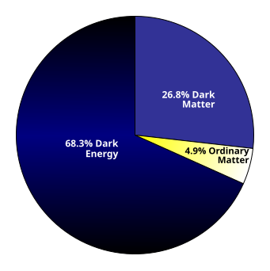
Introduction
Dark Matter Prevalence: Constitutes about 27% of the universe’s total mass-energy and 85% of its matter.
Dark Matter Interaction: Interacts gravitationally but not electromagnetically with regular matter.
Dark Matter Detection: Has not been directly observed but can be indirectly detected using machine learning and scientific computing.
10/18/2025
Institute of Information Technology, Jahangirnagar University

Slide 3
Limitation of Existing Works
Data Needs: Requires higher-quality and larger cosmic survey datasets.
Signal Separation: Needs enhanced classification models to distinguish between overlapping dark matter and cosmic inflation signals.
Algorithm Enhancement: Requires better clustering algorithms to differentiate between dark and baryonic matter signals.
10/18/2025
Institute of Information Technology, Jahangirnagar University

Slide 4
Problem Statement
Research Objective: Explore the potential of machine learning techniques in analyzing dark matter-related data.
Research Goal: Identify new patterns or anomalies that could provide evidence for the existence of a distributed substance.
Motivation: The identification and characterization of dark matter remain some of the most significant open problems in astrophysics today.
10/18/2025
Institute of Information Technology, Jahangirnagar University

Slide 5
Objectives
Dark Matter Distribution Estimation: Use machine learning to predict the spatial distribution of dark matter within cosmic structures.
Dark Matter Detection Sensitivity Enhancement: Develop machine learning algorithms to improve the sensitivity of dark matter detection methods.
Dark Matter Simulation Development: Create computational tools to simulate dark matter interactions in various astrophysical environments.
10/18/2025
Institute of Information Technology, Jahangirnagar University

Slide 6
Literature Review
Author(s) & Year | Method | Tools/Data | Results | Limitations | Research Gap
Jones et al. (2024) | Deep Learning (CNN) | CNN for detecting dark matter in galaxies | 92% accuracy in identifying dark matter structures | Relies on sparse and limited observational data | Need for higher- quality and larger cosmic survey datasets.
Singh et al. (2023) | Machine Learning (Random Forest) | RF for predicting dark matter halos | 85% accuracy in identifying halo regions | Incomplete or noisy data, especially in faint clusters | Handling noisy data in distant and faint galaxy clusters.
Li et al. (2022) | Hybrid Model (SVM + NN) | SVM and neural networks for galaxy formation simulations | 88% accuracy in modeling dark matter impacts | High computational cost from cosmological simulations | Reducing computational burden for large-scale simulations
Chen et al. (2021) | Machine Learning (Decision Trees) | Decision Trees applied to CMB data | 90% efficiency in classifying dark matter signals | Overlap between dark matter and cosmic inflation signals | Improve classification models to separate overlapping signal sources
10/18/2025
Institute of Information Technology, Jahangirnagar University

Slide 7
Literature Review (Continued)
Author(s) & Year | Method | Tools/Data | Results | Limitations | Research Gap
Wang et al. (2020) | Unsupervised Learning | Clustering in galaxy survey datasets | 83% accuracy in locating dark matter rich regions | Confusion between dark and baryonic matter signals | Develop better clustering algorithms for signal differentiation
Singh et al. (2023) | Machine Learning (Random Forest) | RF for predicting dark matter halos | 85% accuracy in identifying halo regions | Incomplete or noisy data, especially in faint clusters | Handling noisy data in distant and faint galaxy clusters.
Miller et al. (2023) | Reinforcement Learning (RL) | Collider Data | 87% success rate uncovering feasible experiments | Computationally intensive | Shortage of Large Training datasets
Khosa et al. (2020) | Deep Learning (CNN) | Simulated XENON1T data | 87% accuracy distinguishing WIMP events from backgrounds | Based only on simulations; lacks real detector data validation | Extend CNN models to real detector data and multidetector transfer learning.
10/18/2025
Institute of Information Technology, Jahangirnagar University

Slide 8
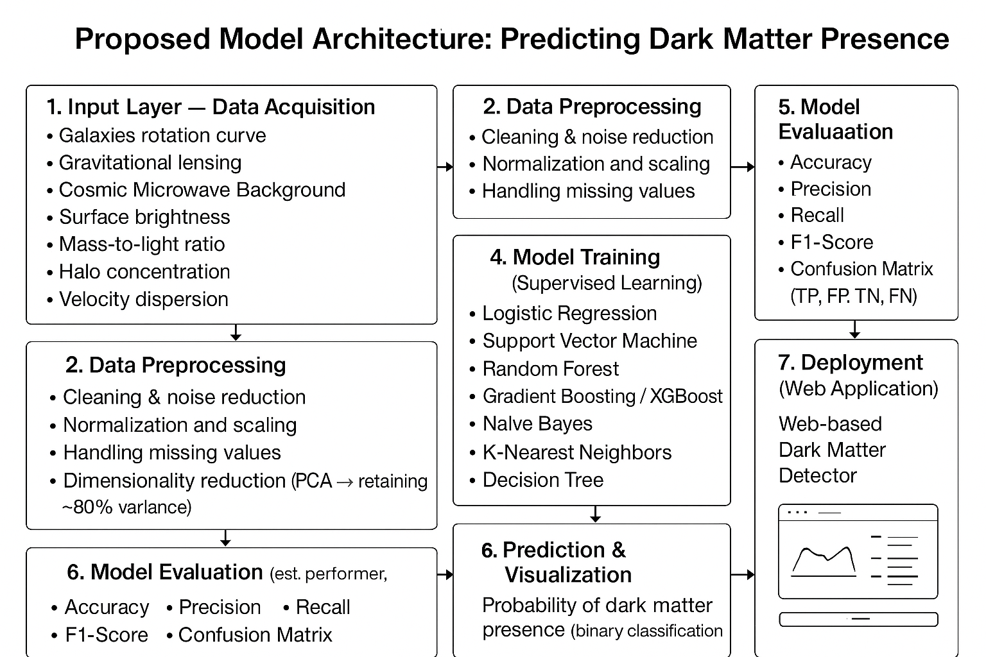
Proposed System Model
10/18/2025
Institute of Information Technology, Jahangirnagar University

Slide 9
Implementation
Data Preparation: Created a synthetic dataset from SDSS and performed preprocessing steps like cleaning, missing value imputation, and normalization.
Feature Engineering: Selected important features such as lensing shear, surface brightness, and mass-to-light ratio.
Model Training: Trained models using various algorithms including Linear Regression, Support Vector Machine, Random Forest, and XGBoost.
10/18/2025
Institute of Information Technology, Jahangirnagar University

Slide 10
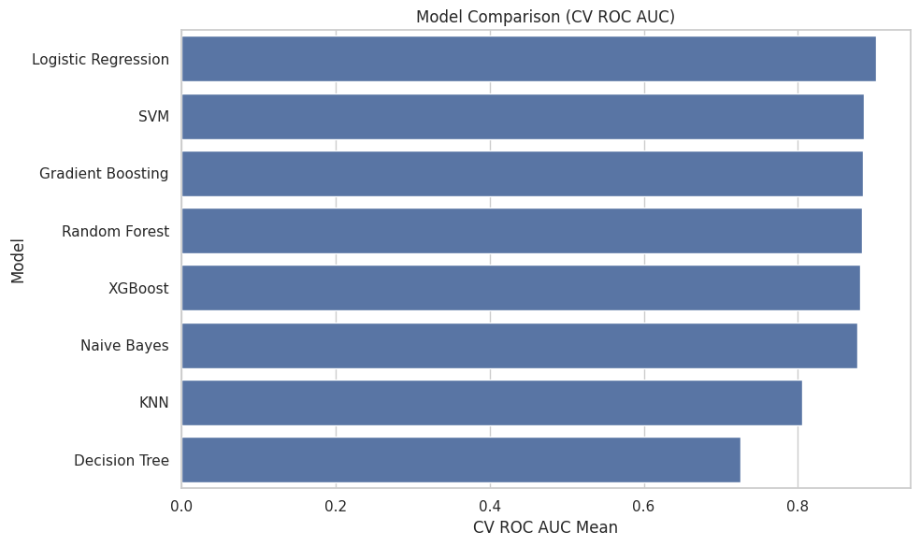
Result Analysis
10/18/2025
Institute of Information Technology, Jahangirnagar University

Slide 11
Result Analysis (Continued)
Best Model: Logistic Regression.
Similar Performance Models: Support Vector Machines, Gradient Boosting, Random Forests, XGBoost, and Naive Bayes.
Worst Model: Decision Tree.
10/18/2025
Institute of Information Technology, Jahangirnagar University

Slide 12
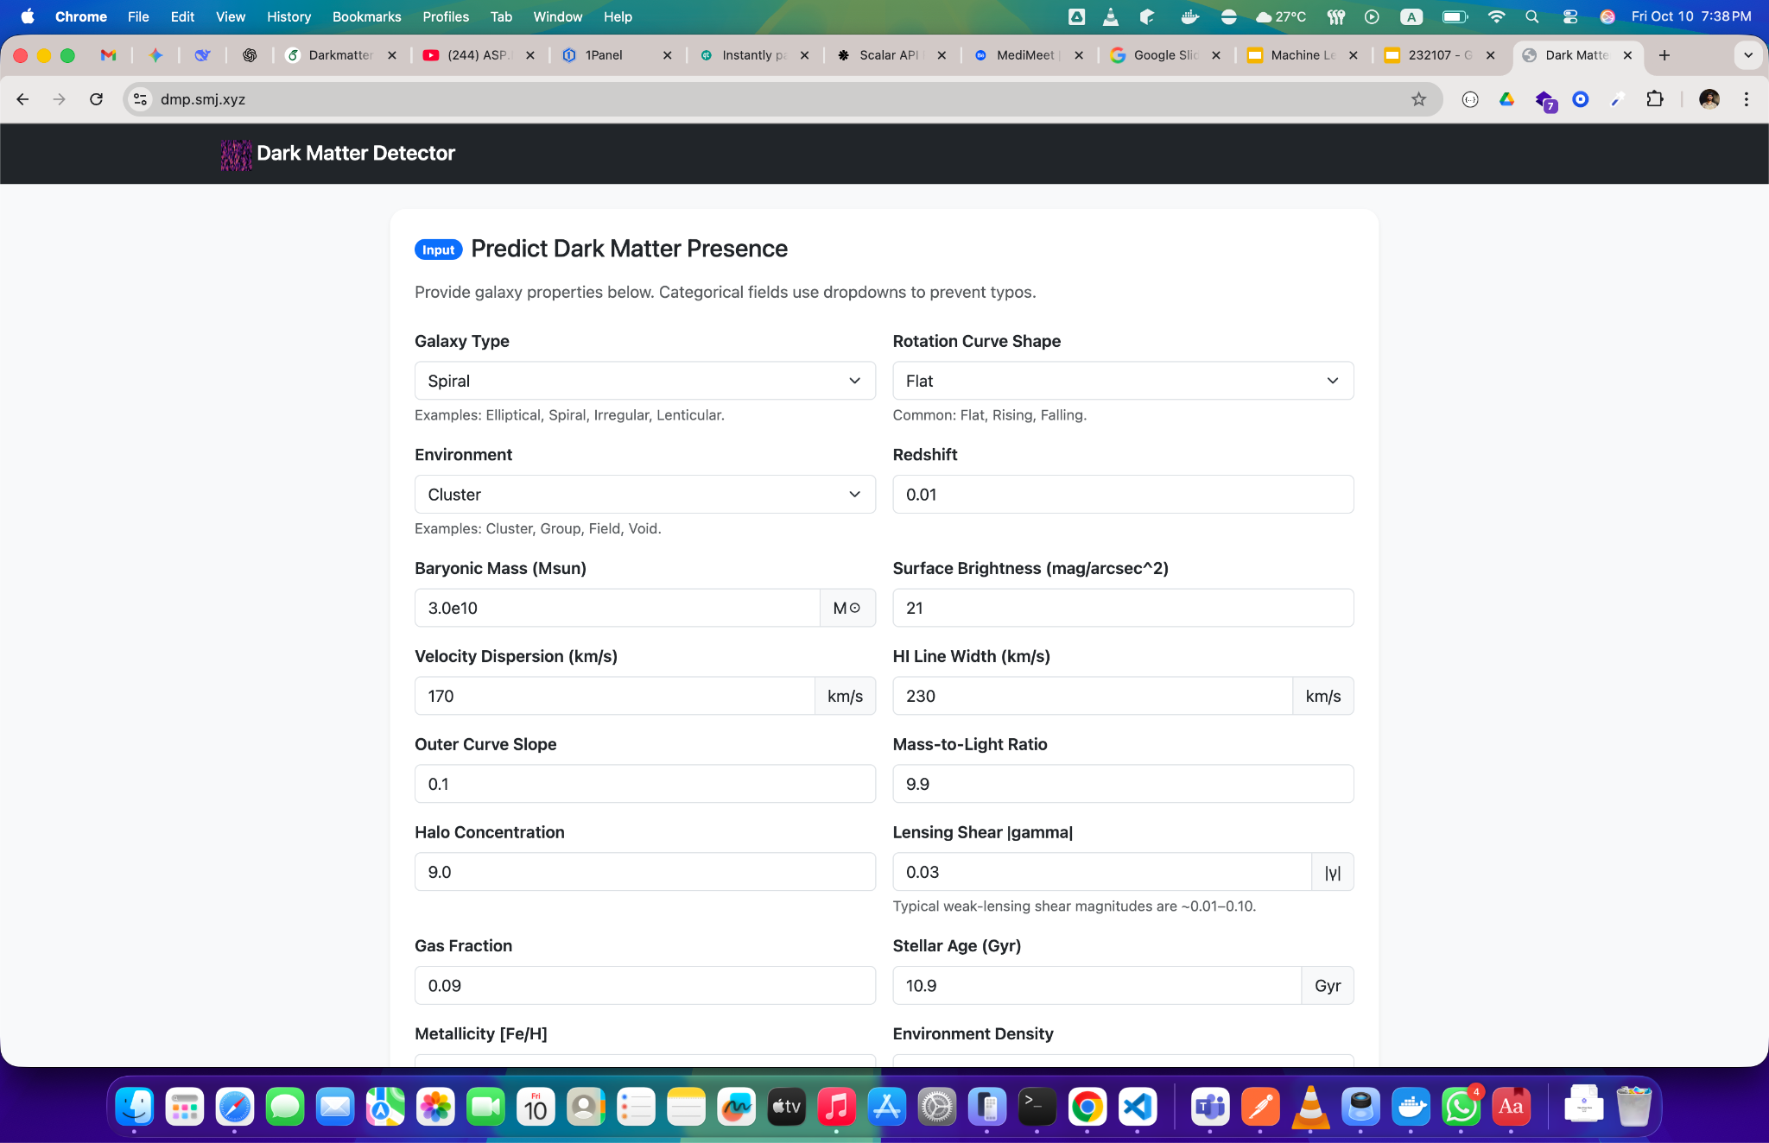
Web Application
10/18/2025
Institute of Information Technology, Jahangirnagar University

Slide 13
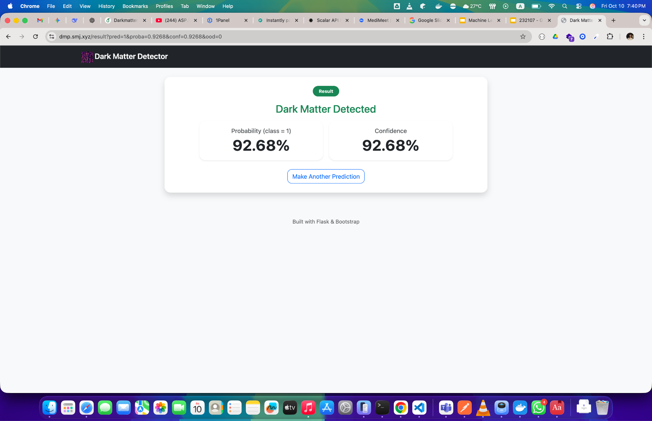
Web Application (Continued)
10/18/2025
Institute of Information Technology, Jahangirnagar University

Slide 14
Future Works
Data Source: Real sensor data from sources like the Sloan Digital Sky Survey.
Input Type: Images.
Image Processing: The system processes images.
10/18/2025
Institute of Information Technology, Jahangirnagar University

Slide 15
Conclusion
Data Limitation: The study was limited by the large size of the sensor data (SDSS).
Computational Limitation: Computing power was a limiting factor.
Methodology: Logistic Regression yielded the best results.
10/18/2025
Institute of Information Technology, Jahangirnagar University

Slide 16
"In a spiral galaxy, the ratio of dark-to-light matter is about a factor of ten. That's probably a good number for the ratio of our ignorance to knowledge. We're out of kindergarten, but only in about third grade." - Vera Rubin (1928-2016)
Dark Matter matters!
10/18/2025
Institute of Information Technology, Jahangirnagar University

