Slide 1
Numerical Analysis
2020 Fall Semester
Hanyang University
Dept of Computer Engineering
Sangback Ma

Slide 2
Chapter I. Introduction
Why Numerical Analysis?
In computer numbers are represented in finite number of bits.(integer in 32 bits, real numbers in 32 or 64 bits. But they are still finite.) On the other hand in mathematics numbers has no bound. So we have to carefully use our finite resources to represent the real mathematics.

Slide 3



Representation of numbers
Integer – quite straightforward.
s = 0 if positive, 1 if negative
Negative numbers are represented in 1’s complement or 2’s complement, usually. It varies with computers.
s |  |  | ……………

Slide 4


What is 2’s complement?
Assume p=3. 5 = 101 in binary. 010 is the 1’s complement of 5(101). 2’s complement is 1’s complement + 1. In this case, 010+001 = 011. (IBM is using 2’s complement.)
So, the ranges of integers are
From - to

Slide 5
Floating point
Much more complicated than the integers. We cannot represent the real numbers efficiently using 2**32 numbers. For example, between 1.5 and 1.6 there are infinitely many real numbers.
We divide our p(32 or 64)bits into sign(1 bit), exponent(7 bits in IBM), and mantissa(remaining parts. 24 bits or 56 bits.)

Slide 6
Also, each computer manufacturer has its own number representation base. The base is 2, 8 or 16. IBM is using 16. Decimal representation is for inputs or outputs. Internally, the base is a power of 2.

Slide 7
IBM – B = 16(Hexadecimal base.)
The mantissa is interpreted as a number between 0 and 1. The first bit always should be 1.(Normalization)
sign | exponent | mantissa
1 bit | 7 bits | 24 bits

Slide 8
Exponent
Exponent is between -64 and 63. So, if the exponent is 0, it means -64 and 110 as 46.( We say that the bias is 64.)
Examples)
X =
010000011001000………..000
Sign = 0, positive

Slide 9
Exponent is 65, subtracting the bias 64, we get 1.
Mantissa is 1001000…..000
Mantissa = 1*2**(-1) + 0*2**(-2)+ 1*2**(-4) = 0.5625
So, X = sign * Mantissa* Base**(exponent)
= + 0.5625 * 16**(1) = 9.

Slide 10
X =
1100001011000…….
Sign = 1 → negative
Exponent is 66, so subtracting the bias 64, we get 2.
Mantissa = 1*2**(-1) + 1*2**(-2) = 0.75
So, x = -0.75 *16**2

Slide 11
X =
00101001101100000000……000
Sign = positive.
Exponent = 41 – bias = 41 – 64 = -23
Mantissa =2*(-1) + 2**(-3) + 2**(-4)
So, x = + Mantissa* 16**(-23)

Slide 12
Exponent overflow and underflow
There are 4 limit numbers, smallest negative number, largest negative number, smallest positive number, and largest positive number.
SN LN 0 SP LP

Slide 13
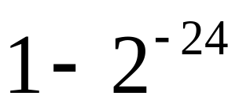
SN = 1111111111111111….1111
sign = negative
exponent = 63
Mantissa = all 1 =
. LP = - SN
. SP =000000000100000….0000
Mantissa = 0.5
Exponent = 0 – bias = 0 – 64 = -64

Slide 14
LN = -SP
So, we cannot represent numbers like
0.5*16**(129) or 0.5*16**(-140).
The former is called as exponent overflow and the latter is called exponent underflow.
But that does not impose any practical limitations !!!

Slide 15

Significant digits
The length of mantissa(24 or 56 bits in IBM) determine the precision.
24 bits correspond to 6 -7 decimal digits and 56 bits to 12-13 decimal digits.
For example, using 32 bits we can approximate as 3.14159 or 3.141592, and using 64 bits

Slide 16
as 3.141592653895 or 3.1415926538959
• The length of meaningful mantissa is called the Significant digits.
• In Numerical analysis we should maintain the number of significant digits.
If we lose it the precision of computation decreases accordingly.

Slide 17

Sources of Error
Evaluation Error
We approximate f(x) by our chosen function.
sin(x) x- (1/3)*x**3 + (1/120)*x**5 - ……..
The Taylor series
• Truncation Error
Since we cannot use infinite number of terms

Slide 18
we have to stop at finite steps
Truncation error
• Round-off error
Due to the nature of floating number representation, most real numbers cannot be represented exactly.
For example, 0.5 is exact, but 0.1 is
0.9999999 → Round-off error

Slide 19
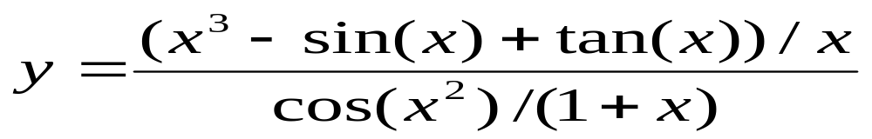
Error Propagation
At each arithmetic operation and mathematical functions, errors propagate.
Ex)
The ideal situation is we maintain our initial number of significant digits, i.e, 6-7 or 12-13 decimal digits.

Slide 20




Absolute error and Relative error
Let and denote the true x value and computer-approximated value of x, respectively.
Then is called the absolute error, and is called the relative error.

Slide 21
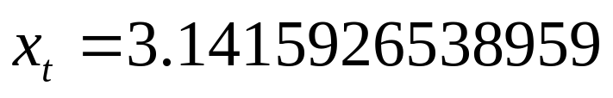

Example)
Then absolute error = 0.0000926538959
And relative error is roughly 3.0*10**(-5)
→ It says we say that roughly 5 digits are correct(or meaningful).

Slide 22
In practice relative errors are more meaningful.
We want to maintain k significant decimal digits is equivalent to
the relative error is roughly of order 10**(-k)

