Slide 1
Chapter 1
Introduction to Statistics
and Data Analysis
Ch.1.1. Overview: Statistical Inference, Samples, Populations, and the Role of Probability
Ch.1.3. Measures of Location: The Sample Mean and Median
Ch.1.4. Measures of Variability
Ch.1.6. Statistical Modeling, Scientific Inspection, and Graphical Diagnostics
Instructor: Sang-Woon Jeon
CourseWeb: https://portal.hanyang.ac.kr
Office: 502 engineering building V
Email: sangwoonjeon@hanyang.ac.kr
Phone: 031-400-5918

Slide 2
Populations & Samples
Ch.1.1
Population: all individuals or items of a particular type (typically unknown)
  Ex) weight of ERICA students
  Interested in the mean weight (true mean)
  But, cannot be attained if we don’t know the population!
Sample (=Observations): a subset collected from a population
  Ex) weight of 100 ERICA students
  Instead, we CAN calculate the sample mean weight!
Relation between the true mean and same mean?
How to choose good samples?

Slide 3


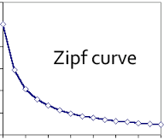
Probability & Statistical Inference
Ch.1.1
Probability
  Useful for various applications
  Some cases, probabilistic models are naturally given
    Ex) Coin tossing
    Pr(Head)=1/2, Pr(Tail)=1/2
  But many cases, probabilistic models are not available
    Ex) Movie or file popularity distribution in Netflix or YouTube
How to estimate underlying probabilistic models or parameters of a population?
  Statistics from sample values are used to estimate the parameters of the population
    Ex) Movie popularity distribution has been reported to follow a Zipf distribution
The access probability
of the most popular file

Slide 4
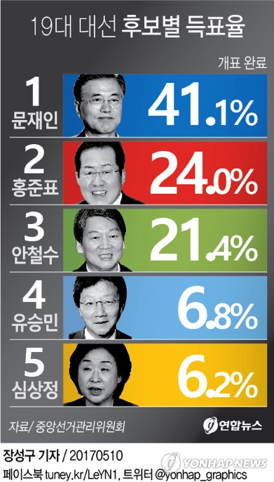
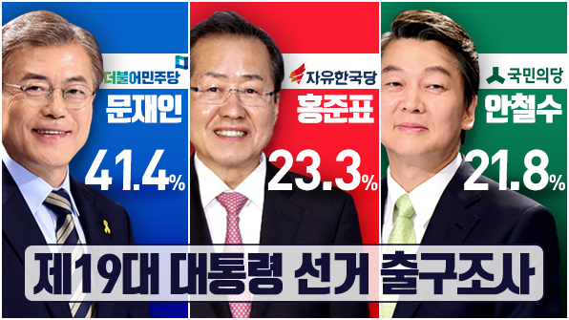
Probability & Statistical Inference
Ch.1.1
Statistical inference
  In general, the population values are unknown
  Hence, (true) statistics from the population is impossible
  Instead, we use statistics from the same values to estimate or approximate true statistics
  Ex) Exit polls of elections
Sample statistics
Statistical inference
True statistics

Slide 5
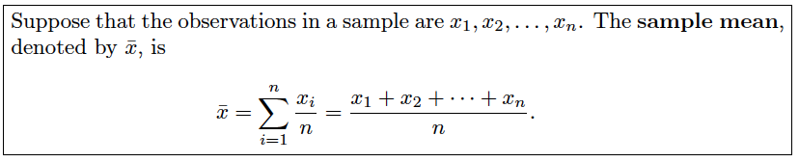
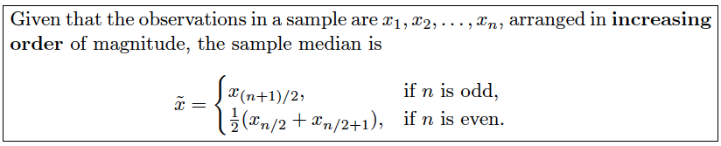
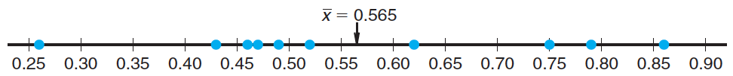
Measures of Location
Ch.1.3
Sample mean
Sample median
[Source] Definition 1.1 of the textbook
[Source] Definition 1.2 of the textbook
[Source] Figure 1.4 of the textbook

Slide 6
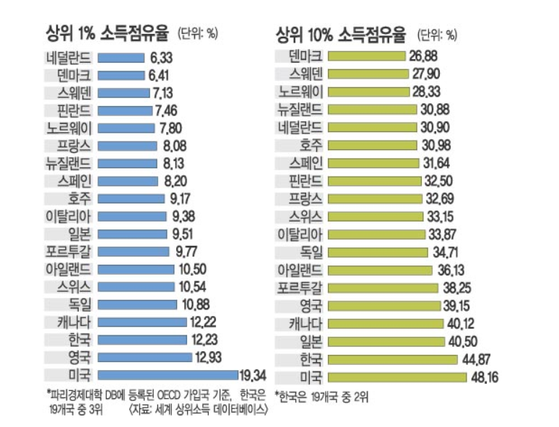
Measures of Location
Ch.1.3
Trimmed sample mean
  Computed by “trimming away” a certain percent of both the largest and the smallest set of sample values
Trimming away 1% or 10%
largest income for calculating
the average income

Slide 7
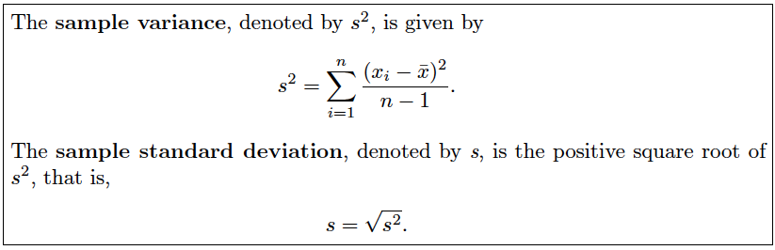
Measures of Variability
Ch.1.4
Sample variation and standard deviation
Degrees of freedom
associated with the variance
[Source] Definition 1.3 of the textbook
Different mean, but same variance
Same mean, but different variance

Slide 8
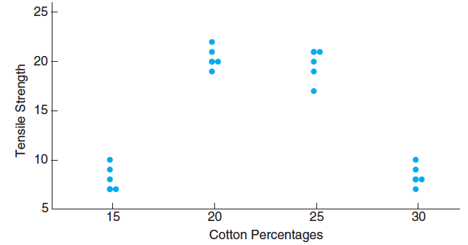
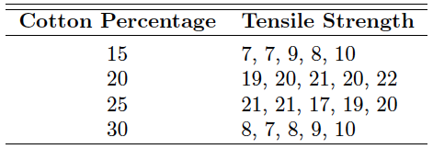
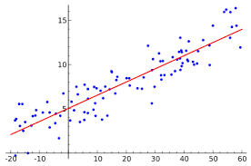
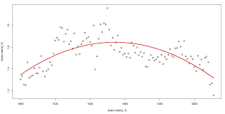
Statistical Modeling
Ch.1.6
Scatter plot
  Useful to apply a regression model (or curve fitting)
[Source] Table1.3 of the textbook
[Source] Figure 1.5 of the textbook
Estimation parameters
Ex) Linear regression
Ex) Quadratic regression

Slide 9
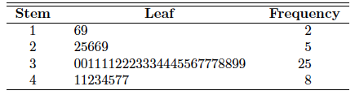
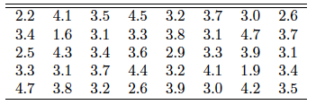
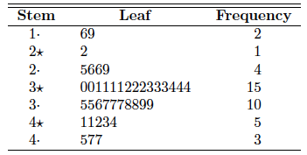
Statistical Modeling
Ch.1.6
Stem-and-Leaf plot
  Useful to see the behavior of a distribution
  Ex) battery life
[Source] Table 1.5 of the textbook
[Source] Table1.4 of the textbook
[Source] Table 1.6 of the textbook

Slide 10
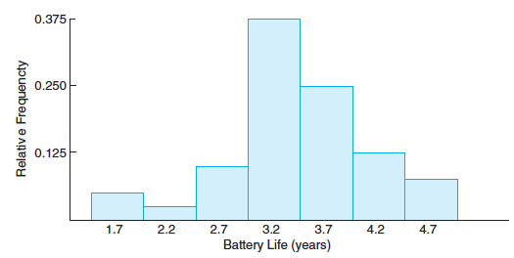
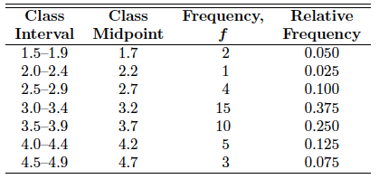
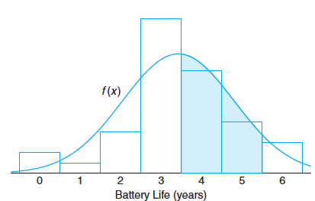
Statistical Modeling
Ch.1.6
Histogram
  Relative frequency distribution
  In many cases, estimating a probability distribution is useful
  Ex) battery life
[Source] Table 1.7 of the textbook
[Source] Figure 1.6 of the textbook
Modeling its probability distribution
[Source] Figure 1.7 of the textbook

Slide 11
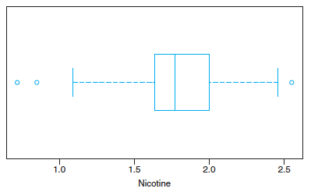
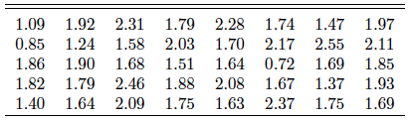
Statistical Modeling
Ch.1.6
Box-and-Whisker plot
  Interquartile range, outliers
  Ex) Nicotine data
25th percentile
75th percentile
median
Data range
[Source] Table 1.8 of the textbook
[Source] Figure 1.9 of the textbook
Outliers in the lower tail
Outlier in the upper tail

