Slide 1
Chapter 1
Introduction to Statistics
and Data Analysis
Matlab introduction
Matlab examples
Instructor: Sang-Woon Jeon
CourseWeb: https://portal.hanyang.ac.kr
Office: 502 engineering building V
Email: sangwoonjeon@hanyang.ac.kr
Phone: 031-400-5918

Slide 2

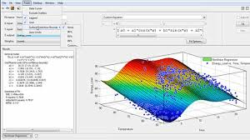
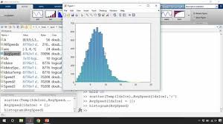
Matlab
Advantages
Easy to program
Easy to plot various figures
Provides many powerful packages
In this class
Generation of random variables
Calculation of sample statistics
Plotting figures

Slide 3
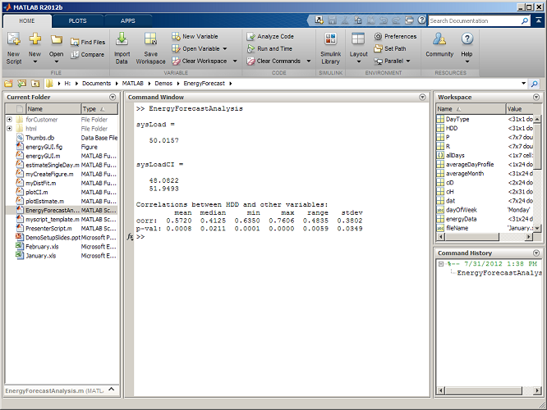
Interface

Slide 4
Help & Search box
Type a specific function at the commend window
Type related words at the search box
Googling
Ex) ‘rand’ function
Commend window
Search box
>> help rand
rand - Uniformly distributed pseudorandom numbers
This MATLAB function returns a pseudorandom scalar drawn from the standard
uniform distribution on the open interval (0,1).
r = rand
r = rand(n)
r = rand(sz1,...,szN)
r = rand(sz)
…
r = rand(sz1,...,szN,'like',p)
r = rand(sz,'like',p)
rand에 대한 참조 페이지
참고 항목 @RandStream, rand (RandStream), randi, randn, randperm, rng, sprand,
sprandn
rand 이름의 다른 함수
distcomp/rand, matlab/rand (RandStream)
Rand
Uniformly distributed pseudorandom number
Syntax
r = rand
r = rand(n)
r = rand(sz1,...,szN)
r = rand(sz)
…
Example 1
Generate values from the uniform distribution on the interval [a,
b]:
r = a + (b-a).*rand(100,1);
Example 2
Use the randi function,
instead of rand, to generate integer values from
the uniform distribution on the set 1:100:
r = randi(100,1,5);
…

Slide 5
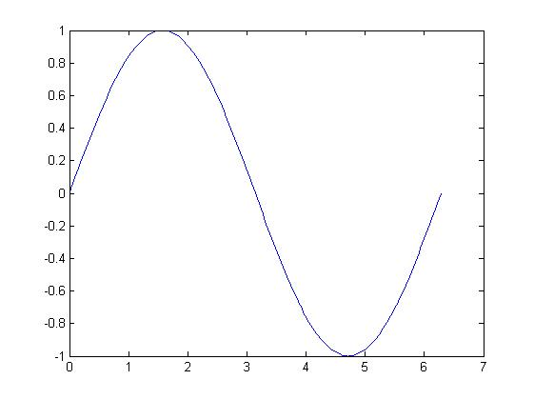
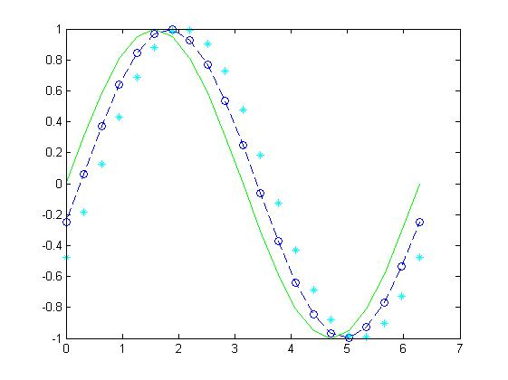
Plot figures
Usually use `plot(x,y)’ function
Ex) Sine function
x = 0:pi/100:2*pi;
y = sin(x);
plot(x,y)
x = 0:pi/10:2*pi;
y1 = sin(x);
y2 = sin(x-0.25);
y3 = sin(x-0.5);
plot(x,y1,’g’,x,y2,’b--o’,x,y3,’c*’)

Slide 6
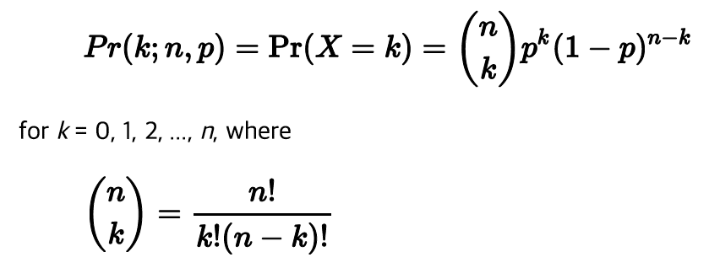


Histogram: Binomial distribution
Binomial distribution
Number of independent trials: n
Each trial will be successful with probability p
Then the probability of getting k successes in n trials follows
Mean and variance
Example
Plot histogram, sample mean, and sample variance for 100, 1000, 10000 samples for the following two cases
Case 1: n = 10, p = 0.5
Case 2: n = 10, p = 0.3
Compare the results with the probability distribution, mean, and variance

Slide 7
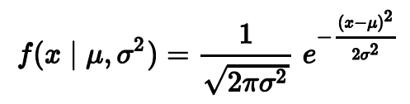


Histogram: Gaussian distribution
Gaussian (normal) distribution
The probability density function
Mean and variance
Homework (Due 19 Sept. pm 11:00)
Plot the histogram, sample mean, and sample variance for 100, 1000, 10000 samples for the following two cases
Case 1: = 0, = 1
Case 2: = 1, = 2
Compare the results with the probability distribution, mean, and variance
Hint) use ‘randn’ function in matlab

