Slide 1
Chapter 2
Probability
Ch.2.1. Sample Space
Ch.2.2. Events
Ch.2.3. Counting Sample Points
Instructor: Sang-Woon Jeon
CourseWeb: https://portal.hanyang.ac.kr
Office: 502 engineering building V
Email: sangwoonjeon@hanyang.ac.kr
Phone: 031-400-5918

Slide 2
Sample Space
Ch.2.1
Statistical (or probabilistic, random) experiment
Experiment that produces a different outcome at each trial
Uncertainty for the expected outcome
Definition: Sample Space
Each outcome in a sample space is called an element or a member of the sample space (or a sample point)
Ex) Flipping a coin
Ex) Tossing a die
Interested in the number on the top face
Interested in whether the number is even or odd
[Source] Definition 2.1 of the textbook

Slide 3
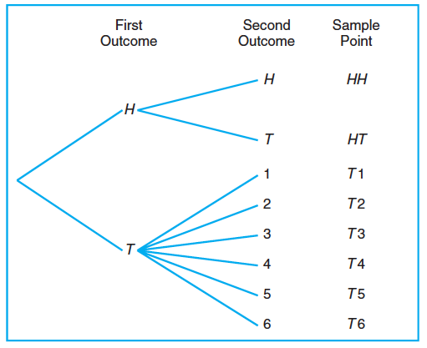
Sample Space
Ch.2.1
Ex) Flipping a coin and then flipping it a second time if a head occurs. If a tail occurs on the first flip, then a die is tossed once
Sample spaces with a large or infinite number of sample points are best described by a statement or rule method
[Source] Figure 2.1 of the textbook

Slide 4

Event
Ch.2.2
We may be interested in the occurrence of certain events rather than in the occurrence of a specific element
To each event we assign a collection of sample points, which constitute a subset of the sample space
Ex) Event that the outcome when a die is tossed is divisible by 3
Definition: Event
[Source] Definition 2.2 of the textbook
[Source] Example 2.4 of the textbook

Slide 5

Operation for Events
Ch.2.2
[Source] Definition 2.3 of the textbook
[Source] Definition 2.4 of the textbook
[Source] Definition 2.5 of the textbook
[Source] Definition 2.6 of the textbook

Slide 6
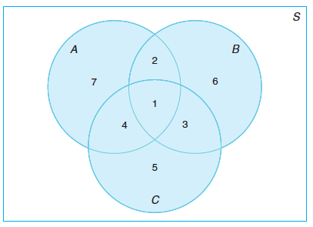
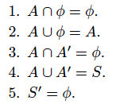
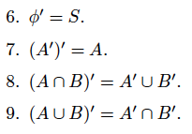
Venn diagrams
Ch.2.2
[Source] Figure 2.3 of the textbook

Slide 7


Counting Sample Points
Ch.2.3
In many cases, counting the number of points in the sample space is required without actually listing each element
Multiplication rule
Ex) How many sample points are there in the sample space when a pair of dice is thrown once?
sample points
[Source] Rule 2.1 of the textbook
[Source] Rule 2.2 of the textbook

Slide 8
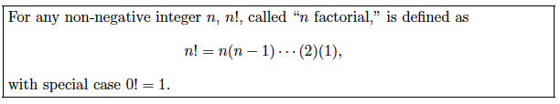
Permutation
Ch.2.3
Definition: Permutation
Ex) Consider the three letters a, b, and c. The possible permutations are abc, acb, bac, bca, cab, and cba
[Source] Definition 2.7 of the textbook
[Source] Definition 2.8 of the textbook
[Source] Theorem 2.1 of the textbook

Slide 9
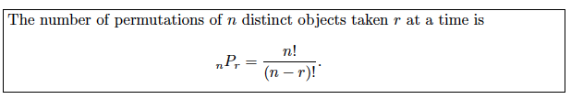
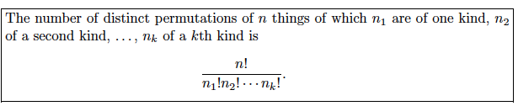
Permutation
Ch.2.3
[Source] Theorem 2.2 of the textbook
[Source] Theorem 2.3 of the textbook
[Source] Theorem 2.4 of the textbook

Slide 10
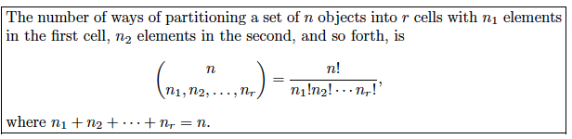
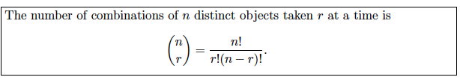
Partition, Combination
Ch.2.3
[Source] Theorem 2.5 of the textbook
[Source] Theorem 2.6 of the textbook

