Slide 1
Chapter 2
Probability
Ch.2.4. Probability of an Event
Ch.2.5. Additive Rules
Ch.2.6. Conditional Probability, Independence, and Product Rule
Ch. 2.7. Bayes’ Rule
Instructor: Sang-Woon Jeon
CourseWeb: https://portal.hanyang.ac.kr
Office: 502 engineering building V
Email: sangwoonjeon@hanyang.ac.kr
Phone: 031-400-5918

Slide 2
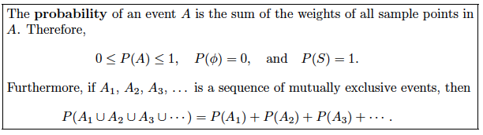


Probability of an Event
Ch.2.4
Probability of an event
Sum of all probabilities assigned to the sample points in
Definition (Axiom): Probability
Ex) Flipping a coin twice. The probability that at least one head occurs ?
[Source] Definition 2.9 of the textbook

Slide 3
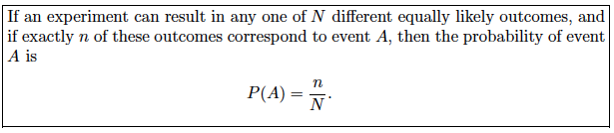




Probability of an Event
Ch.2.4
Ex) In a poker hand consisting of 5 cards, find the probability of holding 2 aces and 3 jacks.
Number of ways of being dealt 2 aces
Number of ways of being dealt 3 jacks
By the multiplication rule, hands with 2 aces and 3 jacks
Total number of 5-card poker hands
Hence, the probability of getting 2 aces and 3 jacks
[Source] Rule 2.3 of the textbook

Slide 4

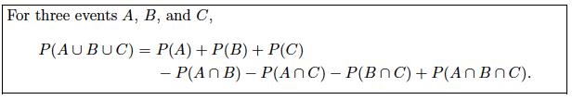


Additive Rules
Ch.2.5
[Source] Theorem 2.7 of the textbook
[Source] Theorem 2.8 of the textbook
[Source] Corollary 2.2 of the textbook
[Source] Theorem 2.9 of the textbook

Slide 5


Additive Rules
Ch.2.5
Ex) What is the probability of getting a total of 7 or 11 when a pair of fair dice is tossed?
Let be the event that 7 occurs and the event that 11 occurs
consists of 6 sample points out of 36 sample points
consists of 2 sample points out of 36 sample points
This result could also have been obtained by counting the total number of points for the event

Slide 6

Conditional Probability
Ch.2.6
Conditional probability
The probability of an event occurring when it is known that some event has occurred
Denoted by
“the probability that occurs given that occurs”
“the probability of , given ”
[Source] Definition 2.10 of the textbook

Slide 7
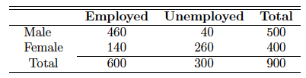






Conditional Probability
Ch.2.6
Ex)
: a man is chosen
: the one chosen is employed
[Source] Table 2.1 of the textbook

Slide 8
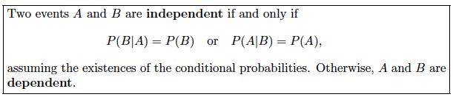


Independent Events
Ch.2.6
implies that and conversely
Ex) 2 cards are drawn in succession from an ordinary deck, with replacement
: the first card is an ace
: the second card is a spade
[Source] Definition 2.11 of the textbook
and are independent

Slide 9
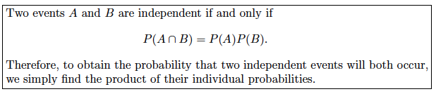
Product Rule
Ch.2.6
Product or multiplicative rule
We can also use
Revisit independency
[Source] Theorem 2.10 of the textbook
[Source] Theorem 2.11 of the textbook

Slide 10
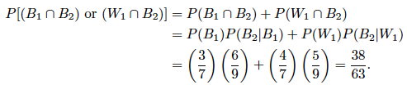
Product Rule
Ch.2.6
Ex) One bag contains 4 white balls and 3 black balls, and a second bag contains 3 white balls and 5 black balls. One ball is drawn from the first bag and placed unseen in the second bag. What is the probability that a ball now drawn from the second bag is black?
: drawing a black ball from bag 1
: drawing a black ball from bag 2
: drawing a white ball from bag 1
Interested in the event or
are mutually exclusive
product rule

Slide 11
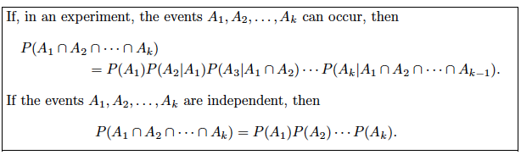
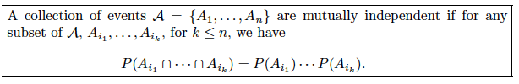
Product Rule
Ch.2.6
General product rule
[Source] Theorem 2.12 of the textbook
[Source] Definition 2.12 of the textbook

Slide 12
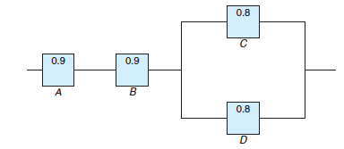
Product Rule
Ch.2.6
Ex) The system works if components A and B work and either of the components C or D works. The reliability (probability of working) of each component is also shown in Figure 2.9. Assume that the four components work independently.
(a) the probability that the entire system works
(b) the probability that the component C does not work, given that the entire system works
[Source] Figure 2.9 of the textbook

Slide 13


Product Rule
Ch.2.6
(a) the probability that the entire system works
(b) the probability that the component C does not work, given that the entire system works
[Source] Figure 2.9 of the textbook

Slide 14
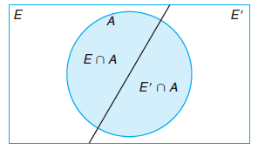

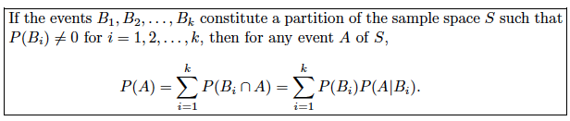
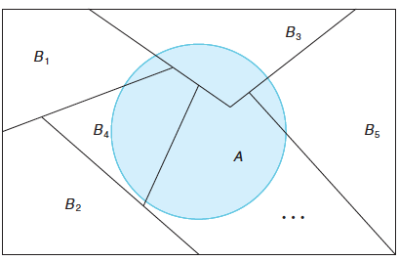
Total Probability
Ch.2.7
[Source] Figure 2.12 of the textbook
[Source] Theorem 2.13 of the textbook
[Source] Figure 2.14 of the textbook

Slide 15

Total Probability
Ch.2.7
Ex) In a certain assembly plant, three machines, B1, B2, and B3, make 30%, 45%, and 25%, respectively, of the products. It is known from past experience that 2%, 3%, and 2% of the products made by each machine, respectively, are defective. What is the probability that it is defective?
: the product is defective
: the product is made by machine
: the product is made by machine
: the product is made by machine

Slide 16
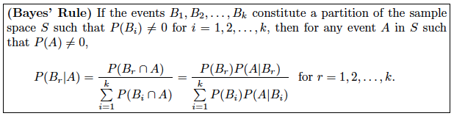
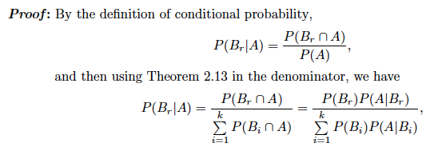
Bayes’ Rule
Ch.2.7

Slide 17


Bayes’ Rule
Ch.2.7
Ex) From the previous example, if a product was chosen randomly and found to be defective, what is the probability that it was made by machine B3?

