Slide 1
Chapter 2
Probability
Ch.2.4. Probability of an Event
Ch.2.5. Additive Rules
Ch.2.6. Conditional Probability, Independence, and Product Rule
Ch. 2.7. Bayes’ Rule
Instructor: Sang-Woon Jeon
CourseWeb: https://portal.hanyang.ac.kr
Office: 502 engineering building V
Email: sangwoonjeon@hanyang.ac.kr
Phone: 031-400-5918

Slide 2
Meaning of Axiom
Ch.2.4
What can be included in an axiom?
  Essential components for deriving many theorems, properties, etc
  Similar to definition, but not the same
  Can be observed by nature or experiment
  No mathematical derivation
Difference between
  Axiom
  Definition
  Proposition
  Theorem
  Corollary
  Property
  Lemma

Slide 3
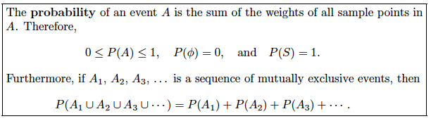


Recap: Probability of an Event
Ch.2.4
Probability of an event
  Sum of all probabilities assigned to the sample points in
  Definition (Axiom): Probability
  Ex) Flipping a coin twice. The probability that at least one head occurs ?
[Source] Definition 2.9 of the textbook

Slide 4

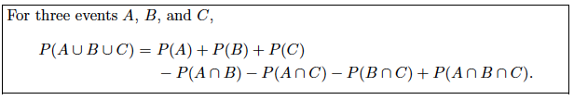


Recap: Additive Rules
Ch.2.5
[Source] Theorem 2.7 of the textbook
[Source] Theorem 2.8 of the textbook
[Source] Corollary 2.2 of the textbook
[Source] Theorem 2.9 of the textbook

Slide 5
Axioms and Properties
Ch.2.5
From the definition of axioms
  Additive rules can be derived from the axiom of probability !!
  Then, how ?

Slide 6
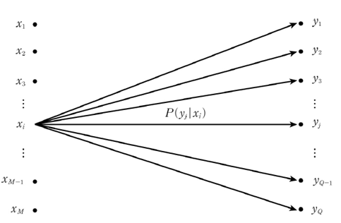
Decoding for Communication Systems
Ch.2.7
Communication Systems
  Communication from to
  Channel is given by
  Optimal decoding of when the receiver observes
MAP (maximum a posterior probability) decoding
Minimize the probability of error

Slide 7
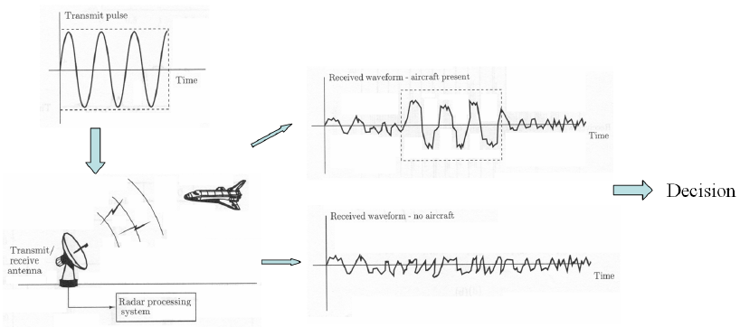
Detection for Radar Systems
Ch.2.7
Radar systems
  Wish to decide on the presence or absence of a target
  Type I error: “False alarm”
  Type II error: “Target miss”
  Cost for type I error is much greater than that of type II error
Minimize the posterior expected cost

Slide 8
Homework
Solve Exercises
  2.25, 2.31, 2.36
  2.51, 2.62, 2.66, 2.71
  2.74, 2.88, 2.93
  2.99, 2.109, 2.106, 2.119, 2.126
Due 11 Oct. pm 3:00
  Submit a handwriting report at the beginning of the class
  No need to write problems

