Slide 1
Chapter 3
Random Variables and
Probability Distributions
Ch.3.1. Concept of a Random Variable
Ch.3.2. Discrete Probability Distributions
Ch.3.3. Continuous Probability Distributions
Instructor: Sang-Woon Jeon
CourseWeb: https://portal.hanyang.ac.kr
Office: 502 engineering building V
Email: sangwoonjeon@hanyang.ac.kr
Phone: 031-400-5918

Slide 2
Random Variable (RV)
Ch.3.1
Statistical (or probabilistic, random) experiment
Experiment that produces a different outcome at each trial
Uncertainty for the expected outcome
Ex) Flipping a coin
Ex) Tossing a die
Interested in the number on the top face
Interested in whether the number is even or odd
[Source] Definition 3.1 of the textbook

Slide 3

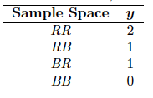
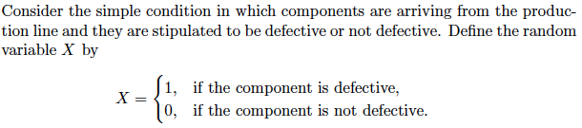
Random Variable (RV)
Ch.3.1
Example 3.1)
Example 3.3)

Slide 4
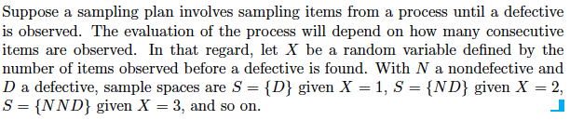
Random Variable (RV)
Ch.3.1
Example 3.5)

Slide 5

Discrete VS Continuous
Ch.3.1
Discrete RV
Discrete RV if its set of possible outcomes is countable
Continuous RV
Continuous RV if its set of possible outcomes is uncountable many
[Source] Definition 3.2 of the textbook
[Source] Definition 3.3 of the textbook

Slide 6
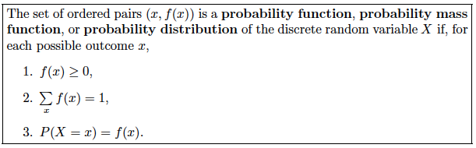
Discrete Probability Distributions
Ch.3.2
Probability distributions associated with discrete RVs
Mathematical definition
[Source] Definition 3.4 of the textbook

Slide 7

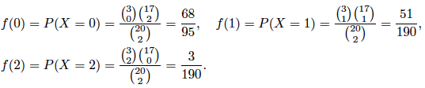

Discrete Probability Distributions
Ch.3.2
Example 3.8)
Let X be a random variable whose values x are the possible numbers of defective computers purchased by the school
Then
Hence the probability distribution of X is

Slide 8


Discrete Probability Distributions
Ch.3.2
Example 3.9)
Let X be the number of cars with side airbags among the next 4 cars
Probability of selling an automobile with side airbags = 0.5
Points in the sample space = 16

Slide 9
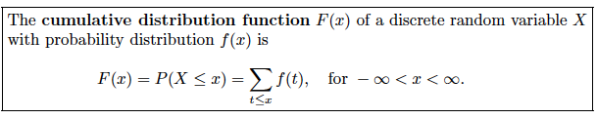
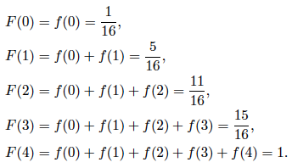
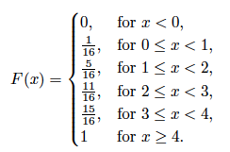

Discrete Probability Distributions
Ch.3.2
Example 3.10)
[Source] Definition 3.5 of the textbook

Slide 10
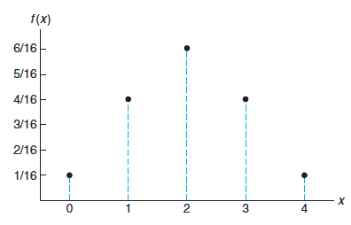
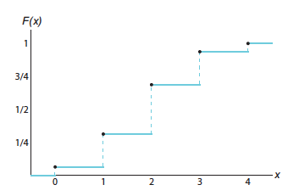
Discrete Probability Distributions
Ch.3.2
Examples 3.9 and 3.10)
CDF can be attained from PMF
PMF can be attained from CDF
Probability mass function (PMF)
Cumulative distribution function (CDF)

Slide 11
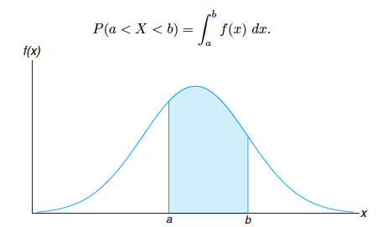
Continuous Probability Distributions
Ch.3.3
A continuous RV has a probability of zero of assuming exactly any of its values
The probability that a continuous RV belongs to a certain range is non-zero
Its probability distribution cannot be given in tabular form
Concept of the probability density function

Slide 12
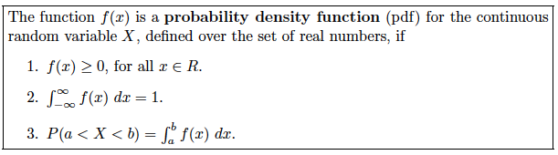
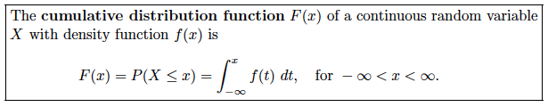

Continuous Probability Distributions
Ch.3.3
Relation between PDF and CDF
[Source] Definition 3.6 of the textbook
[Source] Definition 3.7 of the textbook

Slide 13

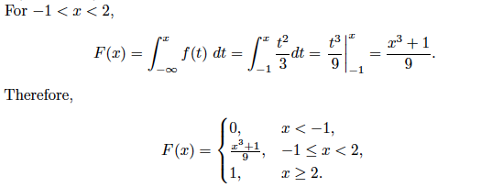

Continuous Probability Distributions
Ch.3.3
Example 3.12)

Slide 14


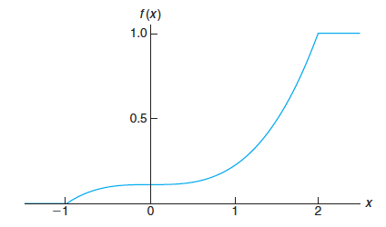

Continuous Probability Distributions
Ch.3.3
Example 3.13)

Slide 15
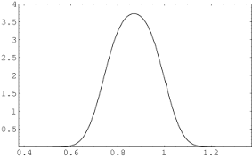
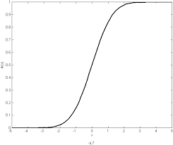
Summary
Ch.3.3 & 3.4
Discrete RVs
Probability mass function (PMF)
Cumulative distribution function (CDF)
Continuous RVs
Probability density function (PDF)
Cumulative distribution function (CDF)
probability
probability
probability
density
probability

