Slide 1
Chapter 3
Random Variables and
Probability Distributions
Ch.3.1. Concept of a Random Variable
Ch.3.2. Discrete Probability Distributions
Ch.3.3. Continuous Probability Distributions
Instructor: Sang-Woon Jeon
CourseWeb: https://portal.hanyang.ac.kr
Office: 502 engineering building V
Email: sangwoonjeon@hanyang.ac.kr
Phone: 031-400-5918

Slide 2
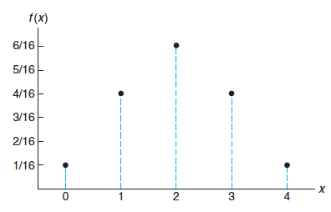
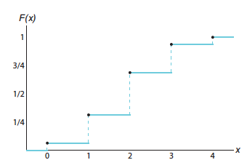
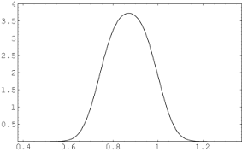
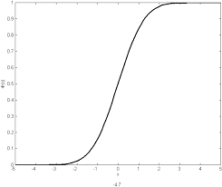
Recap: Summary
Ch.3.3 & 3.4
Discrete RVs
Probability mass function (PMF)
Cumulative distribution function (CDF)
Continuous RVs
Probability density function (PDF)
Cumulative distribution function (CDF)
probability
probability
probability
density
probability

Slide 3
“Hybrid” Random Variables
Ex) Consider a random variable
Let
Uniformly distributed for the rest of the regime
Q) How to describe the probability distribution of
A) PDF with impulse functions or CDF

Slide 4
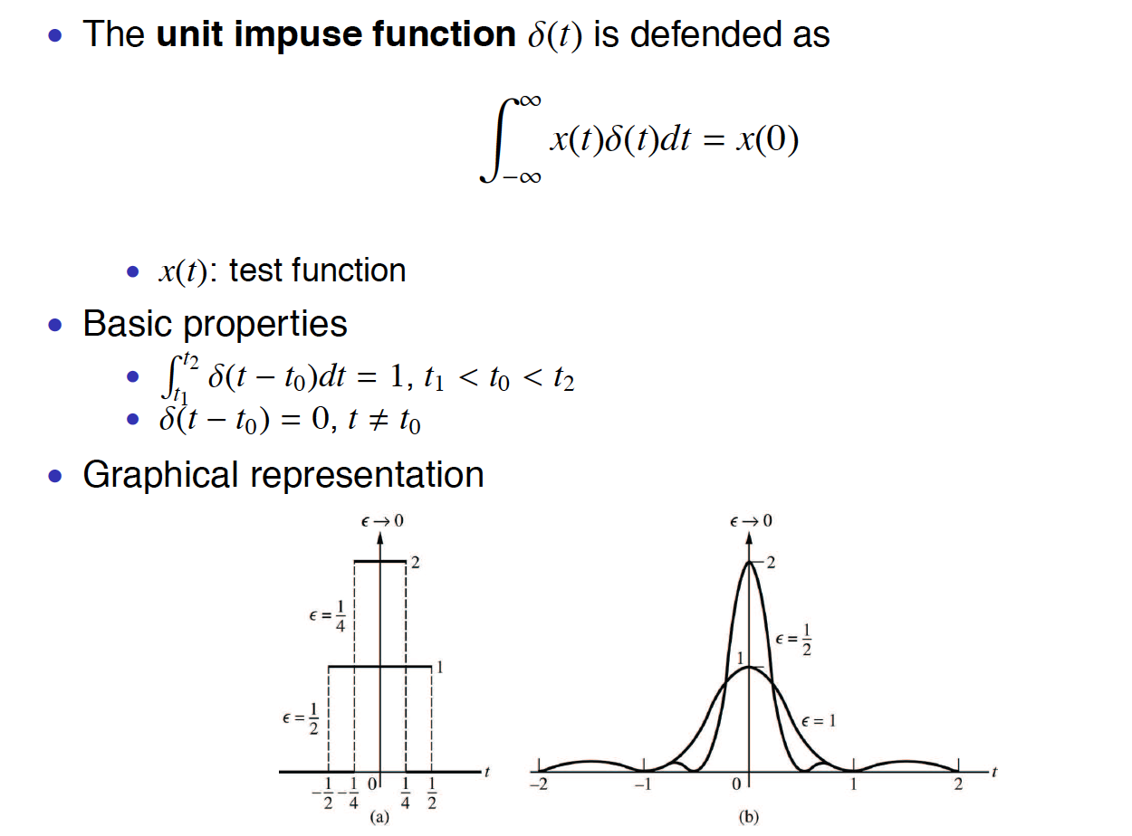
Impulse Function

Slide 5
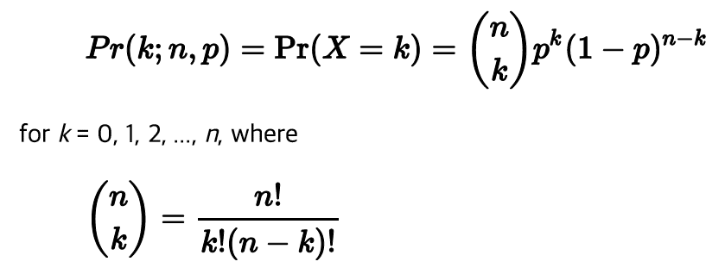


Histogram: Binomial distribution
Binomial distribution
Number of independent trials: n
Each trial will be successful with probability p
Then the probability of getting k successes in n trials follows
Mean and variance
Example
Plot histogram, sample mean, and sample variance for 100, 1000, 10000 samples for the following two cases
Case 1: n = 10, p = 0.5
Case 2: n = 10, p = 0.3
Compare the results with the probability distribution, mean, and variance

Slide 6
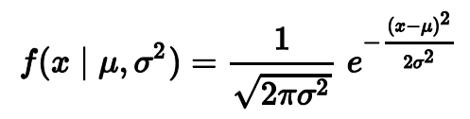


Histogram: Gaussian distribution
Gaussian (normal) distribution
The probability density function
Mean and variance
Homework (Due 19 Sept. pm 11:00)
Plot the histogram, sample mean, and sample variance for 100, 1000, 10000 samples for the following two cases
Case 1: = 0, = 1
Case 2: = 1, = 2
Compare the results with the probability distribution, mean, and variance
Hint) use ‘randn’ function in matlab

