Slide 1
Chapter 3
Random Variables and
Probability Distributions
Ch.3.4. Joint Probability Distributions
Instructor: Sang-Woon Jeon
CourseWeb: https://portal.hanyang.ac.kr
Office: 502 engineering building V
Email: sangwoonjeon@hanyang.ac.kr
Phone: 031-400-5918

Slide 2
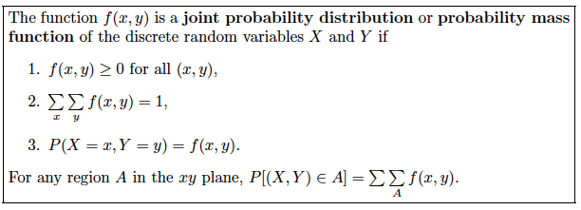
Joint Probability Distributions
Ch.3.4
Joint probability mass function
Let X and Y are two discrete random variables
The probability distribution for their simultaneous occurrence:
Mathematical definition
[Source] Definition 3.8 of the textbook

Slide 3
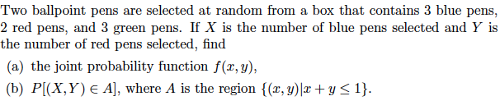

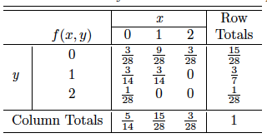

Joint Probability Distributions
Ch.3.4
Example 3.14)
[Source] Table 3.1 of the textbook

Slide 4
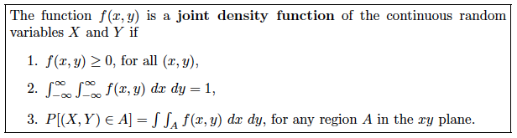
Joint Probability Distributions
Ch.3.4
Joint probability density function
[Source] Definition 3.9 of the textbook

Slide 5
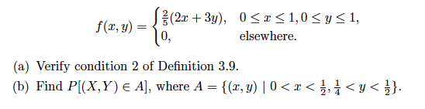
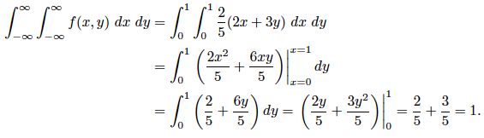
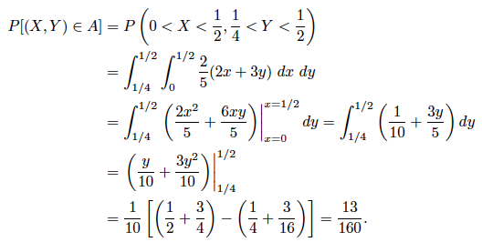
Joint Probability Distributions
Ch.3.4
Example 3.15)

Slide 6
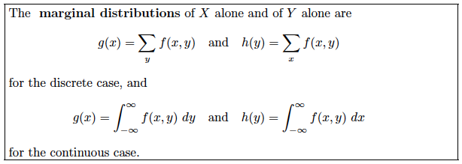


Marginal Distributions
Ch.3.4
Marginal distributions
Marginal distributions are indeed probability distributions
[Source] Definition 3.10 of the textbook

Slide 7




Marginal Distributions
Ch.3.4
Example 3.16)

Slide 8


Marginal Distributions
Ch.3.4
Example 3.17)

Slide 9

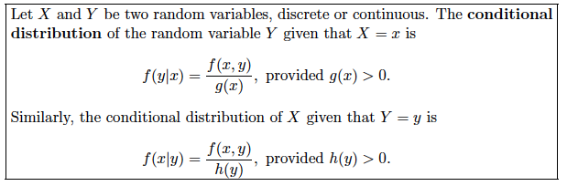


Conditional Distributions
Ch.3.4
Recall in Section 2.6
Conditional distributions
[Source] Definition 3.11 of the textbook
for discrete random variables
for continuous random variables

Slide 10




Conditional Distributions
Ch.3.4
Example 3.18)

Slide 11

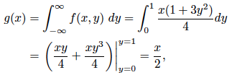
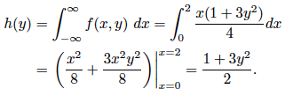


Conditional Distributions
Ch.3.4
Example 3.20)

Slide 12
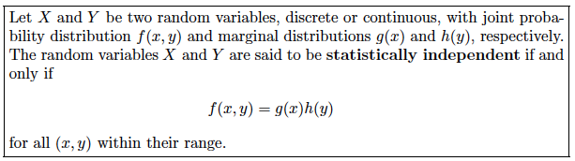
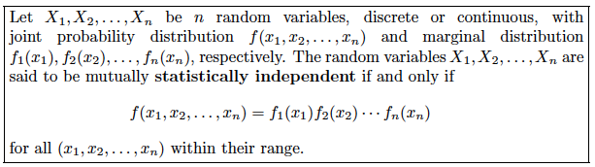
Statistical Independency
Ch.3.4
[Source] Definition 3.12 of the textbook
[Source] Definition 3.13 of the textbook

Slide 13



Statistical Independency
Ch.3.4
Example 3.21)

