Slide 1
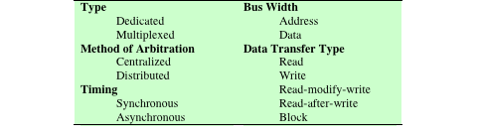
Elements of Bus Design
Notes:
Although a variety of different bus implementations exist, there are a few basic
parameters or design elements that serve to classify and differentiate buses. Table 3.2
lists key elements.
Bus Types: Bus lines can be separated into two generic types: dedicated and
multiplexed. A dedicated bus line is permanently assigned either to one function or
to a physical subset of computer components.
An example of functional dedication is the use of separate dedicated address
and data lines, which is common on many buses. However, it is not essential. For
example, address and data information may be transmitted over the same set of
lines using an Address Valid control line. At the beginning of a data transfer, the
address is placed on the bus and the Address Valid line is activated. At this point,
each module has a specified period of time to copy the address and determine if
it is the addressed module. The address is then removed from the bus, and the
same bus connections are used for the subsequent read or write data transfer. This
method of using the same lines for multiple purposes is known as time multiplexing.
The advantage of time multiplexing is the use of fewer lines, which saves space
and, usually, cost. The disadvantage is that more complex circuitry is needed within
each module. Also, there is a potential reduction in performance because certain
events that share the same lines cannot take place in parallel.
Physical dedication refers to the use of multiple buses, each of which connects
only a subset of modules. A typical example is the use of an I/O bus to interconnect
all I/O modules; this bus is then connected to the main bus through some type of I/O
adapter module. The potential advantage of physical dedication is high throughput,
because there is less bus contention. A disadvantage is the increased size and cost of
the system.
Method of arbitration: In all but the simplest systems, more than one module
may need control of the bus. For example, an I/O module may need to read or write
directly to memory, without sending the data to the processor. Because only one unit
at a time can successfully transmit over the bus, some method of arbitration is needed.
The various methods can be roughly classified as being either centralized arbitration
or distributed arbitration. In a centralized scheme, a single hardware device, referred
to as a bus controller or arbiter, is responsible for allocating time on the bus. The
device may be a separate module or part of the processor. In a distributed scheme,
there is no central controller. Rather, each module contains access control logic and
the modules act together to share the bus. With both methods of arbitration, the
purpose is to designate one device, either the processor or an I/O module, as master.
The master may then initiate a data transfer (e.g., read or write) with some other
device, which acts as slave for this particular exchange.
Timing: Timing refers to the way in which events are coordinated on the bus. Buses
use either synchronous timing or asynchronous timing.

Slide 2
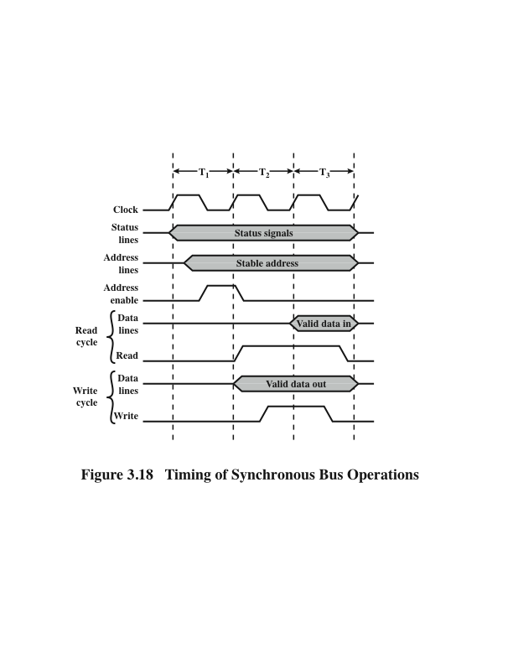
Timing of Synchronous Bus Operations
Notes:
With synchronous timing, the occurrence of events on the bus is determined
by a clock. The bus includes a clock line upon which a clock transmits a regular
sequence of alternating 1s and 0s of equal duration. A single 1–0 transmission is
referred to as a clock cycle or bus cycle and defines a time slot. All other devices on
the bus can read the clock line, and all events start at the beginning of a clock cycle.
Figure 3.18 shows a typical, but simplified, timing diagram for synchronous read
and write operations (see Appendix N for a description of timing diagrams). Other
bus signals may change at the leading edge of the clock signal (with a slight reaction
delay). Most events occupy a single clock cycle. In this simple example, the processor
places a memory address on the address lines during the first clock cycle and
may assert various status lines. Once the address lines have stabilized, the processor
issues an address enable signal. For a read operation, the processor issues a read
command at the start of the second cycle. A memory module recognizes the address
and, after a delay of one cycle, places the data on the data lines. The processor reads
the data from the data lines and drops the read signal. For a write operation, the
processor puts the data on the data lines at the start of the second cycle and issues a
write command after the data lines have stabilized. The memory module copies the
information from the data lines during the third clock cycle.

Slide 3
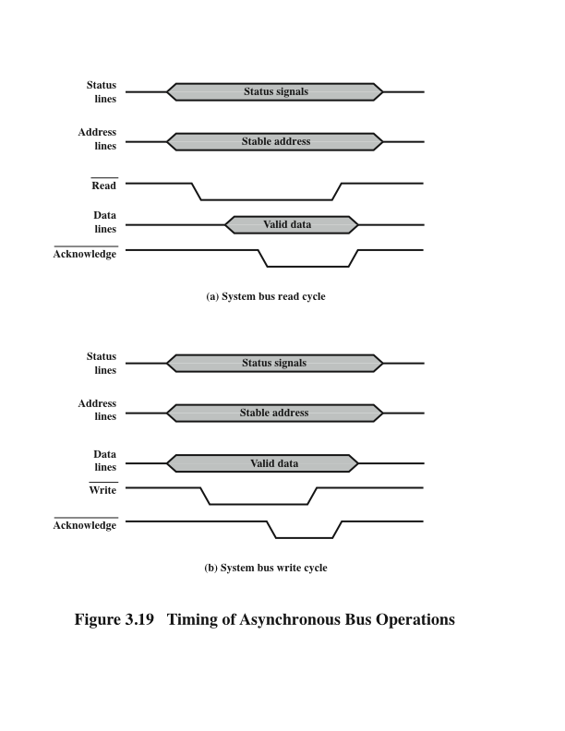
Timing of Asynchronous Bus Operations
Notes:
With asynchronous timing, the occurrence of one event on a bus follows
and depends on the occurrence of a previous event. In the simple read example of
Figure 3.19a, the processor places address and status signals on the bus. After pausing
for these signals to stabilize, it issues a read command, indicating the presence
of valid address and control signals. The appropriate memory decodes the address and
responds by placing the data on the data line. Once the data lines have stabilized,
the memory module asserts the acknowledged line to signal the processor that the
data are available. Once the master has read the data from the data lines, it deasserts
the read signal. This causes the memory module to drop the data and acknowledge
lines. Finally, once the acknowledge line is dropped, the master removes the
address information.
Figure 3.19b shows a simple asynchronous write operation. In this case, the
master places the data on the data line at the same time that it puts signals on the
status and address lines. The memory module responds to the write command by
copying the data from the data lines and then asserting the acknowledge line. The
master then drops the write signal and the memory module drops the acknowledge
signal.
Synchronous timing is simpler to implement and test. However, it is less
flexible than asynchronous timing. Because all devices on a synchronous bus are
tied to a fixed clock rate, the system cannot take advantage of advances in device
performance. With asynchronous timing, a mixture of slow and fast devices, using
older and newer technology, can share a bus.

