Slide 1
Programming Project: Blockchain-Based Safe Sharing of Population Descriptors
Team 3 Members: Sasan Hakimzadeh, Pradyumna Rao, Nithyasree Natarajan, Jack Dulin, Shruthi Sureshkrishnan, Nithya Kandappan, Breanna Higgins, Sean Kearns

Slide 2
Product Overview
Our product is a block-chain based application which allows users to compare their health data to general population descriptors based on demographic.
Users input data such as their name, date of birth, gender, height, and weight to their personal profiles. Daily inputs of their total steps, miles walked, calories burned, and average heart rate are also documented.
Each entry is a block in the block-chain which is associated with a user profile in order to keep the data secure and private. Users will not have access to other user data this way.
Users want an application that is easily navigated and simple to use every day in order to maintain consistency with their data.
Consistency is key as users will ideally be able to track their weekly/monthly progress, set goals for themselves, and maintain their health levels.
This application is for anyone trying to track their health metrics, set fitness goals, or just maintain general health overall.

Slide 3
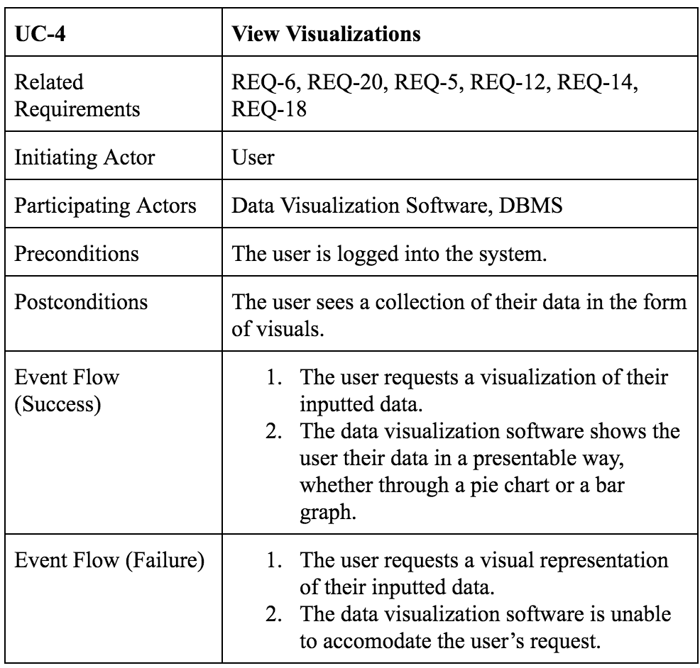
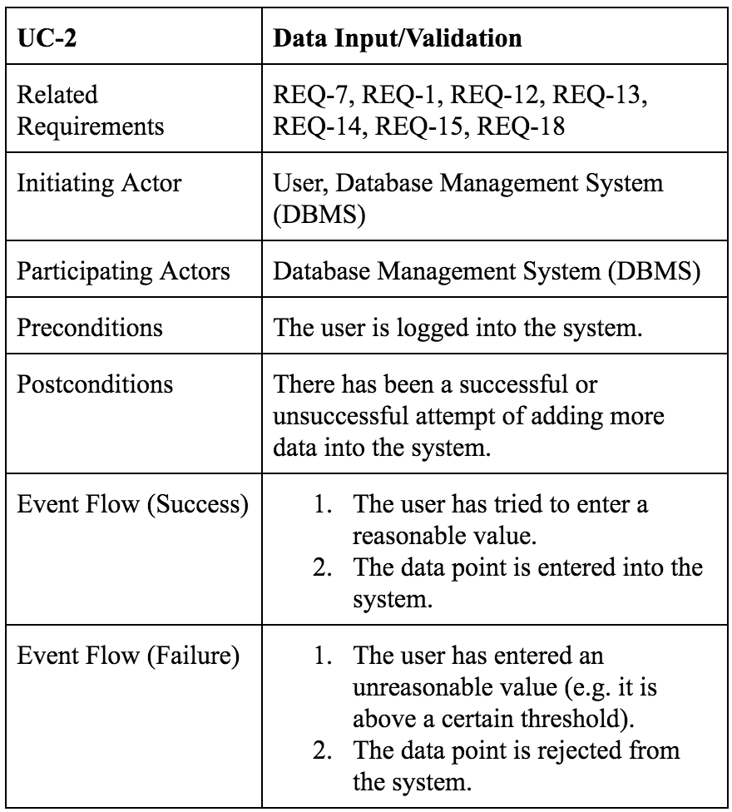
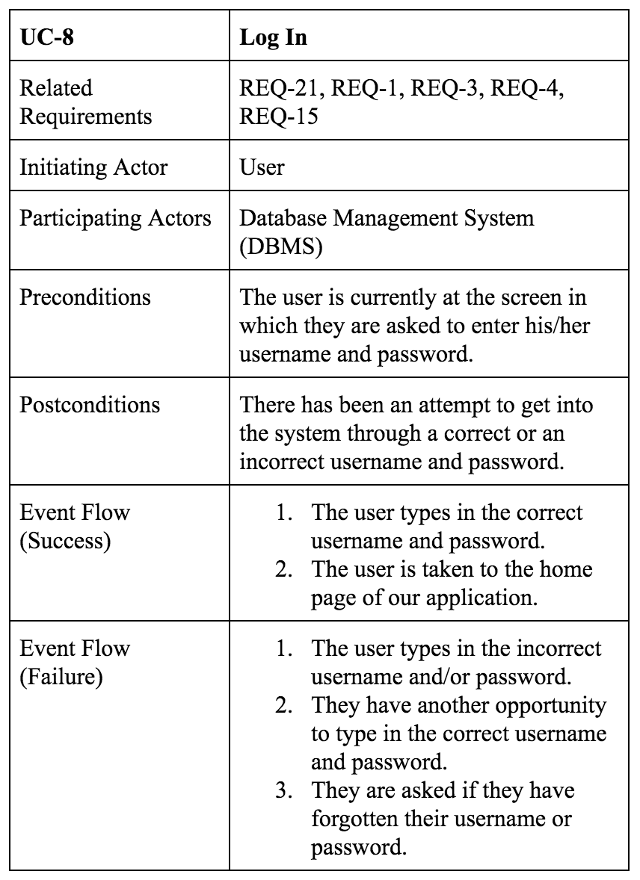
Main Use Cases

Slide 4
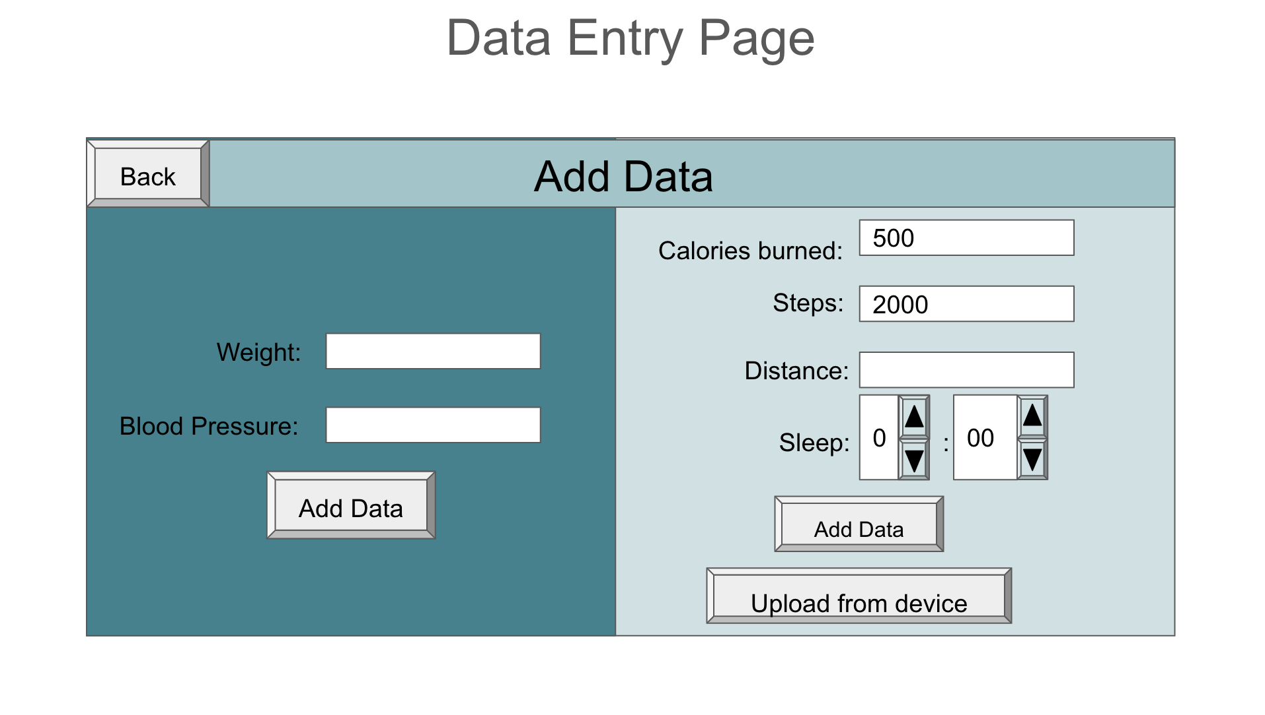
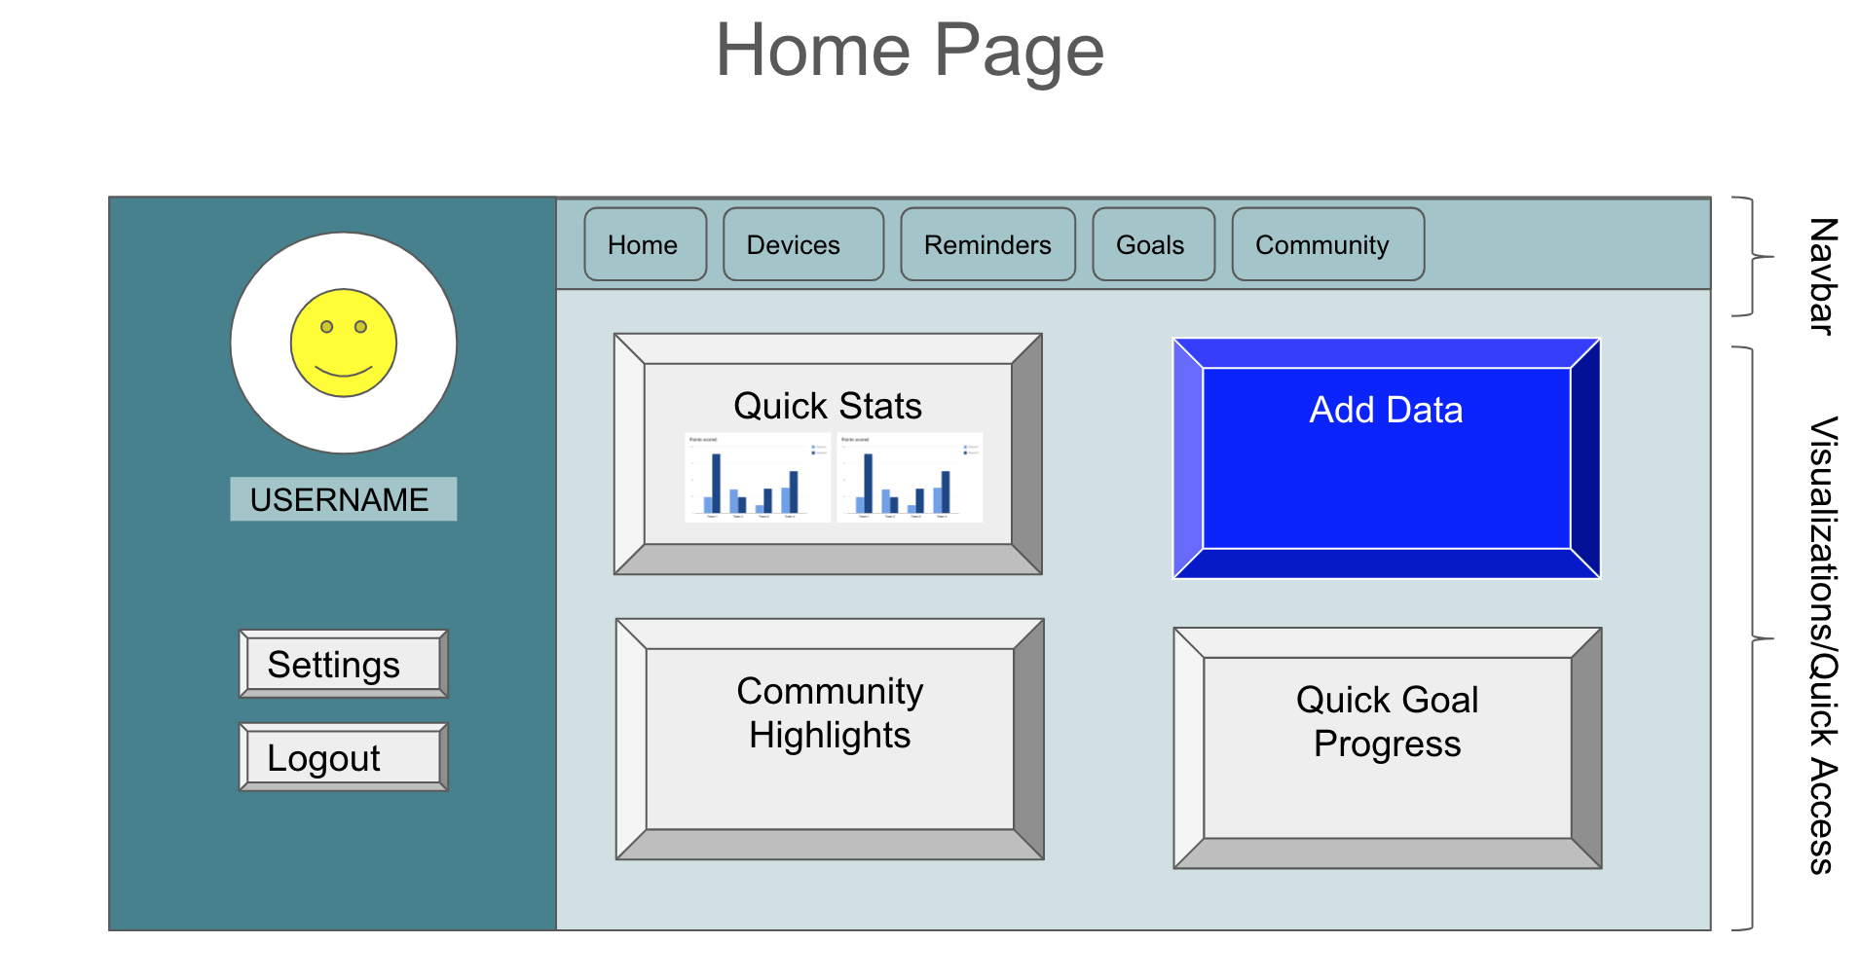
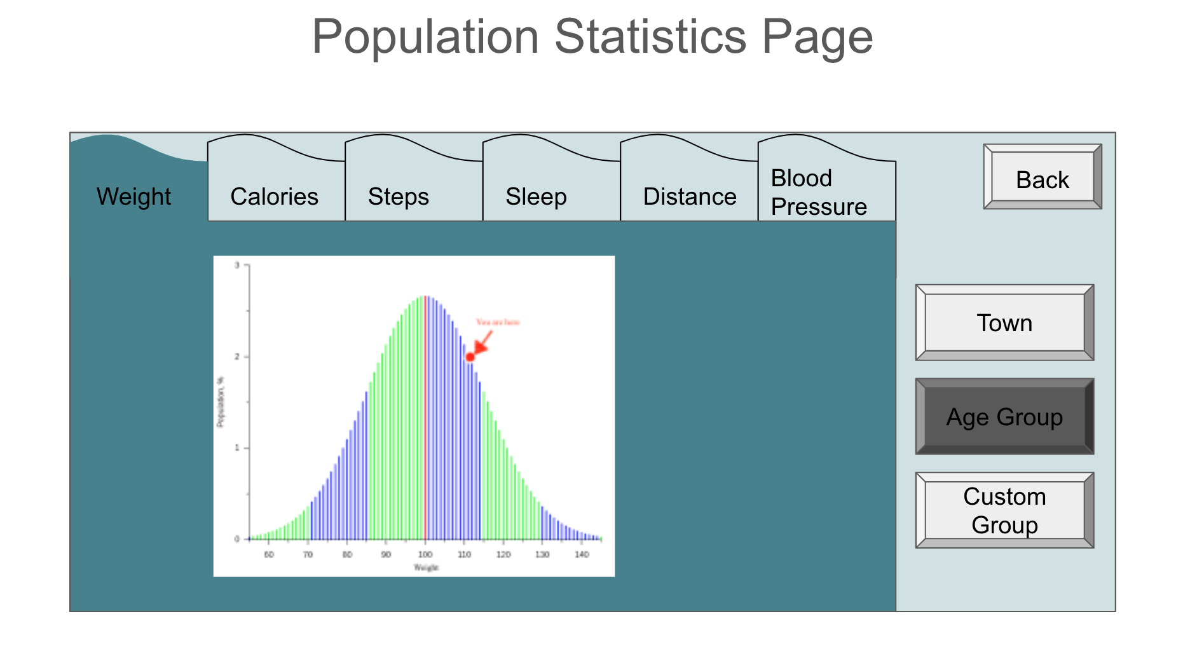
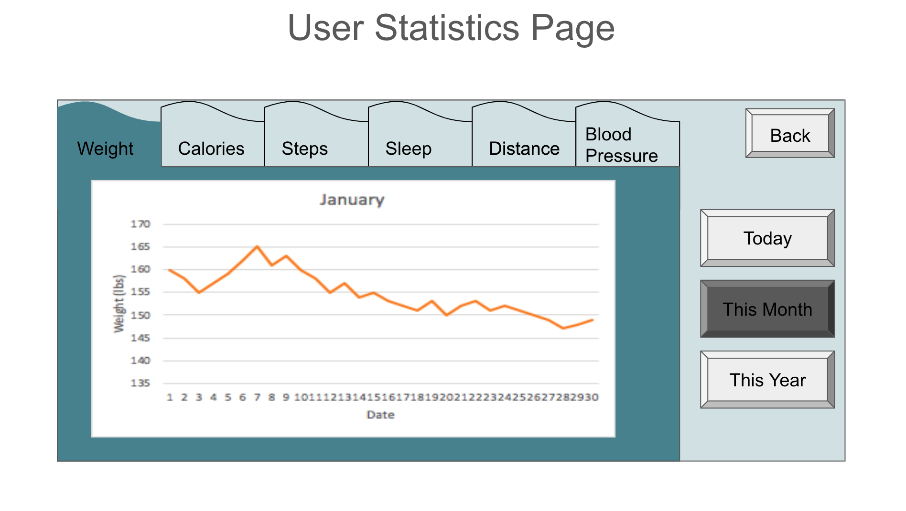
Main Features

Slide 5
