Slide 1
Catalysis

Slide 2
Contents
Types and characteristics of catalysis
Theory of homogeneous catalysis
Kinetics of homogeneous catalysis
Function of a catalyst in terms of Gibbs free energy of activation
Theory of heterogeneous catalysis
Kinetics of heterogeneous catalysis
Effect of temperature on heterogeneous reactions
Acid-base catalysis
Mechanism of acid-base catalysis
Kinetics of acid-base catalysis

Slide 3
Catalyst
In 1836 Berzelius realized that there are some substances which can increase the rate of a reaction without themselves being consumed.
He believed that the function of such a substance was to loosen the bonds which hold the atoms in the reacting molecules together.
Thus he coined the term catalysis (Greek kata = wholly, lein = to loosen).
There is no doubt that usually a catalyst accelerates a reaction as was thought by Berzelius.
But a number of cases are now known where the catalyst definitely retards the rate of reaction.

Slide 4
Catalysis
A catalyst is defined as a substance which alters the rate of a chemical reaction, itself remaining chemically unchanged at the end of the reaction. The process is called catalysis.
As evident from the above definition, a catalyst may increase or decrease the rate of a reaction.
A catalyst which enhances the rate of a reaction is called a positive catalyst and the process is positive catalysis or simply catalysis.
A catalyst which retards the rate of a reaction is called a negative catalyst and the process is negative catalysis.

Slide 5
Types of catalysis
There are mainly two main types of catalysis,
(a) Homogeneous catalysis
(b) Heterogeneous catalysis
Also, there is a third types of catalysis known as enzyme catalysis which is largely of biological interest.

Slide 6
Homogeneous catalysis
Homogeneous catalysis refers to the reactions where the catalyst is in the same phase as the reactants.
This type of catalysis can occur in gas phase or in the liquid (solution) phase.
Examples of homogeneous catalysis in gas phase
(a) Oxidation of sulphur dioxide to sulphur trioxide with nitric oxide as catalyst,
2SO₂(g) + O₂(g) → 2SO₃(g)
(b) Decomposition of acetaldehyde (CH₃CHO) by iodine (I₂) as catalyst,
CH₃CHO(v) + I₂(v) → CH₄(g) + CO(g)

Slide 7
Homogeneous catalysis
Examples of homogeneous catalysis in soln. phase
(a) Hydrolysis of cane sugar in aqueous solution in the presence of mineral acid (H₂SO₄) as catalyst,
C₁₂H22O₁₁ + H₂O → C₆H₁₂O₆ + C₆H₁₂O₆
(b) Hydrolysis of an ester in the presence of acid or alkali,
CH₃CO₂CH₃(l) + H₂O(l) → CH₃COOH(l) + CH₃OH(/)
(c) Decomposition of hydrogen peroxide in the presence of iodide ion (I⁻) as catalyst,
2H₂O₂ → 2H₂O + O₂

Slide 8
Heterogeneous catalysis
Heterogeneous catalysis are chemical reactions in which the reactants and products are not in the same phase.
The most important of such reactions are those in which the reactants are in the gas phase while the catalyst is a solid.
The process is also called contact catalysis, since the reaction occurs by contact of reactants with the catalyst surface.
In contact catalysis, usually the catalyst is a finely divided metal.
This form of this catalysis has a great industrial importance.

Slide 9
Heterogeneous catalysis
Examples of heterogeneous catalysis
(1) Heterogeneous catalysis with gaseous reactants
(a) Combination of sulphur dioxide and oxygen in the presence of finely divided platinum or V₂O₅.
2SO₂(g) + O₂(g) → 2SO₃(g)
(b) Combination of nitrogen and hydrogen to form ammonia in the presence of finely divided iron,
N₂(g)+ H₂(g) → NH₃(g)
(c) Hydrogenation reactions of unsaturated organic compounds are catalyzed by finely divided nickel.
H₂C=CH₂(g) + H₂(g) → H₃C-CH₃(g)

Slide 10
Heterogeneous catalysis
(2) Heterogeneous catalysis with liquid reactants
(a) The decomposition of aqueous solutions of hydrogen peroxide is catalyzed by MnO₂ or platinum in colloidal form,
2H₂O₂(l) → 2H₂O(l) + O₂(g)
(b) Benzene and acetyl chloride react in the presence of anhydrous aluminum chloride to form phenyl methyl ketone
C₆H₆(l) + CH₃COCl(l) → C₆H₅COCH₃ + HCl
(3) Heterogeneous catalysis with solid reactants
Decomposition of potassium chlorate is catalyzed by MnO₂.
2KClO₃(s) → 2KCl + 3O₂

Slide 11
Characteristics of catalysis
Although there are different types of catalytic reactions, the following features or characteristics are common to most of them
1) The catalyst remain unchanged in mass and chemical composition
2) Small amount of catalyst is needed
3) Effect of the equilibrium of a reversible reaction
4) Inability to start a reaction
5) Specific nature of a catalyst
6) A catalyst is more effective when finely divided

Slide 12
Characteristics of catalysis
7) Nature of the products is unaltered by the presence of the catalyst
8) Optimum temperature
9) Action of promoters
10) A catalyst is poisoned by certain substances

Slide 13
1) The catalyst remain unchanged in mass and chemical composition
Qualitative and quantitative analysis show that a catalyst undergoes no change in mass of chemical nature.
However, it may undergo a physical change.
Thus granular MnO₂ is used as a catalyst in the thermal decomposing of potassium chlorate and it is left as a fine powder at the end to the reaction.

Slide 14
2) Small amount of catalyst is needed
Sometimes a trace amount of a metal catalyst is required to affect very large amounts of reactants.
On the other hand, there are catalysts which need to be present in relatively large amount to be effective.
Thus in Friedel-Crafts reaction,
C₆H₆ + C₂H₅Cl → C₆H₅C₂H₅ + HCl
anhydrous aluminium chloride functions as a catalyst effectively when present to the extent of 30 per cent of the mass of benzene.

Slide 15
3) Effect of the equilibrium of a reversible reaction
It implies that in a reversible reaction the catalyst accelerates the forward and the reverse reactions equally.
Thus the ratio of the rates of two opposing reactions i.e., the equilibrium constant, remains unchanged.
For example, in the Haber process for ammonia,
N₂ + 3H₂ → 2NH₃
the reaction is very slow. In the presence of the catalyst, the equilibrium is reached much sooner but the percentage of yield remains unchanged.
The iron catalyst shortens the time to attain equilibrium but cannot alter the percentage of yield.

Slide 16
4) Inability to start a reaction
In most cases a catalyst speeds up a reaction already in progress and does not initiate (or start) the reaction.
But there are certain reactions where the reactants do not combine for very long period (perhaps years).
For example, a mixture of hydrogen and oxygen, which remains unchanged almost indefinitely at room temperature, can be brought to reaction by the catalyst platinum black in a few seconds.
H₂ + O₂ → No reaction (at room temperature)
2H₂ + O₂ → 2H₂O (with platinum black )
Thus it is now considered that the catalyst can initiate a reaction.

Slide 17
5) Specific nature of a catalyst
While a particular catalyst works for one reaction, it will not necessarily work for another reaction.
Different catalysts, moreover, can bring about completely different reactions for the same substance.
For example, ethanol gives ethene when passed over hot aluminium oxide,
C₂H₅OH → CH₂=CH₂ + H₂O (Dehydration)
but with hot copper it gives ethanal.
C₂H₅OH → CH₃CHO + H₂ (Dehydrogenation)

Slide 18
6) A catalyst is more effective when finely divided
In heterogeneous catalysis, the solid catalyst is more effective when in a state of fine subdivision than it is used in bulk.
Thus a lump of platinum will have much less catalytic activity than colloidal or platinized asbestos.
Finely divided nickel is a better catalyst than lumps of solid nickel.

Slide 19
7) Nature of the products is unaltered by the presence of the catalyst
N₂ and H₂ always give ammonia in presence or absent of catalyst.
Similarly SO₂ and O₂ always give SO₃ in presence or absent of catalyst.
But this is not always true.
There are some exceptions.

Slide 20
Exceptions
Nature of the products is altered by the presence of the catalyst
i) When CO and H₂ reacts, it gives three different products due to use of three different catalysts.
CO + 3H₂ → CH₄ + H₂O (for Ni catalyst)
CO + H₂ → HCHO (for Cu catalyst)
CO + 2H₂ → CH₃OH (for ZnO + Cr₂O₃ catalyst)
ii) Chlorination of toluene
C₆H₅CH₃ + Cl₂ → C₆H₅CCl₃ (presence of sunlight)
C₆H₅CH₃ + Cl₂ → C₆H₄CH₃Cl (ortho) + C₆H₄CH₃Cl (para) (presence of Iron catalyst)

Slide 21
8) Optimum temperature
We know the effect of temperature change on reversible reactions under Le-Chatelier principle.
Some catalysts are, however, physically altered by a rise in temperature and hence their catalytic activity may be decreased.
This is particularly true with colloidal solutions like that of platinum, since a rise in the temperature may cause their coagulation.
In such a case the rate of reaction increases up to a certain point and then gradually decreases.
The rate of reaction is maximum at a particular temperature called the optimum temperature.

Slide 22
9) Action of promoters
The activity of a catalyst can often be increased by addition of a small quantity of a second material.
This second substance is either not a catalyst itself for the reaction or it may be a feeble catalyst.
A substance which, though itself not a catalyst, promotes the activity of a catalyst is called a promoter.
Example of Promoters
Molybdenum (Mo) or aluminium oxide promotes the activity of iron catalyst in the Haber synthesis for the manufacture of ammonia.
N₂ + 3H₂ → 2NH₃

Slide 23
10) A catalyst is poisoned by certain substances
Very often a heterogeneous catalyst in rendered ineffective by the presence of small amounts of impurities in the reactants. The poison is adsorbed on the catalyst surface in preference to the reactants.
A substance which destroys the activity of the catalyst to accelerate a reaction, is called a poison and the process is called Catalytic poisoning.
Examples of Catalytic Poisoning
(1) The platinum catalyst used in the oxidation of sulphur dioxide, is poisoned by arsenic oxide (As₂O₃)
SO₂ + O₂ → 2SO₃
(2) The iron catalyst used in the synthesis of ammonia (Haber Process) is poisoned by H₂S.
N₂+ 3H₂ → 2NH₃
(3) The platinum catalyst used in the oxidation of hydrogen is poisoned by carbon monoxide.
2H₂ + O₂ → 2H₂O

Slide 24
Autocatalysis
When one of the products of reaction itself acts as a catalyst for that reaction the phenomenon is called autocatalysis.
In autocatalysis the initial rate of the reaction rises as the catalytic product is formed, instead of decreasing steadily.
Examples of autocatalysis
(1) Hydrolysis of an Ester. The hydrolysis of ethyl acetate forms acetic acid and ethanol. Of these products, acetic acid acts as a catalyst for the reaction.
CH₃COOC₂H₅ + H₂O → CH₃COOH + C₂H₅OH
(2) Oxidation of Oxalic acid. When oxalic acid is oxidised by acidified potassium permanganate, manganese sulphate produced during the reaction acts as a catalyst for the reaction.
2KMnO₄ + 5H₂C₂O₄ + 3H₂SO₄ → 2MnSO₄ + K₂SO₄ + 8H₂O + 10CO₂

Slide 25
Negative catalyst or Inhibitor
When a catalyst reduces the rate of a reaction, it is called a Negative catalyst or Inhibitor.
This phenomenon is called Negative catalysis or Inhibition.
Negative catalysis is useful to slow down or stop altogether an unwanted reaction.
Examples of Negative Catalysis
1) Oxidation of Chloroform
Chloroform is used as anaesthetic. Upon oxidation by air it forms carbonyl chloride (COCl2) which is a poisonous substance.
4CHCl₃ + 3O₂ → 4COCl₂ + 2H₂O + 2Cl₂
2 per cent of ethanol when added to chloroform acts as a negative catalyst and suppresses the formation of carbonyl chloride.

Slide 26
Negative catalyst or Inhibitor
2) Decomposition of Hydrogen peroxide
The decomposition of hydrogen peroxide,
2H₂O₂ → 2H₂O + O₂
is retarded by the presence of dilute acids or glycerol.
3) Tetraethyllead as Antiknock
When tetraethyllead, Pb(C₂H₅)₄, is added to petrol, it retards the too repaid or explosive combustion of the fuel which is responsible for knocking of the engine.

Slide 27
Theories of catalysis
There are two main theories of catalysis :
1) Intermediate compound formation theory
2) The adsorption theory.
In general, the intermediate compound formation theory applies to homogeneous catalytic reactions and
the adsorption theory applies to heterogeneous catalytic reactions.
Intermediate compound formation theory
According to theory of homogeneous catalysis, the function of the catalyst is to bring about reaction to cross a lower energy barrier called activation energy.
Thus, the catalyst can provide an alternative path for a reaction to occur at lower activation energy.

Slide 28
Theories of homogeneous catalysis
At first a highly reactive intermediate compound is formed from a reactant and catalyst then it reacts with the second reactant to yield the product, releasing the catalyst. Let us illustrate it by taking the general reaction
A + B + C→ AB ………………..(1)
where C acts as catalyst. The reaction proceeds through the reactions :
A + C → AC ……………………..(2)
AC + B → AB + C ……………...(3)
where AC is an intermediate. The activation energies of the reactions (2) and (3) are lower than that of the reaction (1).

Slide 29
Theories of homogeneous catalysis
Hence the involvement of the catalyst in the formation of the intermediate compound and its subsequent decomposition, accelerates the rate of the reaction (1) which was originally very slow.
The catalyst is regenerated in the last step and more and more product will be formed.
Thus the rate of homogeneous catalysis reaction is depends on the concentration of the catalyst.
It means the rate of the reaction will increase if the concentration of the catalyst is increased.

Slide 30
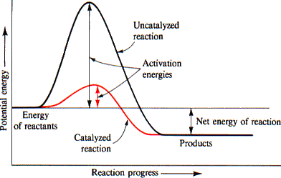
Theories of homogeneous catalysis

Slide 31
Mechanism of homogeneous catalysis
Example 1. Catalytic oxidation of sulphur dioxide in the presence of nitric oxide (NO) as catalyst.
2SO₂ + O₂ → 2SO₃
Mechanism :
2NO + O₂ → 2NO₂ (Intermediate compound)
NO₂ + SO₂ → SO₃ + NO
Example 2. Preparation of diethyl ether from ethanol using sulphuric acid as catalyst.
C₂H₅OH + C₂H₅OH → (C₂H₅)₂O + H2O
Mechanism :
C₂H₅OH + H₂SO₄ → C₂H₅HSO₄ + H₂O
C₂H₅HSO₄ + C₂H₅OH → (C₂H₅)₂O + H₂SO₄

Slide 32
Mechanism of homogeneous catalysis
Example 3. Thermal decomposition of potassium chlorate in the presence of manganese dioxide.
2KClO₃ → 2KCl + 3O₂
Mechanism :
2KClO₃ + 6MnO₂ → 6MnO₃ + 2KCl
6MnO₃ → 6MnO₂ + 3O₂
Example 4. Formation of methylbenzene by reaction between benzene and methyl chloride using aluminium chloride as catalyst (Friedel-Crafts reaction),
C₆H₆ + CH₃Cl → C₆H₅CH₃ + HCl
Mechanism :
CH₃Cl + AlCl₃ → [CH₃] [AlCl₄]
C₆H₆ + [CH₃] [AlCl₄ ] → C₆H₅CH3 + AlCl₃ + HCl

Slide 33
Kinetics of homogeneous catalysis
According to homogeneous catalysis theory, the catalyst first form an intermediate compound with the reactant.
This reactant with which catalyst combines is often called as substrate.
For example
A + X AX
Where A is the substrate and X is the catalyst, AX is the intermediate compound and k₁ and k₂ are the rate constant for the forward and backward reactions.
k₁
⇌
k₂

Slide 34
Kinetics of homogeneous catalysis
Intermediate compound AX then reacts with reactant B to form the product.
AX + B → AB (product) +X
This step is slow and rate determining step. Thus
rate = k₃[AX][B] (1)
where k₃ is the rate constant.
If we assume a steady-state approximation for [AX], we get
d[AX]/dt = k₁[A][X] – k₂[AX] – k₃[AX][B] = 0
or, k₁[A][X] = k₂[AX] – k₃[AX][B]
k₃

Slide 35
Kinetics of homogeneous catalysis
or, [AX] =k₁[A][X]/(k₂ – k₃[B]) (2)
Substituting this value of [AX] in Eq. (1), we get
rate = k₃k₁[A][X][B]/(k₂ – k₃[B]) (3)
From Eq. (3) two cases may arise:
i) If k₂<<k₃[B], then Eq. (3) becomes
rate = k₃k₁[A][X][B]/(k₃[B]) = k₁[A][X] (4)
i) If k₂>>k₃[B], then Eq. (3) becomes
rate = k₃k₁[A][X][B]/k₂ (5)
From Eq. (4) and (5), it flows that the rate of reaction depends upon the concentration of catalyst although it is neither produced or consumed in the reaction.

Slide 36
Function of a catalyst in terms of Gibbs free energy of activation
In general, a catalyst provides alternative path for the reaction that is having lower free energy of activation.
The lowering of free energy is probably attributed to a decrease in energy of activation or a higher frequency factor or both.
From the activated complex theory, it is possible to write
k_{f} = k_{B}T/h exp(-ΔG_{f}⁰/RT) (1)
where k_{f} is the rate constant for the forward reaction, k_{B} is the Boltzmann constant and G_{f}⁰is the standard Gibbs free energy of activation.

Slide 37
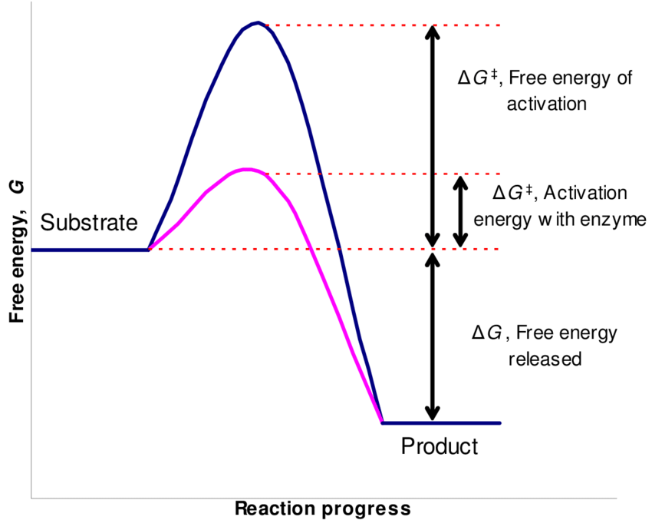
Function of a catalyst in terms of Gibbs free energy of activation
In the presence of a catalyst, it can be write
k_{f}’ = k_{B}T/h exp(-ΔG_{f}^{’0}/RT) (2)
where (‘) denotes a catlyzed reaction.
catalyst

Slide 38
Function of a catalyst in terms of Gibbs free energy of activation
From the figure it is evident that the free energy of activation gets lowered for both forward and backward reactions without altering the overall free energy change of the reaction.
This means that a catalyst is able to change the rate of both forward and backward reactions.
But ΔG_{f}⁰ does not get changed.
Therefore, the equilibrium constant K will not get changed in the presence of catalyst because ΔG_{f}⁰ is related with equilibrium constant.
It further reveals that a catalyst helps in attaining the equilibrium position rapidly but does not help in changing the relative proportion of reactants and products at equilibrium.

Slide 39
Function of a catalyst in terms of Gibbs free energy of activation
Mathematically, it is possible to write the rate constants for the forward and backward reactions as follows:
k_{f} = k_{B}T/h exp(-ΔG_{f}^{’0}/RT) (3)
k_{b} = k_{B}T/h exp(-ΔG_{b}^{’0}/RT) (4)
On dividing Eq. (3) by Eq. (4) we get
K = k_{f}/k_{b} = [k_{B}T/h exp(-ΔG_{f}^{’0}/RT)]/[k_{B}T/h exp(-ΔG_{b}^{’0}/RT)]
or, K = exp[- ΔG_{f}^{’0}/RT – (ΔG_{b}^{’0}/RT) ]
or, K = exp(- ΔG⁰/RT)
Where ΔG⁰ = ΔG_{f}^{’0} – ΔG_{b}^{’0}
Since ΔG⁰ has the same value in the presence or absence of a catalyst, K remains the same.

Slide 40
Theories of heterogeneous catalysis
The Adsorption Theory
This theory explains the mechanism of a reaction between two gases catalysed by a solid.
Here the catalyst functions by adsorption of the reacting molecules on its surface.
Generally speaking, four steps can be put forward for heterogeneous catalysis.
For example, if the reaction is :
A(g) + B(g) + catalyst → C(g) + D(g)

Slide 41
Theories of heterogeneous catalysis
Step 1. Adsorption of Reactant molecules
The reactant molecules A and B strike the catalyst surface. They are held up at the surface by weak van der Waals forces (Physical adsorption) or by partial chemical bonds (Chemisorption).
Step 2. Formation of Activated complex
The particles of the reactants adjacent to one another join to form an intermediate complex (A – B). The activated complex is unstable. It has only short-lived existence.

Slide 42
Theories of heterogeneous catalysis
Step 3. Decomposition of Activated complex
The activated complex breaks to form the products C and D. The separated particles of the products hold to the catalyst surface by partial chemical bonds.
Step 4. Desorption of Products
The particles of the products are desorbed or released from the surface. They are stable and can lead an independent existence.
The mechanism of contact catalysis may vary in details, depending on the nature of the reactants.

Slide 43
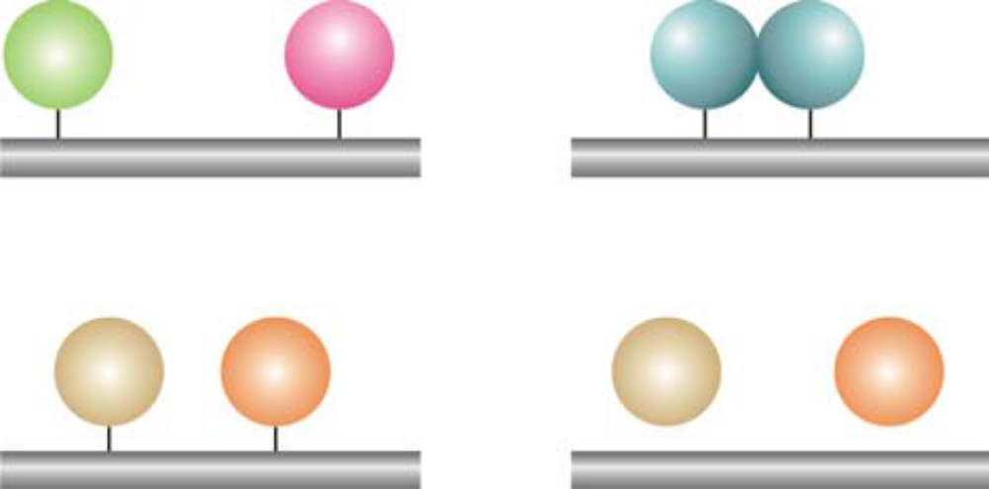
Theories of heterogeneous catalysis
A
B
A – B
Step 1
Step 2
Catalyst
Catalyst
C
D
C
D
Step 3
Step 4
Catalyst
Catalyst

Slide 44
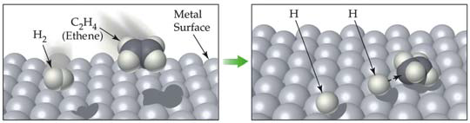
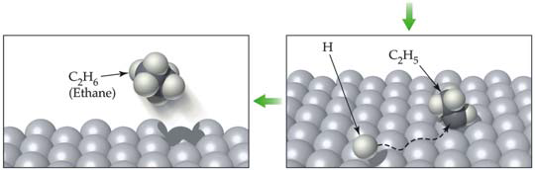
Theories of heterogeneous catalysis
Hydrogenation of ethene in presence of Ni
Ethene adds hydrogen in the presence of nickel catalyst to yield ethane.
C₂H₂ + H₂ + Ni → C₂H₆
Step-1
Step-2
Step-4
Step-3

Slide 45
Theories of heterogeneous catalysis
Mechanism of the hydrogenation of ethene on nickel surface.
The catalyst operates by the following steps.
Step 1. Adsorption of Hydrogen molecules
Hydrogen molecules are adsorbed on the nickel surface due to the residual valence bonds of the nickel atoms.
Step. 2 H–H Bonds are broken
The H–H bond is smaller (0.74Å) than Ni–Ni bond (2.49Å). Therefore, the H–H bond of the adsorbed hydrogen molecule is stretched and weakened. The weakened bond breaks, separating the hydrogen atoms. The separated hydrogen atoms are held to the nickel surface by chemical bonds.

Slide 46
Theories of heterogeneous catalysis
Step 3. Formation of the Activated complex
The chemisorbed hydrogen atoms then attach to ethene molecule by partial chemical bonds.
The unstable activated complex is thus formed.
Step 4. Decomposition of the Activated complex and desorption of ethane molecules.
The unstable activated complex decomposes to release ethane molecules.
The freed catalyst surface is again available for further action.

Slide 47
Mechanism of the hydrogenation of ethene on nickel surface
The catalyst operates by the following steps.
Step- 1: Adsorption of hydrogen molecules
Hydrogen molecules are adsorbed on the nickel surface due to the residual valence bonds of the nickel atoms.
Step- 2: H–H Bonds are broken
The H–H bond is smaller (0.74Å) than Ni–Ni bond.
Therefore, the H–H bond of the adsorbed hydrogen molecule is stretched and weakened.
The weakened bond breaks, separating the hydrogen atoms.
The separated hydrogen atoms are held to the nickel surface by chemical bonds.

Slide 48
Mechanism of the hydrogenation of ethene on nickel surface
Step- 3: Formation of the Activated complex
The chemisorbed hydrogen atoms then attach to ethene molecule by partial chemical bonds.
The unstable activated complex is thus formed.
Step- 4: Decomposition of the activated complex and desorption of ethane molecules
The unstable activated complex decomposes to release ethane molecules.
The freed catalyst surface is again available for further action.

Slide 49
Kinetics of heterogeneous catalysis
Unimolecular surface reactions
If there is a single reactant, it is chemisorbed and subsequently, on activation, breaks up into products.
If A is the reactant and S is the substrate, the elementary processes may be depicted as follows:
A + S AS
AS → Products
Suppose θ be the fraction of the surface covered by A at any instant t and pressure P. According to Langmuir- Hinshelwood the reaction rate would be
rate = r = k₂θ (1)
k₁
⇌
k₋₁
k₂

Slide 50
Kinetics of heterogeneous catalysis
If we assume a steady-state approximation for [AS], we get
d[AS]/dt = k₁[A][S] – k₋₁[AS] – k₂[AS] = 0 (2)
or, [AS] = k₁[A][S]/(k₋₁ + k₂) (3)
Let C_{s} is the total conc. of the surface sites of the catalyst. Therefore, conc. of vacant sites, [S] = C_{s}(1 - θ) and conc. of occupied sites, [AS] = C_{s}θ
Substituting the values [S] and [AS] in Eq. (3), we get
C_{s}θ = k₁[A]C_{s}(1 - θ) /(k₋₁ + k₂)
or, θ = k₁[A] /(k₁[A] +k₋₁ + k₂) (4)

Slide 51
Kinetics of heterogeneous catalysis
and r = k₂k₁[A] /(k₁[A] +k₋₁ + k₂) (5)
Eq. (5) can be written as
1/r = 1/k₂ + (k₋₁ + k₂)/k₂k₁[A] (6)
For the gaseous reactions, concentration term [A] can be replaced by partial pressure and Eq. (6) can be written as
1/r = 1/k₂ + (k₋₁ + k₂)/k₂k₁ x1/p_{A} (7)
A plot of 1/r against 1/p_{A} give a straight line with slope (k₋₁ + k₂)/k₂k₁
Case-I: If k₂>> k₁p_{A} + k₋₁ then
r = k₁p_{A} (8)
Case-II: If k₂<< k₁p_{A} +k₋₁ then
r = k₂k₁p_{A} /(k₁p_{A} +k₋₁)
= (k₁/k₋₁)k₂p_{A}/[(k₁/k₋₁)p_{A} +1]
= Kk₂p_{A}/(Kp_{A} + 1) (9)

Slide 52
Kinetics of heterogeneous catalysis
Eq. (9) is identical to Langmuir adsorption isotherm. Therefore,
a) at low pressure, i.e., Kp_{A}<<1,
r = Kk₂p_{A}
The reaction would be first order.
B) at high pressure, i.e., Kp_{A}>>1
r = k₂
The reaction would be zero order.

Slide 53
Kinetics of heterogeneous catalysis
Bimolecular surface reactions
Now consider a reaction in which two molecules A and B react on a surface and get absorbed on neighboring sites. The process may take place in two ways:
A + S AS
B + S BS
AS + BS → Products
k₁
⇌
k₋₁
k₁
⇌
k₋₁
k₃

Slide 54
Kinetics of heterogeneous catalysis
Suppose θ₁ and θ₂ be the fractions of the surface covered by adsorption of A and B respectively.
The fraction of the surface which is vacant, (1 - θ₁ - θ₂)
The rate of formation of products is given as follows:
r = k₃θ₁θ₂ (1)
On applying steady-state approximation to [AS] and [BS], we have
d[AS]/dt = k₁[A][S] – k₋₁[AS] – k₃[AS][BS] = 0 (2)
d[BS]/dt = k₂[B][S] – k₋₂[BS] – k₃[AS][BS] = 0 (3)
Let C_{s} is the total conc. of the surface sites of the catalyst. Therefore,

Slide 55
Kinetics of heterogeneous catalysis
[AS] = C_{s}θ₁
[BS] = C_{s}θ₂
[S] = C_{s}(1 - θ₁ - θ₂)
On substituting the values [AS], [BS] and [S] in Eq. (2) and (3), we get
k₁[A]C_{s}(1 - θ₁ - θ₂) – k₋₁C_{s}θ₁ –k₃C_{s}²θ₁θ₂ = 0 (4)
k₂[B]C_{s}(1 - θ₁ - θ₂) – k₋₂C_{s}θ₂ –k₃C_{s}²θ₁θ₂ = 0 (5)
If it is assumed that the rate determining step is the chemical reaction between the adsorbed molecules, then k₃ → 0 and Eq. (4) and (5) become as follows
k₁[A] (1 - θ₁ - θ₂) = k₋₁θ₁
k₂[B] (1 - θ₁ - θ₂) = k₋₂θ₂

Slide 56
Kinetics of heterogeneous catalysis
Or, θ₁ = k₁/k₋₁[A](1 - θ₁ - θ₂) = K₁[A](1 - θ₁ - θ₂) (6)
θ₂ = k₂/k₋₂[B](1 - θ₁ - θ₂) = K₂[B](1 - θ₁ - θ₂) (7)
where K₁ = k₁/k₋₁ and K₂ = k₂/k₋₂
On solving for θ₁ and θ₂ , we obtain
θ₁ = K₁[A]/(1 + K₁[A] +K₂[B])
θ₁ = K₂[B]/(1 + K₁[A] +K₂[B])
on inserting the values of θ₁ and θ₂ in Eq. (1), we get
r = k₃K₁K₂[A][B]/(1 + K₁[A] +K₂[B])² (8)
when p_{A} and p_{B} denote the partial pressure of A and B for the gaseous reaction, Eq. (8) becomes
r = k₃K₁K₂p_{A}p_{B}/(1 + K₁ p_{A} +K₂ p_{B})² (9)

Slide 57
Kinetics of heterogeneous catalysis
Three special cases of important significance may arise from Eq. (9).
Case-I: If each gas (A and B) gets adsorbed very slightly, then K₁p_{A}<< 1 and K₂p_{B}<< 1, so
r = k₃K₁K₂ p_{A}p_{B} (10)
This implies that the reaction will be second order.
Case-II: When one reactant, A, relatively more strongly adsorbed than B then, K₁p_{A}>> K₂p_{B}, so
r = k₃K₁ p_{A}K₂ p_{B}/(1 + K₁ p_{A})² (10)
This implies that the reaction will be first order with respect to B.

Slide 58
Kinetics of heterogeneous catalysis
Case-III: When one reactant, A, very strongly adsorbed, then, K₁p_{A}>> K₂p_{B} and K₁p_{A}>> 1, so
r = k₃K₂p_{B}/K₁p_{A} (11)
This implies that the rate will depend on the concentration of strongly adsorbed reactant.

Slide 59
Effect of temperature on heterogeneous reactions
Arrhenius equation may be written as follows
dlnk/dT =E_{a}/RT² (1)
The activation energy E_{a} for a heterogeneous reaction, evaluated from the plot of logk against 1/T, is called apparent energy of activation.
As the adsorption is temperature dependent, the evaluated E_{a} would be equal to the algebraic sum of the true activation energy (E_{t}) and the heat of adsorption of reactant (λ_{R}) and products (λ_{P}) such that
E_{a} = E_{t} + λ_{P} - λ_{R}
The exact relation is dependent on the nature of kinetics.

Slide 60
Effect of T on heterogeneous reactions
For unimolecular surface reaction
A + S AS and AS → Products
rate = k₂θ (2)
Case- I: If the reactant is very strongly adsorbed (zero order reaction). Here θ →1 and
rate = k₂
In this case the fraction of the surface covered has been independent on the temperature and therefore,
E_{a} = E_{t}
k₁
⇌
k₋₁

Slide 61
Effect of T on heterogeneous reactions
Case- II: If the reactant is slightly adsorbed, then KP_{A}<<1
rate = Kk₂P_{A}
From Arrhenius equation, we have
dln(Kk₂) = Ea/RT²
or, dlnK/dt + dlnk₂/dt = Ea/RT²
But dlnK/dt = ΔH_{ads}/RT²
And dlnk₂/dt = E_{t}/RT²
Therefore, Ea/RT² = E_{t}/RT² + ΔH_{ads}/RT²
As ΔH_{ads} is generally negative,
E_{a} < E_{t}
i.e, activation energy of this type of reaction gets lowered.

Slide 62
Effect of T on heterogeneous reactions
Bimolecular surface reactions:
For bimolecular surface reactions rate is given by
r = k₃K₁ p_{A}K₂ p_{B}/(1 + K₁ p_{A} +K₂ p_{B})² (1)
Case I: If both the reactant are weakly adsorbed, then K₁p_{A}<< 1 and K₂p_{A} <<1. We get from Eq. (1)
r = k₃K₁K₂p_{A} p_{B}
From Arrhenius equation, we have
dln(K₁K₂k₃)dt = Ea/RT²
or, dlnK₁/dt + dlnK₂/dt + dlnk₃/dt = Ea/RT²
or, (ΔH_{ads})₁/RT² + (ΔH_{ads})₂/RT² + E_{t}/RT² = Ea/RT²
E_{a} = E_{t} + (ΔH_{ads})₁ + (ΔH_{ads})₂
E_{a} < E_{t}, since ΔH_{ads} is generally negative.

Slide 63
Effect of T on heterogeneous reactions
Case II: If one of the reactants get very strongly adsorbed, then K₁p_{A}>> 1 and K₂p_{A} >>1. We get from Eq. (1)
r = (k₃K₂/K₁)p_{B}/p_{A}
From Arrhenius equation, we have
dln(k₃K₂/K₁)/dt = Ea/RT²
or, dlnK₂/dt – dlnK₁/dt + dlnk₃/dt = Ea/RT²
or, (ΔH_{ads})₂/RT² - (ΔH_{ads})₁/RT² + E_{t}/RT² = Ea/RT²
E_{a} = E_{t} + (ΔH_{ads})₂ - (ΔH_{ads})₁
It means that the strongly adsorbed reactant increases the actvation energy, thereby inhibiting the overall reaction.

Slide 64
Absolute rate theory in heterogeneous gas reactions
The absolute rate theory offers a very satisfactory means to calculate the rates of heterogeneous reactions involving the gases.
Le us consider a bimolecular reaction between A and B involving a reaction center, S, on the surface.
Then A+B+S ⇌ A-B-S → Products (1)
In this type of reaction there exists an equilibrium between the reactants (A and B) and activated complex.
If C_{A} , C_{B} and C_{S} are the concentration of A, B and S respectively, the value of equilibrium constant K≠ of the activated state is obtained by applying the law of mass action to Eq. (1)
K≠ = C≠/C_{A}C_{B}C_{S} (2)
where C≠ is the conc. Of the activated complex.

Slide 65
Absolute rate theory in heterogeneous gas reactions
If we consider the partition function, Eq. (2) becomes as
K≠ = θ≠/θ_{A}θ_{B}θ_{S}exp(-E/RT) (3)
where E denotes the activation energy for the heterogeneous reaction. On combining Eq. (2) and (3), we get
C≠/C_{A}C_{B}C_{S} = θ≠/θ_{A}θ_{B}θ_{S}exp(-E/RT)
or C≠ = C_{A}C_{B}C_{S} θ≠/θ_{A}θ_{B}θ_{S}exp(-E/RT) (4)
The rate of the bimolecular reaction
r = C≠ kT/h
substituting Eq. (4) in Eq. (5), we get

Slide 66
Absolute rate theory in heterogeneous gas reactions
r = kT/h C_{A}C_{B}C_{S} θ≠/θ_{A}θ_{B}θ_{S}exp(-E/RT) (6)
The rate of the reaction may also be given by
r = k_{r}C_{A}C_{B} (7)
where k_{r} is the specific rate constant. On comparing Eq. (6) and (7), we get
k_{r} = C_{S}kT/h θ≠/θ_{A}θ_{B}θ_{S}exp(-E/RT) (8)
The s part of the surface possesses no translational, no rotational but it has only vibrational contribution is of the order of unity. Thus θ≠/θ_{s} may be taken as unity. Hence Eq. (8) becomes

Slide 67
Absolute rate theory in heterogeneous gas reactions
k_{r} = C_{S}kT/h 1/θ_{A}θ_{B}exp(-E/RT) (9)
The partition functions A and B are determined by the known properties of the reactants.
the value of Cs may be evaluated for a thinly covered surface where it is equal to the number of atoms.

Slide 68
Acid-Base catalysis
A number of homogeneous catalytic reactions are known which are catalysed by acids or bases, or both acids and bases.
These are often referred to as acid-base catalysts.
Arrhenius pointed out that acid catalysis was, in fact, brought about by H⁺ ions supplied by strong acids, while base catalysis was caused by OH– ions supplied by strong bases.
Examples of Acid-Base catalysis
(1) Inversion of Cane sugar :
C₁₂H22O₁₁ + H₂O → C₆H₁₂O₆ + C₆H₁₂O₆
H⁺

Slide 69
Acid-Base catalysis
2) Keto-enol tautomerism of acetone :
CH₃COCH₃ → CH₃C(OH)=CH₂
Keto form Enol form
3) Decomposition of Nitramide :
NH₂NO₂ → N₂O + H₂O
4) Hydrolysis of an ester :
CH₃COOC₂H₅ → CH₃COOH + C₂H₅OH
H⁺
H⁺
H⁺

Slide 70
Mechanism of Acid-Base catalysis
a) In acid catalysis, the H⁺ forms an intermediate complex with the reactant, which then reacts to give back the proton.
For example, the mechanism of keto-enol tautomerism of acetone is:
CH₃CCH₃ → CH₃CCH₃ → CH₃C(OH)=CH₂ + H⁺
H⁺

Slide 71
Mechanism of Acid-Base catalysis
b) In base catalysis, the OH– ion (or any Bronsted base) accepts a proton from the reactant to form an i intermediate complex which then reacts or decomposes to regenerate the OH–.
For example, the decomposition of nitramide by OH– ions and CH₃COO– ions may be explained as follows :
i) By OH– ions :
NH₂NO₂ + OH⁻ → H₂O + NHNO₂⁻
Intermediate
complex
NHNO₂⁻ → N₂O + OH⁻

Slide 72
Mechanism of Acid-Base catalysis
ii) By CH3COO– ions:
NH₂NO₂ + CH3COO⁻ → CH₃COOH + NHNO₂⁻
NHNO₂⁻ → N₂O + OH⁻
OH⁻ + CH3COOH → H₂O + CH3COO⁻

Slide 73
Kinetics of acid-base catalysis
Acid-base catalysed reactions take place by transfer of proton from an acid to a substrate molecule (S)
or from a substrate molecule to a base.
Hence the reaction between and acid, HA and a substrate, S may be occurred as follows:
HA + S SH⁺ + A⁻
SH⁺ + H₂O → Products
Reaction rate = k₂[SH⁺]
By applying steady-state principle
d[SH⁺]/dt = k₁[HA][S] – k₋₁[SH⁺][A⁻] – k₂[SH⁺] = 0
or, [SH⁺] = k₁[HA][S]/(k₋₁[A⁻] + k₂)
Case I: If k₂ >> k₋₁[A⁻] then
[SH⁺] = k₁[HA][S]/k₂
k₁
⇌
k₋₁
k₃

Slide 74
Therefore, reaction rate = k₁[HA][S]
Case –II: If k₂ << k₋₁[A⁻] then
[SH⁺] = k₁[HA][S]/k₋₁[A⁻]
Now consider the dissociation of HA
HA H⁺ + A⁻
K_{a} = [H⁺][A⁻]/[HA]
Or [HA]/[A⁻] = [H⁺]/K_{a}
Therefore,
[SH⁺] = k₁[H⁺][S]/K_{a}k₋₁ and
Reaction rate = k₁k₂[H⁺][S]/K_{a}k₋₁
or Reaction rate = k’[H⁺][S]
Hence the reaction rate is proportional to [H⁺] even in the presence of HA and A⁻.
⇌

Slide 75
Thanks

