Slide 1
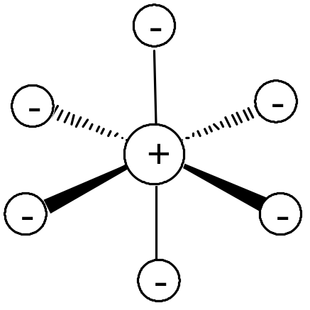
Crystal field theory: an electrostatic model
The metal ion will be positive and therefore attract the negatively charged ligands
But there are electrons in the metal orbitals, which will experience repulsions
with the negatively charged ligands

Slide 2
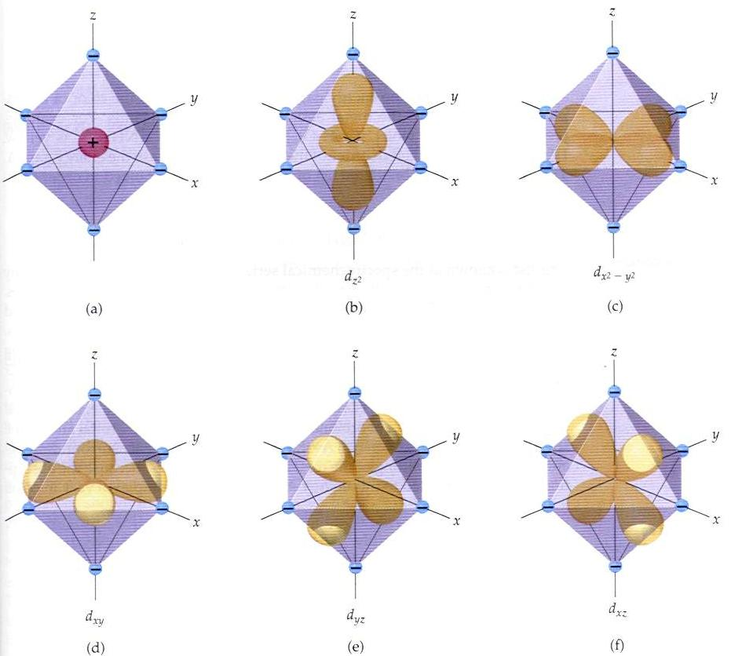
Ligand/d orbital interactions
Orbitals point at ligands
(maximum repulsion)
Orbitals point
between ligands
(less pronounced repulsion)

Slide 3
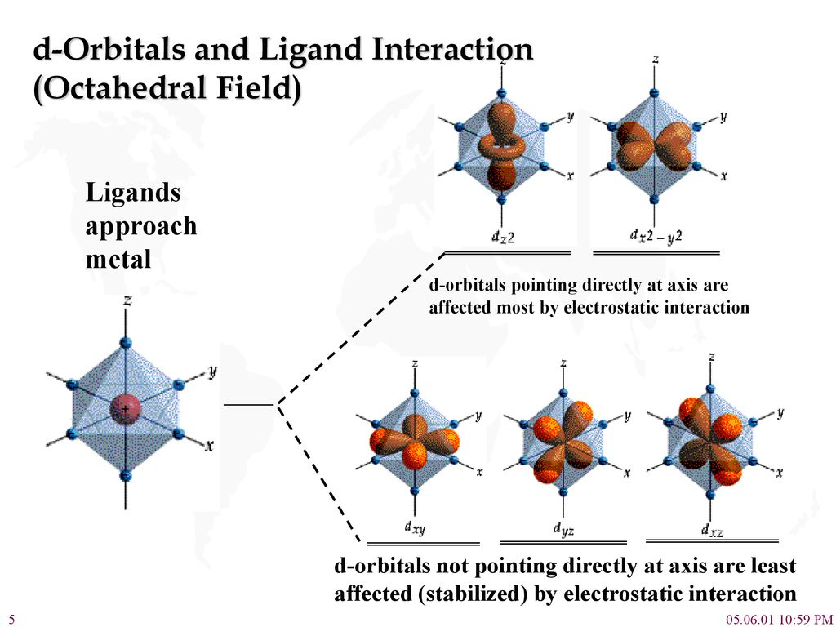

Slide 4
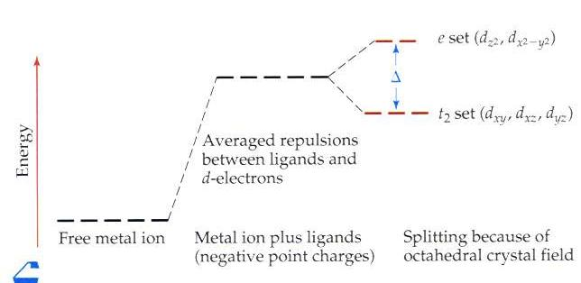
The two effects of the crystal field

Slide 6
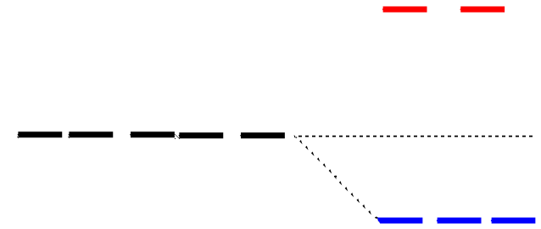
Splitting of d orbitals in an octahedral field
e_{g}
3/5 Δo
Δo
2/5 Δo
t_{2g}
Δo is the crystal field splitting
E(t_{2g}) = -0.4Δo x 3 = -1.2Δo
E(e_{g}) = +0.6Δo x 2 = +1.2Δo

Slide 7
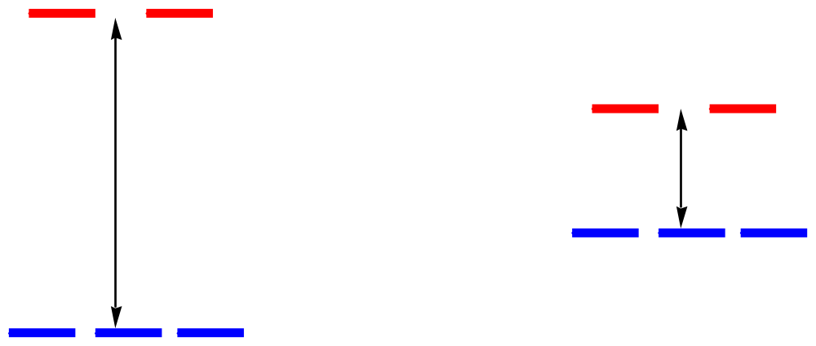
The magnitude of the splitting
(ligand effect)
Weak
field
Strong
field
The spectrochemical series
CO, CN⁻ > phen > NO₂⁻ > en > NH₃ > NCS⁻ > H₂O > F⁻ > RCO₂⁻ > OH₋ > Cl⁻ > Br⁻ > I⁻

Slide 8
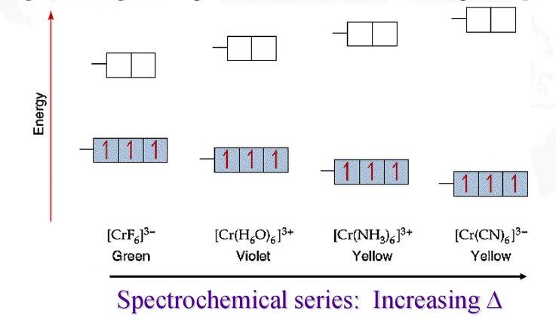
The spectrochemical series
CO, CN⁻ > phen > NO₂⁻ > en > NH₃ > NCS⁻ > H₂O > F⁻ > RCO₂⁻ > OH₋ > Cl⁻ > Br⁻ > I⁻

Slide 9
The magnitude of the splitting
(metal ion effect)
Weak
field
Strong
field
increases with increasing formal charge on the metal ion
increases on going down the periodic table

Slide 10

Energy
Energy
M²⁺
M³⁺
[Co(NH₃)₆]³⁺ 275 kJ/mole
[Rh(NH₃)₆]³⁺ 406 kJ/mole
[Ir(NH₃)₆]³⁺ 490 kJ/mole
Geometry
Energy
Δ_{o}
Δ_{t}
Δ_{t} = 4/9Δ_{o}

Slide 11
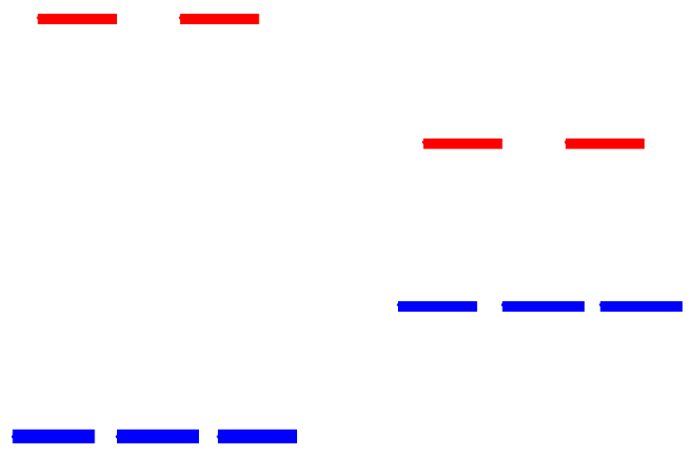
Placing electrons in d orbitals
Strong field Weak field
Strong field Weak field
d¹
d²
d³
d⁴

Slide 12
When the 4th electron is assigned it will either go into the higher energy e_{g} orbital at an energy cost of Δ₀ or be paired at an energy cost of Π, the pairing energy.
d⁴
Strong field =
Low spin
(2 unpaired)
Weak field =
High spin
(4 unpaired)
p < Δ_{o}
p > Δ_{o}

Slide 13
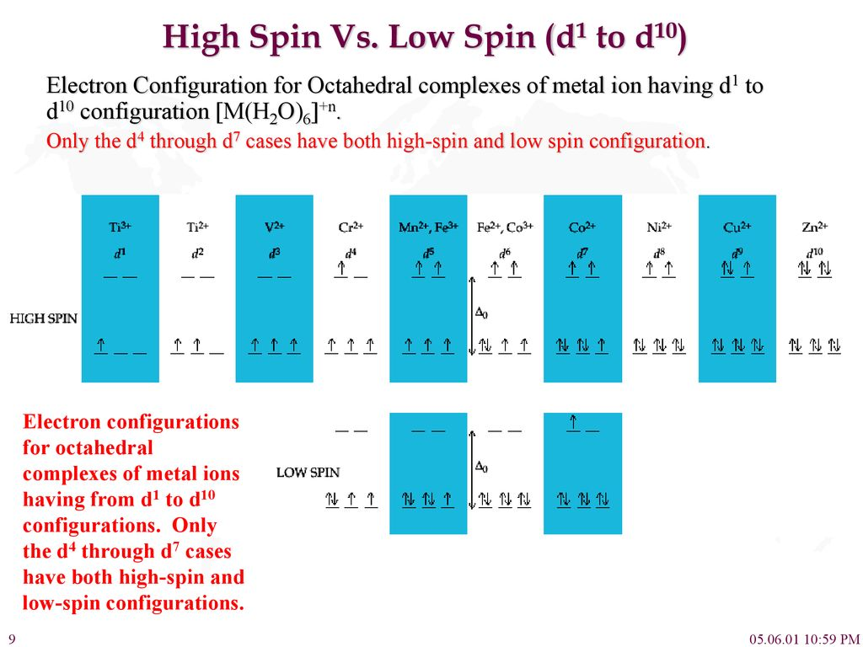

Slide 14
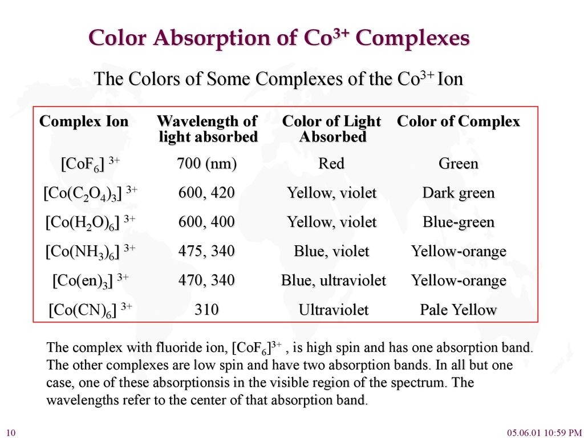

Slide 15
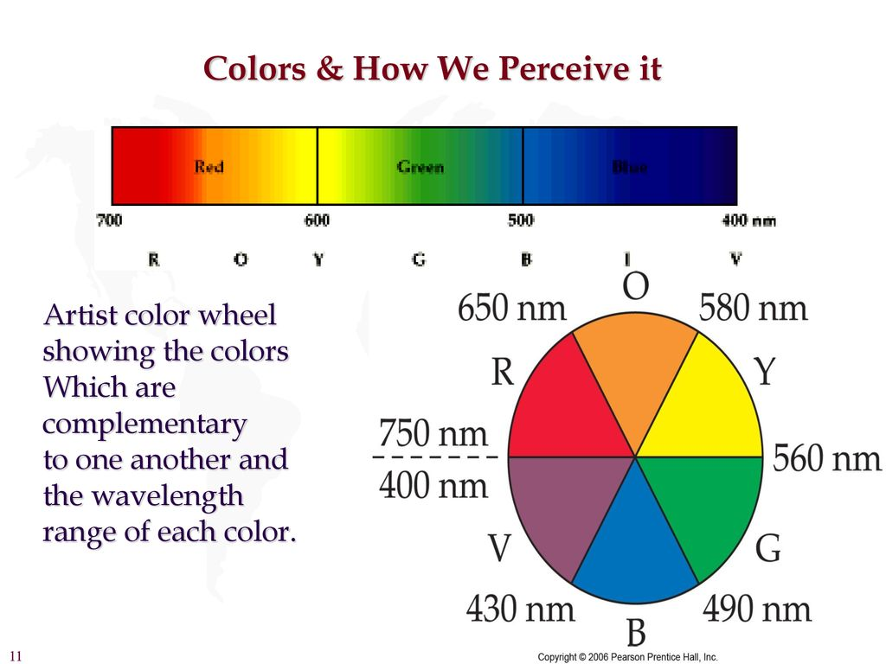

Slide 16
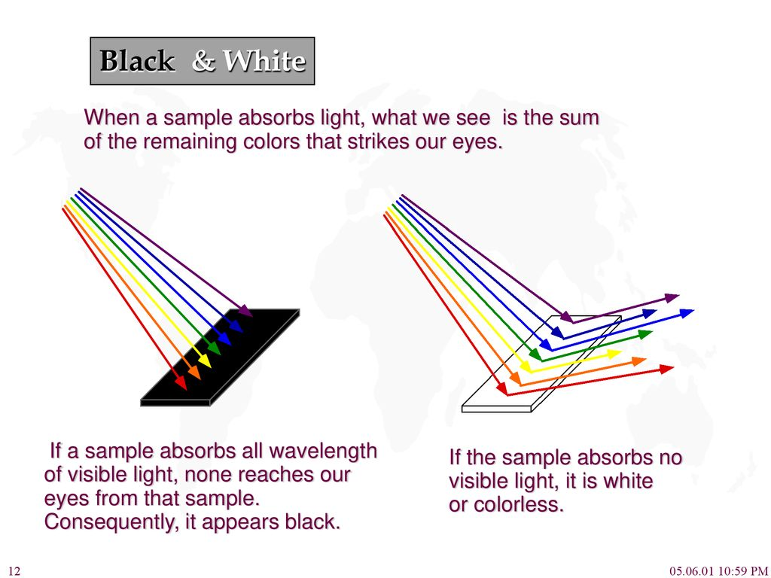

Slide 17
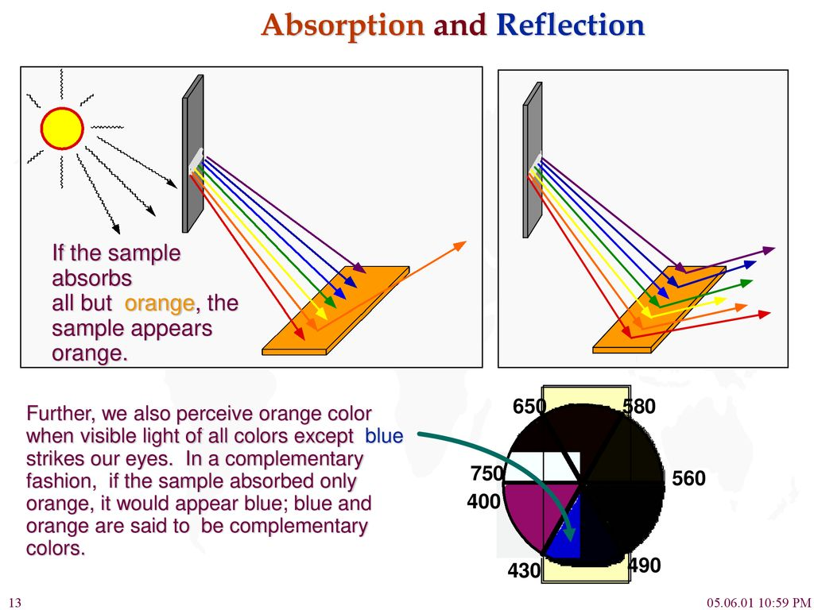

Slide 18
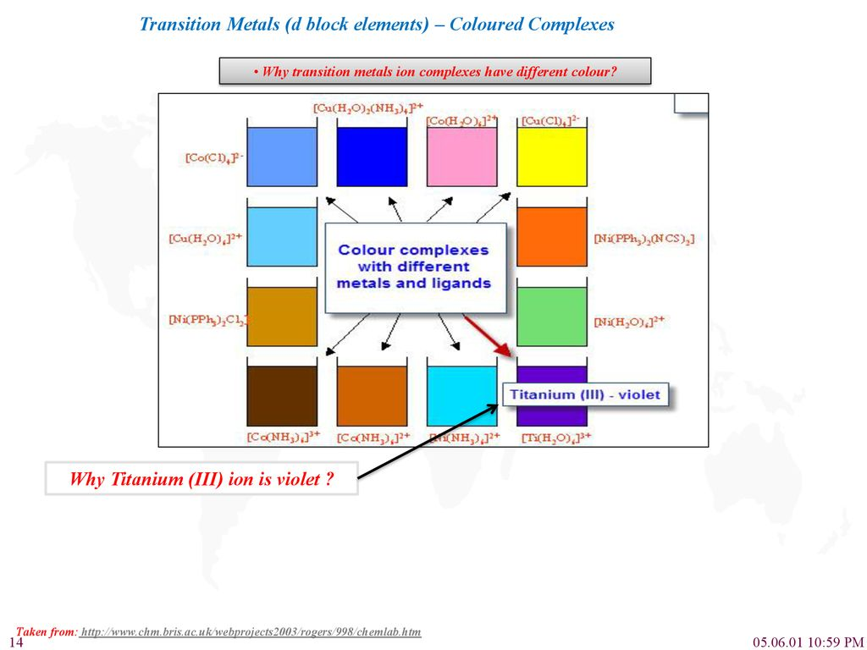

Slide 19
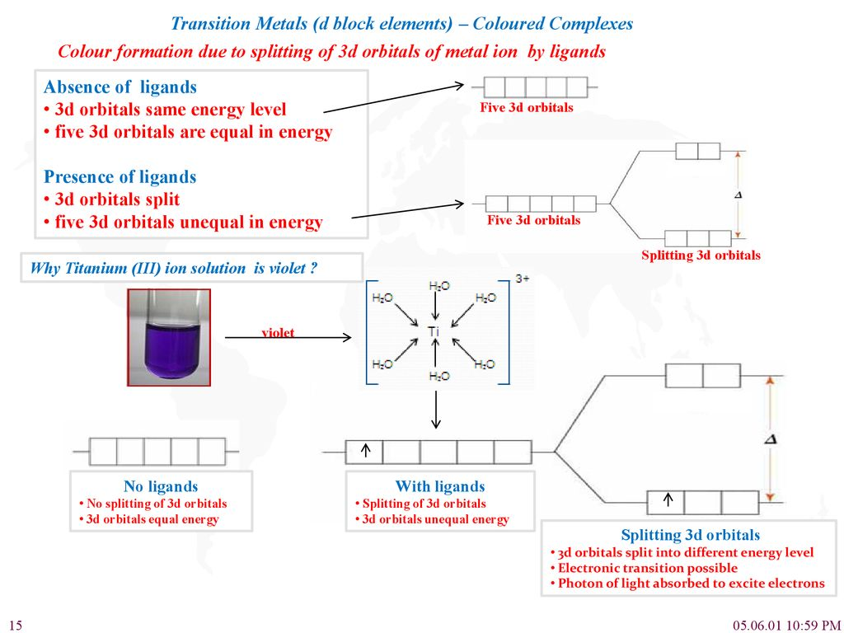

Slide 20
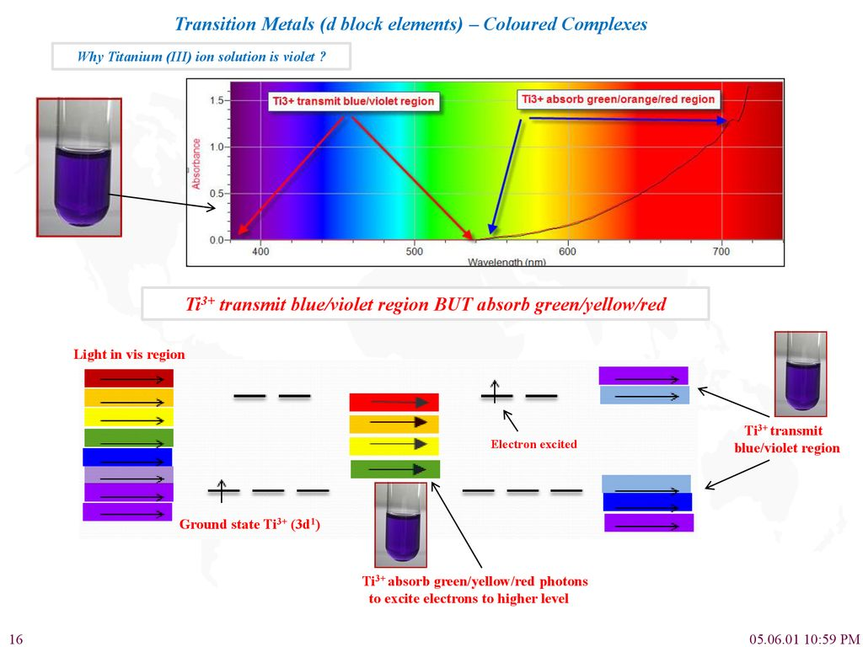

Slide 21
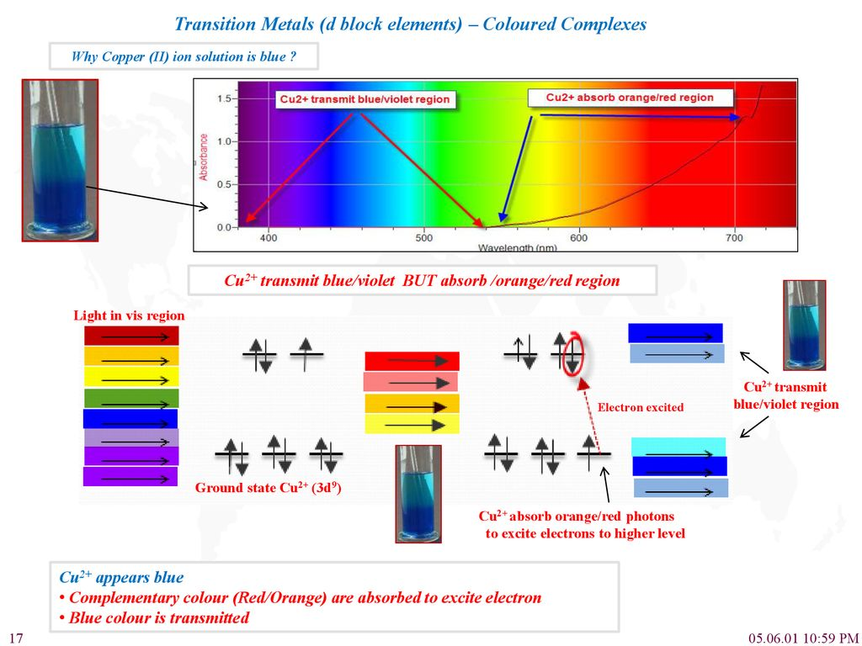

Slide 22
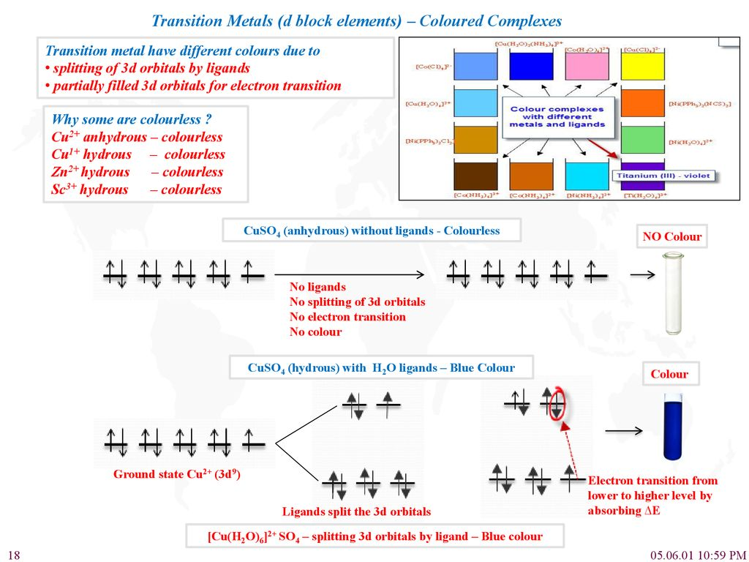

Slide 23
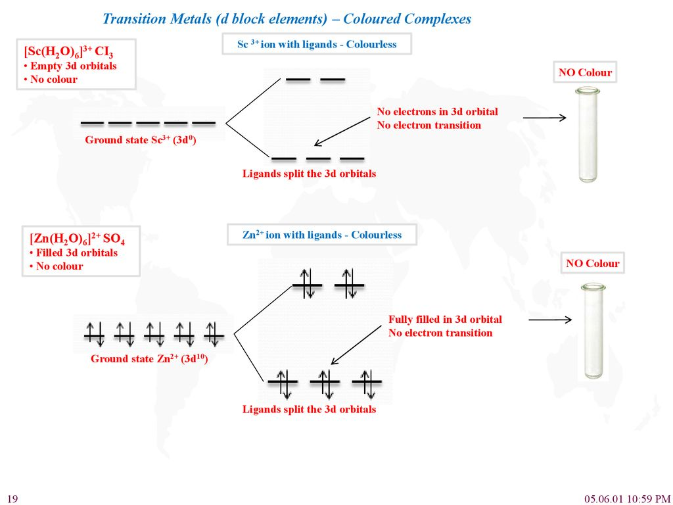

Slide 24
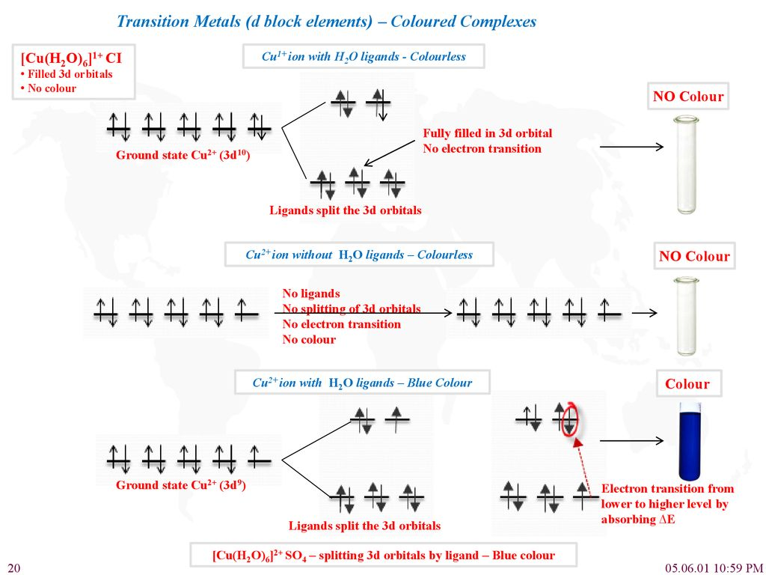

Slide 25
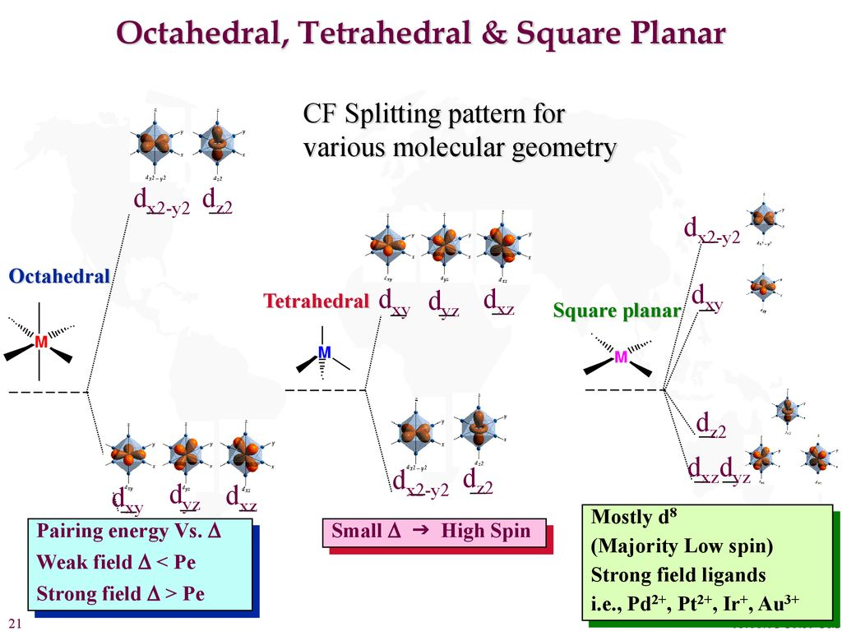

Slide 26
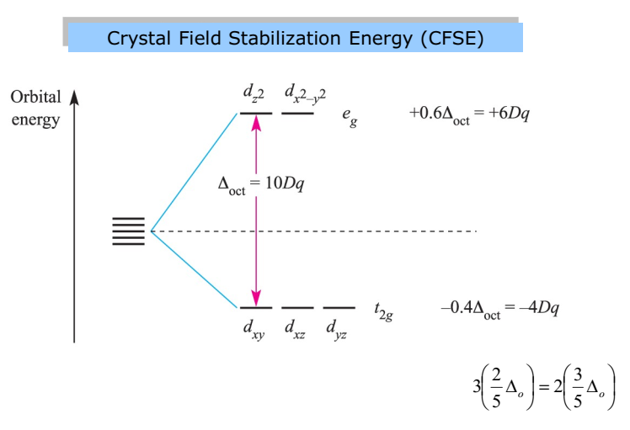
For d¹ System t₂g¹
CFSE = 1x(-0.4) ∆o = -0.4 ∆o
For d² System t₂g²
CFSE = 2x(-0.4) ∆o = -0.8 ∆o
For d³ System t₂g³
CFSE = 3x(-0.4) ∆o = -1.2 ∆o
For d⁴ System (High spin) t₂g³e_{g}¹
CFSE = 3x(-0.4) + 1x(0.6)∆o
= (-1.2+0.6) ∆o = - 0.6 ∆o
For d⁴ System (Low spin) t₂g⁴e_{g}⁰
CFSE = 4x(-0.4) ∆o + P
= -1.6 ∆o + P

Slide 27
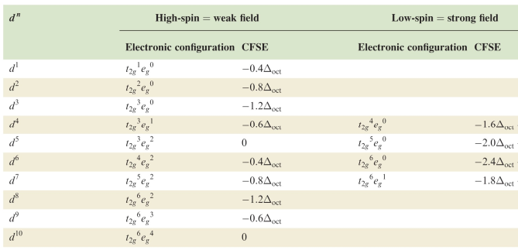
Octahedral crystal field stabilization energies (CFSE) for dn configurations;
pairing energy, P, terms are included where appropriate
High Spin : Δo < P
Low Spin : Δo > P

Slide 28
Some Consequences of Crystal Field Splitting
Lattice Energy
Hydration Energy
M²⁺ + H₂O [M(H₂O)₆]²⁺
Lattice Energy
Hydration Energy kJ/mole
Ca²⁺ Sc²⁺ Ti²⁺ V²⁺ Cr²⁺ Mn²⁺ Fe²⁺ Co²⁺ Ni²⁺ Cu²⁺ Zn²⁺
Ca²⁺ Sc²⁺ Ti²⁺ V²⁺ Cr²⁺ Mn²⁺ Fe²⁺ Co²⁺ Ni²⁺ Cu²⁺ Zn²⁺
Ionic Radius
Ca²⁺ Sc²⁺ Ti²⁺ V²⁺ Cr²⁺ Mn²⁺ Fe²⁺ Co²⁺ Ni²⁺ Cu²⁺ Zn²⁺

Slide 29
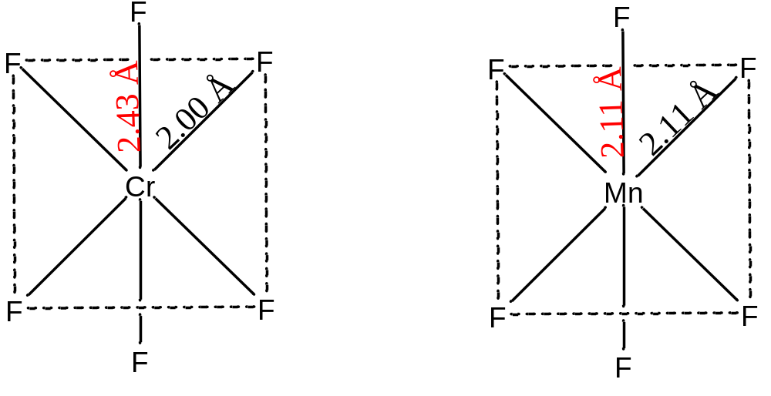
t_{2g}
e_{g}
t_{2g}
e_{g}
d⁰
d⁴
d³
d⁷
d⁵
d⁹
d⁶
d⁸
d¹⁰
Cr d⁴; Mn d⁶

Slide 30
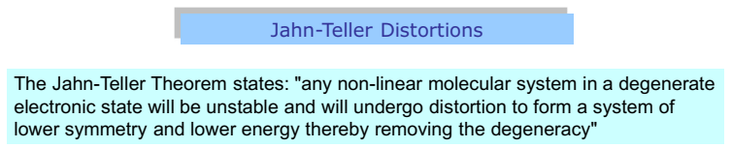
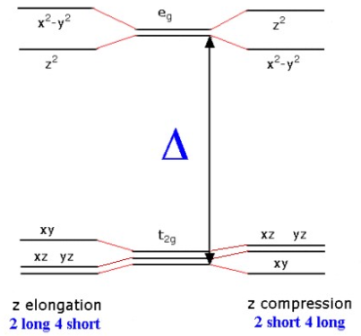
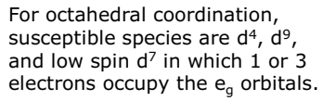

Slide 31
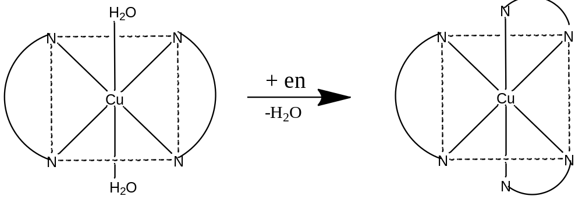
K₁
[M(H₂O)₆]²⁺ + en [M(en)(H₂O)₄]²⁺ + 2H₂O
[M(en)(H₂O)₄]²⁺ + en [M(en)₂(H₂O)₂]²⁺ + 2H₂O
[M(en)₂(H₂O)₂]²⁺ + en [M(en)₃]²⁺ + 2H₂O
K₁<K₂,K₃ for all metals Mn(II to Zn(II)
But for Cu(II) K₃<< K₁, K₂
K₂
K₃

Slide 32
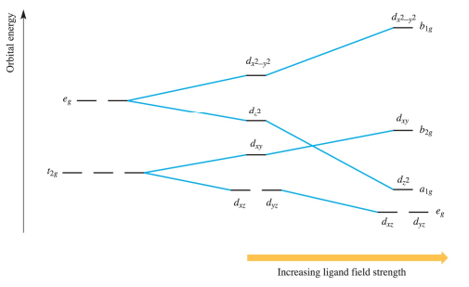

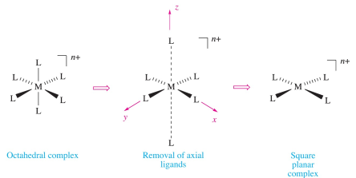

Slide 33
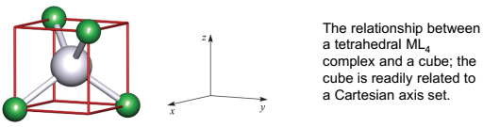
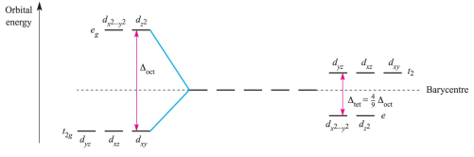

Slide 34
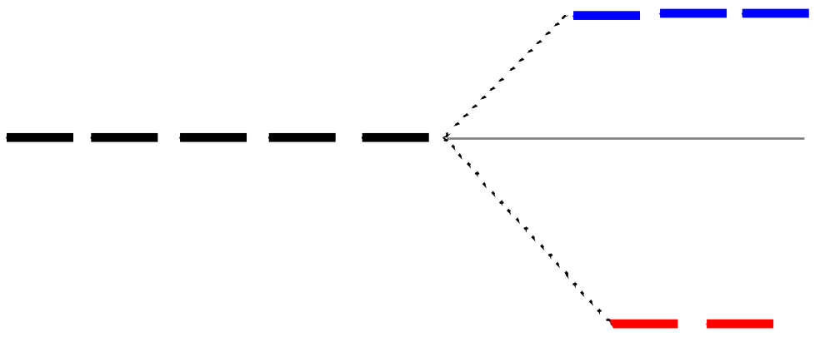
Splitting of d orbitals in a tetrahedral field
t₂
Δt
e
Δ_{t} = 4/9Δ_{o}
Always weak field (high spin)

