Slide 1
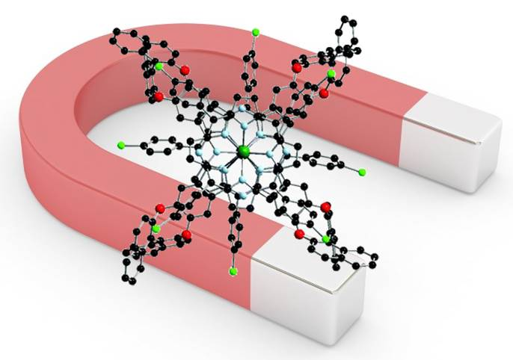
Molecular Magnetism

Slide 2
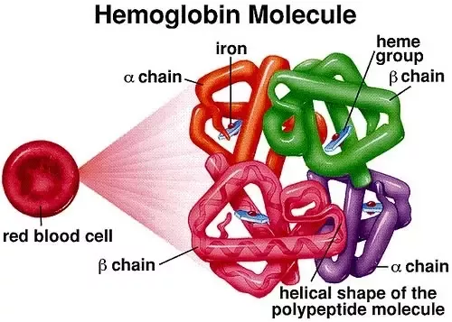

Slide 3
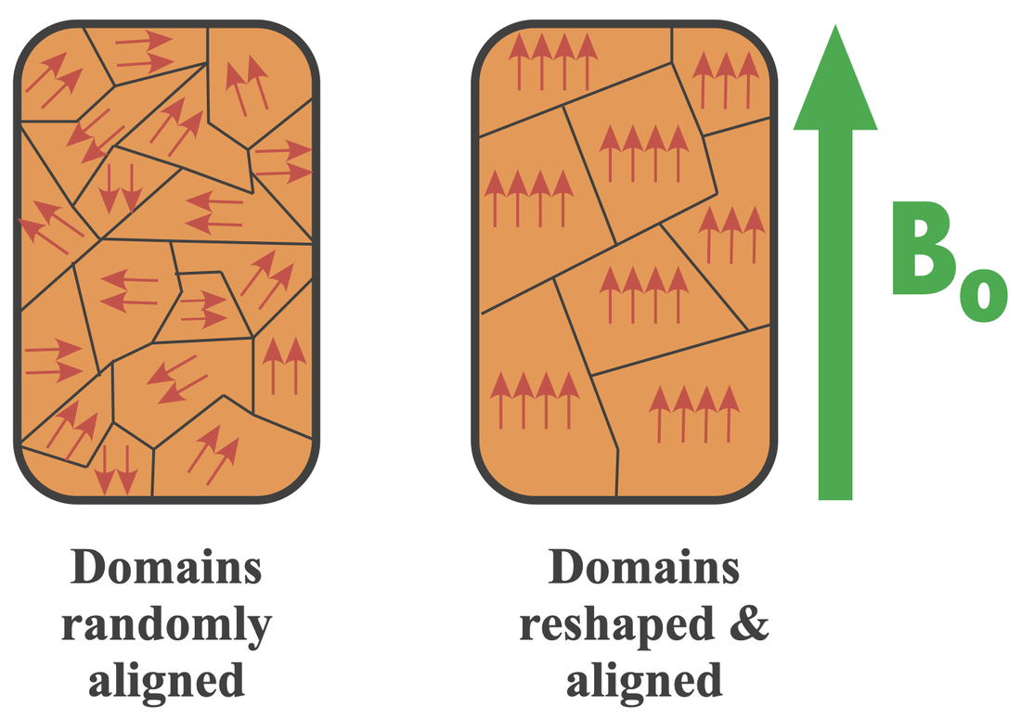
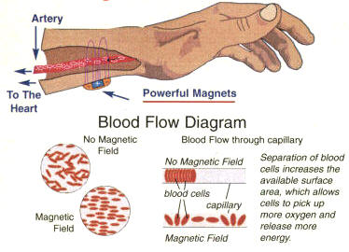
Males of average height have about 4 grams of iron in their body, females about 3.5 grams; children will usually have 3 grams or less. These 3-4 grams are distributed throughout the body in hemoglobin, tissues, muscles, bone marrow, blood proteins, enzymes, ferritin, hemosiderin, and transport in plasma.

Slide 4
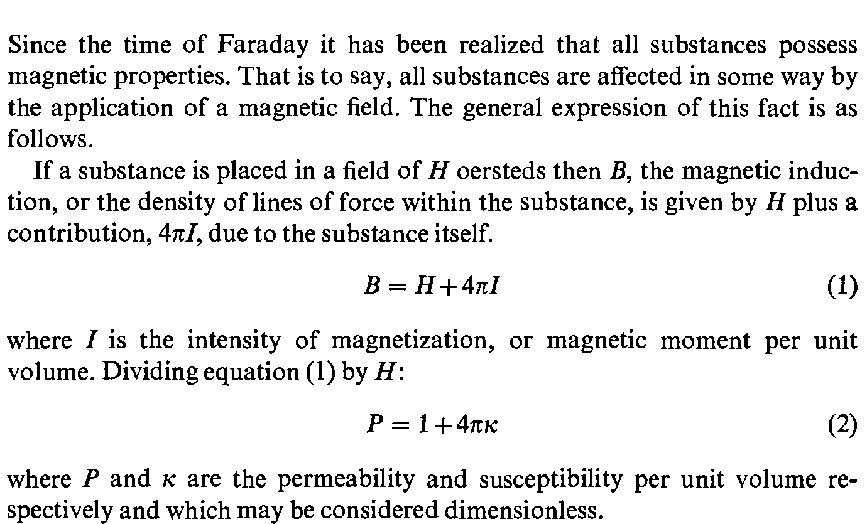
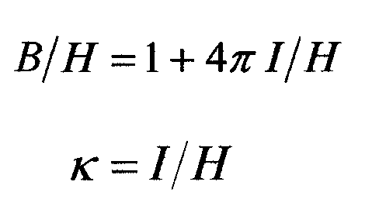
History
1. P< 1 i.e. /, K and χ negative

Slide 5
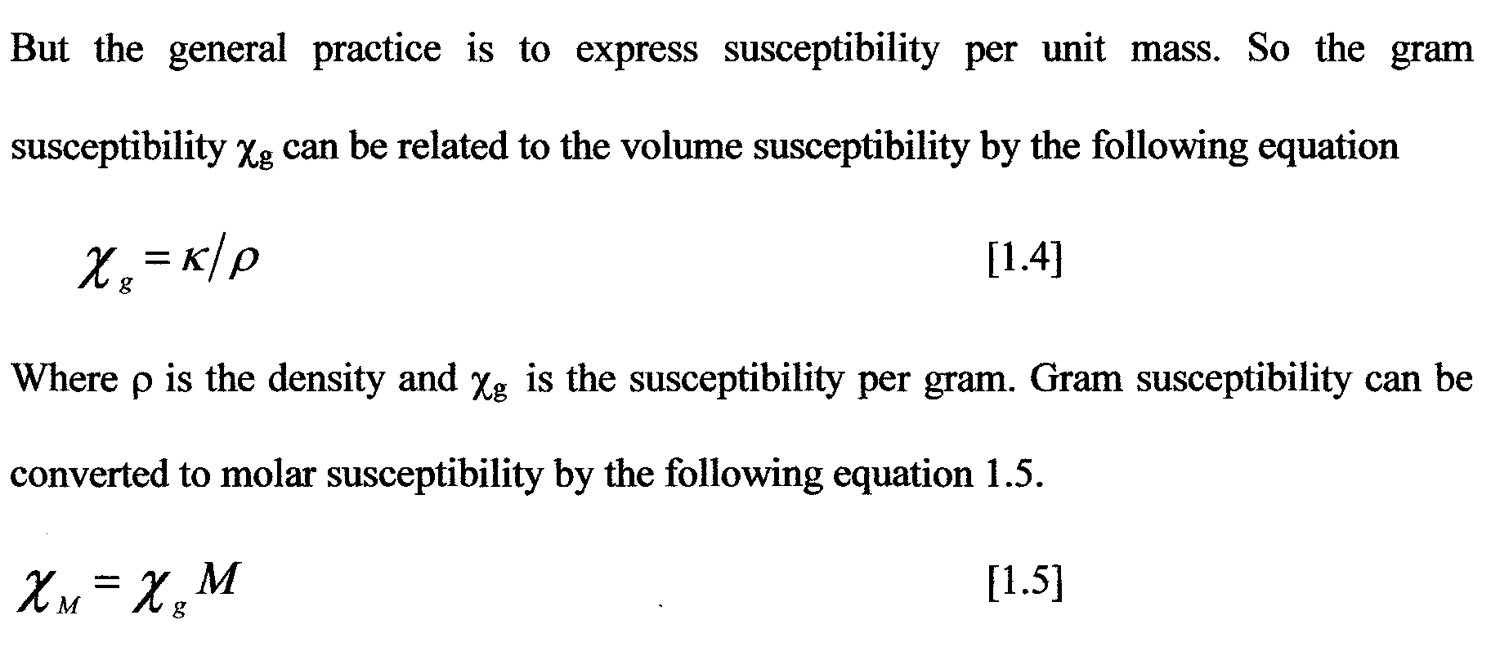
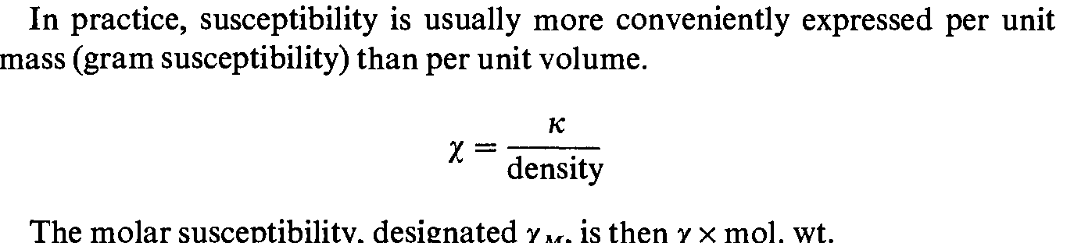

Slide 6
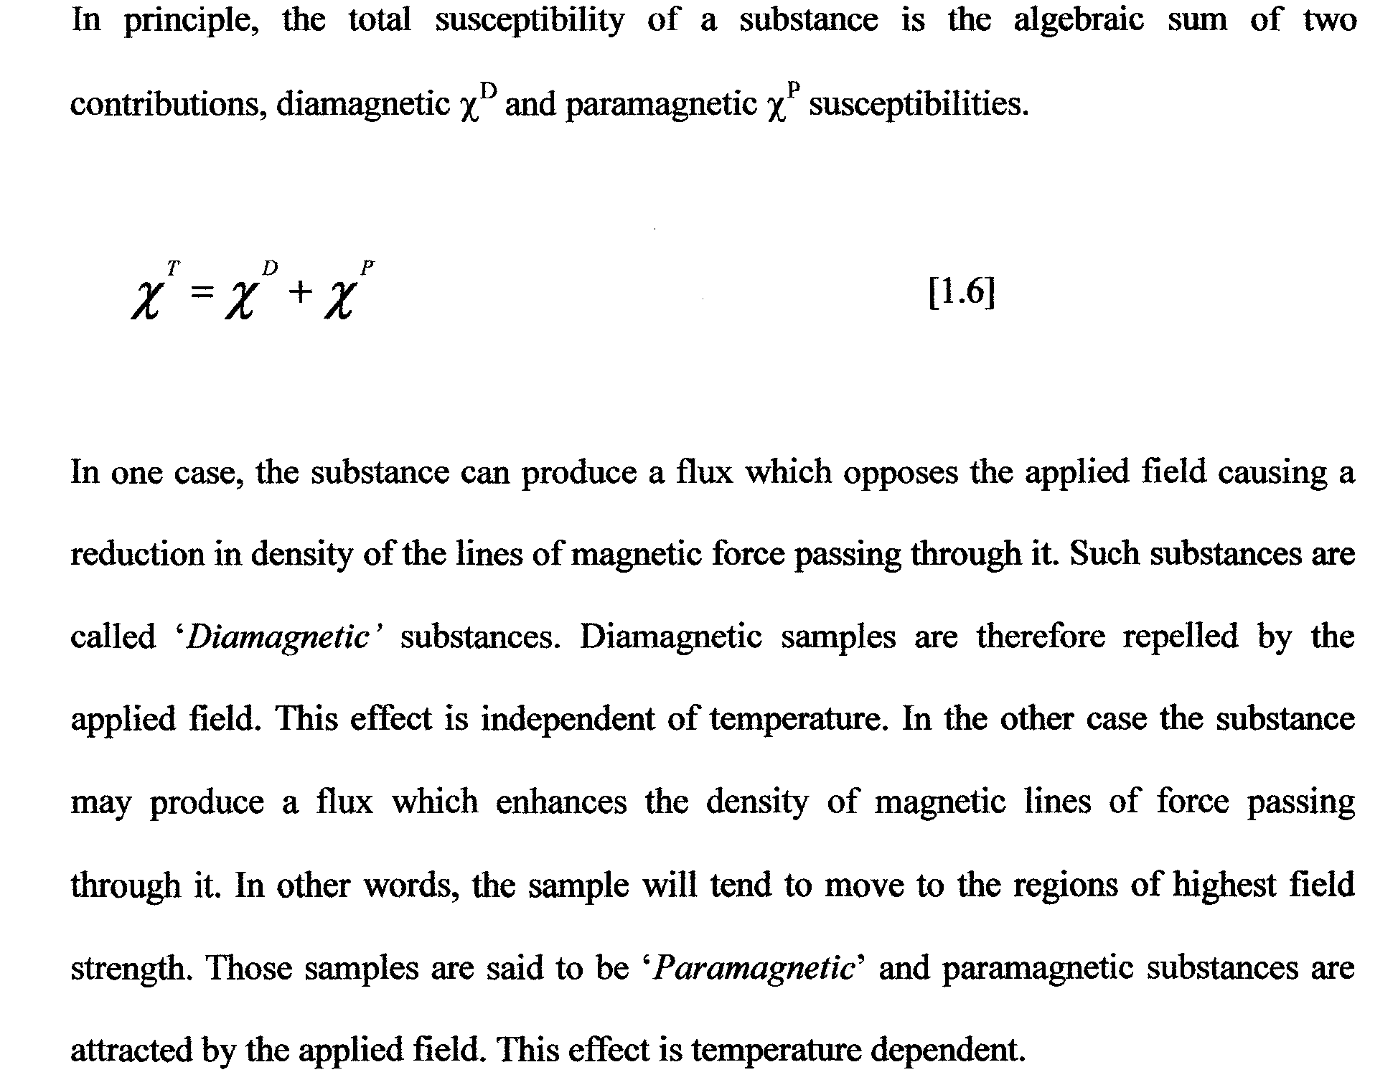

Slide 7
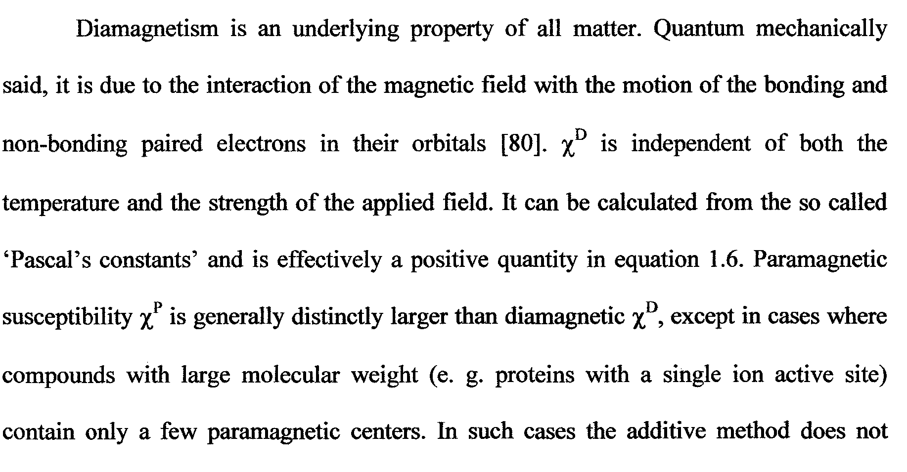
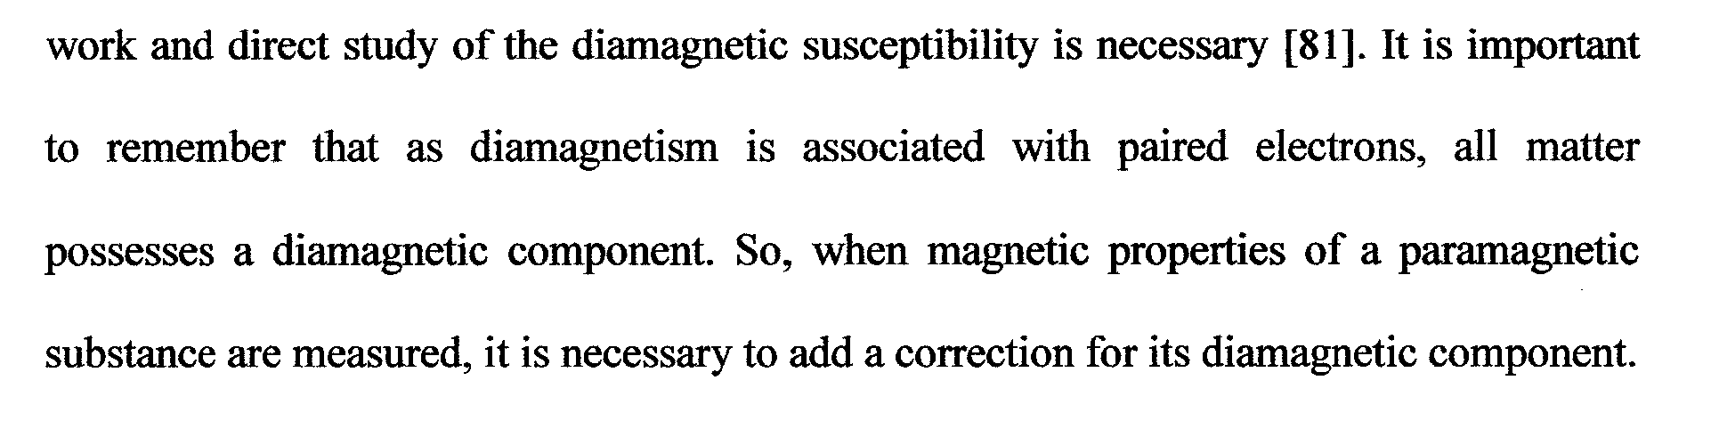

Slide 8
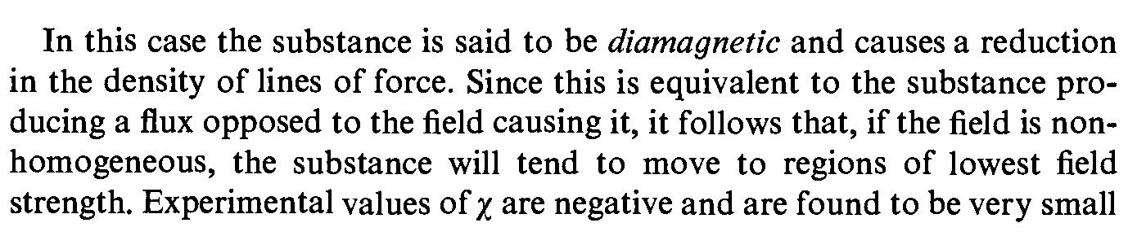

Slide 9
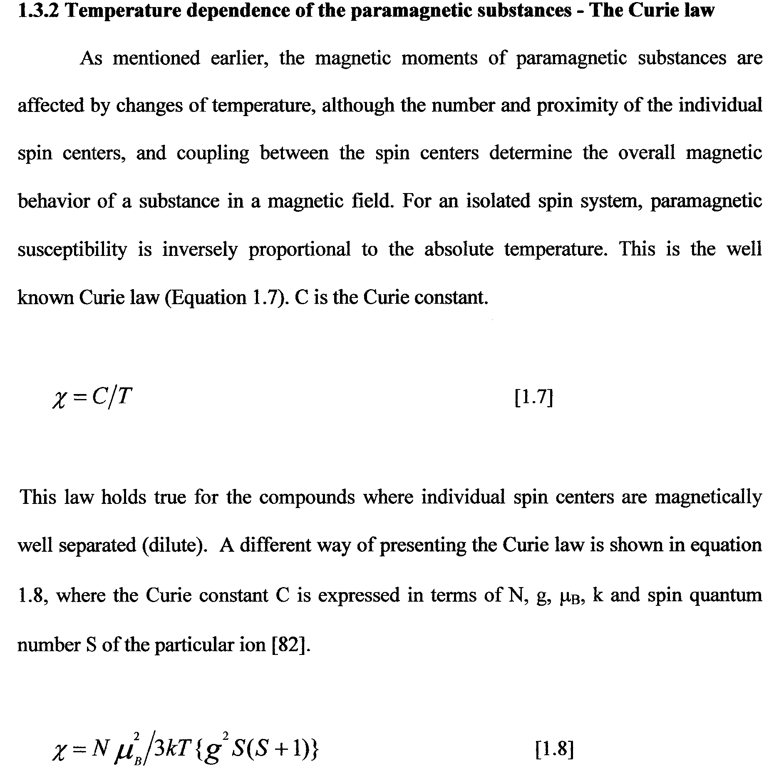
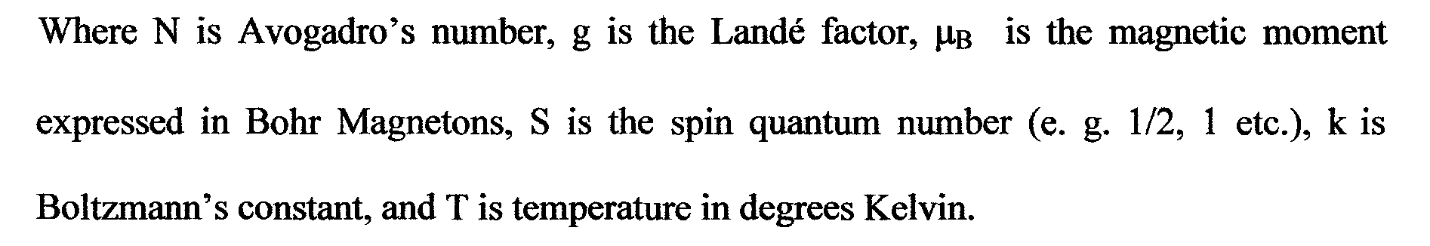

Slide 10
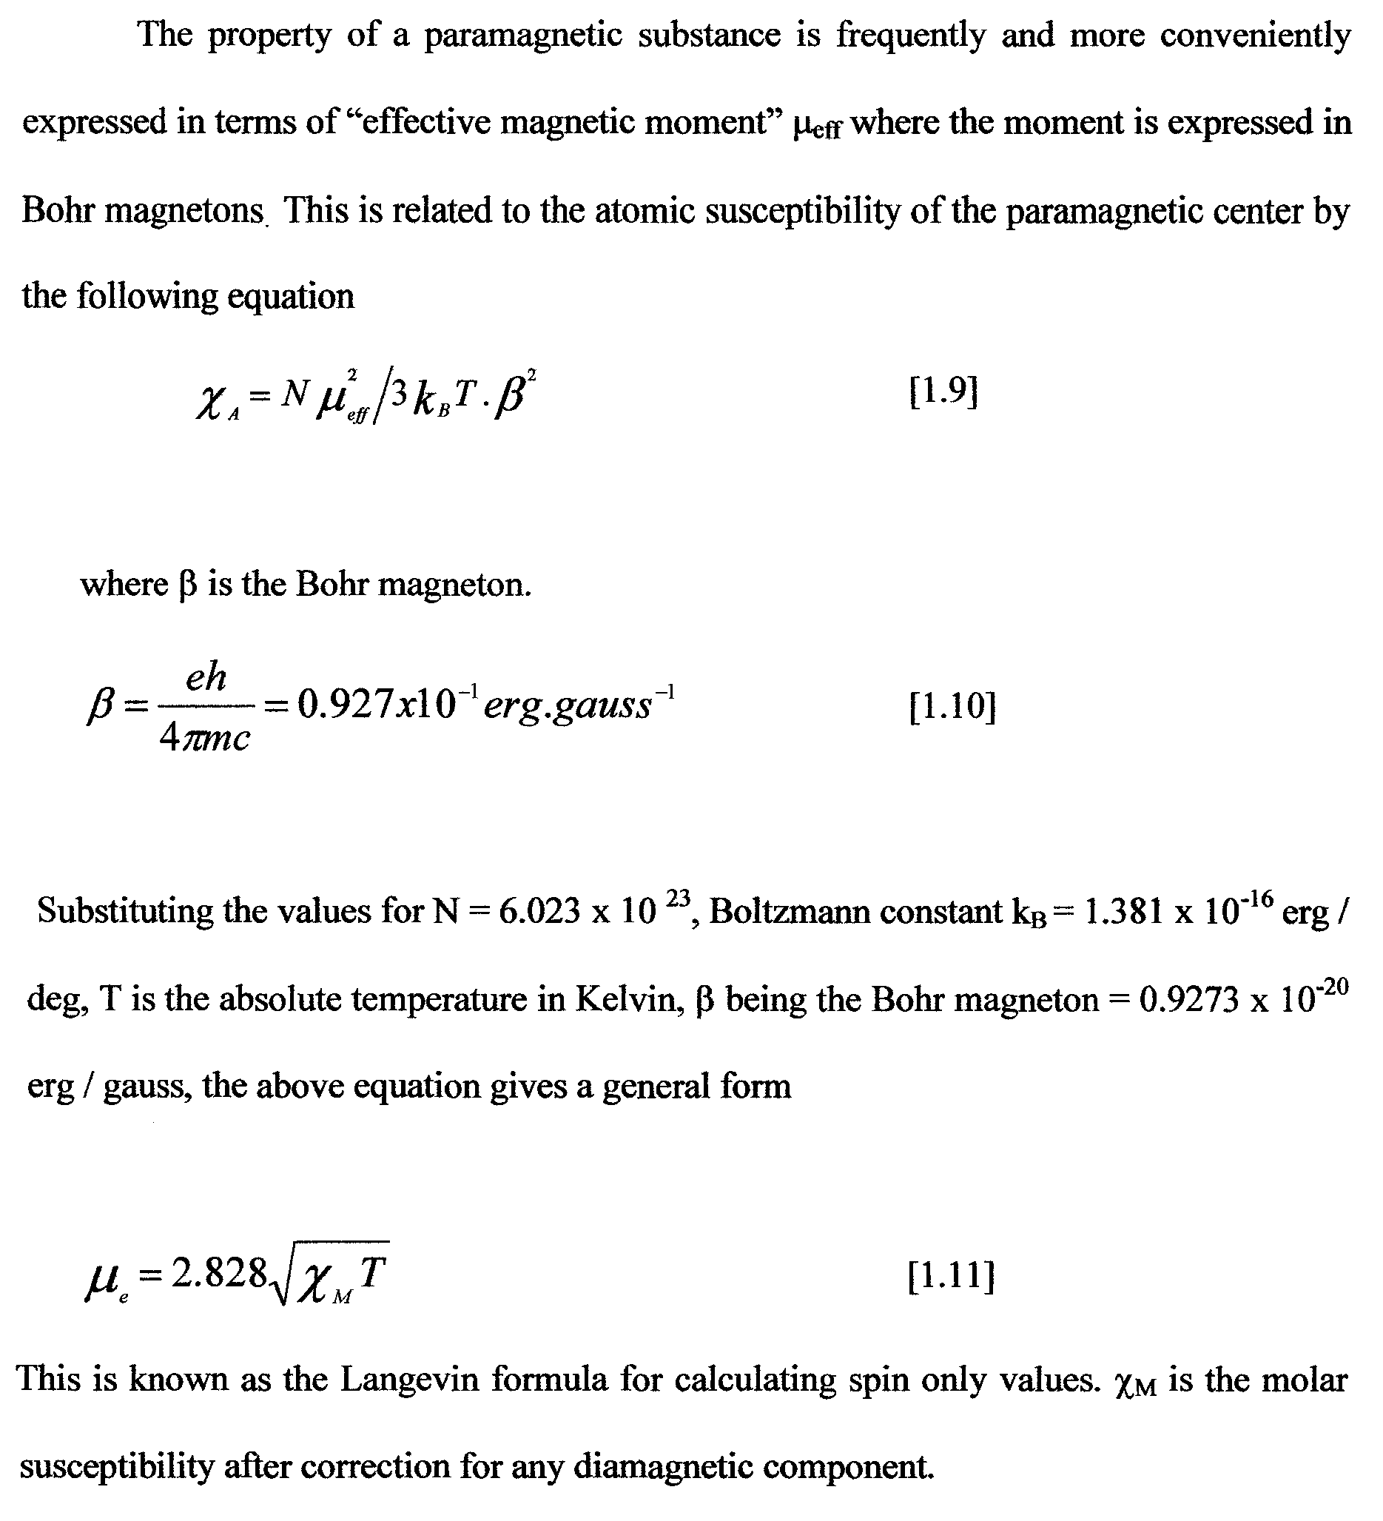

Slide 11
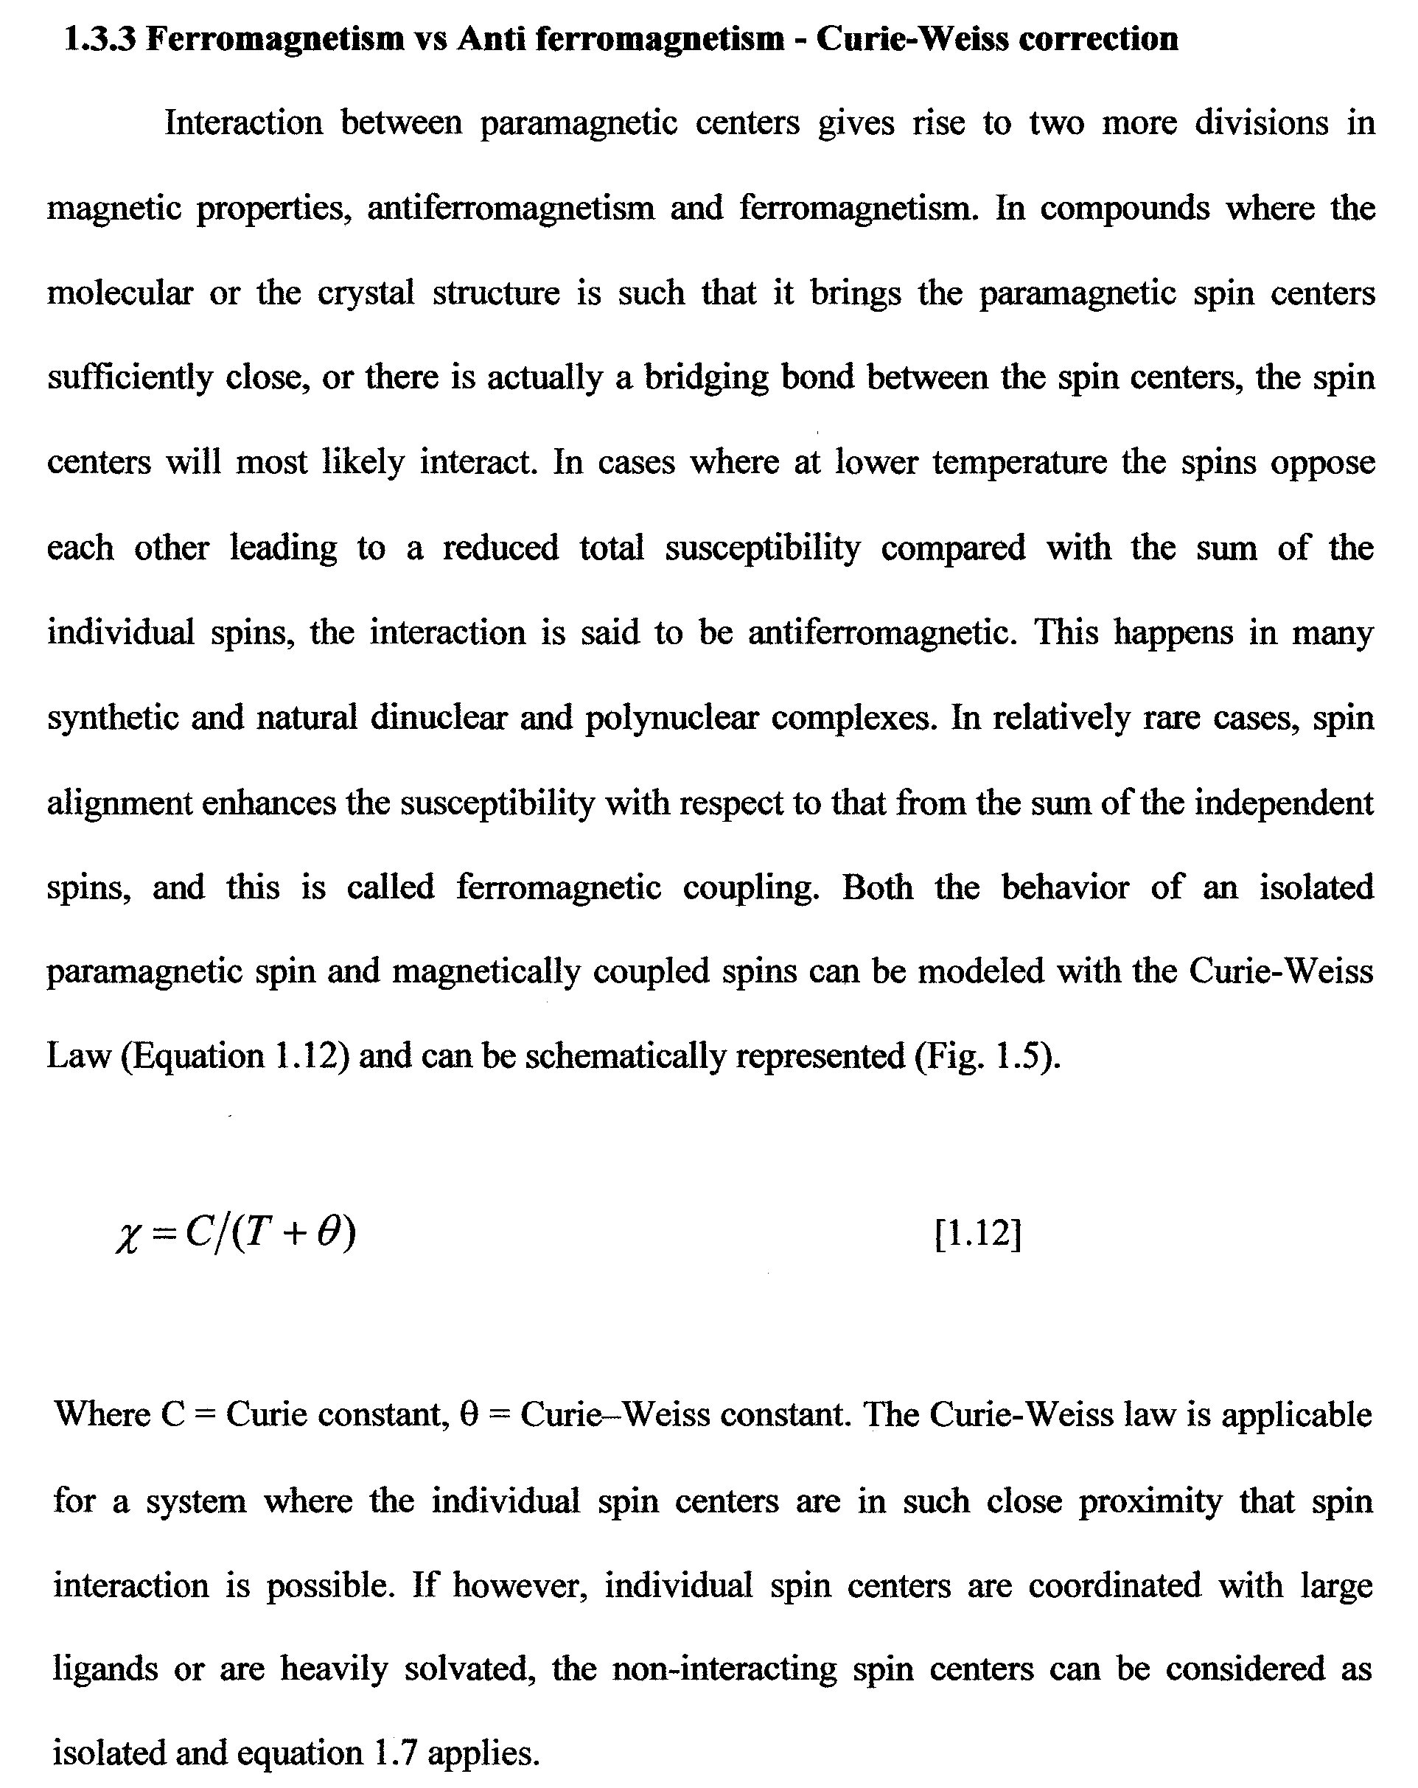

Slide 12
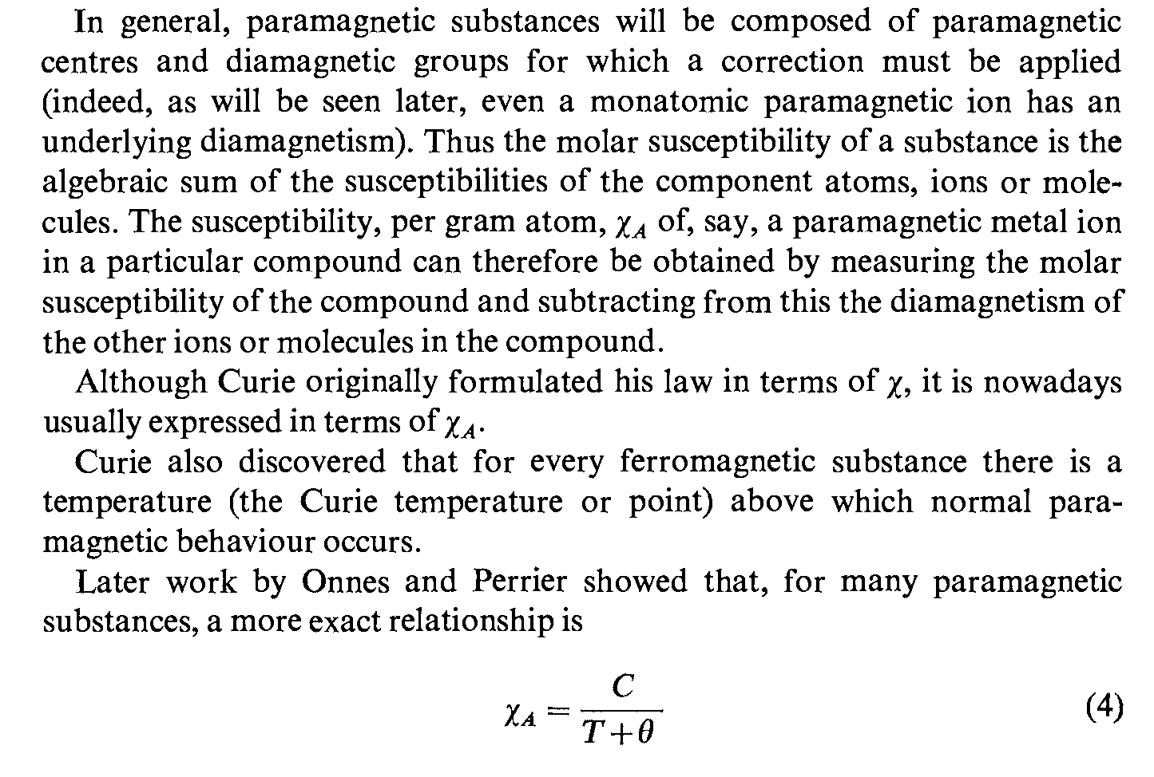

Slide 13
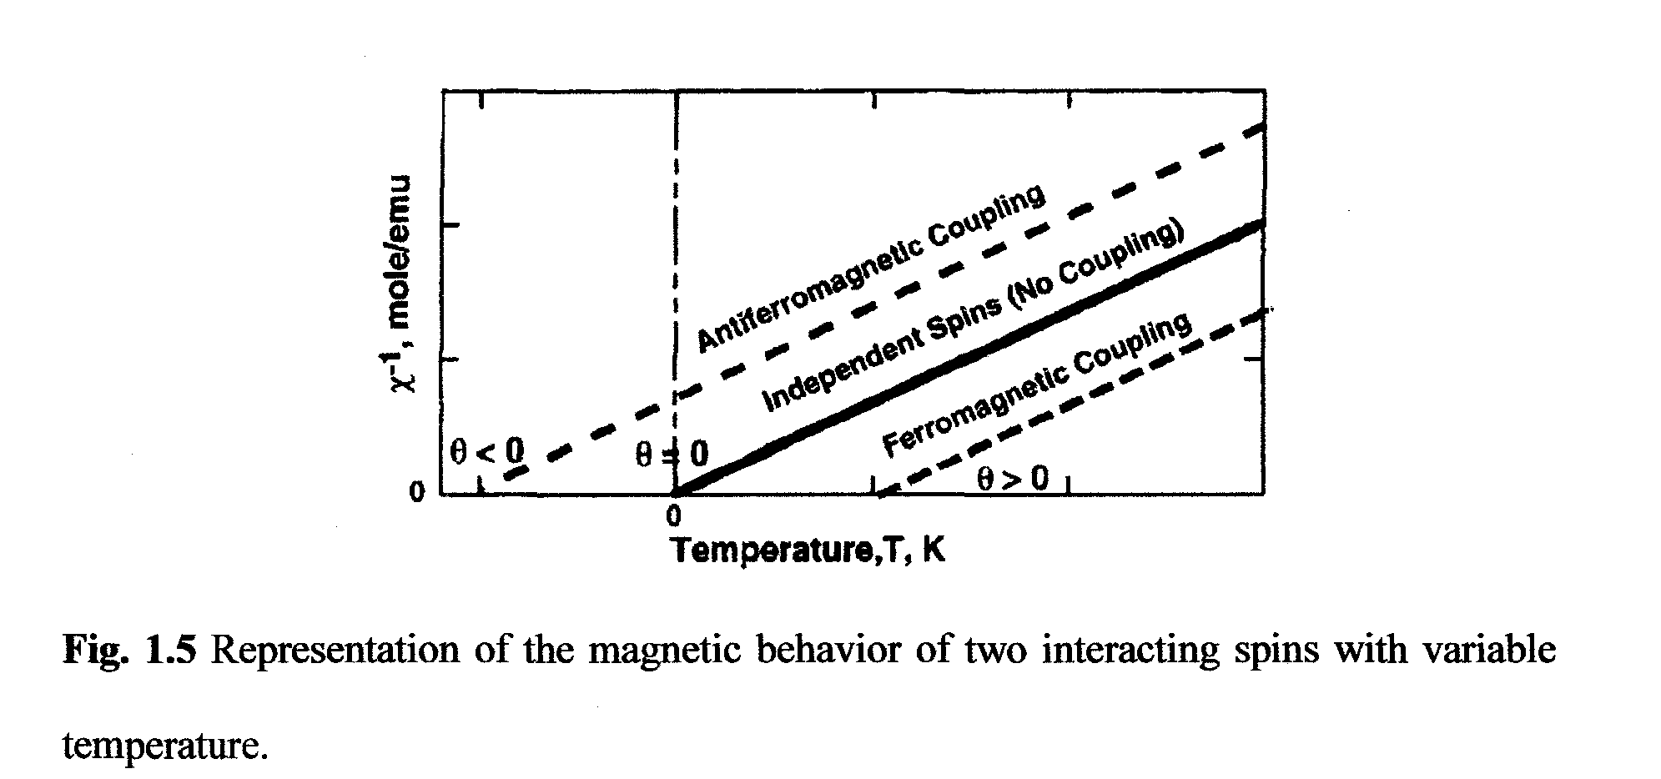
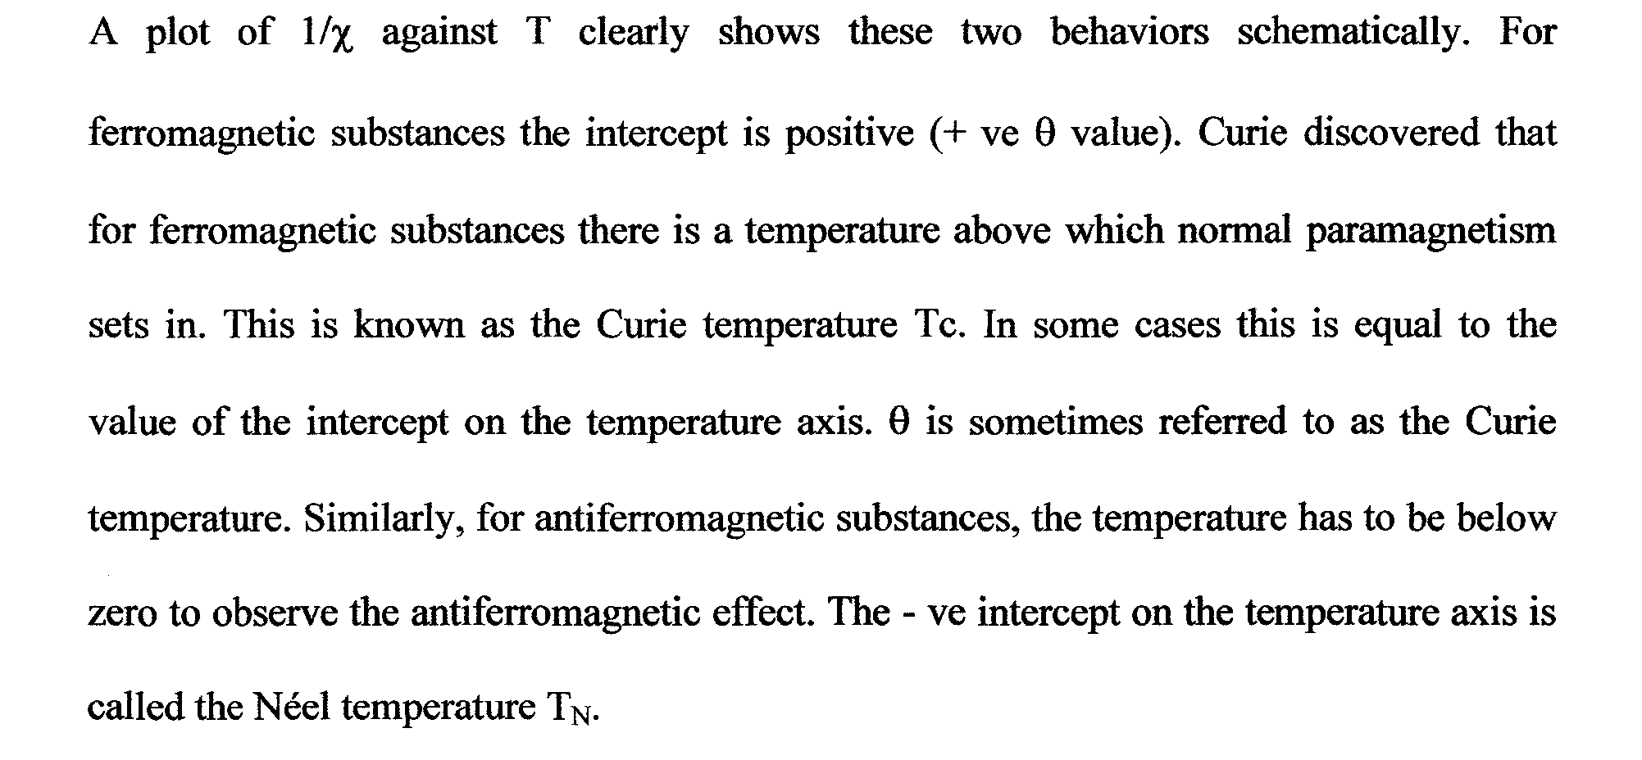

Slide 14
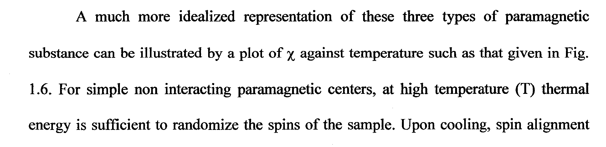
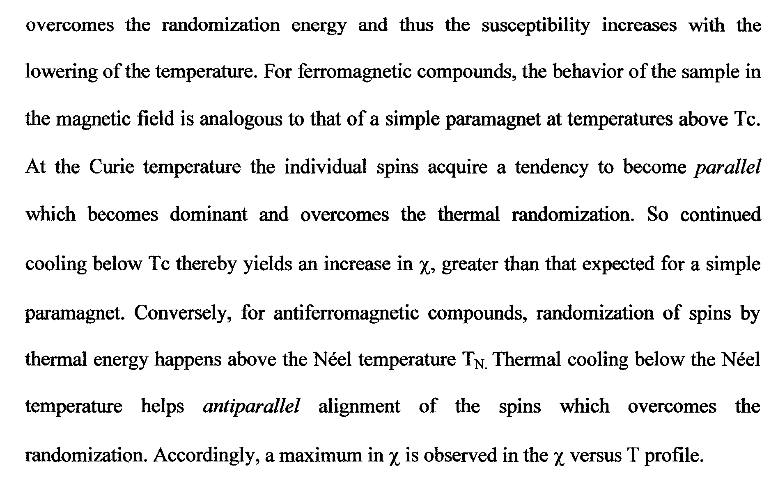

Slide 15
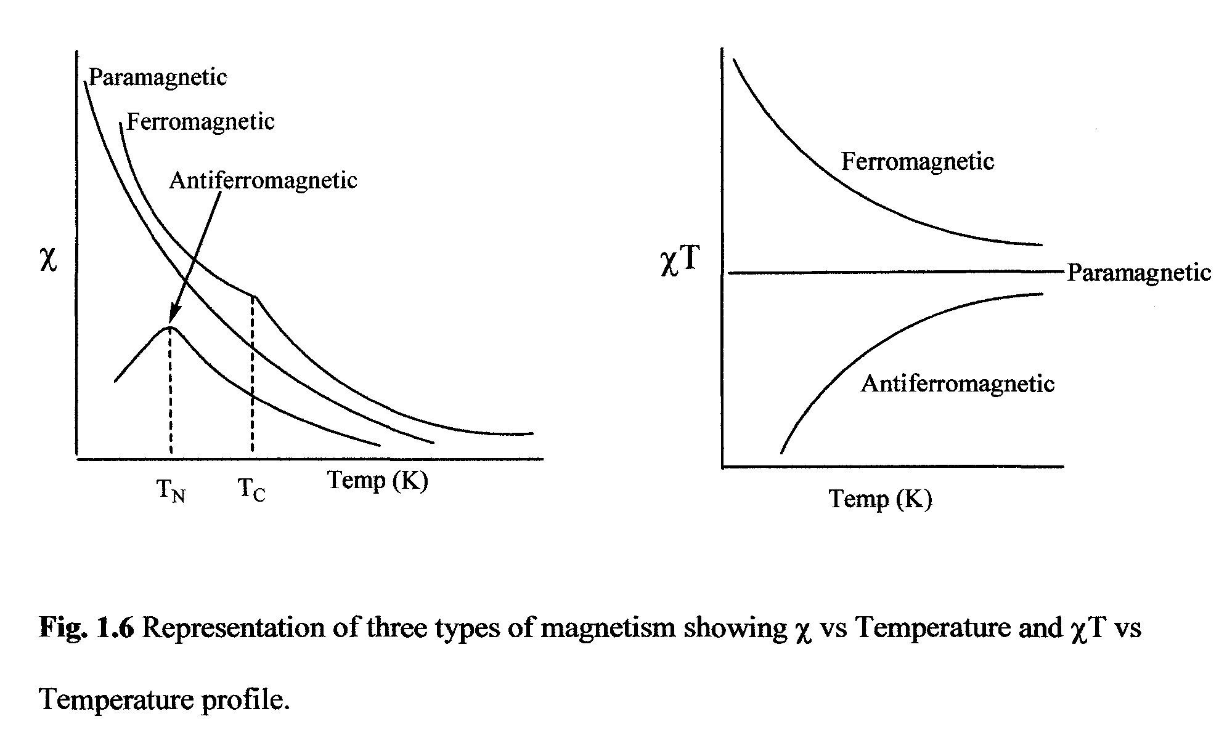
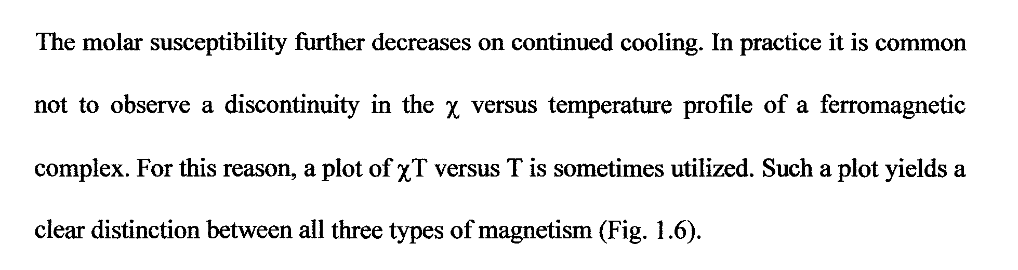
0 o K

Slide 16
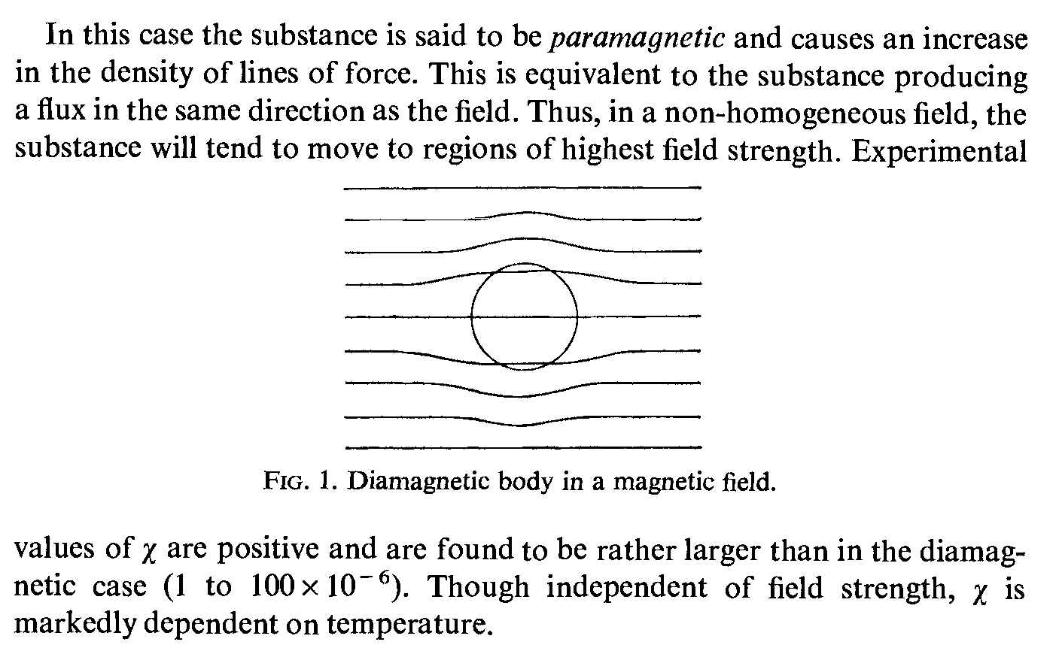

Slide 17
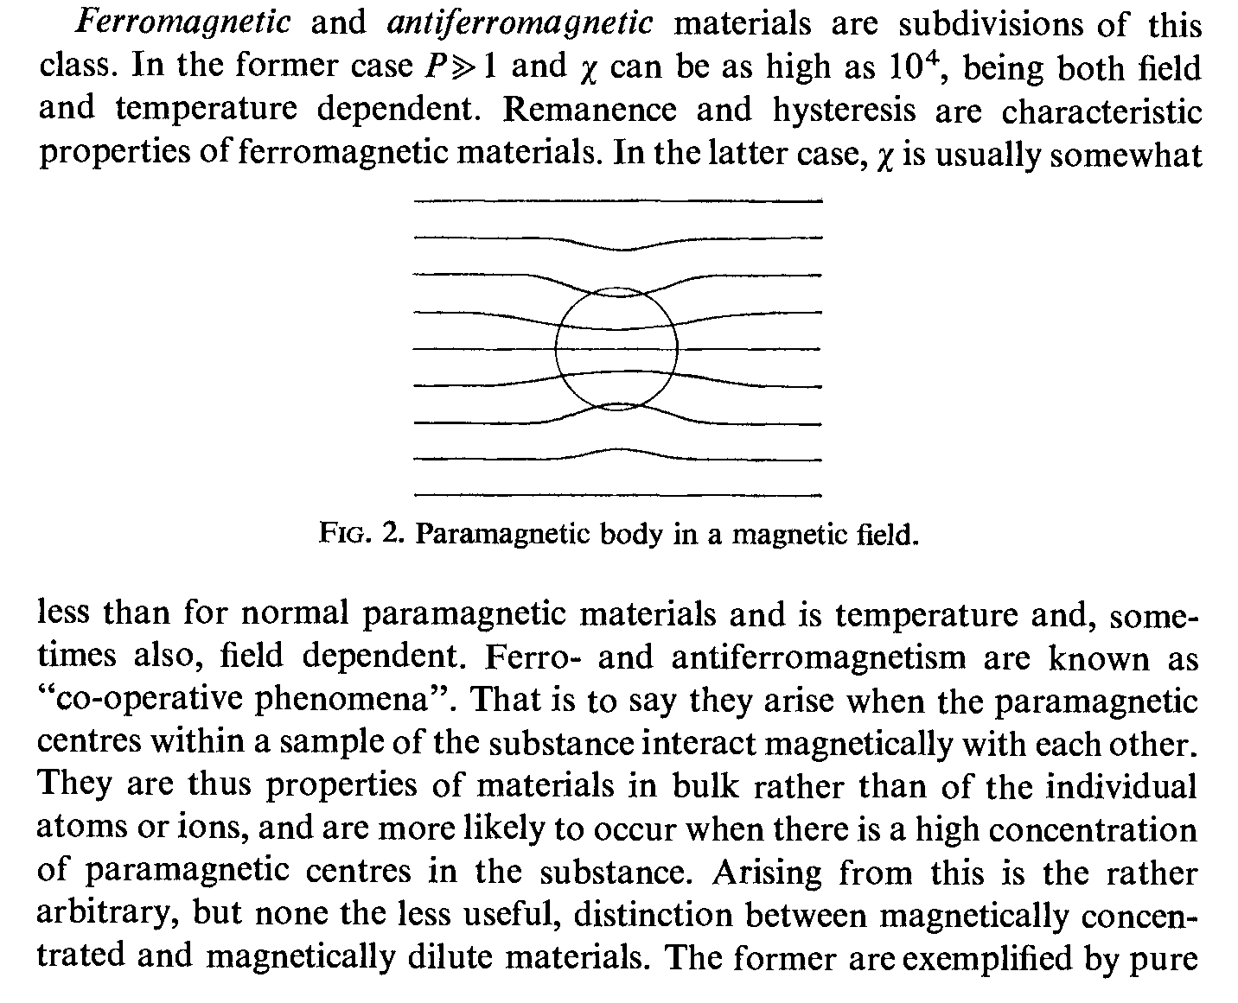

Slide 18
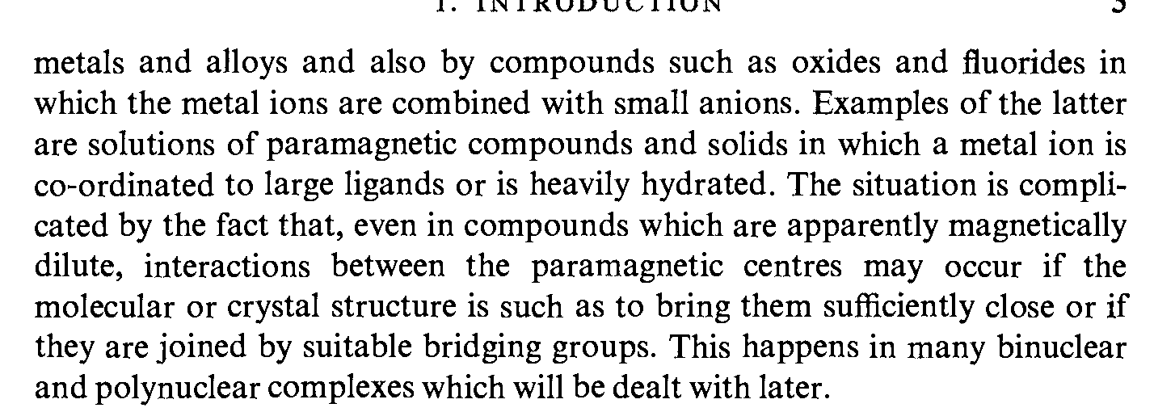
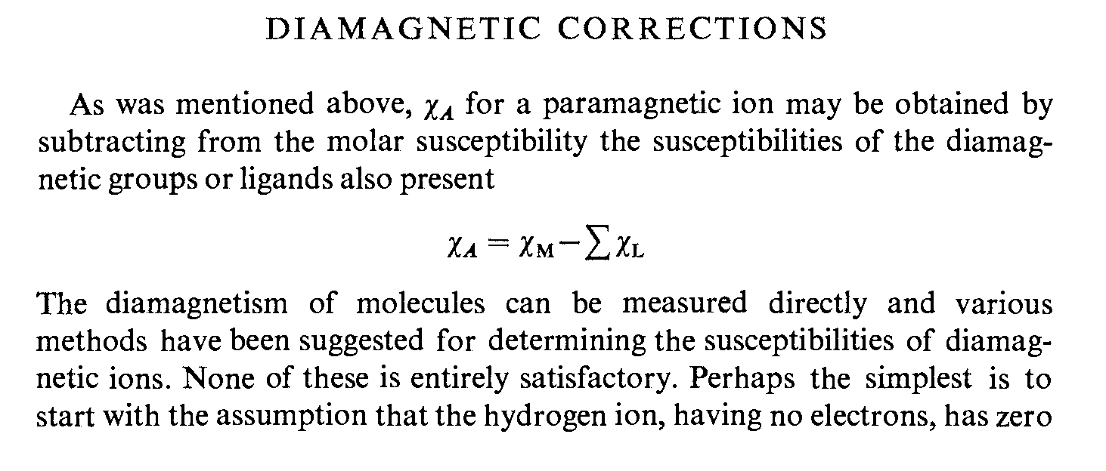

Slide 19
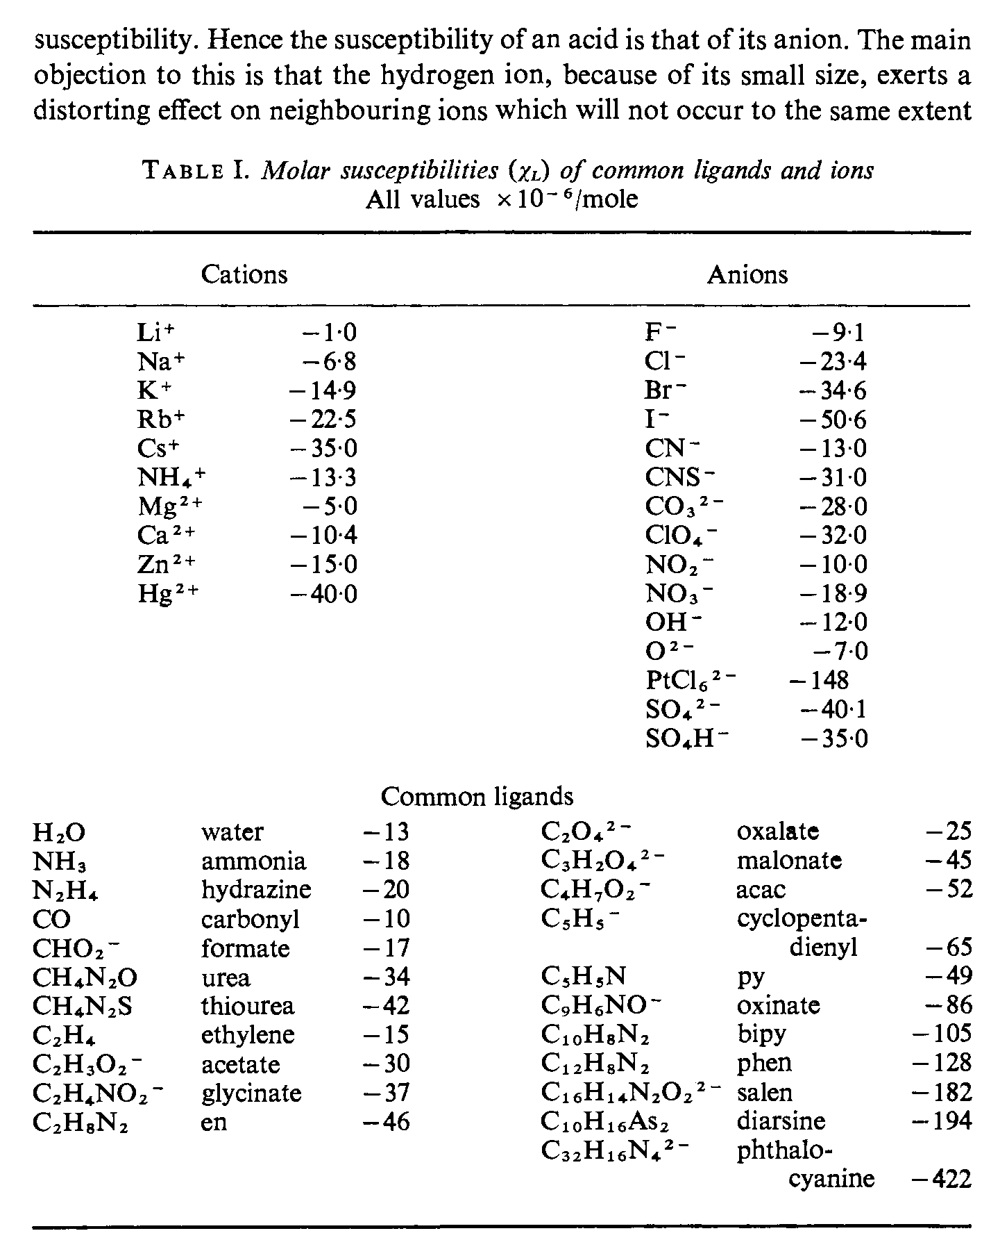

Slide 20
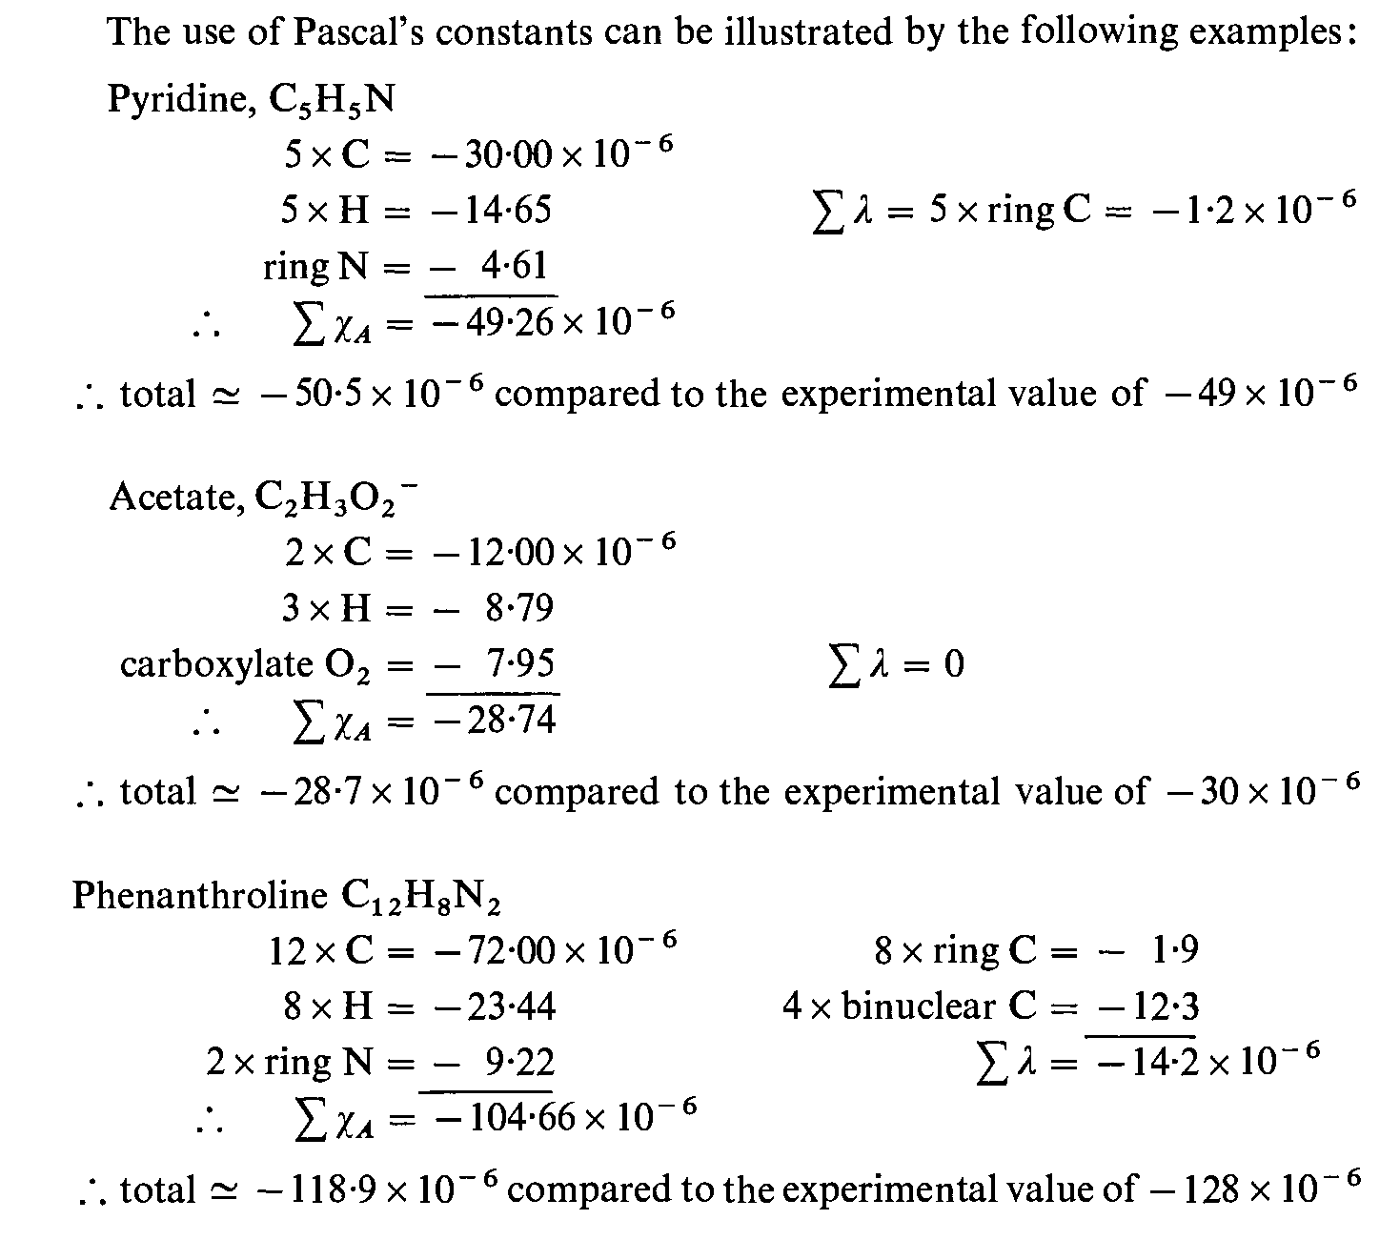

Slide 21
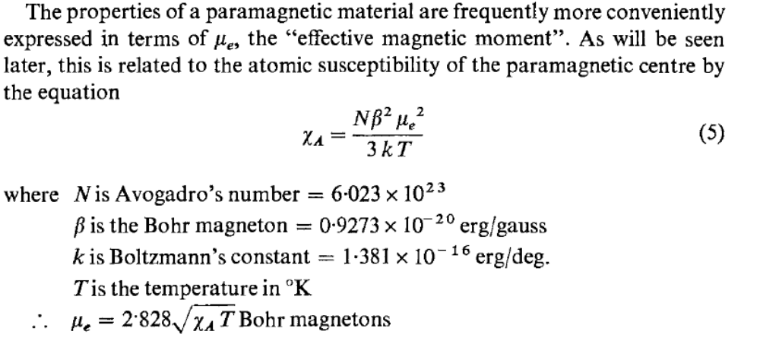
χ_{A} is the susceptibility per gram of the paramagnetic ion.

Slide 22
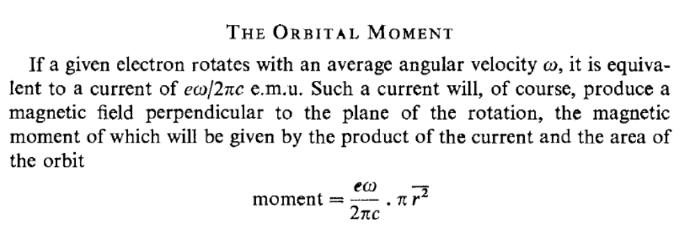

Slide 23
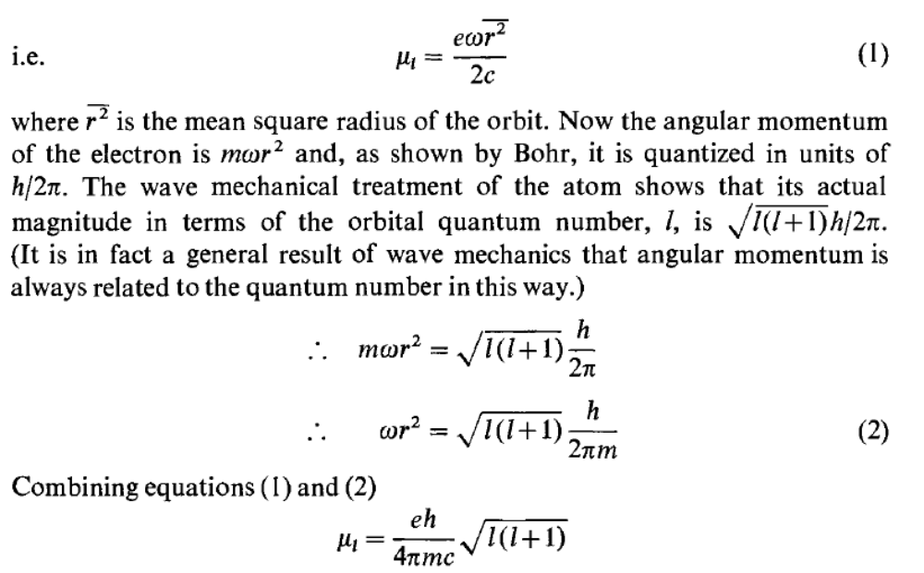
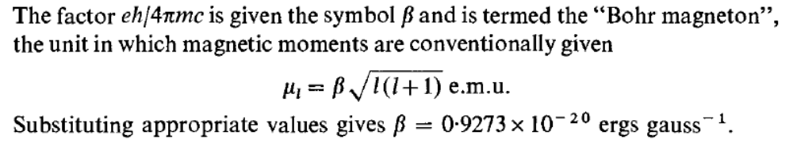

Slide 24



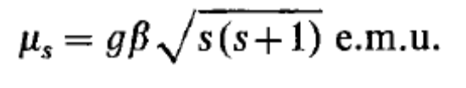
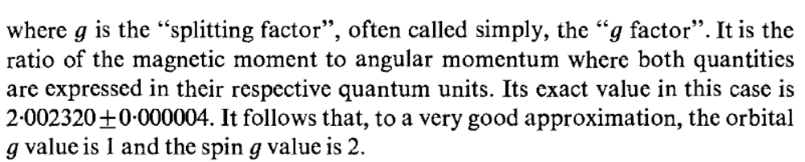
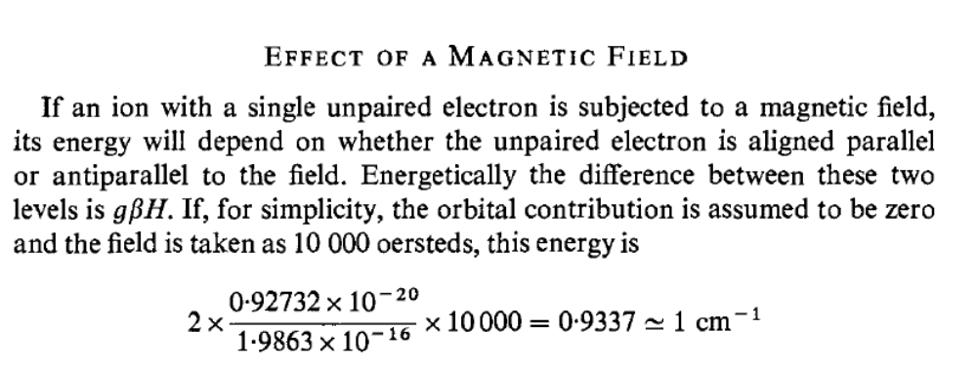

Slide 25
The Earth's magnetic field intensity is roughly between 25,000 - 65,000 nT (. 25 - . 65 gauss). Magnetic declination is the angle between magnetic north and true north.
The conversion between gauss and tesla is an easy one: 1 tesla = 10,000 gauss.
The relation between Magnetic strength H and flux density B can be defined by B = μH. μ in this case is permeability, the unit of magetizability. In the air, μis usually about 1, except special case, and 1 Gauss ≒ 1 Oersted. Usually, magnetic field strength is defined by the unit of Oe・A/m ( Oersted・Ampere/meter ).
For instance, a 500 MHz magnet is actually 11.7 Tesla (unit of magnetic flux density, or magnetic field strength), and the 500 MHz is a measure of the frequency that a 1H will resonate in an 11.7 Tesla field. For a 21.1 Tesla field, the 1H will resonate at 900 MHz.
NMR 600 MHz = 14 tesla

Slide 26
