Slide 1
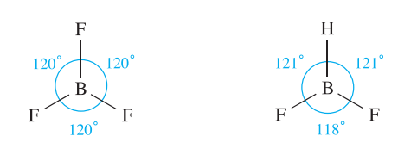
Symmetry
A molecule is said to have symmetry if it has two or more orientations in space that are indistinguishable.
trigonal planar
pseudo-trigonal planar

Slide 2

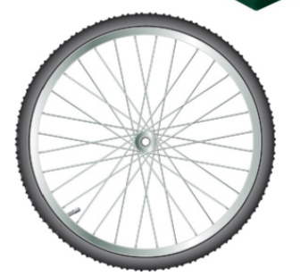
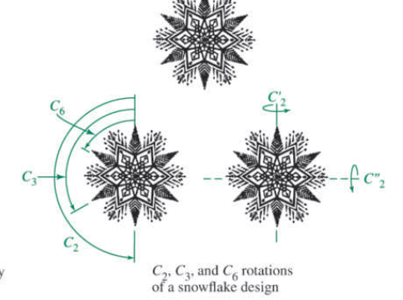
Symmetry is a phenomenon of the natural world, as well as the world of human invention. In nature, many flowers and plants, snowflakes, insects, certain fruits and vegetables, and a wide variety of microscopic plants and animals exhibit characteristic symmetry.
The term symmetry is derived from the Greek word “symmetria” which means “measured together”. An object is symmetric if one part (e.g. one side) of it is the same* as all of the other parts. You know intuitively if something is symmetric but we require a precise method to describe how an object or molecule is symmetric.

Slide 3
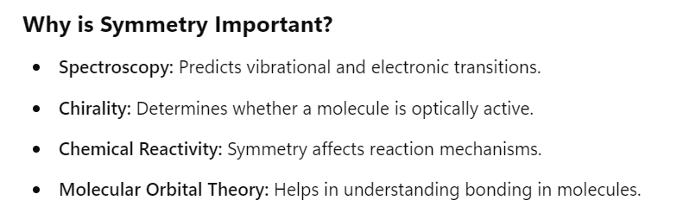
Molecular symmetry is the study of the symmetry elements and symmetry operations present in a molecule. It describes the balanced spatial arrangement of atoms in a molecule that remains unchanged under specific transformations, such as rotation, reflection, or inversion. Molecular symmetry is fundamental in group theory, which helps classify molecules into point groups and predict their chemical and physical properties, including spectroscopy, chirality, and molecular bonding.
By analyzing the symmetry of molecules, we can predict infrared spectra, describe orbitals used in bonding, predict optical activity, interpret electronic spectra, and study a number of additional molecular properties.

Slide 4
Molecules or any other objects may contain symmetry elements such as mirror planes, axes of rotation, and inversion centers.
The actual reflection, rotation, or inversion is called a symmetry operation.
To contain a given symmetry element, a molecule must have exactly the same appearance after the operation as before.
In other words, photographs of the molecule (if such photographs were possible) taken from the same location before and after the symmetry operation would be indistinguishable.

Slide 5
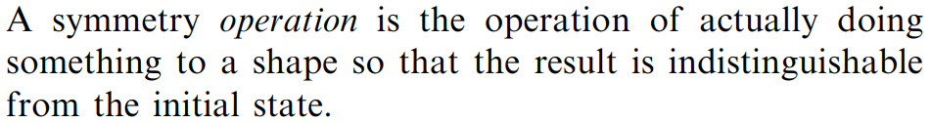
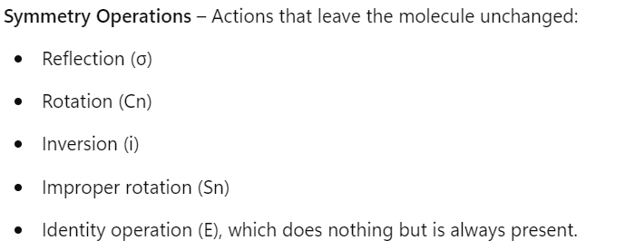
A symmetry operation moves a molecule about an axis, a point, or a plane (the symmetry element) into a position indistinguishable from the original position.
A symmetry operation is an action that leaves an object looking the same after it has been carried out. For example, if we take a molecule of water and rotate it by 180° about an axis passing through the central O atom (between the two H atoms) it will look the same as before. Each symmetry operation has a corresponding symmetry element, which is the axis, plane (2-dimensional), line (1-dimensional) or point (0-dimensional) with respect to which the symmetry operation is carried out:

Slide 6
A symmetry operation moves a molecule about an axis, a point, or a plane (the symmetry element) into a position indistinguishable from the original position.
If there is a point in space that remains unchanged under all of the symmetry operations, the resultant symmetry is referred to as point symmetry.

Slide 7
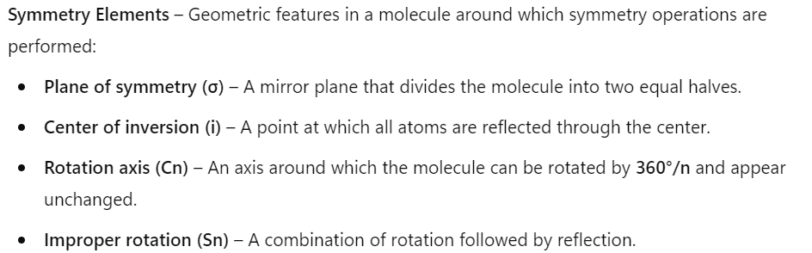

Slide 8
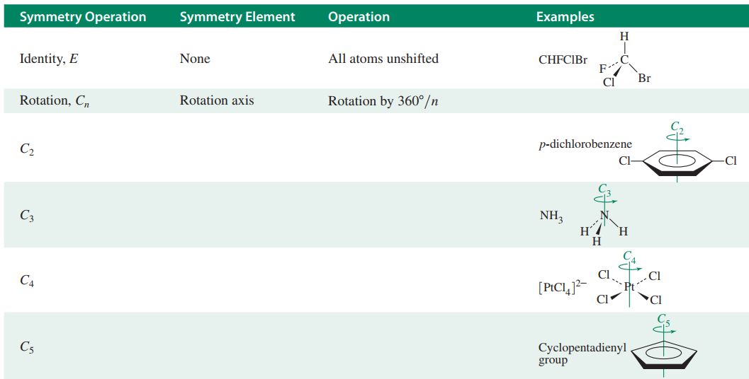

Slide 9
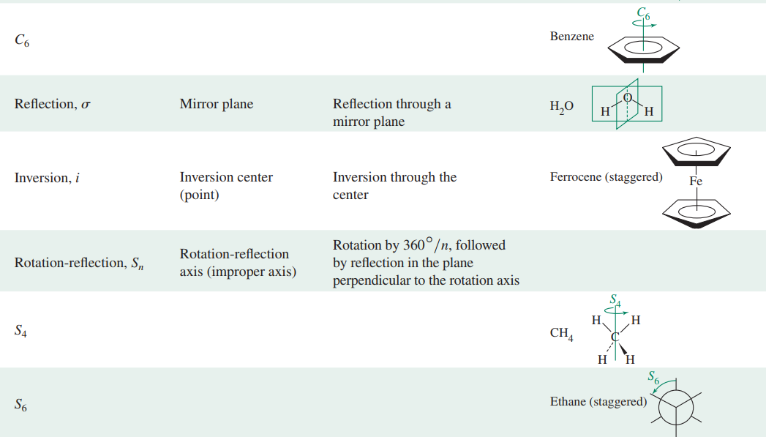

Slide 10
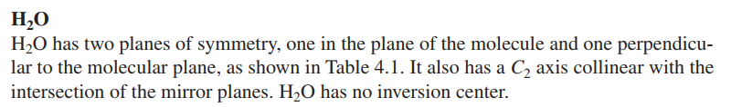
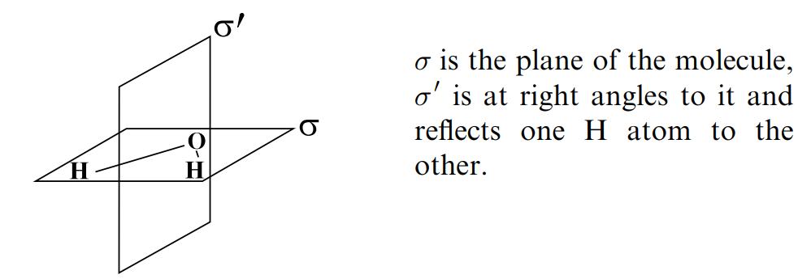

Slide 11
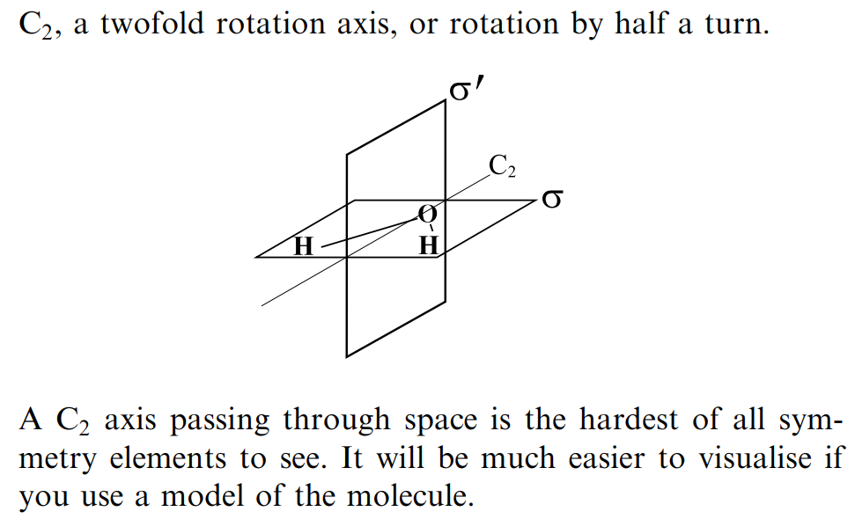


Slide 12
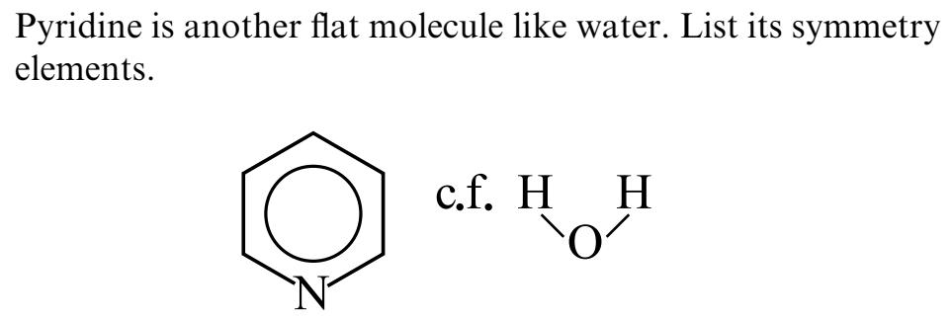
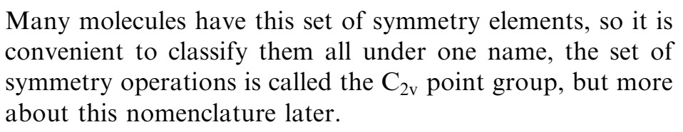

Slide 13

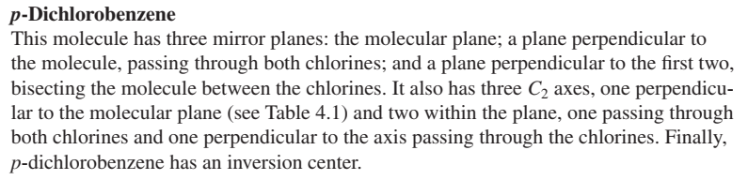
  3 mirror plane
  3 C₂ axes
  Inversion center

Slide 14
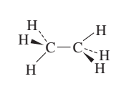
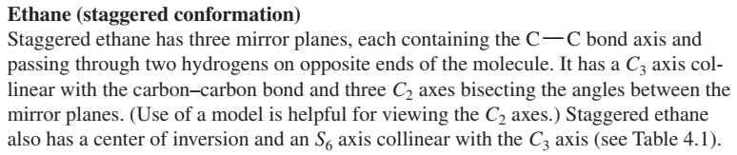
  3 mirror plane containing C-C bond axis
  1C₃ axis
  3 C₂ axes
  Inversion center
  S₆ axis

Slide 15
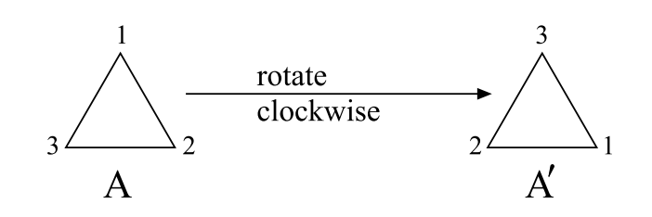
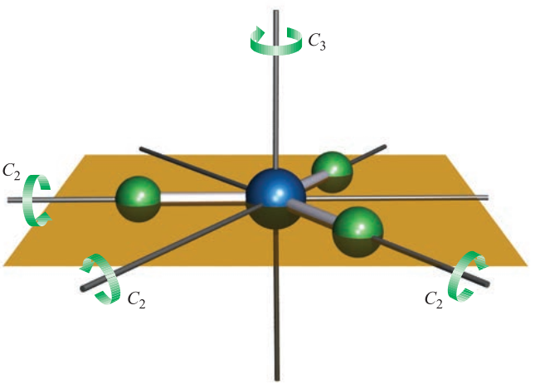
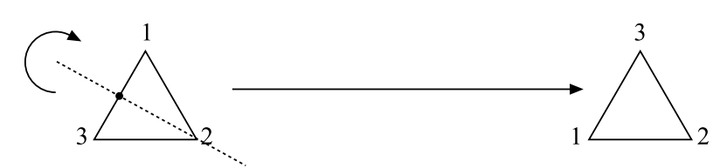
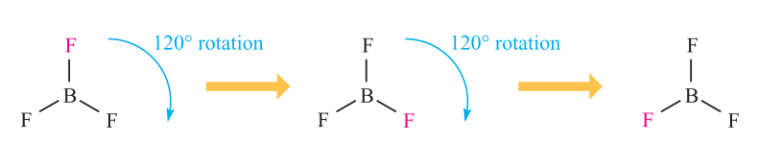
Rotational axis
If rotation of a molecule by 360°/n about an axis results in an indistinguishable configuration, the molecule is said to have an n-fold rotational axis.
Rotation = 120⁰ = C₃
BF₃ Molecule
Rotation = 180⁰ = C₂
For example, in BF₃, the C₃ axis is the principal axis.
In molecules with more than one rotation axis, the C_{n} axis having the largest value of n is the highest order rotation axis or principal axis.

Slide 16
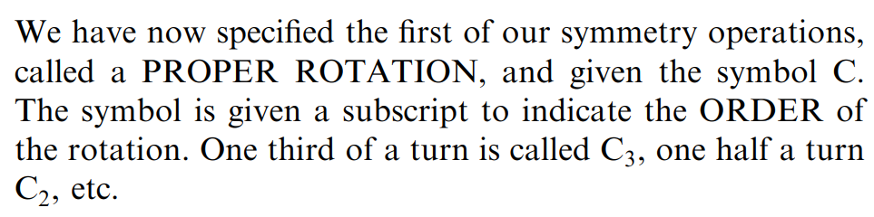
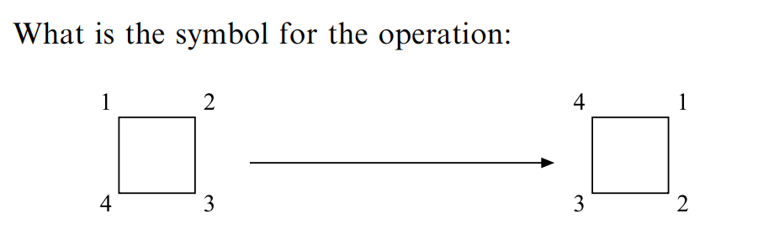

Slide 17
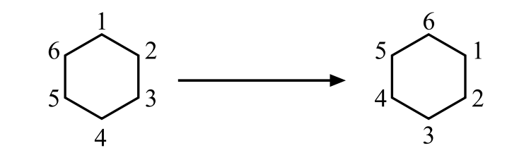
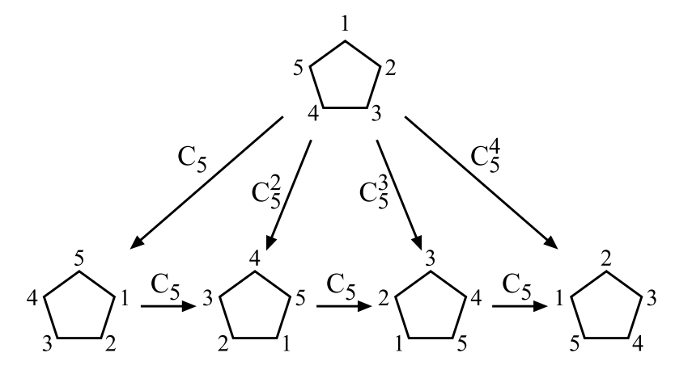

Slide 18
Rotational axis
Proper rotational axis
Improper rotational axis

Slide 19
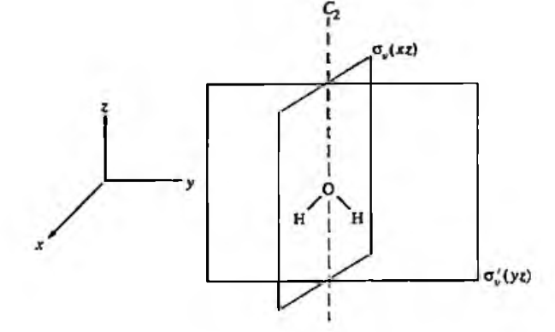
Reflection through a plane of symmetry (mirror plane), σ
If reflection of all parts of a molecule through a plane produces an indistinguishable configuration, the plane is a plane of symmetry; the symmetry operation is one of reflection and the symmetry element is the mirror plane (denoted by σ). For BF₃, the plane containing the molecular framework (the brown plane shown in Fig. 3.2) is a mirror plane. In this case, the plane lies perpendicular to the vertical principal axis and is denoted by the symbol σ

Slide 20
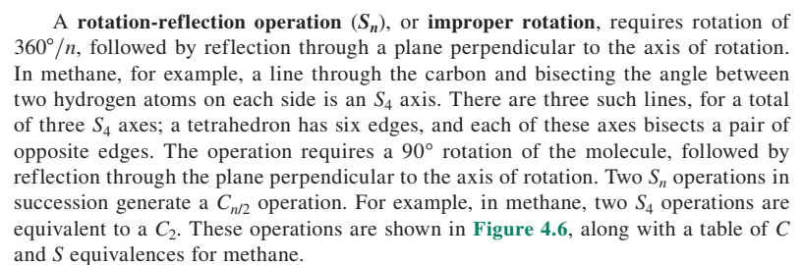
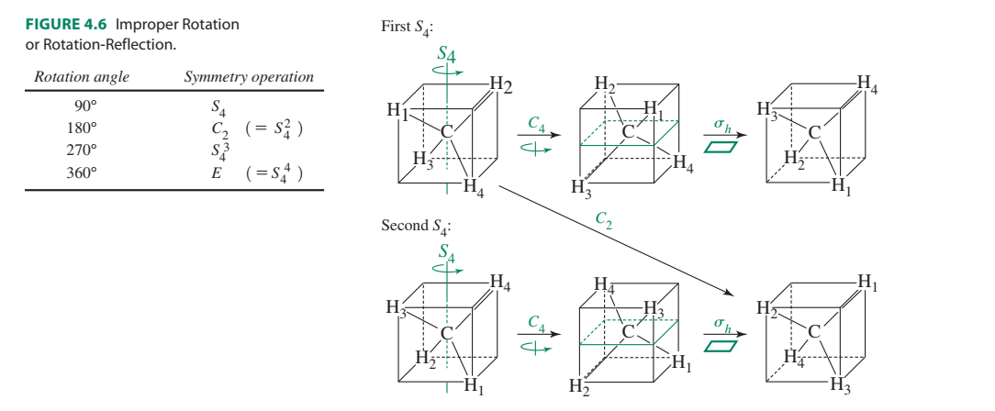

Slide 21
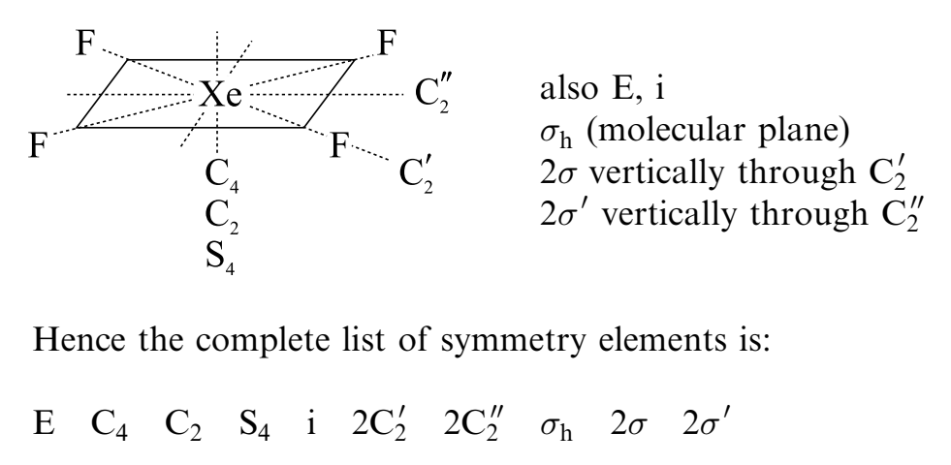

Slide 22

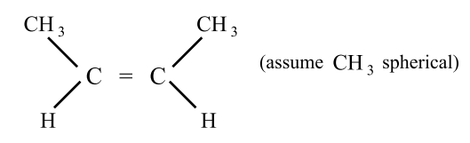

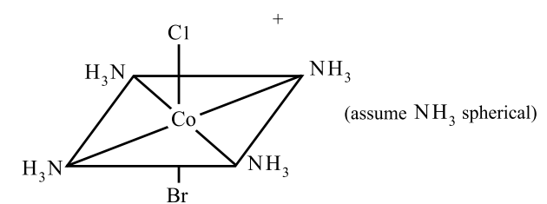

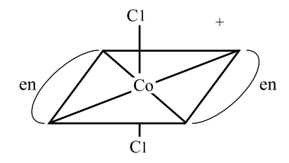
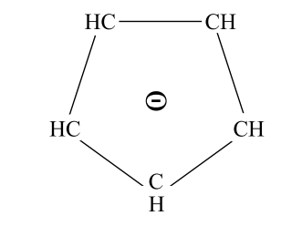


Slide 23
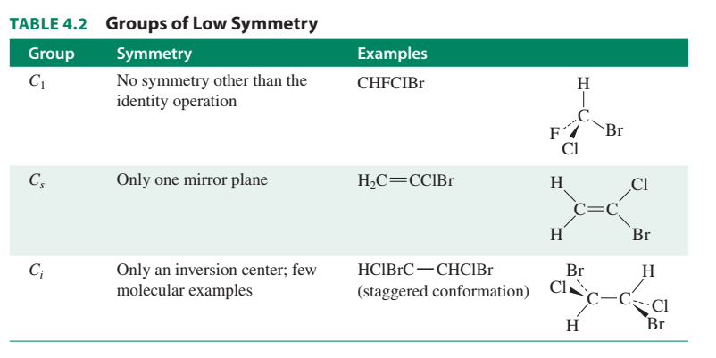

Slide 24
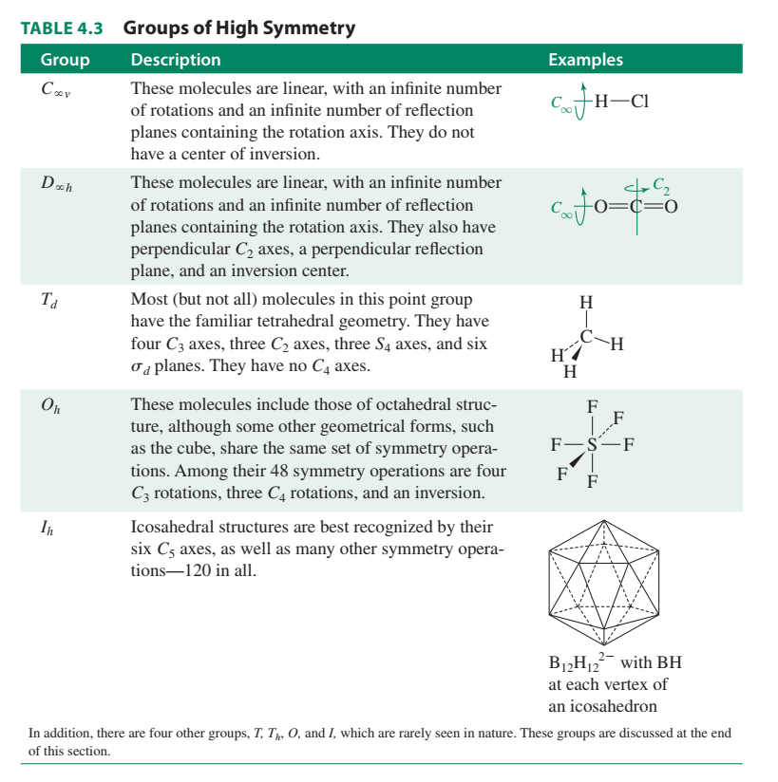

Slide 25
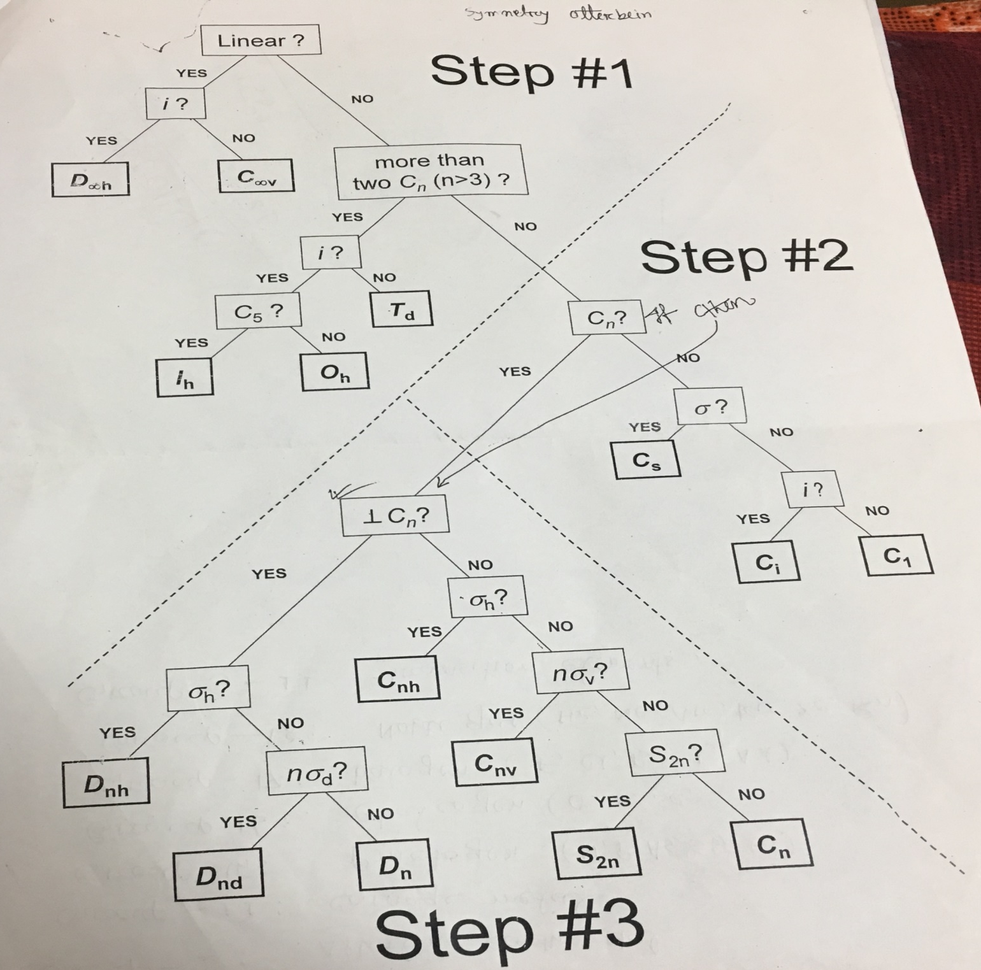

Slide 26
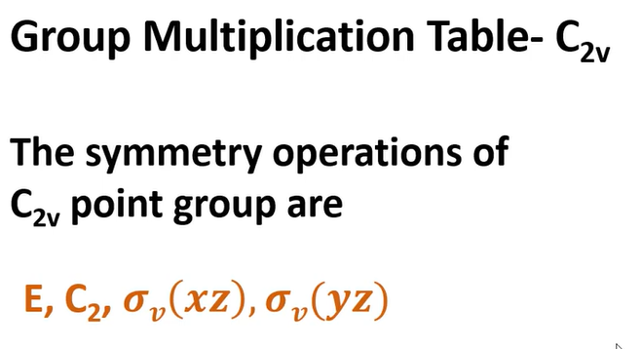

Slide 27
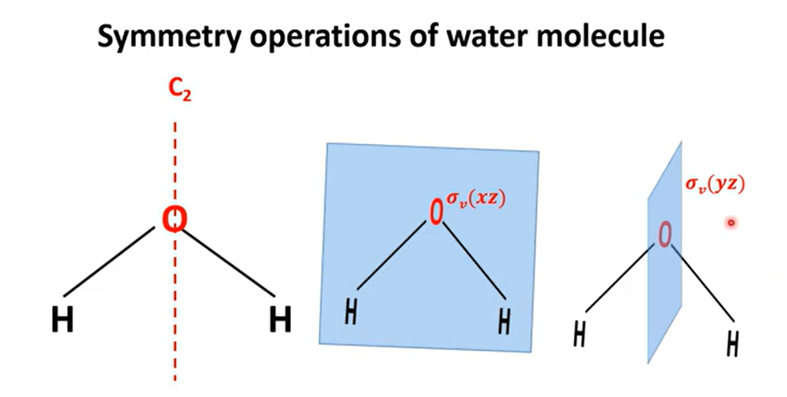

Slide 28
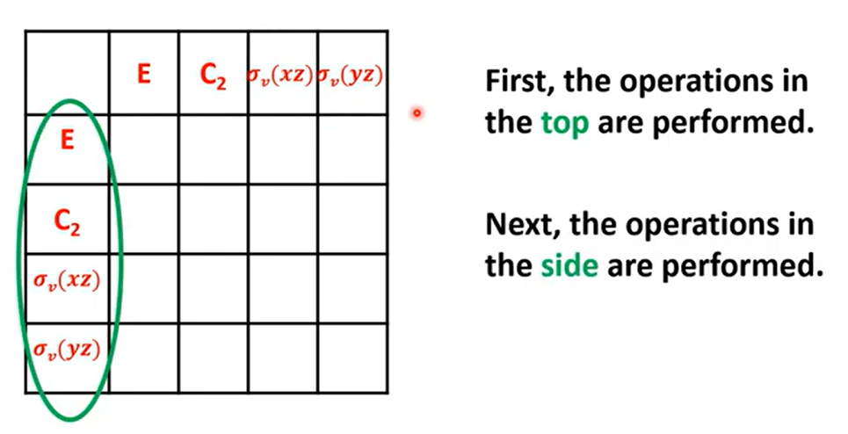

Slide 29
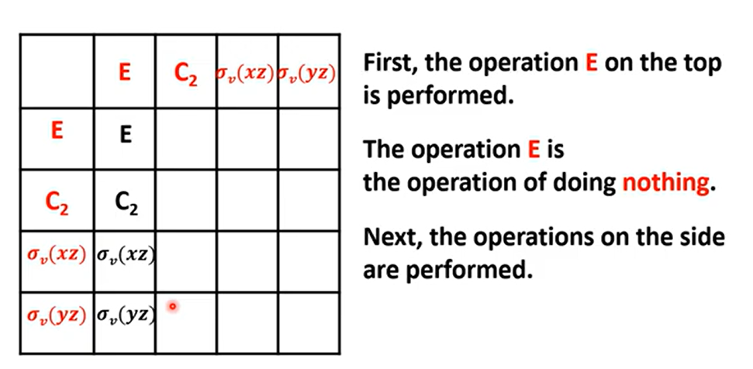

Slide 30
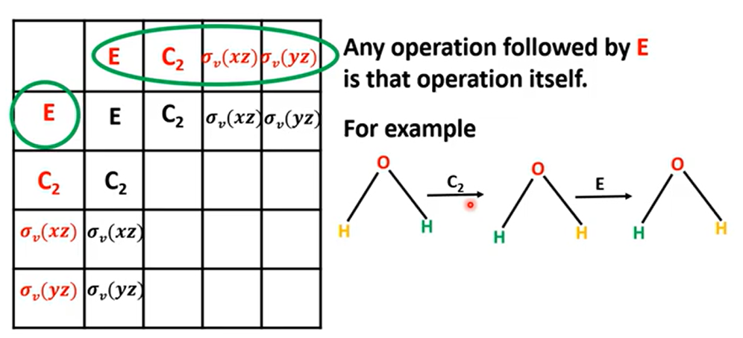

Slide 31
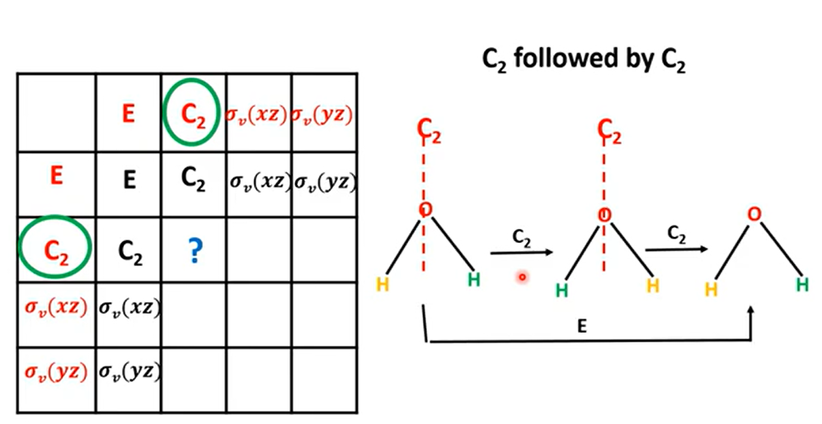

Slide 32
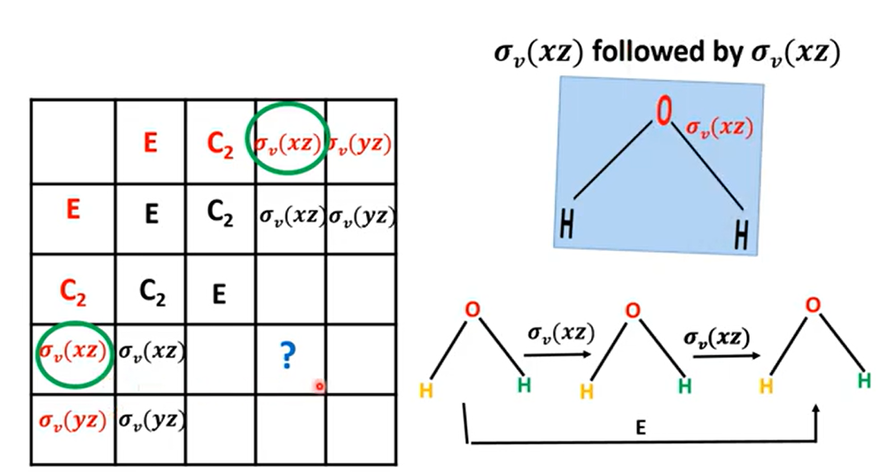

Slide 33
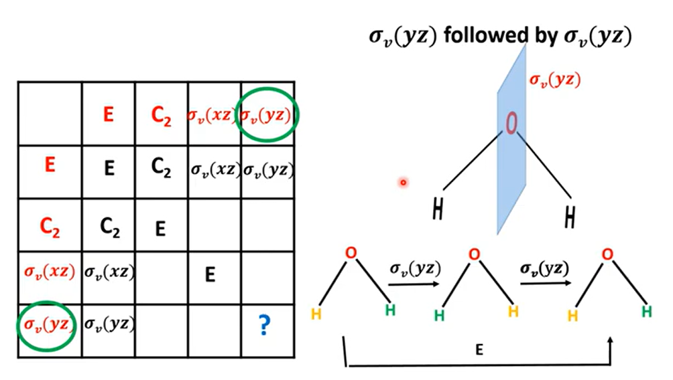

Slide 34
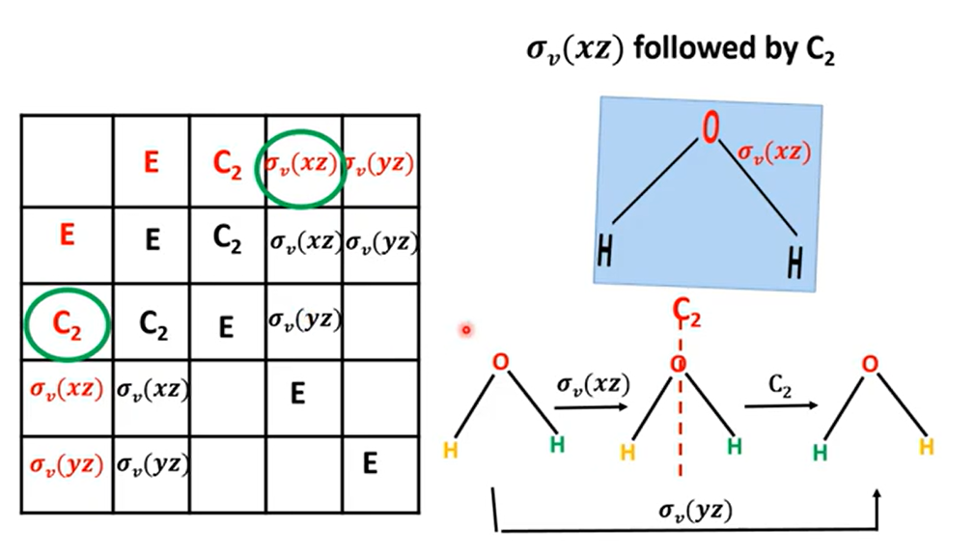

Slide 35
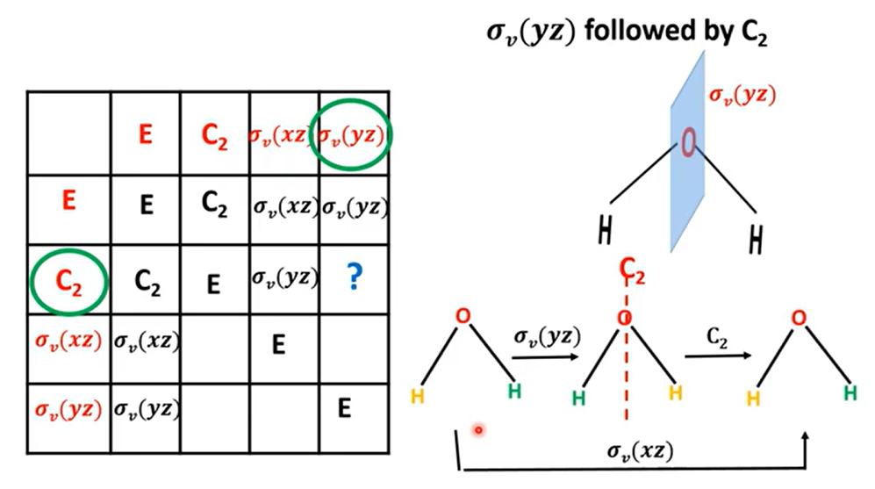

Slide 36
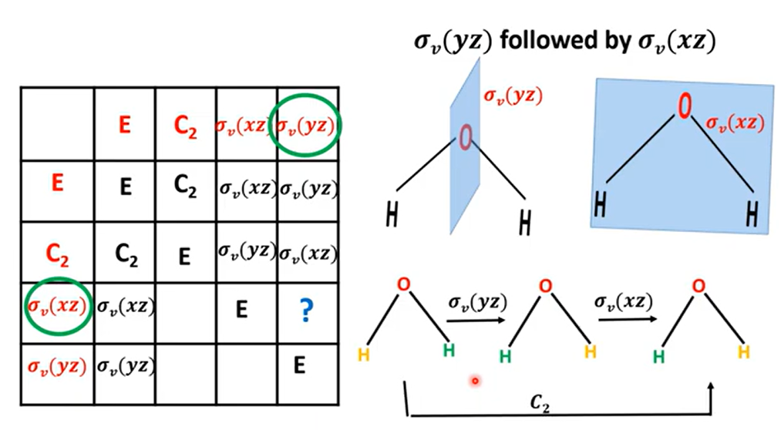

Slide 37
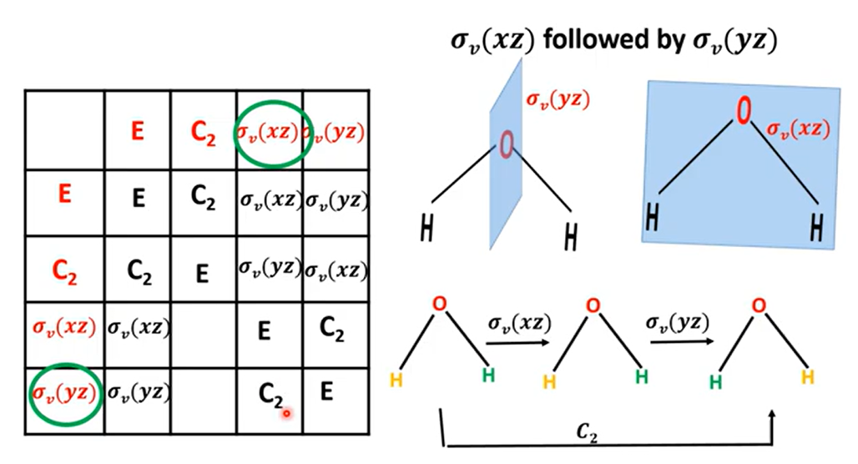

Slide 38
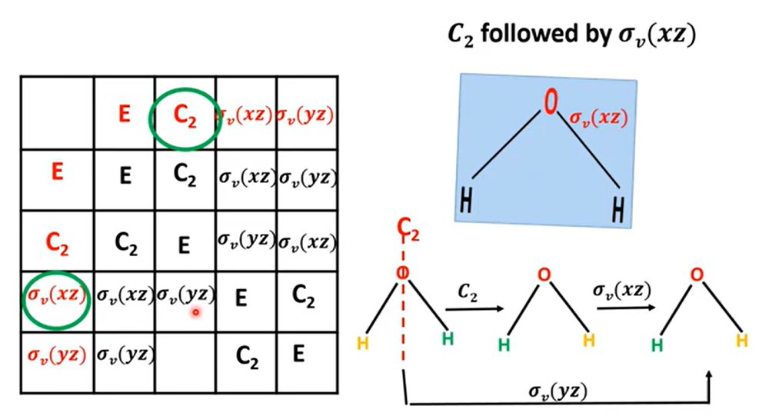

Slide 39
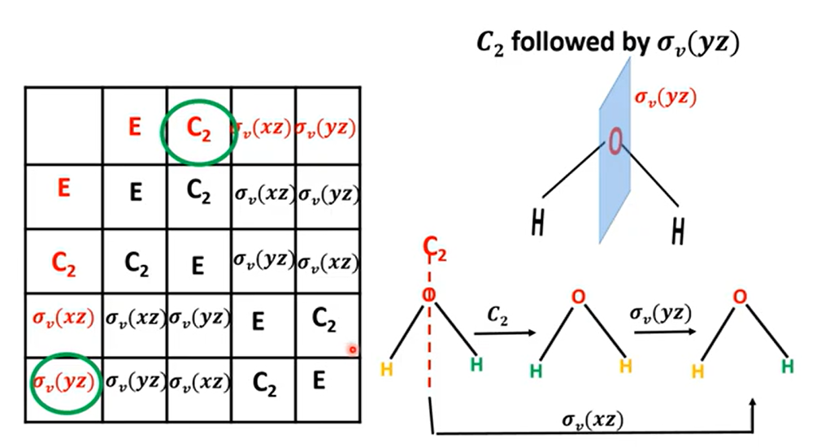

Slide 40


Slide 41


Slide 42


Slide 43


Slide 44



Slide 45



Slide 46


Slide 47





Slide 48



Representation
Symmetry operations: E, C₂, σ(xz), σ(zy)
Quantitative description of molecular symmetry by using number
1, ─1, 1, ─ 1

Slide 49



Slide 50



Slide 51



Slide 52



Slide 53



Slide 54



Slide 55


For water molecule

Slide 56

Multiplication Table

Slide 57




Slide 58





Slide 59



Slide 60


Slide 61



Find the effect of the group operations on P_{z} orbitals, and hence derive a set of numbers which represent the effect of the operation on P_{z}

Slide 62




Slide 63




Slide 64



Character Table

Slide 65



The information we have just deduced is included in the full character table e.g.:

Slide 66

Matrix

Slide 67


Matrix

Slide 68

Matrix

Slide 69


Slide 70




Symmetry Operations: Matrix Representations
The water molecule possesses C_{2v} symmetry. It has a C₂ axis through the oxygen and in the plane of the molecule, no perpendicular C₂ axes, and no horizontal mirror plane; but it does have two vertical mirror planes, as shown in the following fig. The z axis is usually chosen as the axis of highest rotational symmetry; for H₂O, this is the only rotational axis. The other axes are arbitrary. We will use the xz plane as the plane of the molecule.

Slide 71



Symmetry Operations: Matrix Representations
Fig. Symmetry Operations of the Water Molecule

Slide 72

Symmetry Operations: Matrix Representations
Fig. Symmetry Operations of the Water Molecule

Slide 73

Symmetry Operations: Matrix Representations
Fig. Symmetry Operations of the Water Molecule

Slide 74





Prove that, C₂ x σ_{v}(xz) = σ_{v}(yz) through matrix representation
We know
and

Slide 75


Symmetry Operations: Matrix Representations
Characters
Fig. Symmetry Operations of the Water Molecule
Characters
This set of characters also forms a representation, a shorthand version of the matrix representation. This representation is called a reducible representation. Reducible representations are frequently designated with a capital gamma (Г)

Slide 76

Reducible and Irreducible Representation
Characters

Slide 77

Reducible and Irreducible Representation
  B₁, B₂ and A₁ are Irreducible Representation
  Г is Reducible Representation

Slide 78

Character Table
A complete set of irreducible representations for a point group is called the character table for that group. The character table for each point group is unique.
Important information about the symmetry aspects of point groups is summarized in character tables.
The full set of representation is included in a table called the character table of the group

Slide 79

Character Table

Slide 80

Character Table

Slide 81



Slide 82


Slide 83



Slide 84


Reduction Formula

Slide 85



For the reducible representation 3 3 1 1
C_{2v} | E | C₂ | σ(xz) | σ(yz)
A₁ | 1 | 1 | 1 | 1
A₁ | 1 | 1 | 1 | 1
A₂ | 1 | 1 | ─1 | ─1
2A₁+A₂ | 3 | 3 | 1 | 1

Slide 86

For the reducible representation 3 3 1 1
C_{2v} | E | C₂ | σ(xz) | σ(yz)
A₁ | 1 | 1 | 1 | 1
A₁ | 1 | 1 | 1 | 1
A₂ | 1 | 1 | ─1 | ─1
2A₁+A₂ | 3 | 3 | 1 | 1

Slide 87



For the reducible representation 3 3 1 1
For the B₁ representation, the values of χ_{I} are 1, ─ 1, 1, ─ 1
For the B₂ representation, the values of χ_{I} are 1, ─ 1, ─ 1 , 1,

Slide 88


Slide 89

Representation Flowchart of H₂O(C_{2v})
Symmetry Element of H₂O = E, C₂, σ_{v}(xz), σ_{v}(yz),

Slide 90

Representation Flowchart of H₂O(C_{2v})

Slide 91

Representation Flowchart of H₂O(C_{2v})
Symmetry Element of H₂O = E, C₂, σ_{v}(xz), σ_{v}(yz),

Slide 92





For C_{3v} point group
Order, h = 1+2+3= 6

Slide 93


For C_{3v} point group
Order, h = 1+2+3= 6

Slide 94


For C_{2v} point group

Slide 95



Reduce the following reducible representations

Slide 96


Slide 97


Slide 98

Matrix

Slide 99


a turn rotation = 360º rotation = C₁
1/2 turn rotation = 180º rotation =C₂
1/4 turn rotation = 90º rotation = C₄

Slide 100


Matrix

Slide 101


Matrix

Slide 102




Matrix

Slide 103

Matrix

Slide 104


Slide 105


Matrix
X₃ and Y₃ are reversed and contribute ─1
Z₃ is unaffected and contributes + 1

Slide 106

Matrix

Slide 107




Slide 108



