Slide 1
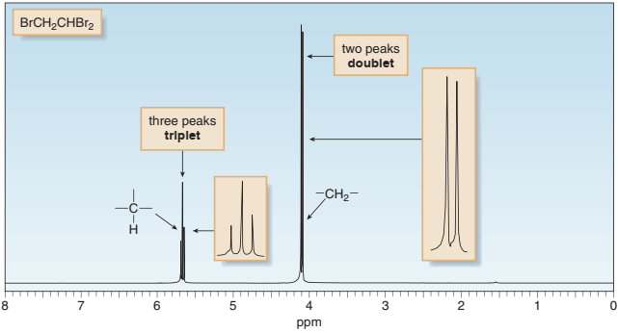
Advanced
Organic Chemistry
Chapter 1
¹H NMR Spectroscopy

Slide 2
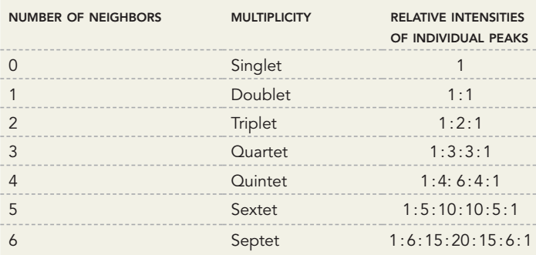
Multiplicity Indicates The Number of
Neighboring Protons

Slide 3
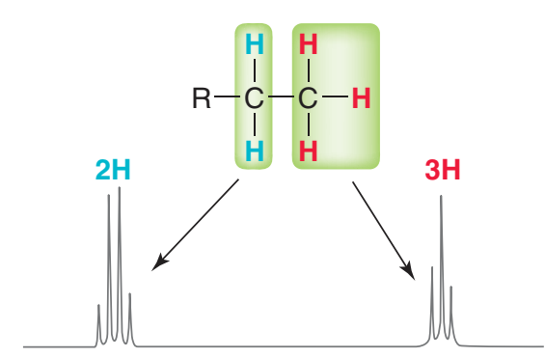
The Characteristic Splitting Pattern for an isolated ethyl group
isolated means that the CH₂ protons are only being split by the CH₃ protons

Slide 4
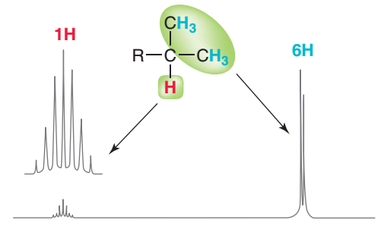
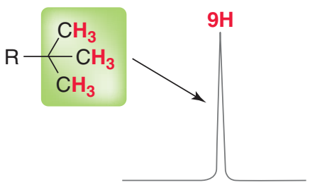
The Characteristic Splitting Pattern
The characteristic splitting
pattern for a tert-butyl group.
The characteristic splitting pattern for an isolated isopropyl group.

Slide 5
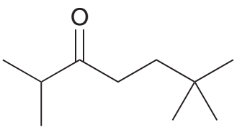
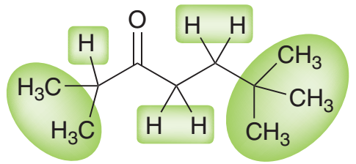
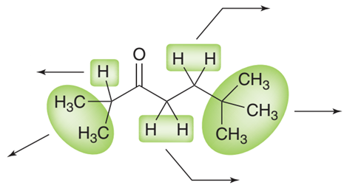
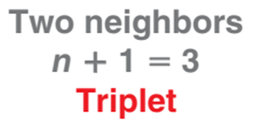
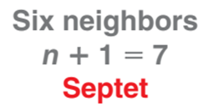
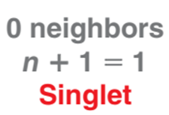
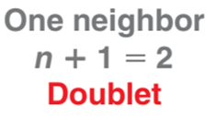
¹H NMR: Spin-Spin Splitting
No proton

Slide 6

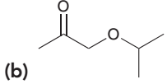
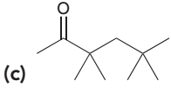
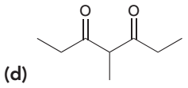

Practice Problem
1. For each of the following compounds, determine the multiplicity of each signal in the expected ¹H NMR spectrum:
(e)

Slide 7
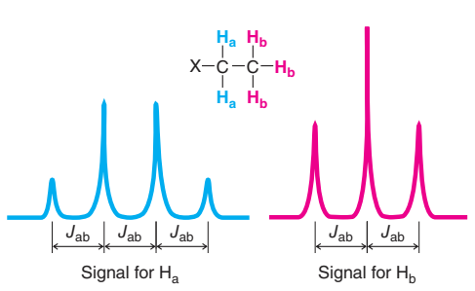
Coupling Constant
When signal splitting occurs, the distance between the individual peaks of a signal is called the coupling constant, or J value, and is measured in hertz.
The coupling constant (J_{ab}) is the same for both signals because these signals are splitting each other.

Slide 8
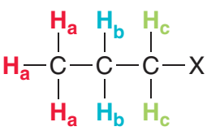
Complex Splitting
Complex splitting occurs when a proton has two different kinds of neighboring protons.
CH₃‒CH₂‒CH₂‒X
Here H_{b} proton has CH₃ protons on one side and CH₂ protons on the other side.
The appearance of the signal will depend greatly on the J values.

Slide 9
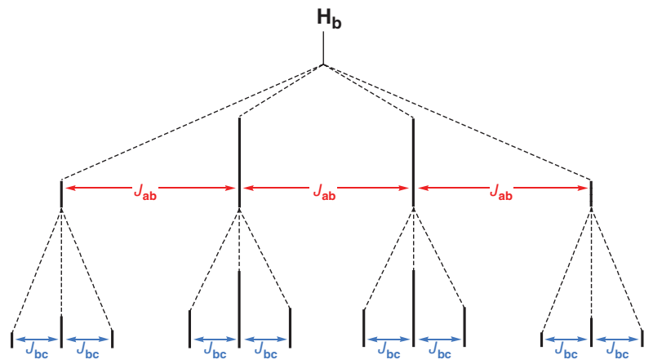
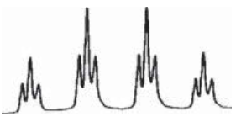
Complex Splitting: CH₃‒CH₂‒CH₂‒X
a
b
c
(When J_{ab} is much greater than J_{bc})
The signal for H_{b} is being split into a quartet because of the nearby H_{a} protons, and then it is being split into a triplet because of the nearby H_{c} protons. The signal will be comprised of 12 peaks.
H_{b}
J_{ab}
J_{ab}
J_{ab}
A quartet of triplets

Slide 10
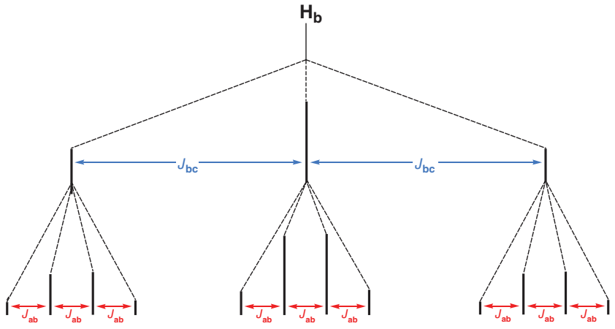
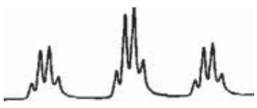
Complex Splitting: CH₃‒CH₂‒CH₂‒X
a
b
c
(When J_{bc} is much greater than J_{ab})
The signal for H_{b} is first split into a triplet, and then then it is being split into a quartet. So, the signal will appear as a triplet of quartets.
H_{b}
J_{bc}
J_{bc}
A triplet of quartets

Slide 11
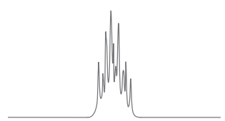
Complex Splitting: CH₃‒CH₂‒CH₂‒X
a
b
c
(When J_{bc} is similar to J_{ab})
In most cases, the J values will be fairly similar, and we will observe neither a clean quartet of triplets nor a clean triplet of quartets.
More often, several of the peaks will overlap, producing a signal that requires a more detailed analysis and is called a multiplet.
A multiplet

Slide 12
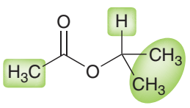
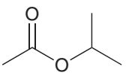
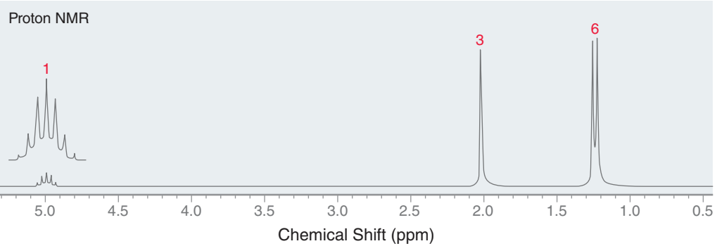
Practice Problem
Draw the expected ¹H NMR spectrum of isopropyl acetate.

Slide 13
Practice Problem
An organic compound, C₉H₁₁NO has the following spectral data:
IR: 3410, 3360, 3065, 2980, 2865, 1697, 1600, 1500 cm^{–1} and
δ_{H} = 7.72 (2H, d), 7.60 (2H, d), 4.9 (2H, s, br), 2.2 (2H, q), 1.0 (3H, t).
Deduce the structure of the compound with proper explanation.

