Slide 1
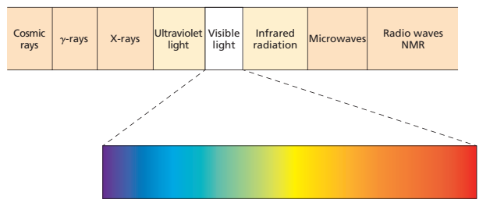
Advanced
Organic Chemistry
Chapter 1
UV-Vis Spectroscopy

Slide 2
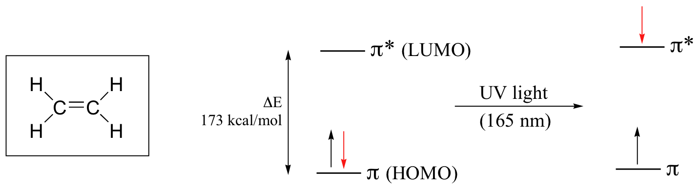
UV-Vis Spectroscopy
Since the absorption of ultraviolet or visible radiation by a molecule leads transition among electronic energy levels of the molecule, it is also often called as electronic spectroscopy.
These transitions are quantized and depend on the electronic structure of the molecule.
The most probable transitions is from the Highest Occupied Molecular Orbital (HOMO) to the Lowest Unoccupied Molecular Orbital (LUMO).

Slide 3
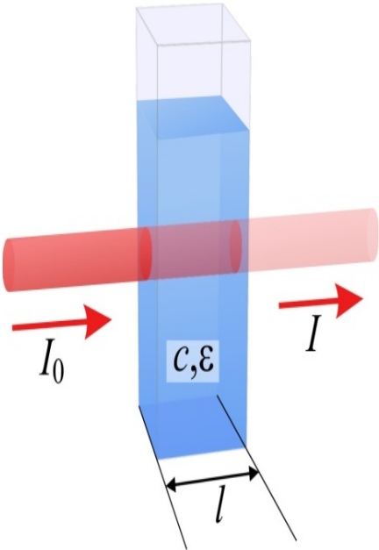

Principles of UV Absorption Spectroscopy
When electromagnetic radiations of ultraviolet and visible wavelengths are passed through the compound with multiple bonds, a portion of radiation is normally absorbed.
The amount of light absorbed by the sample is explained by the following empirical expression, known as the Beer-Lambert Law,
A = absorbance,
I₀ = intensity of incident light,
I = intensity of transmitted light ,
ε = molar absorptivity [ L mol⁻¹ cm⁻¹]
c = molar concentration of solute,
l = length of the sample cell

Slide 4
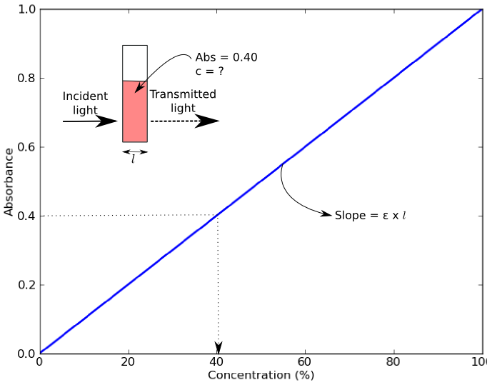
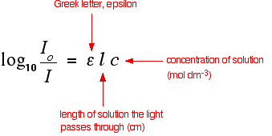
Beer-Lambert Law
Beer-Lambert Law states that the fraction of incident radiation absorbed is proportional to the number of absorbing molecules in its path.
That means, the absorbance of light is directly proportional to the thickness of the media through which the light is being transmitted multiplied by the concentration of absorbing chromophore.

Slide 5
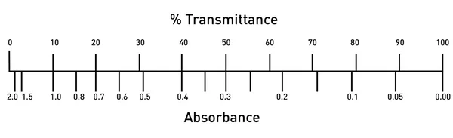
Absorbance and Transmittance
The ratio of intensity of transmitted light (I) to the intensity of incident light (I₀) is known as transmittance (T = I/ I₀) .
Therefore,
- Log I / I₀ = - log T = ε c l
and Log I₀ / I = A = ε c l
or A = - log T
Abs = 0; 100% light transmitted.
Abs = 1; 10% light transmitted

Slide 6
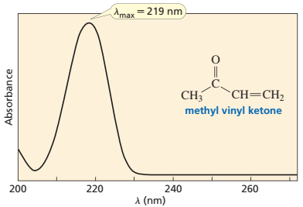
λ_{max}
λ_{max} is the wavelength of light corresponding to maximum absorption and can be read directly from the horizontal axis of the spectrum.

Slide 7

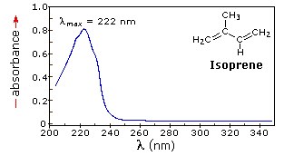
Molar Absorptivity (ε)
ε is a constant and is a characteristic of a given absorbing species (molecule or ion) in a particular solvent at a particular wavelength.
ε_{max} = 20000

Slide 8
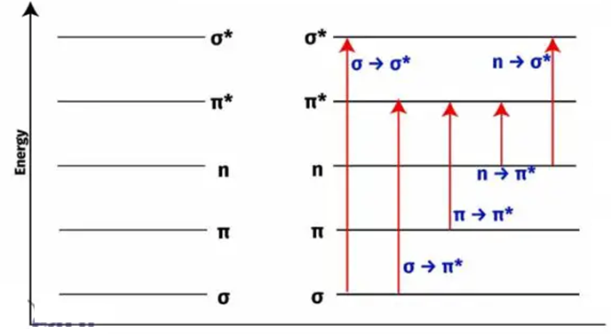
Electronic Energy Levels and Transition

Slide 9
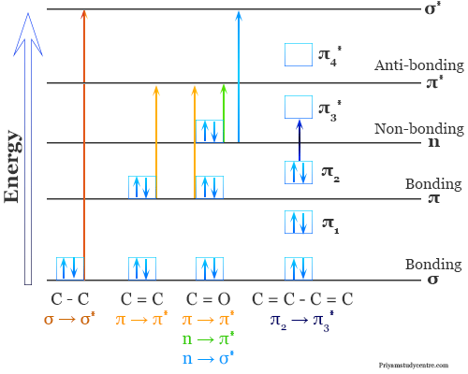
Types of Electronic Transition

Slide 10
Types of Electronic Transition
From the molecular orbital diagram it is clear that, in all compounds other than alkanes there are several possible electronic transitions that can occur with different energies.
σ
σ
π
n
n
σ∗ alkanes (∼150 nm)
π∗ carbonyls (∼170 nm)
π∗ unsaturated compounds (170-190 nm)
σ∗ halide, alcohol, amine, carbonyls etc
π∗ carbonyls (sat. aliphatic ketone
∼ 280 nm)
σ∗
π∗
Energy
n
π
σ
Energy required for various transitions obey the order: σ → σ* > n → σ* > π → π*> n → π*

Slide 11
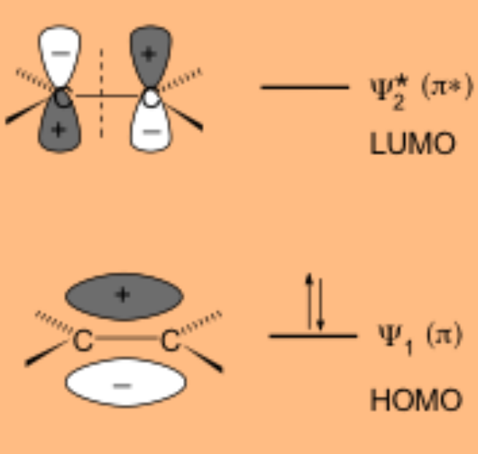
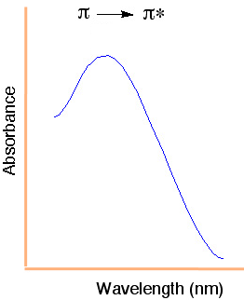
π → π* Transition
π → π* occur in 170 − 190 nm range in unconjugated alkenes.
Molar absorptivity: High [ε_{max} = 1000 − 10000]
ε_{max} is high because the π and π* orbitals are in same plane and consequently the probability of jump of an electron from π → π* orbital is very high.
343 nm

Slide 12
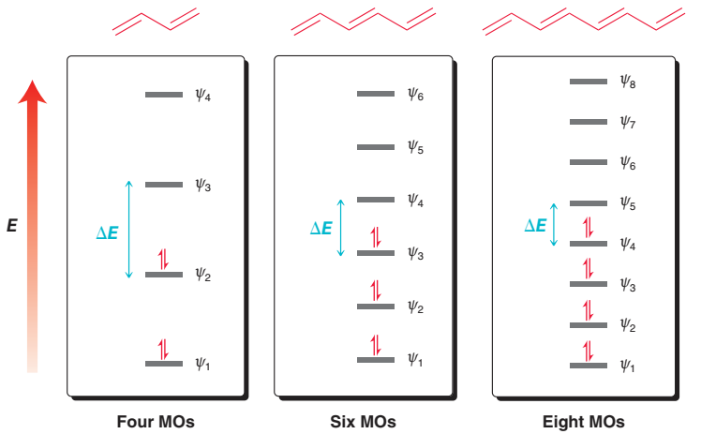
Effect of Conjugation
The value of λ_{max} for a particular compound is highly dependent on the extent of conjugation.

Slide 13


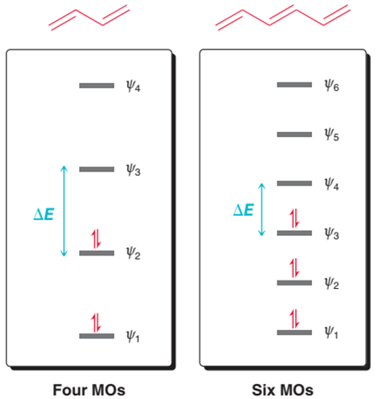
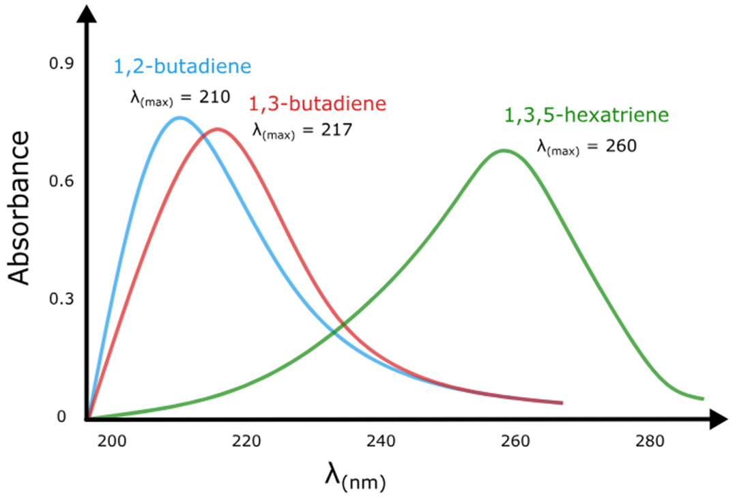
Effect of Conjugation
The effect of increasing conjugation is to shift the absorption maximum to longer wavelengths.

Slide 14
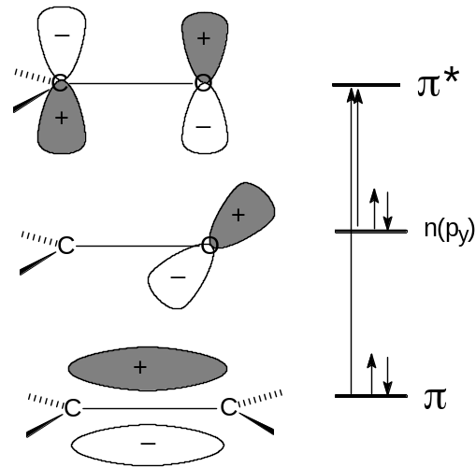
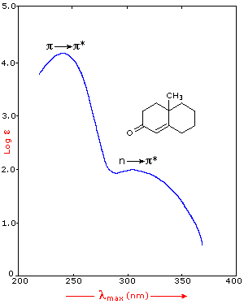
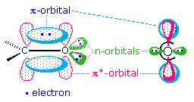
n → π* Transition
n → π* occur in 200 ̶ 700 nm range.
Molar absorptivity: Low [ε_{max} = 10 ̶ 100 ]
Examples:
  Compounds with double bonds involving unshared pair(s) of electrons [ C=O, C=S, N=O etc.]
n → π* transition is always less intense because the electrons in the n-orbitals are situated perpendicular to the plane of π bond and hence to the plane of π* orbital.

Slide 15
Designation of UV bands
The absorption bands in the UV - Visible spectrum may be designated either by using electronic transitions [σ → σ*, σ → π*, π → π*, n → π*, n → σ*] or the letter designation as given below.
R – bands:
The bands due to n→ π* transitions of single chromophoric groups are referred to as the R – Bands.
Example: Carbonyl group, Nitro group
Shows low molar absorptivity (ε_{max}<100) and hypsochromic shift with an increase in solvent polarity.
K – bands:
The bands due to π→ π* transitions in molecules containing conjugated π systems are referred to as the K – Bands.
Example: Butadiene, mesityl oxide
They show high molar absorptivity (ε_{max}<10,000).

Slide 16
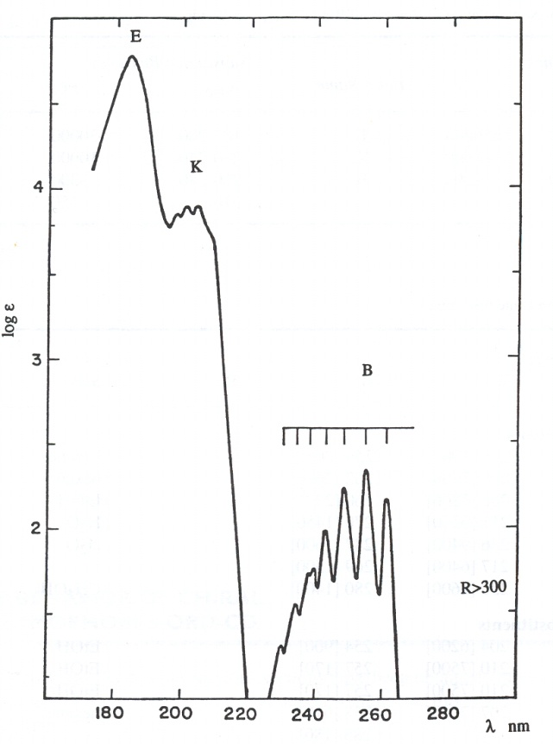
Designation of UV bands
B and E – bands:
The B and E bands are characteristic of the spectra of aromatic or heteroaromatic molecules.
All benzenoid compounds exhibit E and B bands representing π → π* transitions.
In benzene, E₁ and E₂ bands occur near 180 nm and 200 nm respectively and their molar absorptivity varies between (ε_{max} = 2000 to ε_{max} = 14000).
The B-band occurs in the region from 250 nm to 255 nm as a broad band containing multiple fine structure and represents a symmetry-forbidden transition which has finite but low probability due to forbidden transitions in high symmetrical benzene molecule.
The vibrational fine structure appears only in the B-band and disappears frequently in the more polar solvents.

Slide 17
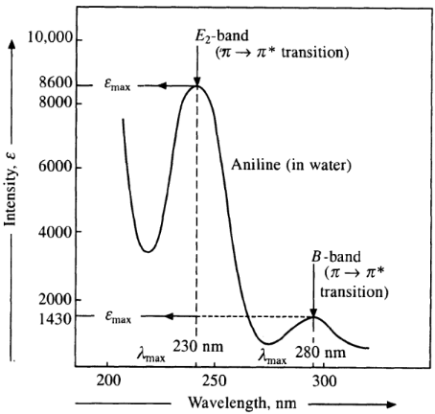
B and E – Bands of Aniline

