Slide 1
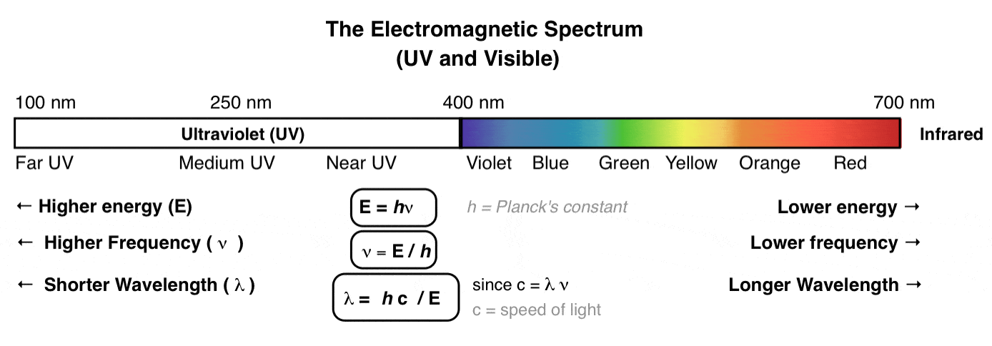
Advanced
Organic Chemistry
Chapter 1
UV-Vis Spectroscopy

Slide 2
Chromophore
A chromophore is the part (unsaturated group) of a molecule that is responsible for electronic absorption and thus imparts color to the molecule.
Chromophore | Excitation | λ_{max} (nm) | ε | Solvent
C=C | π → π* | 171 | 15,000 | hexane
C≡C | π → π* | 180 | 10,000 | hexane
C=O | n → π* π → π* | 290 180 | 15 10,000 | hexane hexane
N=O | n → π* π → π* | 275 200 | 17 5,000 | ethanol ethanol

Slide 3
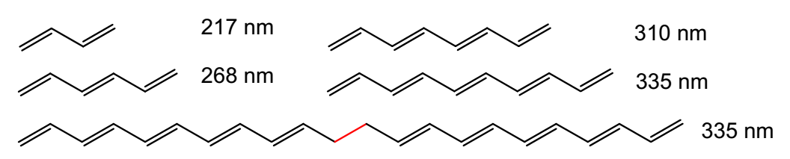

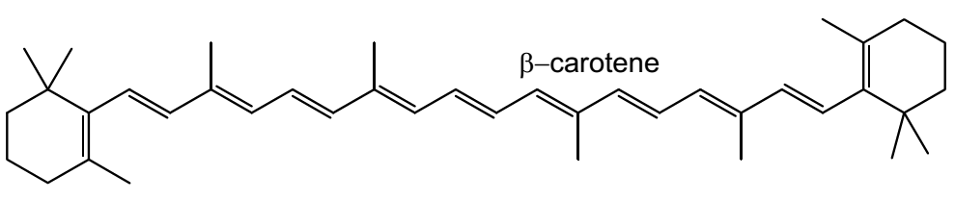
Chromophore
A compound with absorption at 335 nm would still be colorless, since it is in the UV region (not observed by our eyes).
If we continue to increase the number of conjugated C=C bonds, then eventually we reach a point where the compound will absorb visible light (β-carotene ~475 nm).

Slide 4
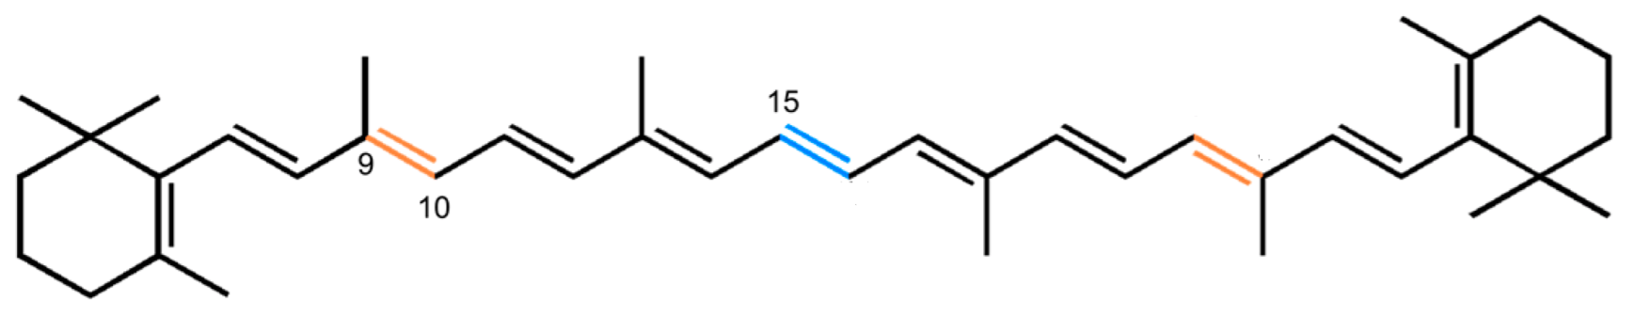
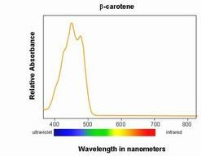
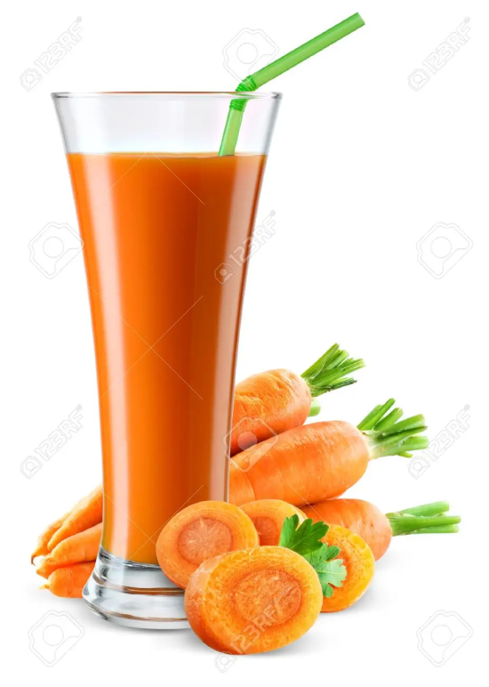
β-Carotene

Slide 5
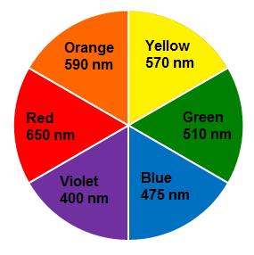

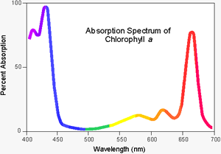
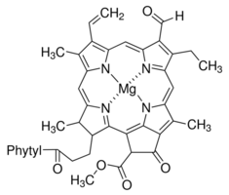
Why Chlorophyll is Green?
The UV absorption spectrum of chlorophyll is shown on the right.
Notice it absorbs mostly blue (450 nm) and red (650 nm).
In the absence of blue and red the transmitted radiation appears green.

Slide 6
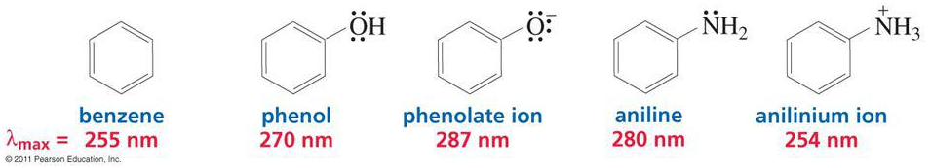
Auxochromes
The substituents that themselves do not absorb ultraviolet radiations but their presence shifts the absorption maximum to longer wavelength are called auxochromes.
Examples: NH₂, NHR and NR₂, OH and OR groups.
Properties of an auxochromic group:
Provides additional opportunity for charge delocalization and thus provides smaller energy increments for transition to excited states.
The auxochromic groups have at least one pair of non-bonding electrons (lone pair) that can interact with the π electrons and stabilizes the π* state .

Slide 7
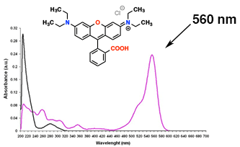
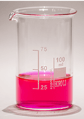
Chromophore and Auxochromes

Slide 8
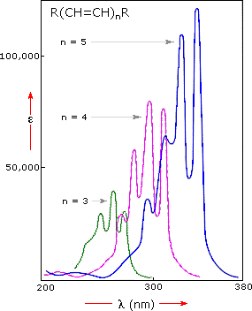
Bathochromic Shift (Red Shift)
Shift of an absorption maximum to longer wavelength is called bathochromic shift (red shift).
Red shift occurs
due to extension of conjugation.
due to change of medium (π → π* transitions undergo bathochromic shift with an increase in the polarity of the solvent).
when an auxochrome is attached to a carbon-carbon double bond (C=C).

Slide 9
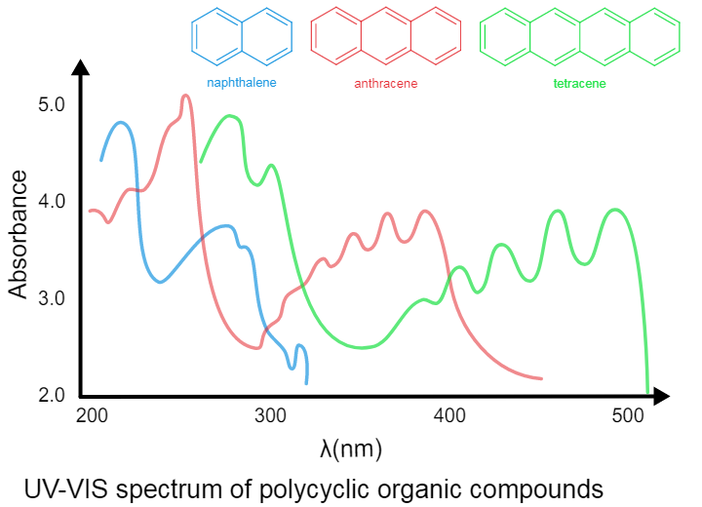
Bathochromic Shift (Red Shift)
(due to extension of conjugation)

Slide 10
Hypsochromic Shift (Blue Shift)
Shift of absorption maximum to shorter wavelength is known as hypsochromic shift (blue shift).
Blue shift occurs:
due to change of medium (n → π* transitions undergo hypsochromic shift with an increase in the polarity of solvent)
when an auxochrome is attached to double bonds where n electrons (eg: C=O) are available.

Slide 11
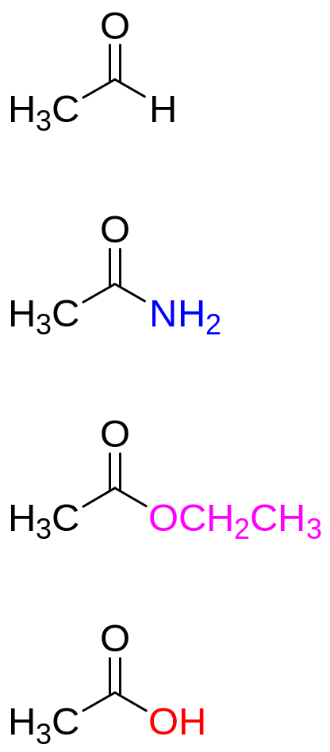
For auxochromic substitution on the carbonyl compound, hypsochromic (blue) shifts are observed for the n → π* transition
λ_{max}
In this case, when the carbonyl group is substituted by an auxochrome, the π* orbital is raised, but the n level of the lone pair is left largely unaltered. So the n → π* transition is shifted to shorter wavelength (200-220 nm) range
It is important to note this is different from the auxochromic effect on π → π* which extends conjugation and causes a bathochromic shift
293 nm
220 nm
207 nm
204 nm
Blue Shift

Slide 12
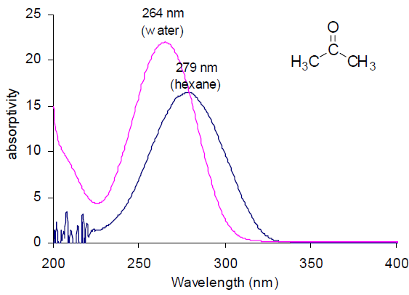
The n → π* transitions undergo hypsochromic shift (blue shift) with an increase in the polarity of solvent
Blue Shift
UV-spectra of acetone in hexane and in water

Slide 13
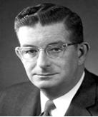

Woodward–Fieser Rules
Robert Burns Woodward
Louis Frederick Fieser
In 1945 Robert Burns Woodward gave certain rules for correlating λ_{max} with molecular structure.
In 1959 Louis Frederick Fieser modified these rules with more experimental data, and the modified rule is known as Woodward-Fieser Rules.
It is used to calculate the position and λ_{max} for a given structure by relating the position and degree of substitution of chromophore.

Slide 14

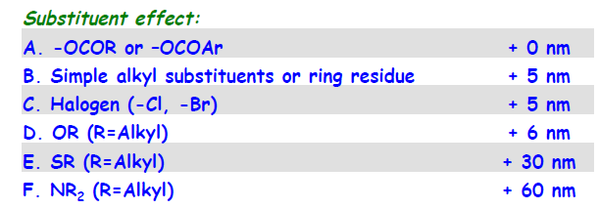
Woodward–Fieser Rules for Diene
Woodward (1941) predicted λ_{max} values only for the energy transition (π →π*) from HOMO to LUMO.
Base value for an unsubstituted, conjugated, acyclic or heteroannular diene
= 214 nm
Base value for an unsubstituted, conjugated, homoannular diene
= 253 nm

Slide 15
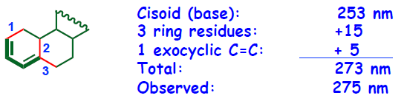
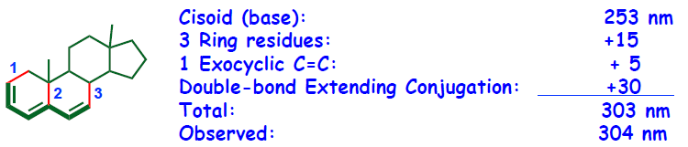
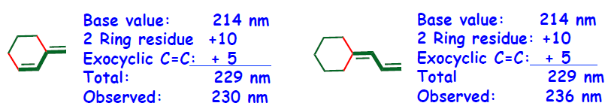
Woodward–Fieser Rules for Diene

Slide 16
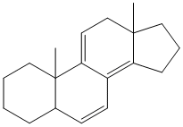
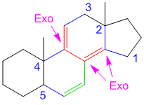
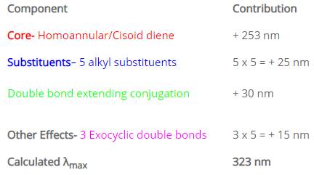
Sample Problem

Slide 17
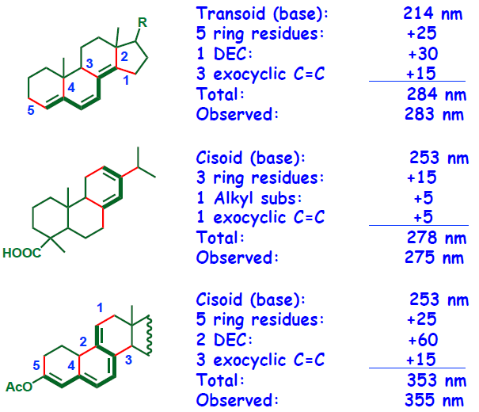
Woodward–Fieser Rules for Diene

Slide 18
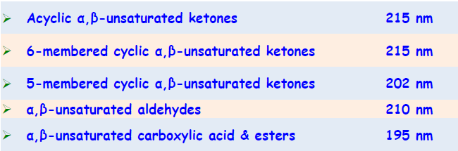
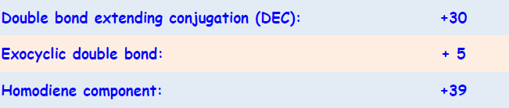
Woodward-Fieser Rule for Enones
Base Value
Increment for

Slide 19
