Slide 1
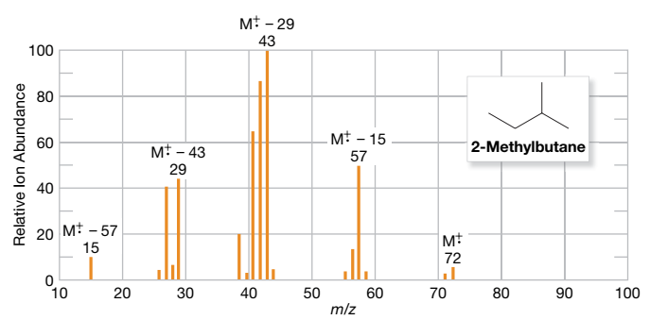
Advanced
Organic Chemistry
Chapter 1
Mass Spectrometry

Slide 2
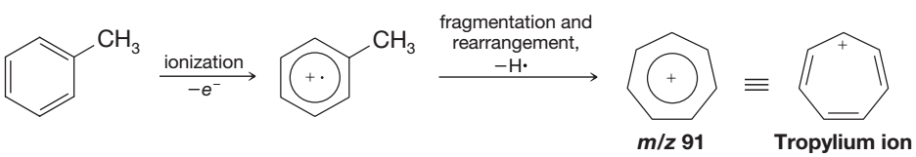
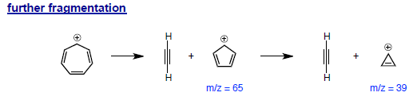
Mass Spectra of Aromatic Hydrocarbon
Alkyl-substituted benzenes ionize by loss of a π electron and undergo loss of a hydrogen atom or methyl group to yield the relatively stable tropylium ion at m/z 91:

Slide 3
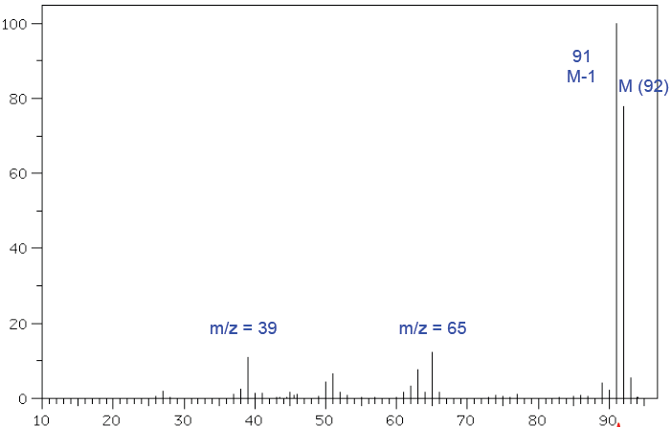


Mass Spectra of Toluene
Base peak
Relative Ion Abundance
m/z

Slide 4
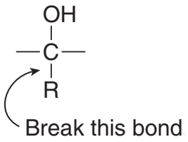
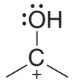


Mass Spectra of Alcohol
Alcohols undergo fragmentation in two different ways — α cleavage and dehydration.
Alpha (α) cleavage occurs by breaking a bond between an alkyl group and the carbon that bears the OH group, resulting in an alkyl radical and a resonance-stabilized carbocation.
α cleavage
Molecular ion
m/z

Slide 5
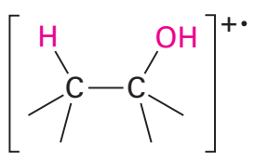

Mass Spectra of Alcohol
Alcohols undergo fragmentation in two different ways — α cleavage and dehydration.
Alcohols undergo dehydration, the elimination of H₂O, from two adjacent atoms.
Dehydration results in the cleavage of two bonds and forms H₂O and alkene radical cation.
dehydration
Molecular ion
m/z

Slide 6
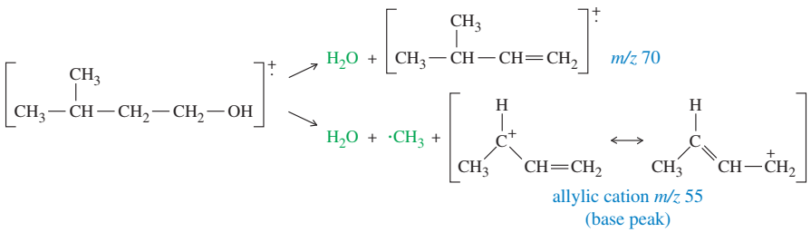
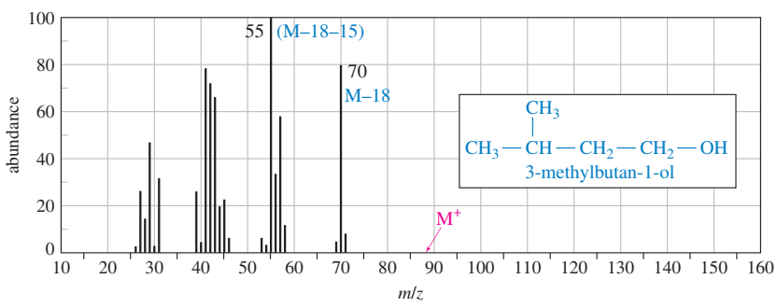
Mass Spectra of Alcohol

Slide 7
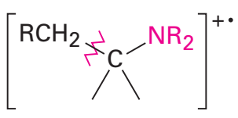
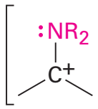
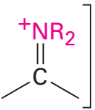

Mass Spectra of Amines
Aliphatic amines undergo a characteristic a cleavage in the mass spectrometer, similar to that observed for alcohols.
A C‒C bond nearest the nitrogen atom is broken, yielding an alkyl radical and a resonance-stabilized, nitrogen containing cation.
α cleavage
Molecular ion
m/z

Slide 8

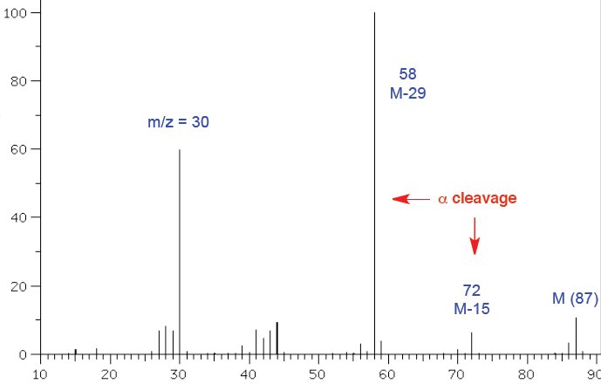
Mass Spectra of Amines
Relative Ion Abundance
m/z

Slide 9
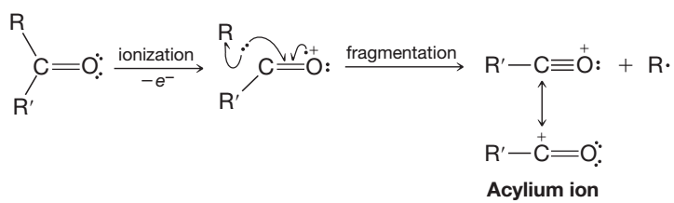
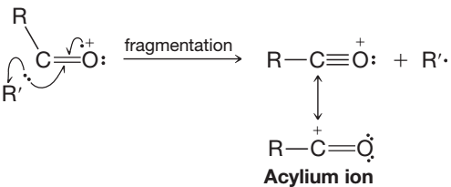
Mass Spectra of Carbonyl Compounds
Carbon–carbon bonds next to the carbonyl group of an aldehyde or ketone break readily because resonance-stabilized ions called acylium ions are produced:
or

Slide 10
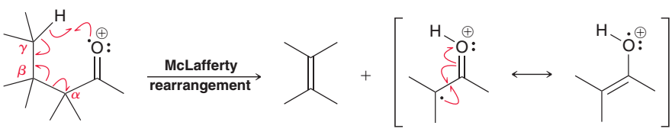
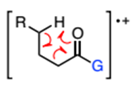
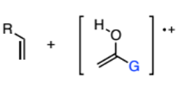


Mass Spectra of Carbonyl Compounds
Carbonyl compounds with a hydrogen on their γ carbon undergo a fragmentation called the McLafferty rearrangement.

Slide 11
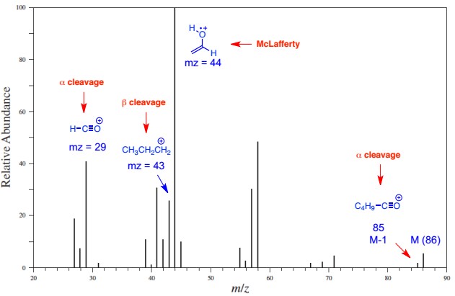

Mass Spectra of Carbonyl Compounds

Slide 12
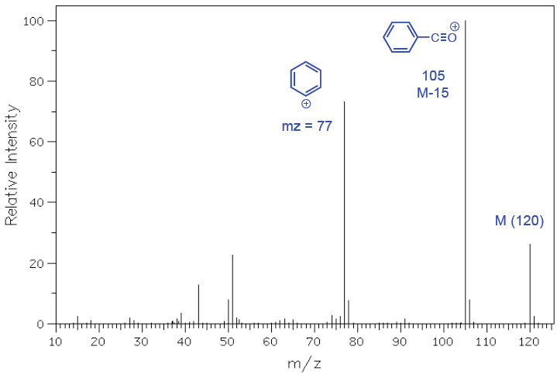
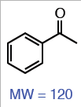
Mass Spectra of Carbonyl Compounds

Slide 13

An increasing trend in aerosol concentration has been observed in Himalayas in recent years, but the understanding of the chemical composition and sources of aerosol remains poor.
Molecular characterization of organic aerosol in Himalayas can be determined by ultra-high resolution mass spectrometry

