Slide 1
Advanced
Organic Chemistry
Chapter 2
Stereochemistry

Slide 2
Dermination of Configuration of cis-trans isomers
The configuration cis-trans isomers can be determined by
(i) Physical Methods and (ii) Chemical Methods
Chemical Methods
Absolute method
Correlative method
Mechanistic method
(not affecting the configuration of double bond)

Slide 3
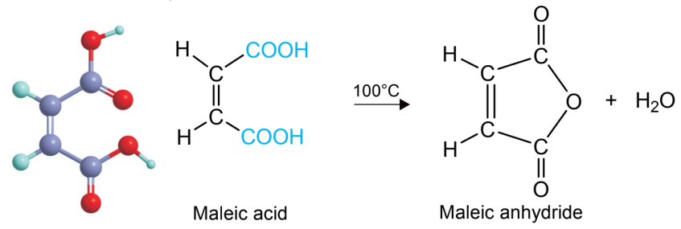
Absolute Methods for cis-trans Configuration Determination
Absolute methods rest on the fact that isomers in which functional or reactive groups are located cis to each other can sometimes be converted to cyclic lactones, anhydrides, amides, and so on, whereas the corresponding trans isomer cannot.
The maleic acid [cis-isomer] is converted, by gentle heating, into its cyclic anhydride.

Slide 4
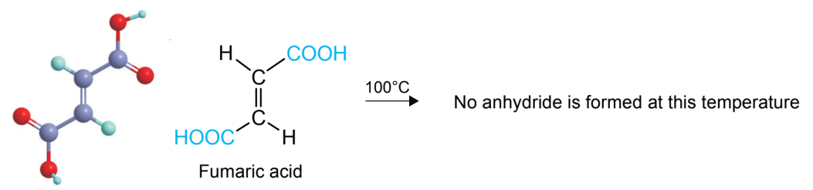
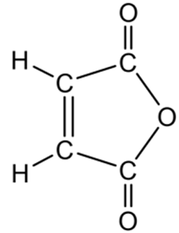
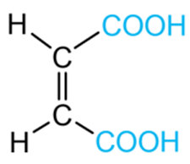
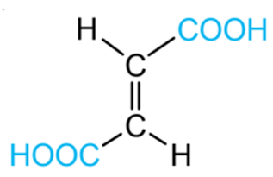
Absolute Methods for cis-trans Configuration Determination
The trans-isomer, fumaric acid can not be converted into the cyclic anhydride at 100 °C.
A very high temperature is required to convert fumaric acid to the cyclic anhydride.
100 °C
H₂O

Slide 5
Correlative Methods for cis-trans Configuration Determination
Sometimes it is possible to determine the configurations of pairs of geometrical isomers by converting them into compounds of known configurations.
There are two trichlorocrotonic acids (I) and (II), one of which can be hydrolyzed to fumaric acid. Therefore this trichlorocrotonic acid must be the trans-isomer or E-isomer (I) and consequently the other isomer is the cis-isomer or Z-isomer (II).
E-isomer
E-isomer
Z-isomer

Slide 6
Correlative Methods for cis-trans Configuration Determination
Sometimes it is possible to determine the configurations of pairs of geometrical isomers by converting them into compounds of known configurations.
There are two trichlorocrotonic acids (I) and (II), one of which can be hydrolyzed to fumaric acid. Therefore this trichlorocrotonic acid must be the trans-isomer or E-isomer (I) and consequently the other isomer is the cis-isomer or Z-isomer (II).
E-isomer
E-isomer
Z-isomer

Slide 7
Correlative Methods for cis-trans Configuration Determination
E-isomer
Z-isomer
E-isomer
Z-isomer

Slide 8
Problem Solution
Q. Show configurational correlation of crotonic acid with fumaric acid
Solution:
E-isomer
E-isomer
E-isomer

Slide 9
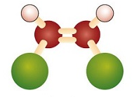
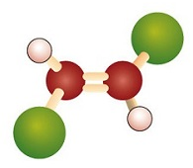
Physical Methods for cis-trans Configuration Determination
Since cis-trans isomers are diastereomers, they will generally differ in physical properties.
Physical Methods
Dipole Moments
Melting Points
UV-Vis spectra
IR spectra
NMR spectra
cis-isomer
trans-isomer

Slide 10
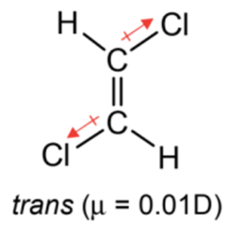
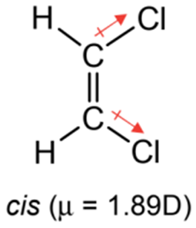
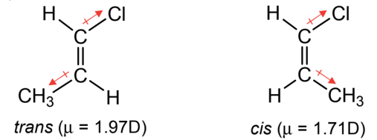
Dipole Moments
The trans isomers have normally less dipole moments than their corresponding cis isomers
However, if one substitueent is electron-donating and the other electron-withdrawing, the bond moments are fully additive in trans-isomer. In this case, trans isomers have higher dipole moments than their corresponding cis isomers

Slide 11
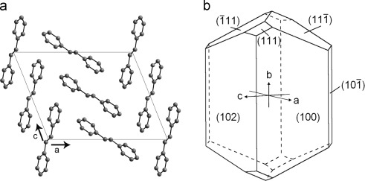
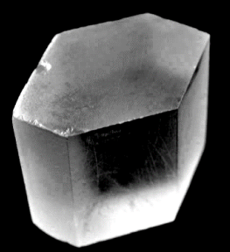
Melting Points
In general, a trans isomer has greater symmetry than the corresponding cis isomer. Thus it packs more easily in the crystal lattice and hence has a higher melting point.
trans-Stilbene
trans-Stilbene
[crystal, m.p. 123 – 125 °C]
cis-Stilbene
[liquid, b.p. 82 – 84 °C

Slide 12
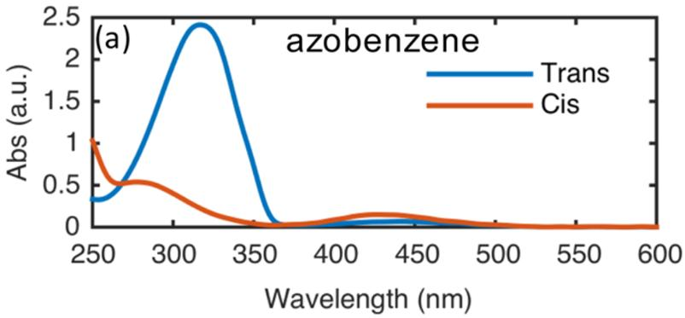
UV-Vis Spectra
Normally a trans isomer absorbs at higher wavelength than the corresponding cis isomer in UV-Vis spectroscopy.
cis-stilbene
λ_{max} = 280 nm
trans-stilbene
λ_{max} = 295 nm
Coplanarity is needed for the most effective overlap of the π - orbitals and increased ease of the π → π* transition. The cis-stilbene is forced into a nonplanar conformation due to steric effects.
trans-azobenzene
cis-azobenzene
λ_{max} = 320 nm
λ_{max} = 281 nm

Slide 13
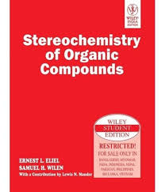
HomeWork
Interconversion of cis-trans iosmers
Stereochemistry of Organic Compounds
by
Ernest L. Eliel
Samuel H. Wilen

