Slide 1
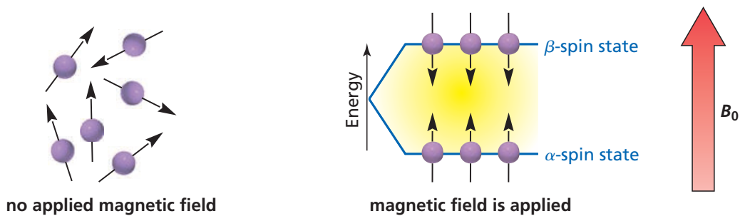
Advanced
Organic Chemistry
Chapter 1
¹H NMR Spectroscopy

Slide 2
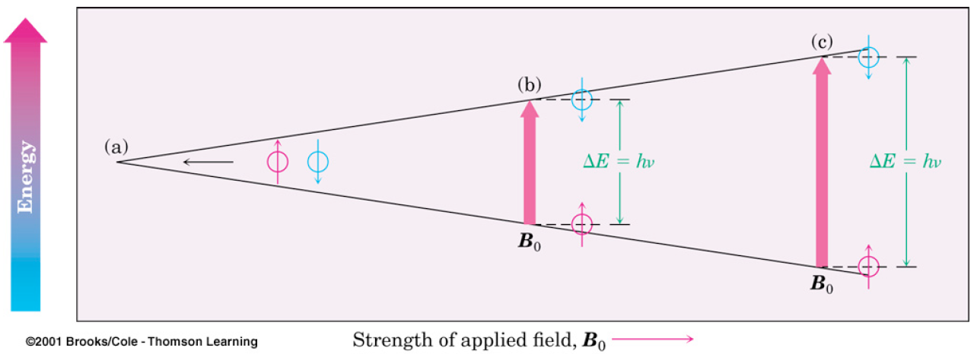
2μH₀
ΔE = 2μH₀ = hν
ν =
h
The stronger the applied magnetic field H₀, the greater the energy difference between the possible spin states, thus higher the frequency for proton resonance
A stronger magnetic field hold the nuclear magnetic dipole more tightly in its more stable state, so more energy (higher frequency) is required to flip the nucleus.

Slide 3
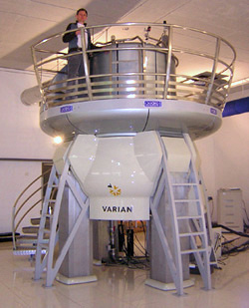
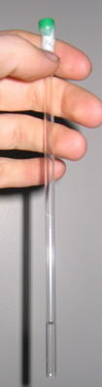
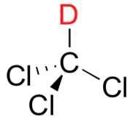
NMR Spectrometer
The most common way to obtain an NMR spectrum is to dissolve a small amount of a compound in about 0.5 mL of deuterated solvent.
A 900 MHz NMR instrument
deuterated Chloroform
(CDCl₃)
This solution in a NMR tube is then placed within a powerful magnetic field.

Slide 4
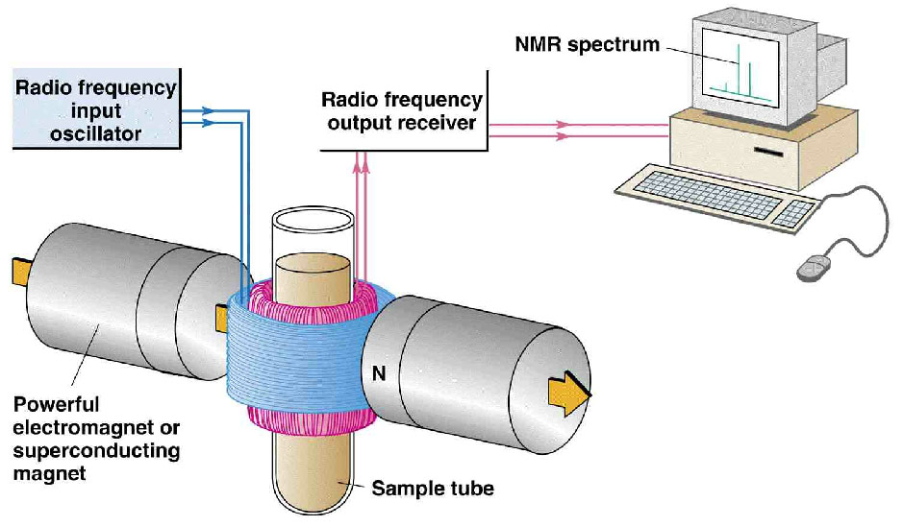
The Working of the NMR Spectrometer
The NMR spectrometer can be designed so that the radiofrequency is kept constant e.g. at 60 MHz and the magnetic field is varied.
As H₀ varies, so does ΔE.
[ΔE = 2μH₀ = hν]
When the applied magnetic field H₀ reaches the correct strength i.e. (hν/2μ), ΔE the matches the energy of the incident radiation.
At this field strength, absorption of energy from the incident radiation will take place and transition from α-spin state to β-spin state will occur.
This causes a tiny electrical current to flow in a coil surrounding the sample tube. The instrument amplifies this current which is displayed as a signal.

Slide 5
The Working of the NMR Spectrometer

Slide 6
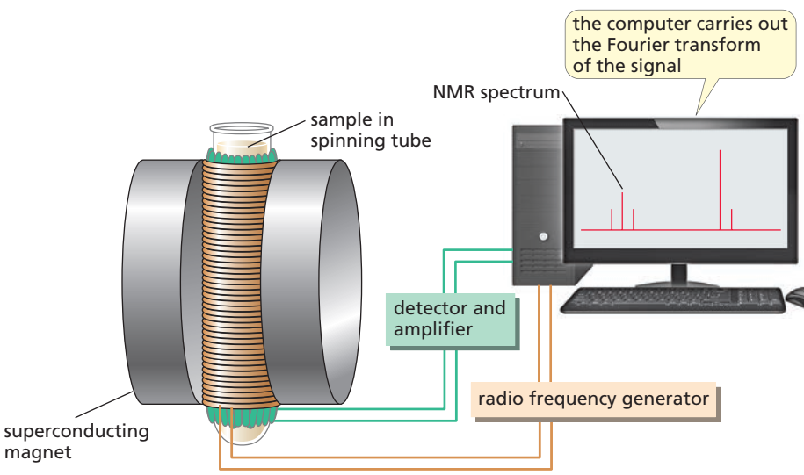
FT-NMR Spectrometer
In modern instruments called pulsed Fourier Transform (FT) spectrometers, the magnetic field is held constant and an radio frequency (rf) pulse of short duration excites all the protons simultaneously.
The rf pulse covers a range of frequencies, so each nucleus can absorb the frequency it requires to come into resonance (flip its spin) and produce a signal—called a free induction decay (FID) —at a frequency corresponding to ∆E.
A computer measures the change in intensity over time and converts it into intensity vs frequency data, in a mathematical operation known as a Fourier transform, to produce a spectrum called a Fourier transform NMR (FT–NMR) spectrum.

Slide 7
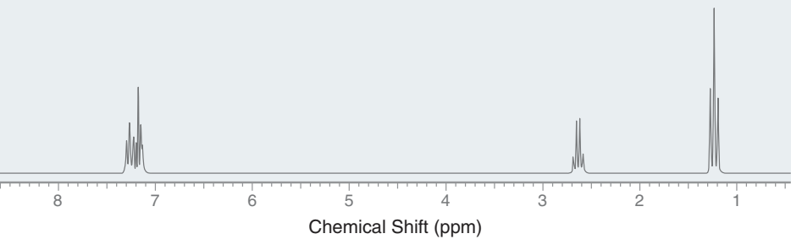
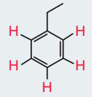
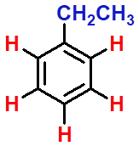
¹H NMR Spectrum
The spectrum produced by ¹H NMR spectroscopy is generally rich with information that can be interpreted to determine a molecular structure.
To Be Able to Go From This:
To This:
≡

Slide 8
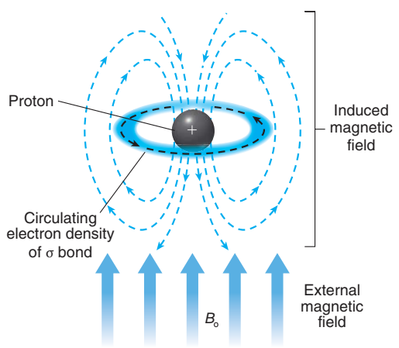
Magnetic Shielding by Electron
The frequency of an NMR signal depends on the strength of the magnetic field experienced by the nucleus.
If all the hydrogens in a compound were to experience the same magnetic field, they would all give signals of the same frequency.
If this were the case, all ¹H NMR spectra would consist of one signal, which would tell us nothing about the structure of the compound.
Luckily, this is not the case, as nuclei are surrounded by electrons.
In the presence of an external magnetic field, the electron density circulates, which produces a local (induced) magnetic field that opposes the external magnetic field.

Slide 9
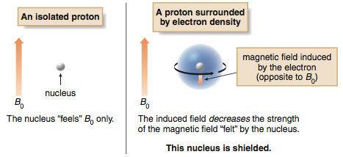
Magnetic Shielding by Electron
This effect is called local diamagnetic shielding.
The shielding varies for different hydrogens in a molecule.
So, all the hydrogens do not experience the same magnetic field.

Slide 10
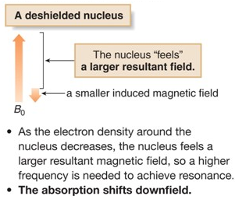
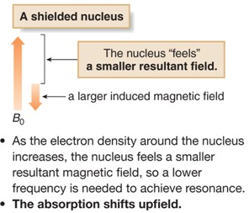
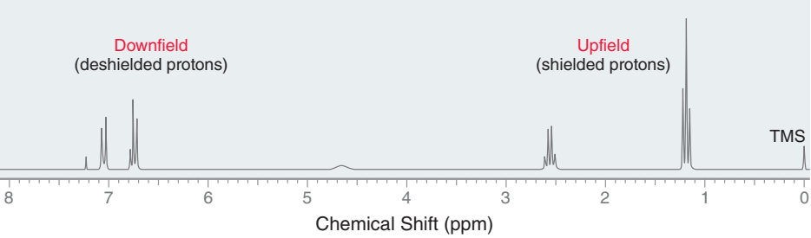
Deshielding and Shielding Effect

Slide 11
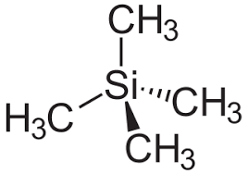
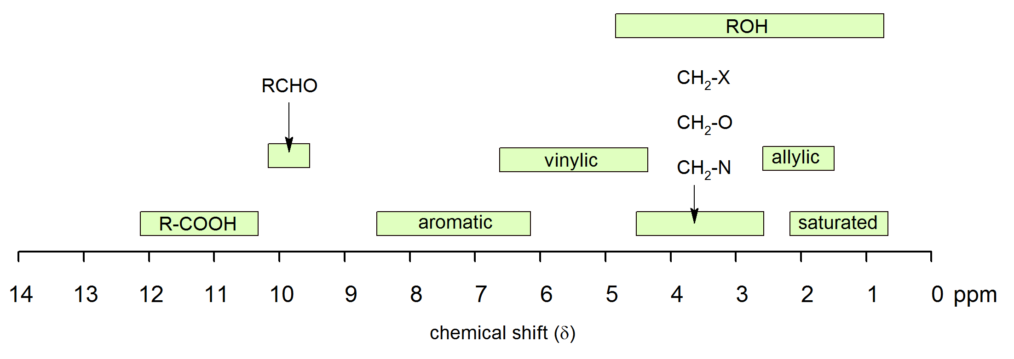
Chemical Shift (ppm)
In nuclear magnetic resonance (NMR) spectroscopy, the chemical shift is the resonant frequency of a nucleus relative to a standard (TMS) in a magnetic field.
Tetramethylsilane, (CH₃)₄Si, is the standard for ¹H NMR which is set at 0.00 ppm.

Slide 12
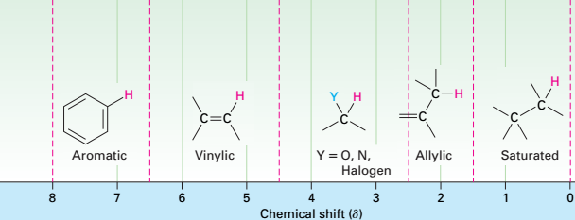
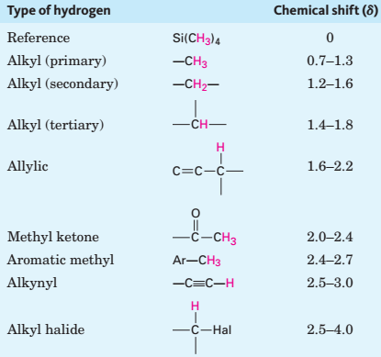
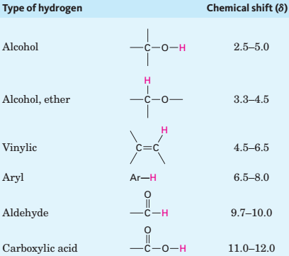
Correlation of ¹H Chemical Shift with Environment
In general, protons bonded to saturated, sp³-hybridized carbons absorb at higher fields, whereas protons bonded to sp²-hybridized carbons absorb at lower
fields.

Slide 13
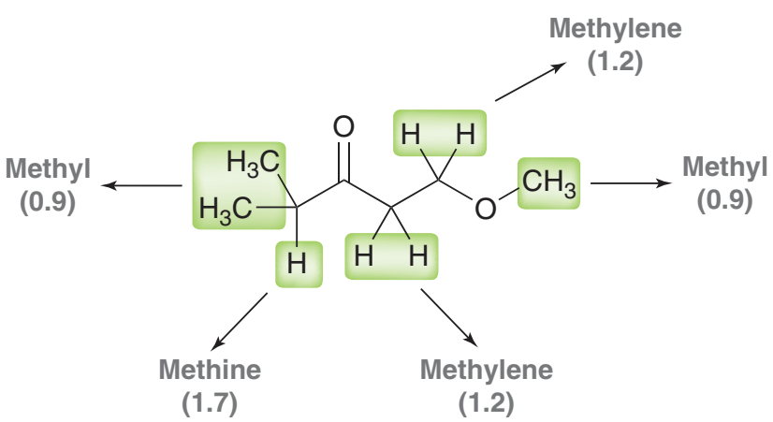
Chemical Shift (ppm)
(3.7 ppm)
(1.1 ppm)
(3.3 ppm)
(2.6 ppm)
(2.7 ppm)

