Slide 1
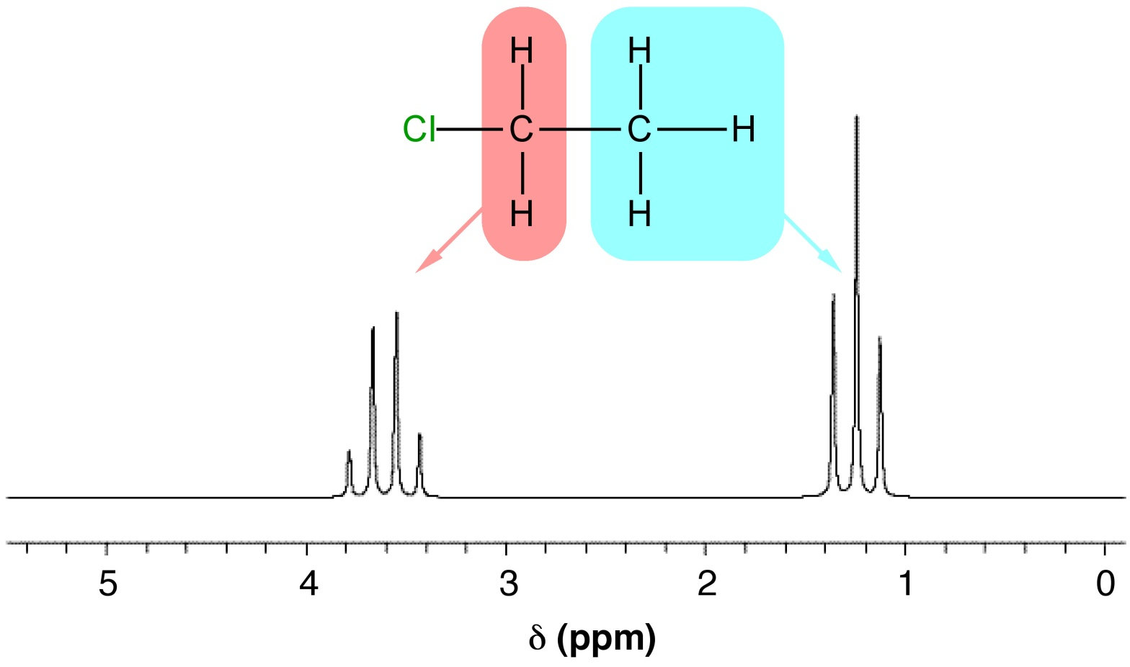
Advanced
Organic Chemistry
Chapter 1
¹H NMR Spectroscopy

Slide 2
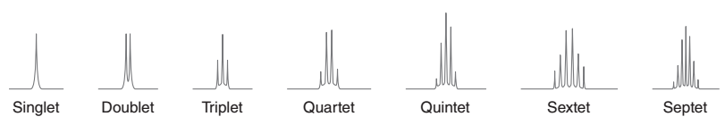
¹H NMR: Spin-Spin Splitting
Nonequivalent protons on adjacent carbons have magnetic fields that may align with or oppose the external field.
All possibilities exist, so signal is split.
If a signal is split by n equivalent protons on adjacent carbon, it is split into n + 1 peaks ⇒ n + 1 rule.
The result of spin–spin splitting, can be used to determine how many protons reside on the carbon atoms near the absorbing proton.

Slide 3
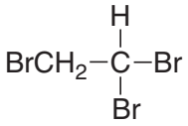
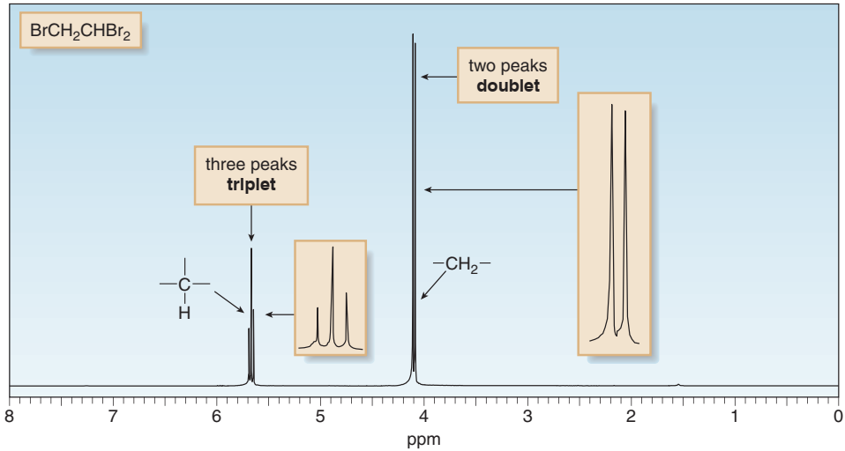
¹H NMR: Spin-Spin Splitting
The CH₂ signal appears as a doublet (1:1 ratio).
The CH signal appears as a triplet (1:2:1 ratio).

Slide 4
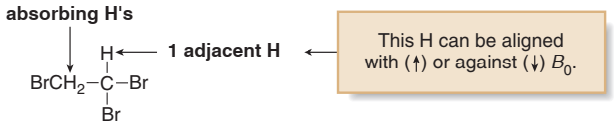
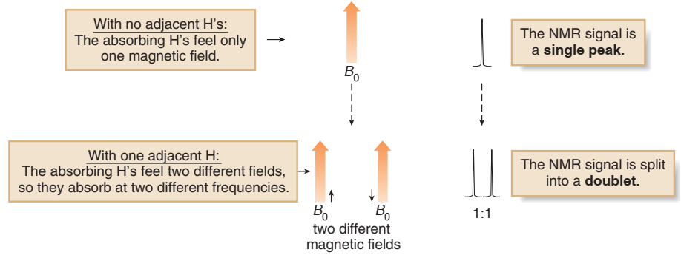
Splitting: How a Doublet Arises

Slide 5
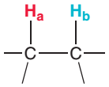

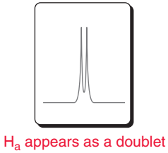
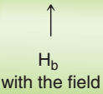
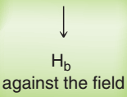
Splitting: How a Doublet Arises
If H_{a} and H_{b} are not equivalent to each other, then the presence of H_{b} splits the signal for H_{a} into a doublet.
The signal for H_{b} is also impacted by the
presence of H_{a} in the same way.
Two possible electronic environments produced by the H_{b} proton

Slide 6
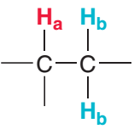
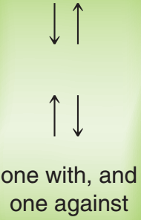
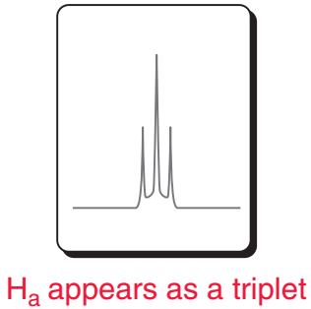

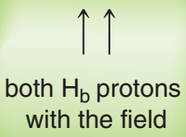
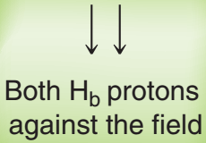
Splitting Pattern applying n+1 rule
H_{a} has two neighboring H_{b} protons.
So the signal of H_{a} is split into triplet (1:2:1 ratio)
Three possible electronic environments produced by the H_{b} proton

Slide 7
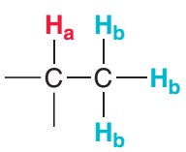


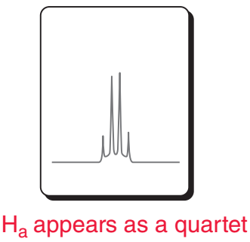



Splitting Pattern applying n+1 rule
H_{a} has three neighboring H_{b} protons.
So the signal of H_{a} is split into quartet (1:3:3:1 ratio)
Four possible electronic environments produced by the H_{b} proton

Slide 8
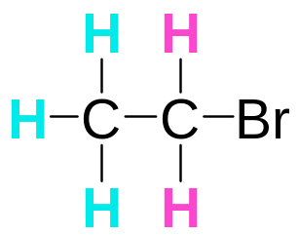
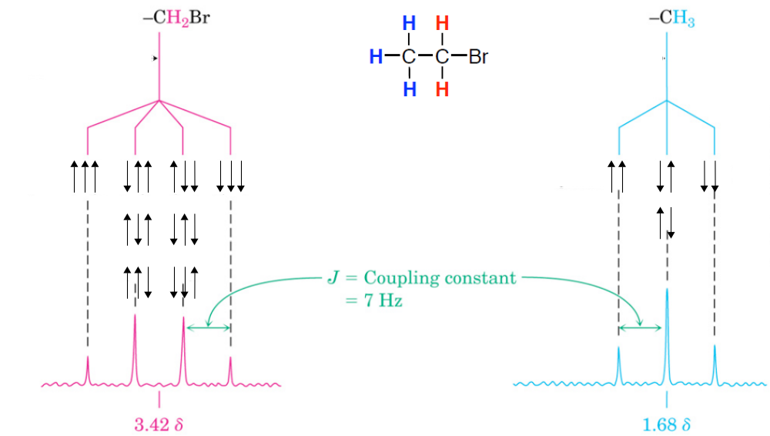

Splitting Pattern applying n+1 rule
≡
1 : 3 : 3 : 1
1 : 2 : 1

Slide 9
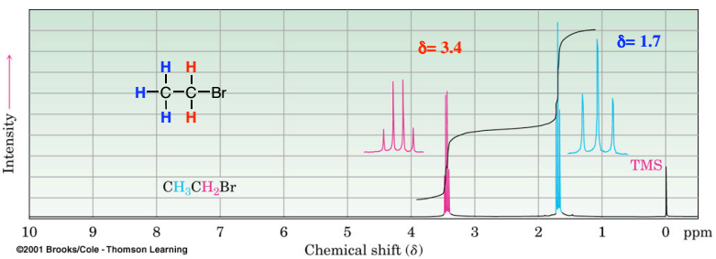
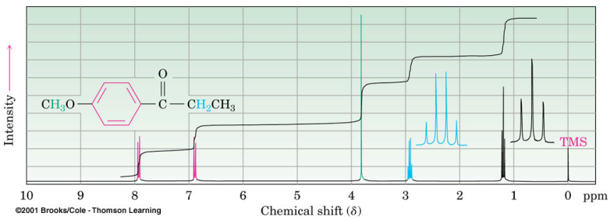
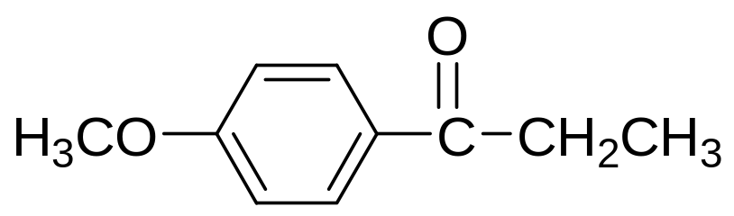
CH₃CH₂Br

