Slide 1
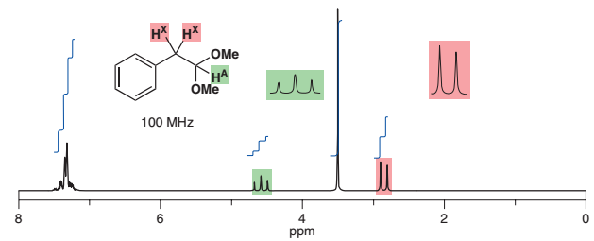
Advanced
Organic Chemistry
Chapter 1
¹H NMR Spectroscopy

Slide 2
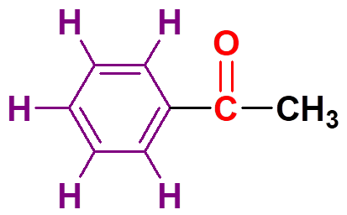
Practice Problem
Q.1: An organic compound, C₈H₈O has the following spectral data:
IR: 3080, 2850, 1690, 1600 cm^{–1} and
δ_{H} = 7.2‒7.3 (5H, m), 2.2 (3H, s).
Deduce the structure of the compound with proper explanation.
Conjugation lowers the C=O stretching frequency.
δ 2.2 (3H, s)

Slide 3
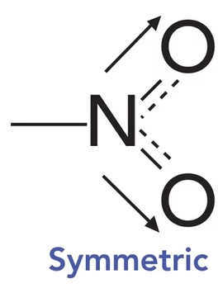
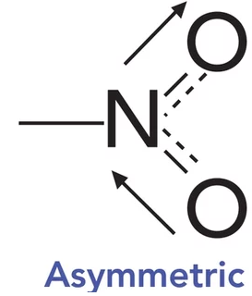
Practice Problem
Q.2: An organic compound, C₇H₇NO₂ has the following spectral data:
IR: 3072, 2980, 2860, 1600, 1525, 1364 cm^{–1} and
δ_{H} = 8.1 (2H, d), 7.3 (2H, d), 2.5 (3H, s).
Deduce the structure of the compound with proper explanation.
δ 2.5 (3H, s)
δ 7.3 (2H, d)
δ 8.1 (2H, d)
1525 cm^{–1}
1364 cm^{–1}

Slide 4
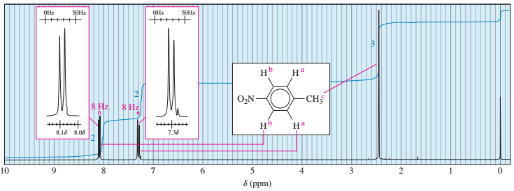
Practice Problem
Q.2: An organic compound, C₇H₇NO₂ has the following spectral data:
IR: 3072, 2980, 2860, 1600, 1525, 1364 cm^{–1} and
δ_{H} = 8.1 (2H, d), 7.3 (2H, d), 2.5 (3H, s).
Deduce the structure of the compound with proper explanation.

Slide 5
Practice Problem
Q.3: A compound with molecular formula C₅H₈O₃ gave the following spectral data:
IR: 3000 ‒ 2500 (br), 1715 (s), 1342 (w) cm^{–1} and
¹H-NMR: δ 2.12 (s, 3H), 2.25 (t, 2H), 2.60 (t, 2H), 11.1 (s, 1H).
Find the structural formula of the compound.
δ 2.12
δ 2.25
δ 11.1
δ 2.60

Slide 6
Practice Problem
Q.4: A compound with molecular formula C₄H₈O₃ gave the following spectral data:
IR: 3000 ‒ 2500 (br), 1715 (s) cm^{–1} and
¹H-NMR: δ 1.27 (t, 3H), 3.66 (q, 2H), 4.13 (s, 2H), 10.95 (s, 1H).
Find the structural formula of the compound.
δ 3.66
δ 1.27
δ 4.13
δ 10.95

Slide 7
Practice Problem
Q.5: A compound with molecular formula C₅H₁₀O shows the following spectral data:
IR: 2960, 2845, 1718, 1460, 1370 cm^{–1} and
¹H-NMR: δ 2.3 (2H, t), 2.1 (3H, s), 1.6 (2H, m), 0.9 (3H, t).
Deduce the structure of the compound with justification of the above data.
δ 2.1
δ 2.25
δ 0.9
δ 1.6

