Slide 1
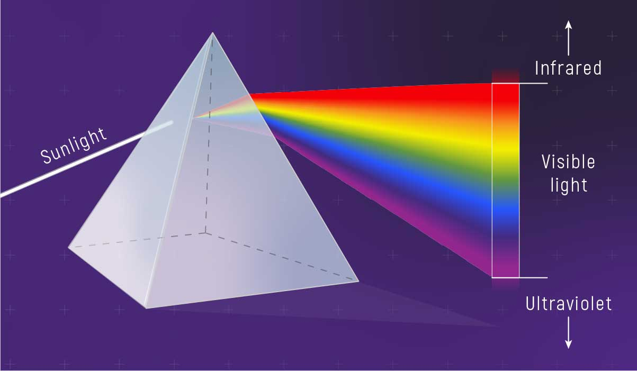
Advanced
Organic Chemistry
Chapter 1
Spectroscopy

Slide 2
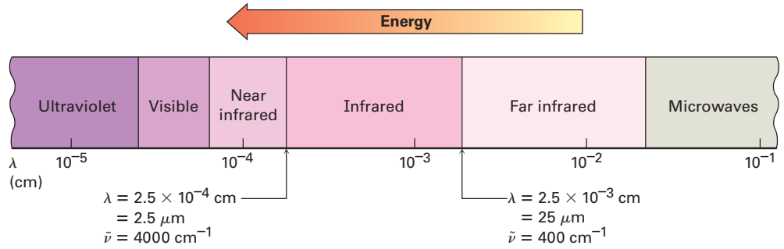
Infrared Spectroscopy
The infrared (IR) region of the electromagnetic spectrum covers the range from just above the visible (7.8 × 10^{‒5} cm) to ⁓10^{‒2} cm, but only the mid portion from 2.5 × 10^{‒4} cm to 2.5 × 10^{‒3} cm is used by organic chemists.
So, the useful IR region is from 4000 to 400 cm^{‒1}.

Slide 3
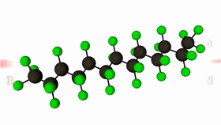
Infrared Spectroscopy
When infrared light radiations between 4000 – 400 cm⁻¹ are passed through a sample of an organic compound, some of these radiations are absorbed by the sample and are converted into energy of molecular vibrations.
When the radiant energy matches the energy of a specific molecular vibration, absorption occurs.

Slide 4
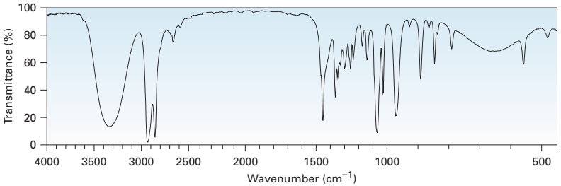
IR Absorbance Spectrum
An IR spectrometer measures the percent transmittance as a function of frequency.
The plot of % transmittance against wavenumber (cm^{‒1}) is called the infrared spectrum of the compound.
The presence of such characteristic vibrational bands in an infrared spectrum indicates the presence of specific bonds in the sample under investigation

Slide 5
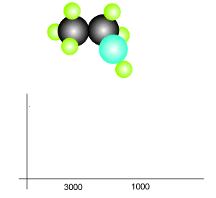
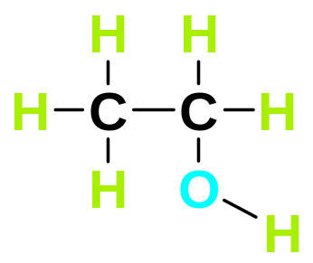
IR Absorbance Spectrum
Lets have a look at the molecular structure of ethanol and how it generates an IR spectrum.
Ethanol has a number of different types of covalent bonds, namely:
O—H
C—H
C—C
C—O
Each bond has its characteristic wavelength which it absorbs in order to stretch or bend.

Slide 6
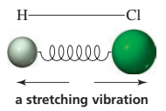
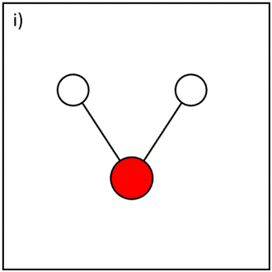
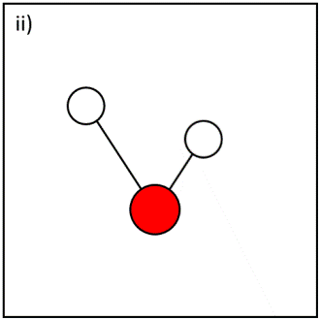

Stretching and Bending Vibration
A bond vibrates with both stretching and bending motions:
A stretch is a vibration occurring along the line of the bond; a stretching vibration changes the bond length.
A bend is a vibration that does not occur along the line of the bond; a bending vibration changes the bond angle.
A diatomic molecule such as H—Cl can undergo only a stretching vibration because it has no bond angles.
H₂O (triatomic molecule) can undergo both stretching and bending vibrations.

Slide 7
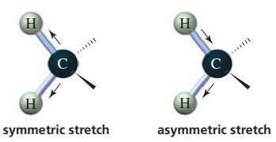
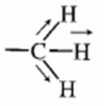
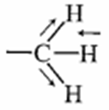
Stretching and Bending Vibration
So, the vibrations of a molecule containing three or more atoms are more complex because they include stretching and bending.
The stretching vibrations, moreover, can be symmetric or asymmetric.
Stretching Vibrations
Symmetric
Stretch.
Asymmetric
Stretch.
⁓2872 cm^{‒1}
⁓2962 cm^{‒1}

Slide 8
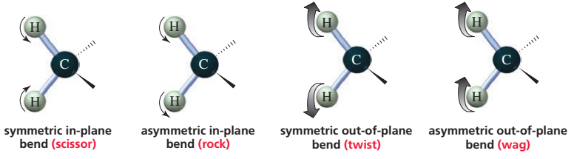
Stretching and Bending Vibration
The bending vibrations can be either in-plane or out-of-plane.
Bending vibrations are often referred to by the terms rock, scissor, wag, and twist.
Bending Vibrations

Slide 9
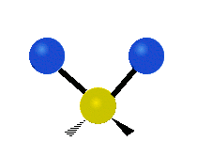
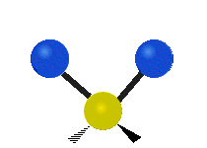



Stretching and Bending Vibration
1. Stretching Vibrations
2. Bending Vibrations
(a) Symmetric stretching
(a) In-plane bending
Scissoring
Rocking
(b) Asymmetric stretching
(b) Out-of-plane bending
Twisting
Wagging

Slide 10
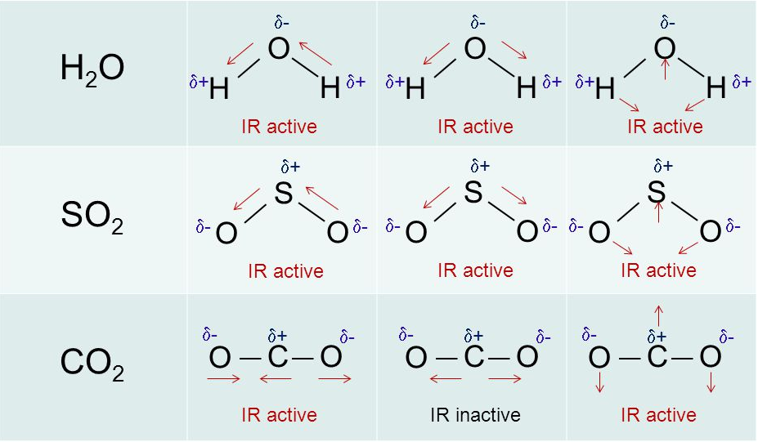
Not All Bond Vibrations are IR Active
Molecular vibrations which will lead to a change in the dipole moment of the molecule will give rise to absorption bands in the infrared.
Symmetric bonds, such as those of H₂ or Cl₂, do not absorb infrared
radiation.
Asymmetric Stretch.
Symmetric Stretch.
Bending

Slide 11
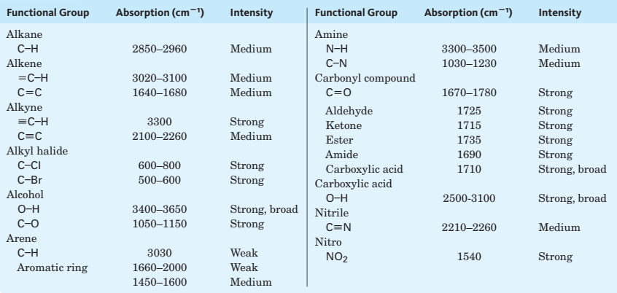

Characteristic Infrared Absorptions of Some Functional Groups

Slide 12
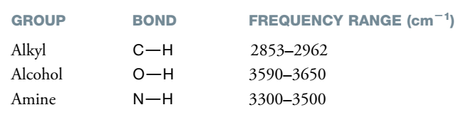
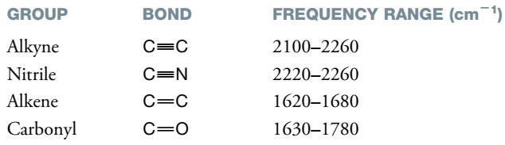
Characteristic Infrared Absorptions of Some Functional Groups
The stretching frequencies of groups such as C-H, N-H, and O-H all occur at relatively high frequencies:
The triple bonds vibrate at higher frequencies than double bonds:

Slide 13


Hooke’s Law
The stretching frequency of a bond can be approximated by Hooke’s Law. In this approximation, two atoms and the connecting bond are treated as a simple harmonic oscillator composed of 2 masses (atoms) joined by a spring:
According to Hooke’s law, the natural frequency of vibration of a bond
is given by the equation:
where
K = the force constant
μ = the reduced mass
= the wavenumber of the vibration

Slide 14
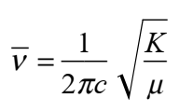


Hooke’s Law
The Hooke’s Law expression given earlier may be transformed into a very useful equation as follows:
Where
= the wavenumber of the vibration (cm^{‒1})
K = the force constant (dynes/cm)
c = the velocity of light = 3 × 10¹⁰ cm/s

Slide 15
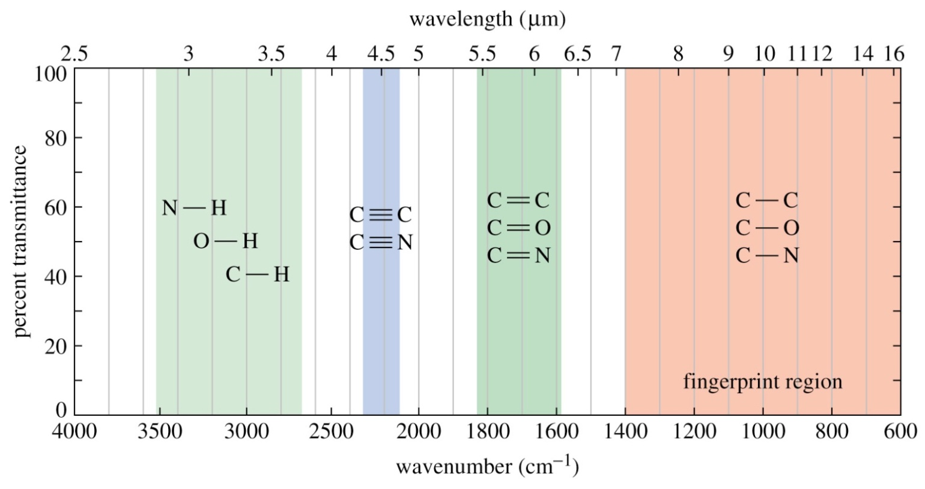
The Functional Group & Fingerprint Regions
An infrared spectrum can be divided into two areas:
The area on the left (4000‒1400 cm^{‒1}) is where most of the functional groups show absorption bands. This is called the functional group region.
The area on the right (1400‒600 cm^{‒1}) is called the fingerprint region.

Slide 16
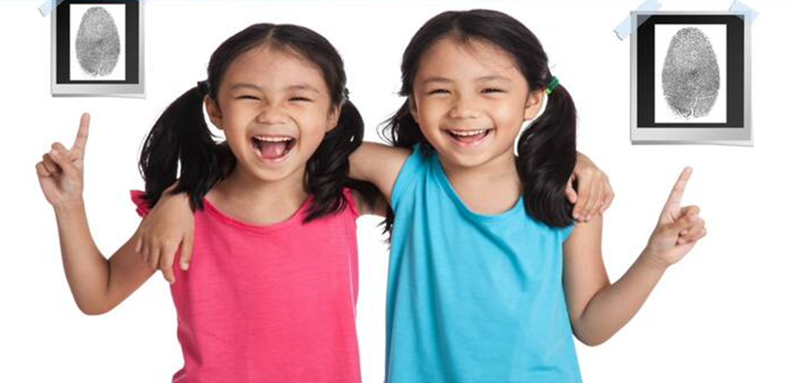
The Fingerprint Regions
The fingerprint region of IR spectrum is characteristic of the compound as a whole, just as a fingerprint is characteristic of an
individual.

Slide 17
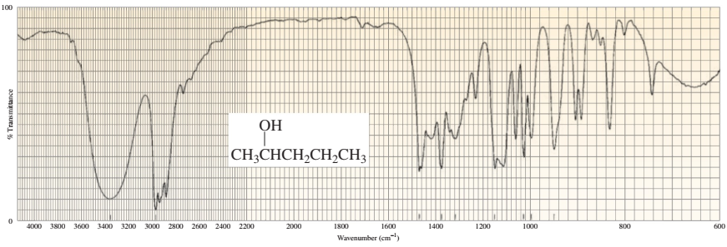
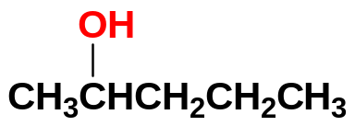
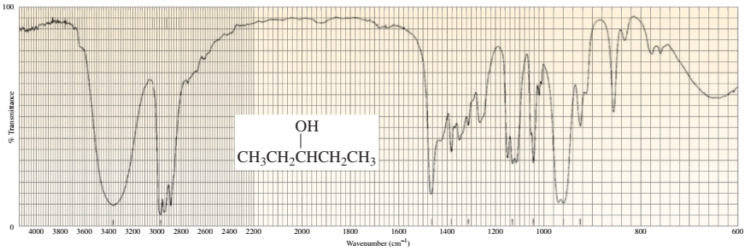
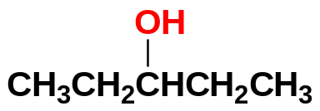
Even if Two Different Molecules have the same functional groups, their IR Spectra will not be Identical

