Slide 1
Carbohydrates
(+) Glucose
Cellulose
(Supporting framework of plant)
Starch
( stored in seeds to serve as food
for new , growing plants)
Glycogen
Food, clothing and shelter

Slide 2
Carbohydrates
Definition: Early observation: Hydrates of Carbon, general formula, C_{x}(H₂O)_{y}
Simple cabohydrates known as sugar, or saccharides; Ending: -ose
Sucrose: Table Sugar
Glucose: Principal sugar in Blood
Fructose: sugar in fruits and honey
Maltose: for malt sugar

Slide 3
Carbohydrates
Definition: polyhydroxy aldehydes and ketones
C=O; -OH
Exists primarily as hemiacetals
or
acetals

Slide 4
Carbohydrates: Classification
Monosaccharides: those that can not be hydrolyzed into simpler carbohydrates
Disccharides: undergo hydrolysis to produce two molecules of momosaccharides
Trisaccharides: those that produces three molecules of monosaccharides
Oligosaccharides: upon hydrolysis produces 2-10 molecules of monosaccharides
Polysaccharides: large no. of molecules (>10)

Slide 5
examples
1 mol Sucrose
(Disaccharide)
1 mol Glucose + 1 mol Fructose
(Monosaccharides)
1 mol Maltose
(Disaccharide)
2 mol Glucose
Starch or cellulose (polysaccharides)
Many moles of Glucose

Slide 6
Monosaccharides (classification)
No. of carbon atoms
Whether they contain any aldehyde or keto group
Three carbon: triose
Four carbon: tetrose
Pentose, hexose
Aldehyde: aldose
Keto: ketose
Combination: C₄ aldose: aldotetrose;
C₅ ketose: ketopentose

Slide 7
Carbohydrates: Glucose
Structure
Configuration
Conformation
Reactions

Slide 8
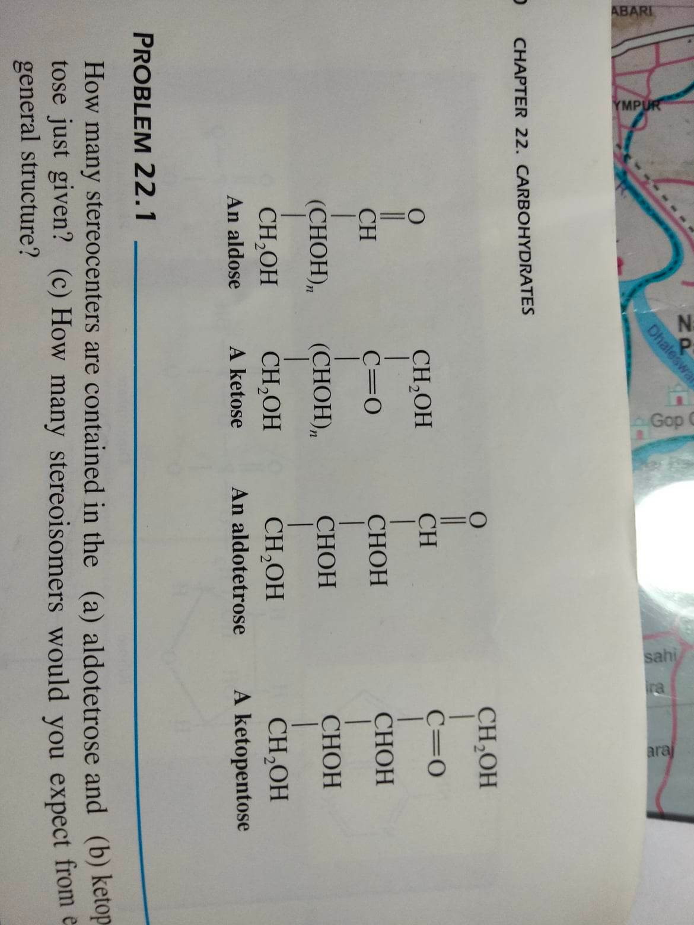

Slide 9
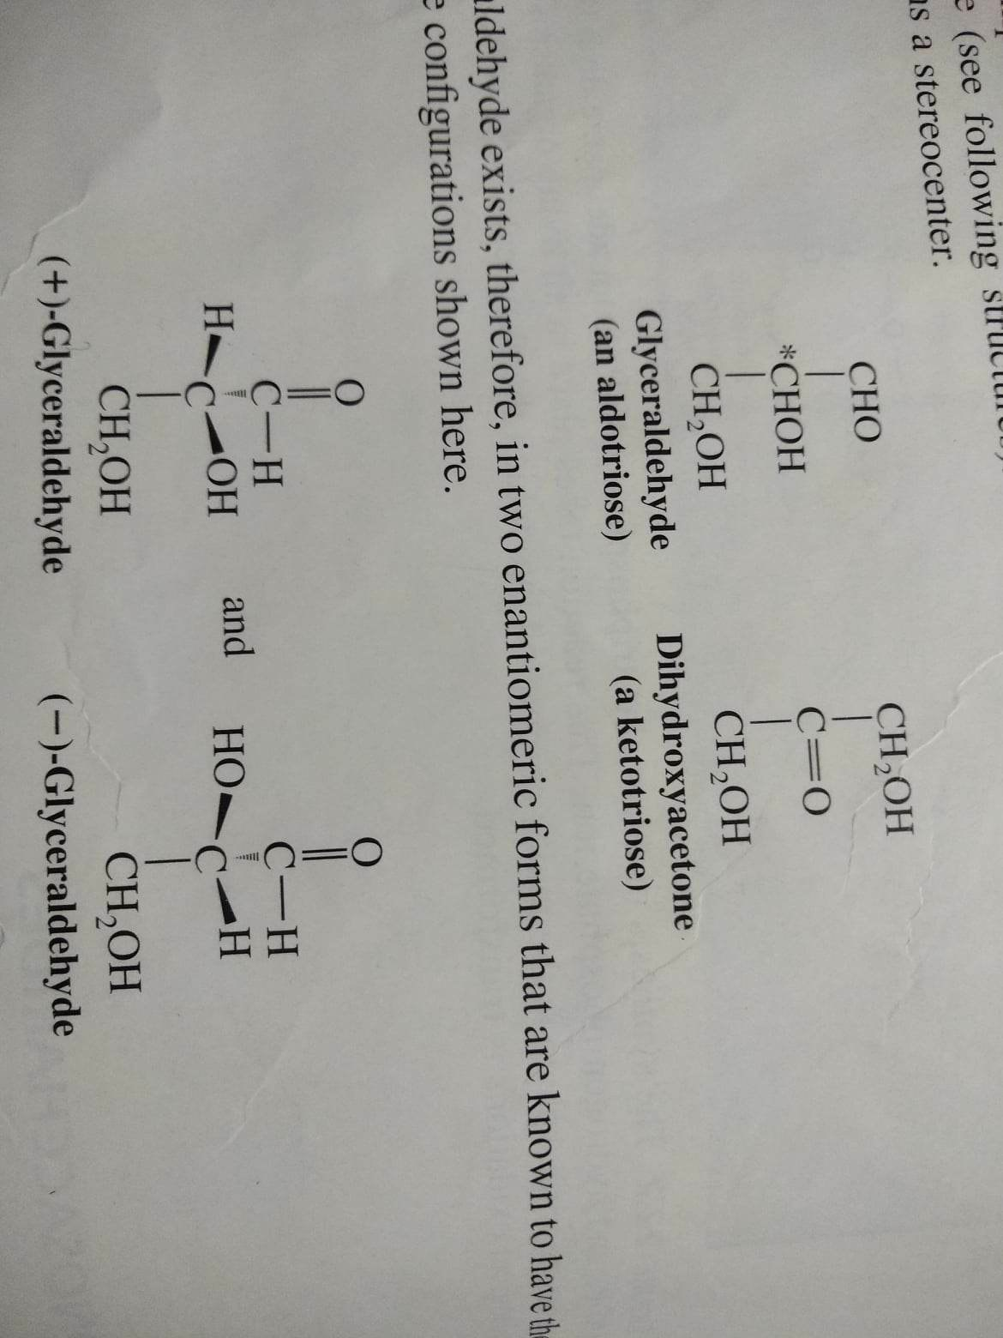

Slide 11
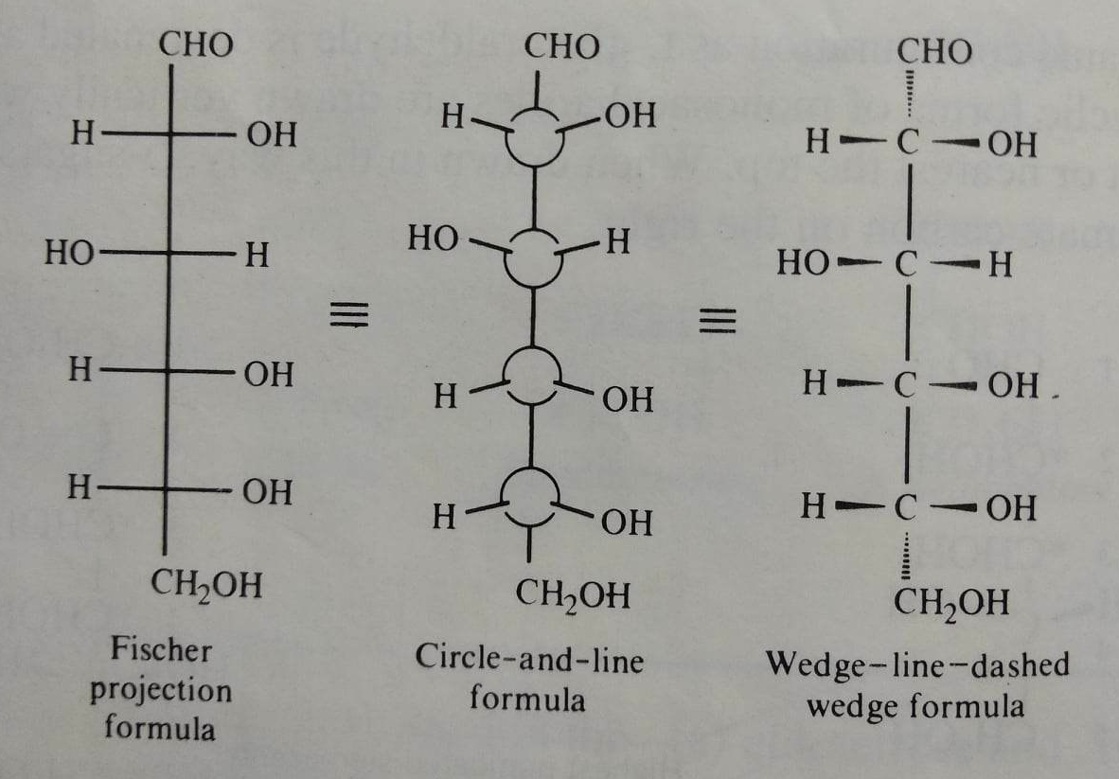

Slide 12
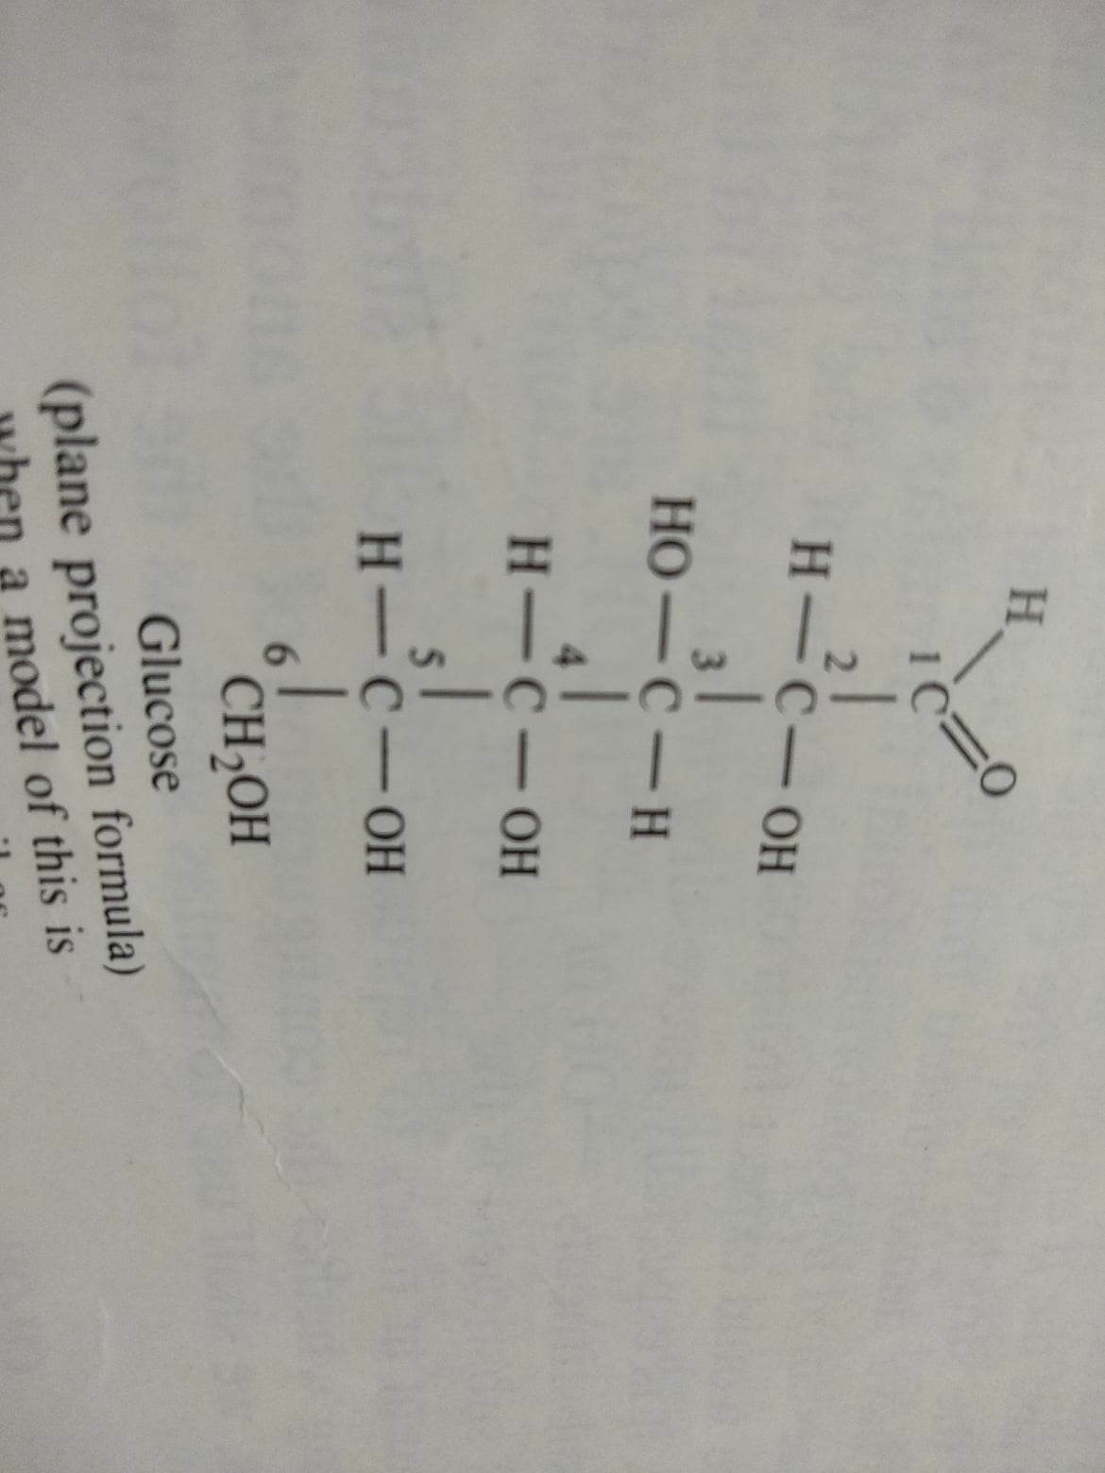
Carbohydrates:Monosaccharide: Glucose
Most abundant monosaccharide,
C₆H₁₂O₆
2^{n}
= 2⁴= 16
stereoisomer

Slide 13
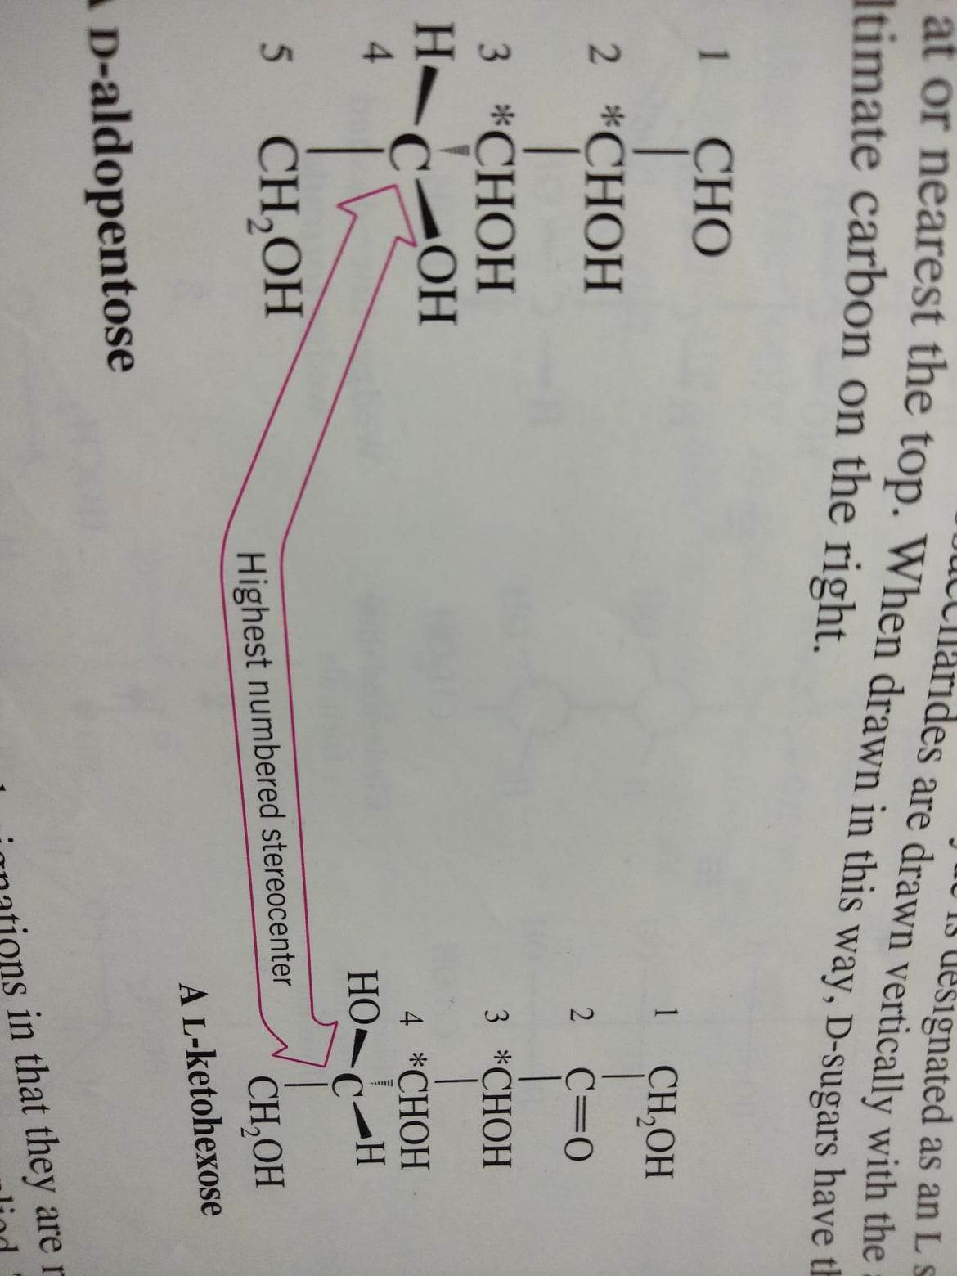

Slide 14
Oxidation reactions of monosaccharides
Tollens’ reagent [Ag⁺ (NH₃)₂OH⁻]
RCHO + Ag(NH₃)₂⁺ → RCOO⁻ + Ag (ppt)
Benedict’s reagent (alkaline solution containing a cupric citrate complex ion)
Cu²⁺ (complex) + aldose/ketose → Cu₂O +
oxidation products
These test are positive even though the aldoses and ketoses exists primarily as cyclic hemiacetals
Fehling’s solution (cupric tartrate complex ion)
Carbohydrates (hemiacetal) that reduce those reagents known as reducing sugars; Non reducing sugar (acetals):

Slide 15
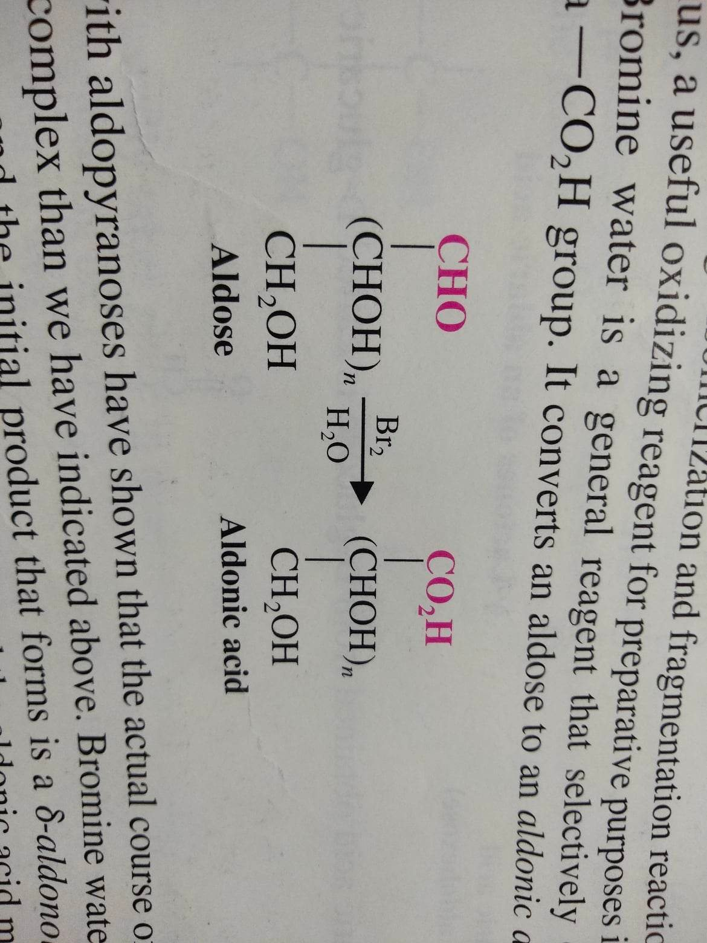

Slide 16
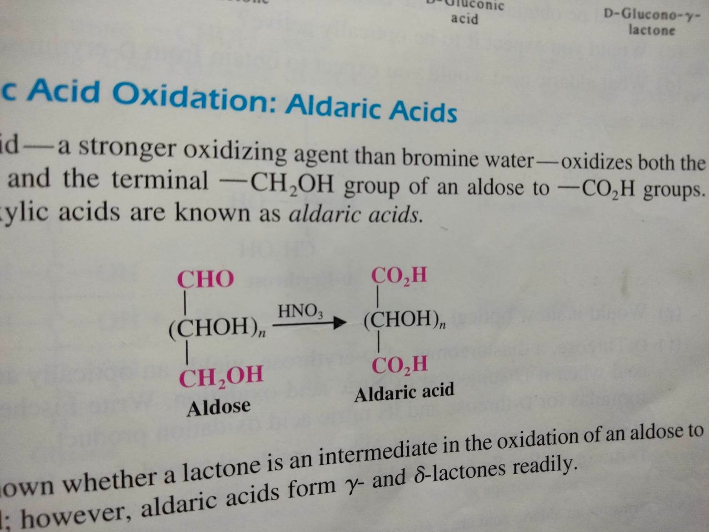

Slide 17
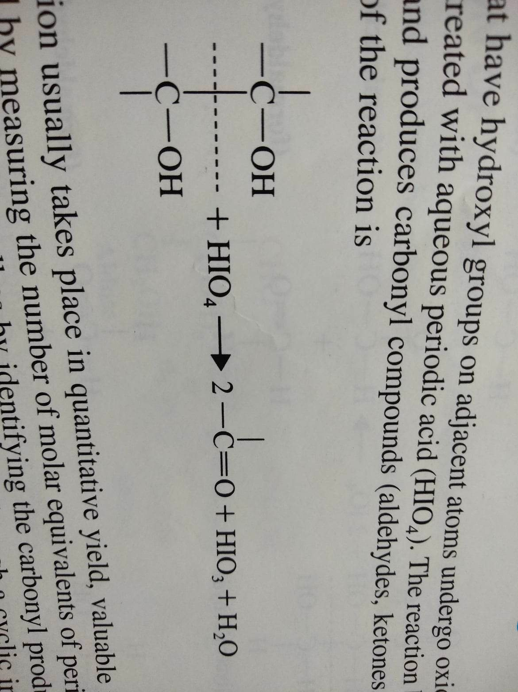

Slide 18
