Slide 1
Electronic Spectroscopy of Atoms
■ The Structure of Atoms:
Electronic Wave Functions:
It is well known that an atom consists of a central, positively charged nucleus, which contributes nearly all the mass to the system, surrounded by negatively charged electrons in sufficient number to balance the nuclear charge. Hydrogen, the smallest and simplest atom, has a nuclear charge of +1 units (where the unit is the electronic charge, 1.60 x 10⁻¹⁹ coulomb) and one electron; each succeeding atom increases the nuclear charge and electron total by unity, up to atoms with 100 or more electrons.

Slide 2
Electronic Spectroscopy of Atoms
■ The Structure of Atoms:
Electronic Wave Functions:
Modern theories have long ceased to regard the electron as a particle which obeys the laws of classical mechanics applicable to massive, everyday objects; instead, in common with all entities of subatomic size, we consider that it obeys the laws of quantum mechanics (or wave mechanics) as embodied in the Schrödinger wave equation.
In principle, this equation may be used to determine many things: e.g., the way in which electrons group themselves about a nucleus when forming an atom, the energy which each electron may have, the way in which it can undergo transitions between energy states, etc.

Slide 3
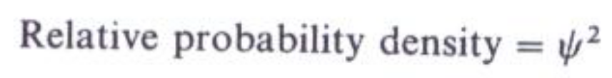
Electronic Spectroscopy of Atoms
■ The Structure of Atoms:
Electronic Wave Functions:
The Schrödinger theory can be used to predict the probability of an electron with a particular energy being at a particular point in space, and it expresses this probability in terms of a very important algebraic expression called the wave function of the electron.
The wave function is given the Greek symbol Ψ. Quite simply, the probability of tending an electron, whose wave function is Ψ, within unit volume at a given point in space, is proportional to Ψ² the value of at that point:

Slide 4
Electronic Spectroscopy of Atoms
Electronic Wave Functions:
Let us see what this means. Electronic wave functions consist of three elements:
(1) some fundamental physical constants (It, h, c, m, e, etc.—where m and e are the mass and charge, respectively, of the electron);
(2) parameters peculiar to the system under discussion—e.g., for atoms, distance from the nucleus, either radially (r) or along some coordinate axes (x, y, z);
(3) one or more quantum numbers.
These latter are by no means arbitrarily introduced into the problem in order to make the predictions match experiment; they belong to the solution of the Schrödinger equation in the sense that Ψ represents a sensible physical situation only if the quantum numbers have certain values.

Slide 5
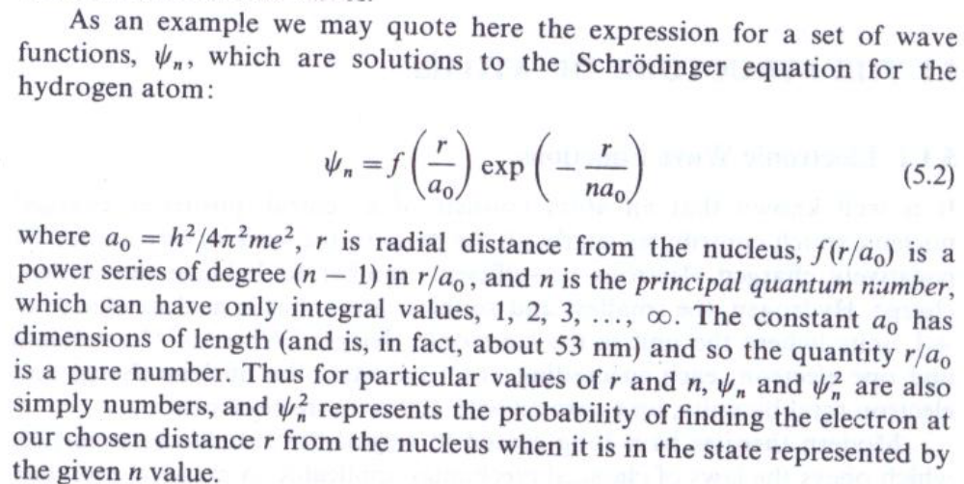
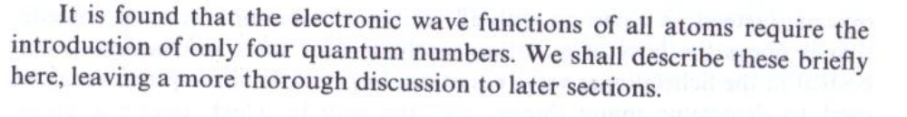
Electronic Spectroscopy of Atoms

Slide 6
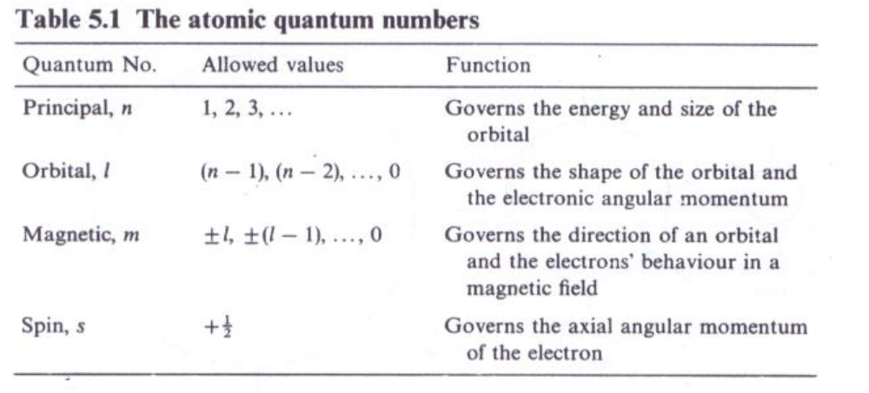
Electronic Spectroscopy of Atoms
The Shape of Atomic Orbitals; Atomic Quantum Numbers:
The principal quantum number, as stated earlier can take integral values from one to infinity. It governs the energy of the electron mainly (although we shall see later that the other quantum numbers also affect this energy to some extent).

Slide 7
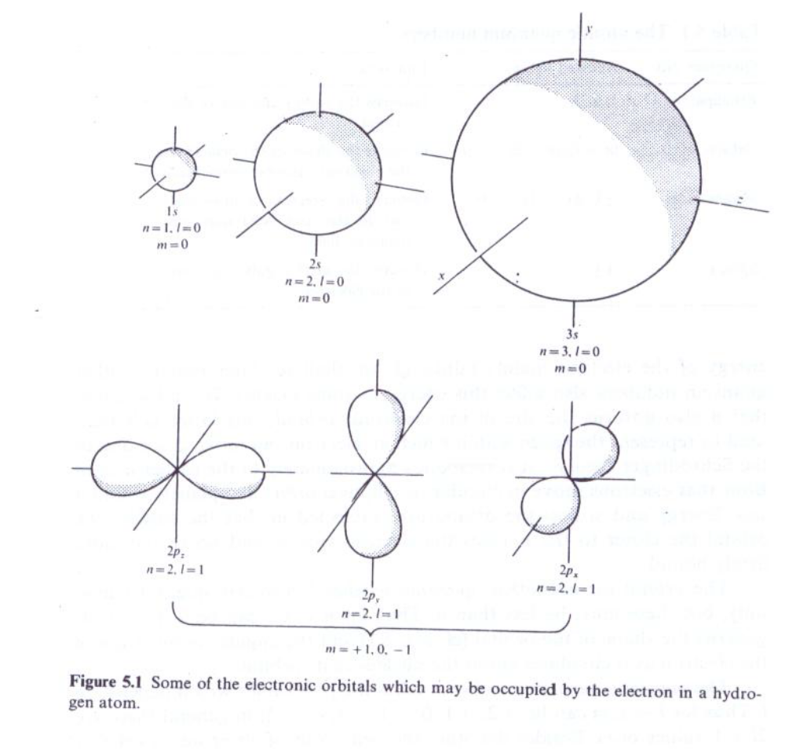
Electronic Spectroscopy of Atoms

Slide 8
Electronic Spectroscopy of Atoms
The Energies of Atomic Orbitals; Hydrogen Atom Spectrum:
However an atom its electrons take up orbitals of the s, p, d, . type (according to very specific laws which we shall discuss later) and so the overall shape of each electron's domain is unaltered.
The energy of each orbital, on the other hand, varies considerably from atom to atom.
There are two main contributions to this energy:
  (1) attraction between electrons and nucleus,
  (2) repulsion between electrons in the same atom.

Slide 9
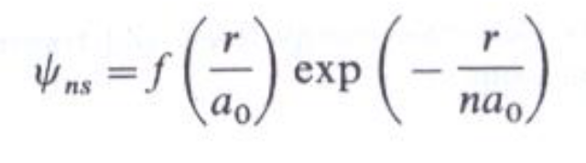
Electronic Spectroscopy of Atoms
The Energies Of Atomic Orbitals; Hydrogen Atom Spectrum:
We consider first the case of hydrogen in some detail: this is the simplest because, having only one electron, factor (2) is completely absent.
Because of the absence of interelectronic effects all orbitals with the same n value have the same energy in hydrogen. Thus the 2s and 2P orbitals, for instance, are degenerate, as are the 3s, 3p, and 3d. However the energies of the 2s, 3s, 4s, . . orbitals differ considerably. For the s orbitals given by Eq.

Slide 10
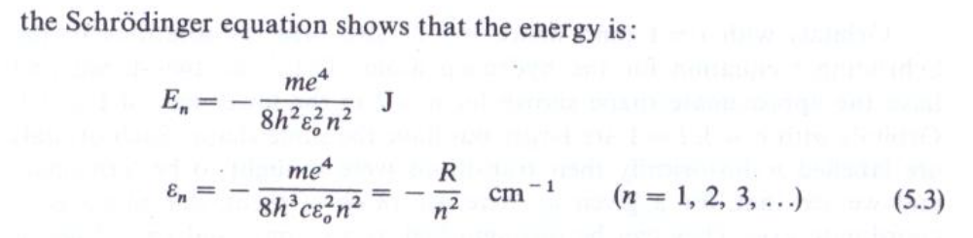
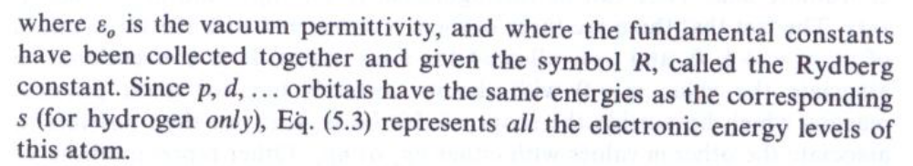
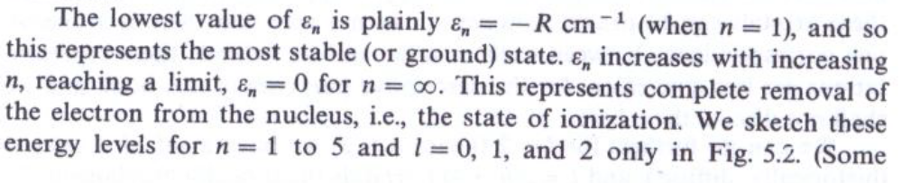
Electronic Spectroscopy of Atoms

Slide 11
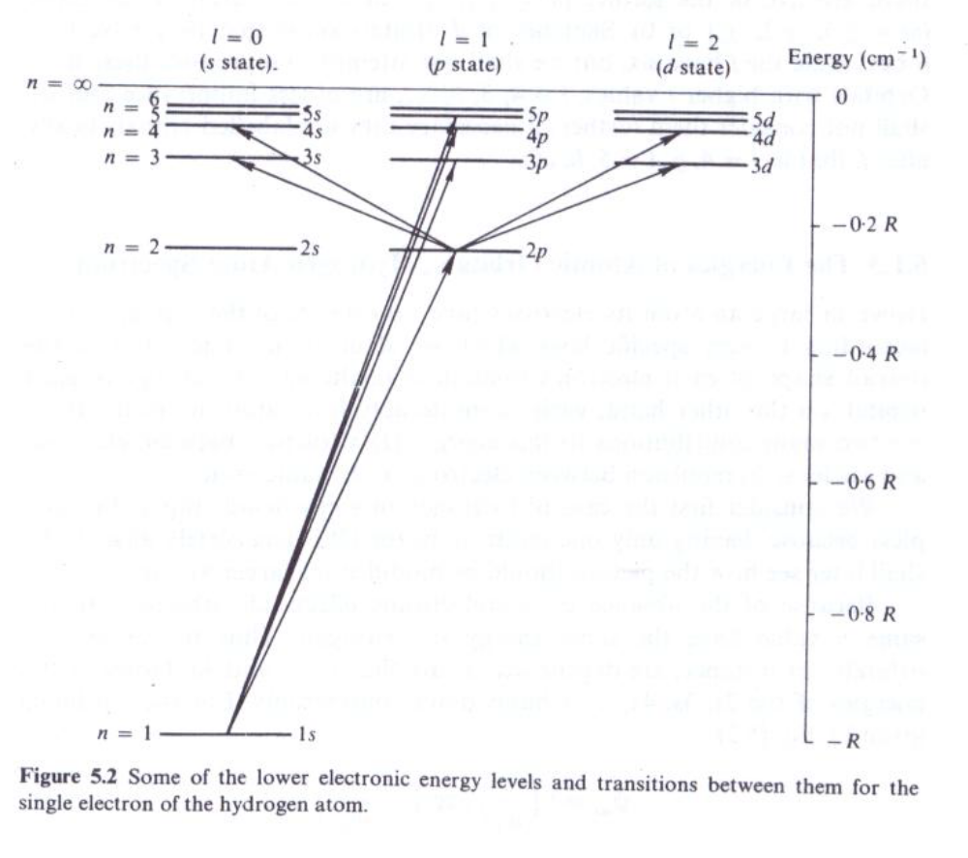
Electronic Spectroscopy of Atoms

Slide 12
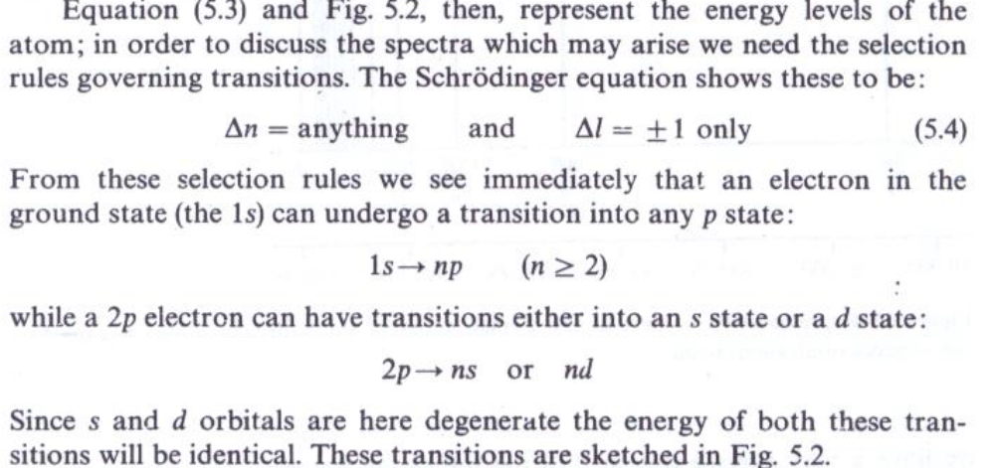
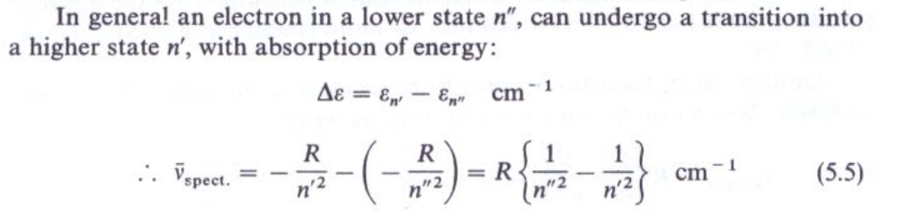
Electronic Spectroscopy of Atoms

Slide 13
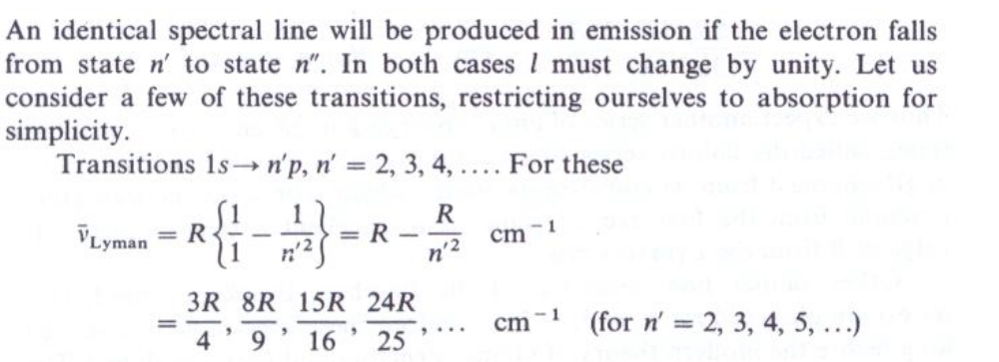
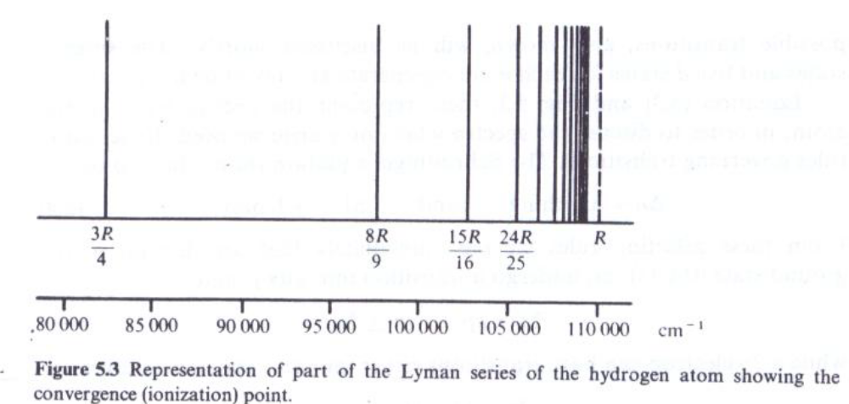
Electronic Spectroscopy of Atoms

Slide 14
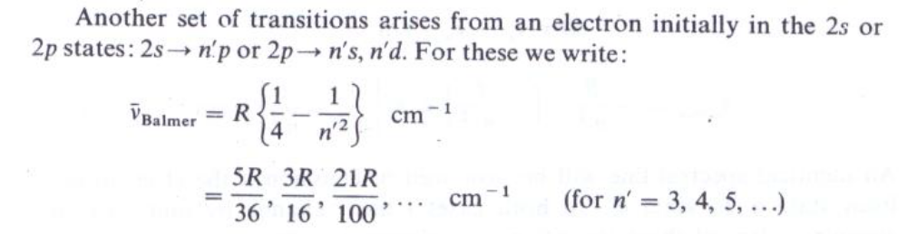
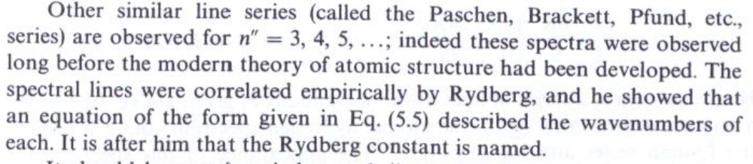
Electronic Spectroscopy of Atoms

Slide 15
Electronic Spectroscopy of Atoms
The Energies Of Atomic Orbitals; Hydrogen Atom Spectrum:
It should be mentioned that each line series discussed above shows a continuous absorption or emission to high wavenumbers of the convergence limits.
The convergence limit represents the situation where the atomic electron has absorbed just sufficient energy from radiation to escape from the nucleus with zero velocity.
It can, however, absorb more energy than this and hence escape with higher velocities and since the kinetic energy of an electron moving in free space is not quantized, any energy above the ionization energy can be absorbed. Hence the spectrum in this region is continuous.

Slide 16
Electronic Spectroscopy of Atoms
■ Electronic Angular Momentum:
Orbital Angular Momentum:
An electron moving in its orbital about a nucleus possesses orbital angular momentum, a measure of which is given by the I value corresponding to the orbital. This momentum is, of course, quantized, and it is usually expressed in terms of the unit h/2π, where h is Planck's constant. We may write:
Now angular momentum is a vector quantity, by which we mean that its direction is important as well as its magnitude—the axis of a spinning top, for instance, points in a particular direction.

Slide 17

Electronic Spectroscopy of Atoms
■ Electronic Angular Momentum:
Orbital Angular Momentum:
It is usual to distinguish vector quantities by the use of bold-face type and we shall accordingly represent orbital angular momentum by the symbol I where:
Now angular momentum is a vector quantity, by which we mean that its direction is important as well as its magnitude—the axis of a spinning top, for instance, points in a particular direction.
The angular momentum vector can point only so that its components along the reference direction are integral multiples of h/2π Figure 5.4(a) and (b) show the situation for an electron with I = 1 and I = 2 respectively (i.e., a p and a d electron).

Slide 18
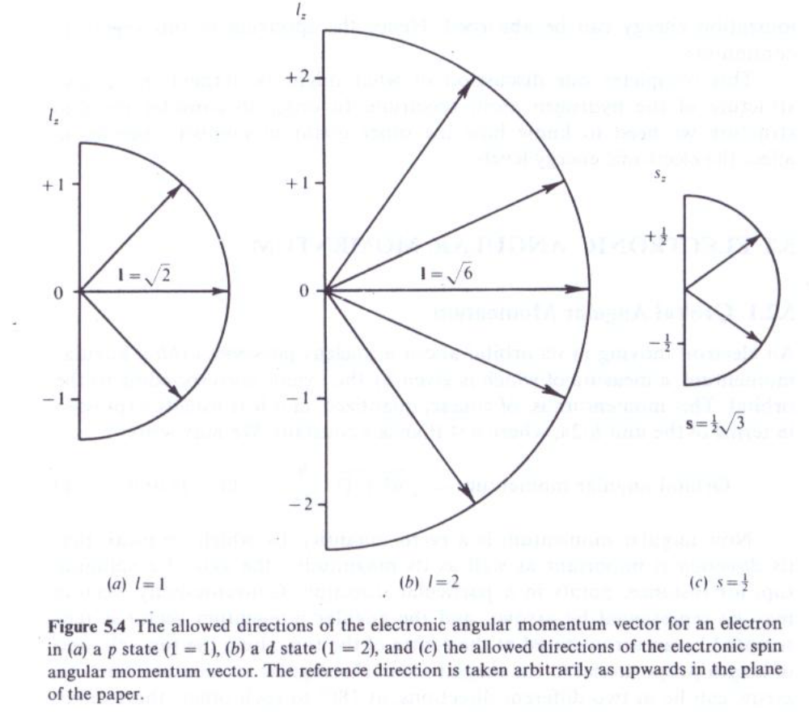
Electronic Spectroscopy of Atoms

Slide 19
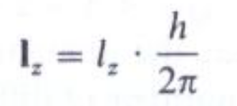
Electronic Spectroscopy of Atoms
Orbital Angular Momentum:
The reference direction, here taken to be vertical in the figure, is conventionally used to define the z axis, and so we can write the components of I in this direction as (note the use of bold-face type for I: , since the components of angular momentum are clearly vectors, having both magnitude and direction). Alternatively, since we know that the I_{z} are integral multiples of h/2π, we can represent the components in terms of an integral number l: (not bold-face), where

Slide 20
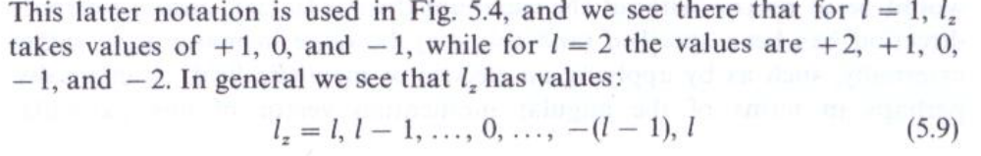
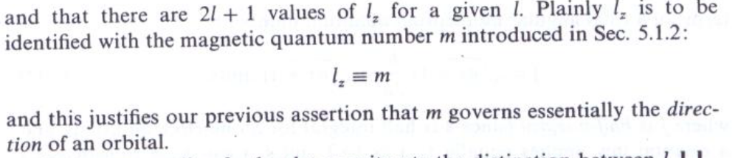
Electronic Spectroscopy of Atoms

Slide 21
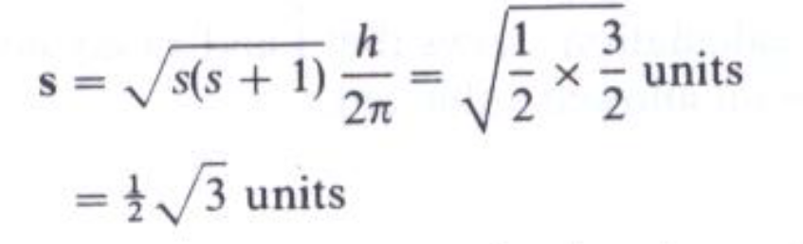
Electronic Spectroscopy of Atoms
Electron Spin Angular Momentum:
Every electron in an atom can be considered to be spinning about an axis as well as orbiting about the nucleus. Its spin motion is designated by the spin quantum number s, which can be shown to have a value of ½ only. Thus the spin angular momentum is given by:
The quantization law for spin momentum is that the vector can point so as to have components in the reference direction which are half-integral multiples of h/2π, that is that S_{z} = s × h/2π with taking the values of + ½ or – ½ .
The two (that is, 2s + I) allowed directions are shown in Fig. 5.4(c); they are normally degenerate.

Slide 22

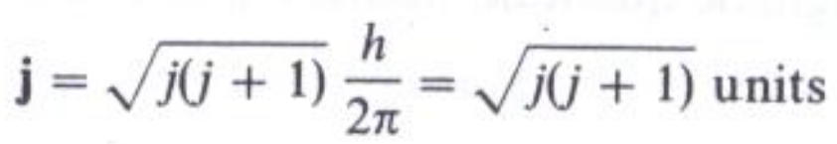
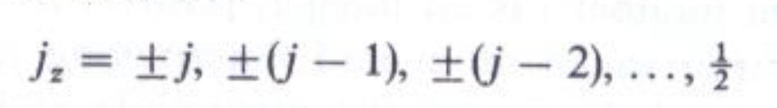
Electronic Spectroscopy of Atoms
Total Electronic Angular Momentum:
We now need to discover some means whereby the orbital and spin contributions to the electronic angular momentum may be combined. Formally we can write:
where j is the total angular momentum. Since I and s are vectors, Eq. must be taken to imply vector addition. Also formally, we can express j in terms of a total angular momentum quantum number j:
where j is half-integral (since s is half-integral for a one-electron atom), and a quantal law applies equally to j as to I and s : j can have z-components which are half-integral only, i.e.,

Slide 23
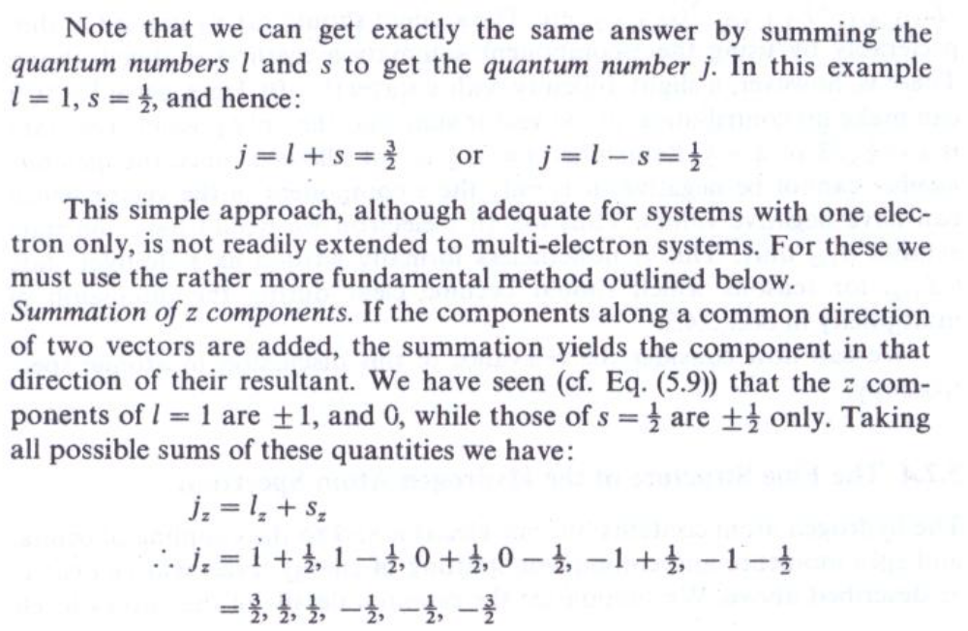
Electronic Spectroscopy of Atoms

Slide 24
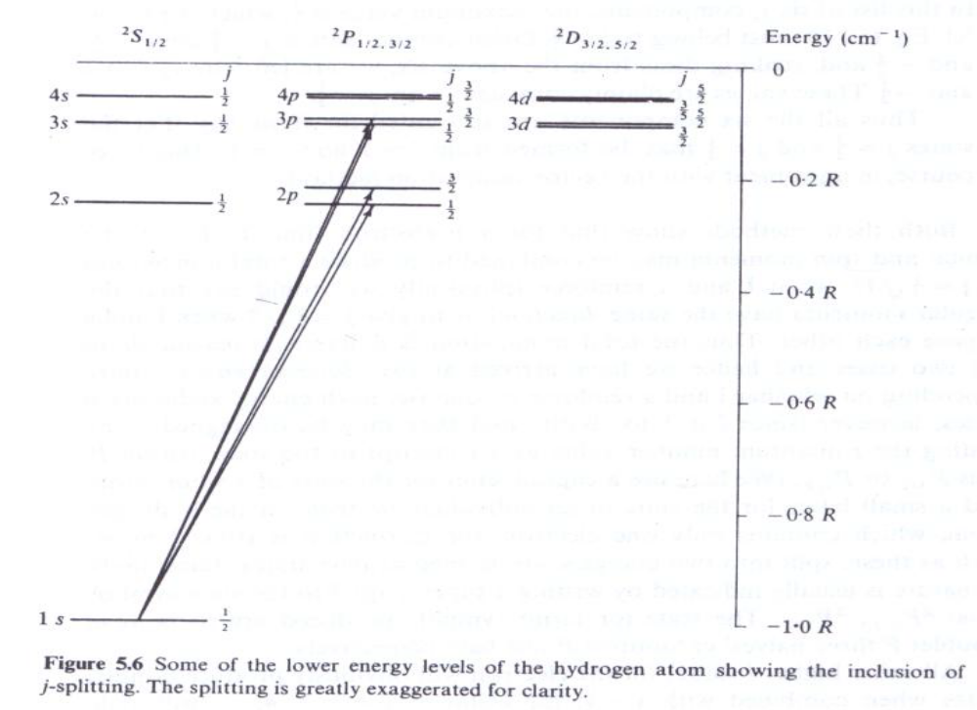
Electronic Spectroscopy of Atoms
The Fine Structure of the Hydrogen Atom Spectrum:
The hydrogen atom contains but one electron and so the coupling of orbital and spin momenta and consequent splitting of energy levels will be exactly as described above. The essential details of the energy levels

Slide 25
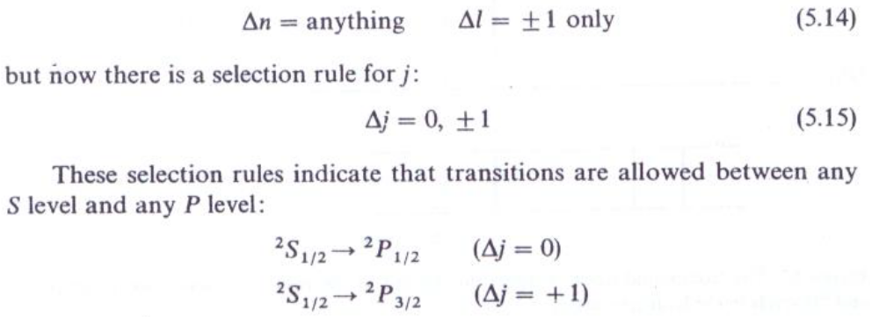
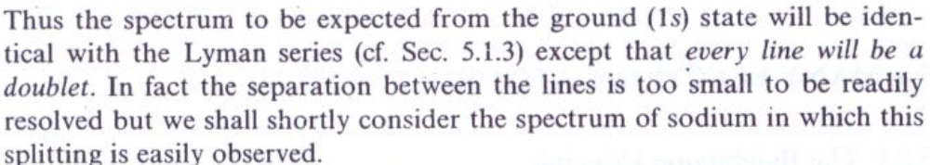
Electronic Spectroscopy of Atoms
The Fine Structure of the Hydrogen Atom Spectrum:
Each level is labelled with its n quantum number on the extreme left, and its j value on the right; the I value is indicated by the state symbols S, P, D, at the top of each column.
The selection rules for n and I are the same as before:

Slide 26
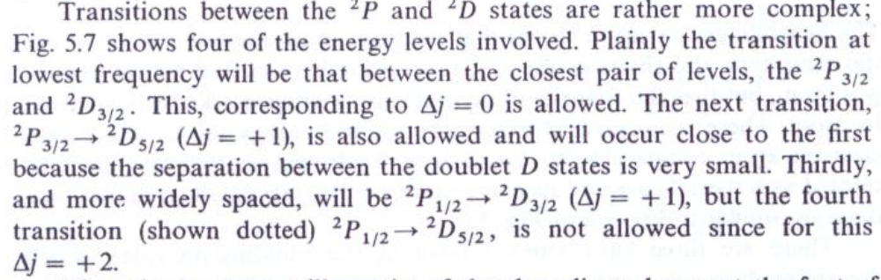
Electronic Spectroscopy of Atoms
The Fine Structure of the Hydrogen Atom Spectrum:

Slide 27
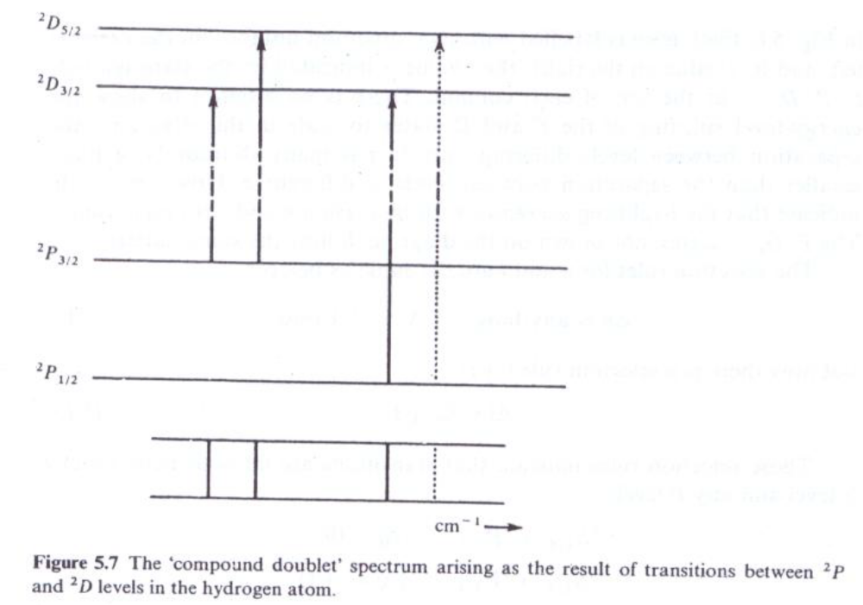
Electronic Spectroscopy of Atoms

Slide 28
Electronic Spectroscopy of Atoms
■ Many-electron Atoms:
The Building-up Principle:
The Schrödinger equation shows that electrons in atoms occupy orbitals of the same type and shape as the s, p, d, , orbitals discussed for the hydrogen atom, but that the energies of these electrons differ markedly from atom to atom.
There are three basic rules, known as the building-up rules, which determine how electrons in large atoms occupy orbitals. These may be summarized as:
1. Pauli's principle: no two electrons in an atom may have the same set of values for n, l, I_{z} ( = m), and s_{z}.
2.Electrons tend to occupy the orbital with lowest energy available.
3.Hund's principle: electrons tend to occupy degenerate orbitals singly with their spins parallel.

Slide 29
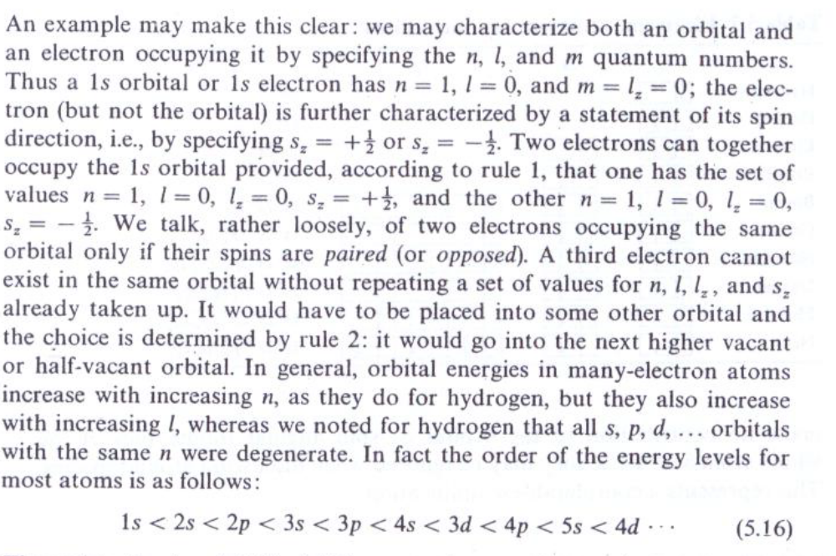
Electronic Spectroscopy of Atoms

Slide 30
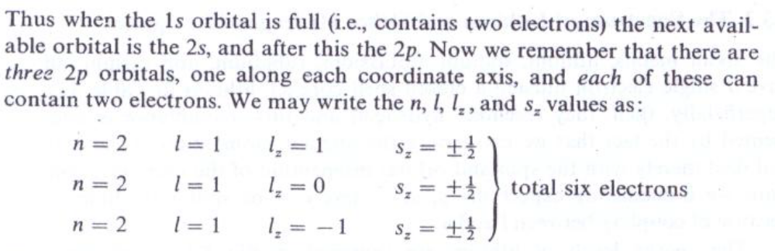
Electronic Spectroscopy of Atoms

Slide 31
Electronic Spectroscopy of Atoms
■ The Spectrum of Lithium and Other Hydrogen-like Species:
The alkali metals, lithium, sodium, potassium, rubidium, and cesium, all have a single electron outside a closed-shell core (cf. lithium in Table 5.2). Superficially, then, they resemble hydrogen and this resemblance is augmented by the fact that we can ignore the angular momentum of the core and deal merely with the spin and orbital momentum of the outer electron. Thus we immediately expect the p, d, levels to be split into doublets because of coupling between I and s.

Slide 32
Electronic Spectroscopy of Atoms
■ The Spectrum of Lithium and Other Hydrogen-like Species:
The energy levels of lithium are sketched in Fig. 5.8, which figure should be compared with the corresponding Fig. 5.6 for hydrogen. The two diagrams are similar except for the energy difference between the s, p, and d orbitals of given n in the case of lithium, and the fact that, for this metal, the Is state is filled with electrons which do not generally take part in spectroscopic transitions, it requiring much less energy to induce the 2s electron to undergo a transition. Under high energy conditions, however, one or both of the Is electrons may be promoted.

Slide 33
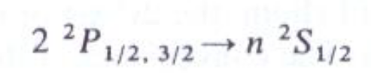

Electronic Spectroscopy of Atoms
■ The Spectrum of Lithium and Other Hydrogen-like Species:
The selection rules for alkali metals are the same as for hydrogen, that is, Δn = anything, Δl ± 1, Δj = O, ± 1, and so the spectra will be similar also. Thus transitions from the ground state (1s² 2s¹) can occur to p levels: 2S_{1/2}—• nP_{1/2}, and a series of doublets similar to the Lyman series will be formed converging to some point from which the ionization potential can be found. From the 2P state, however, two separate series of lines will be seen :
And
The former will be doublets, the latter compound doublets, but their frequencies will differ because the s and d orbital energies are no longer the same.

Slide 34
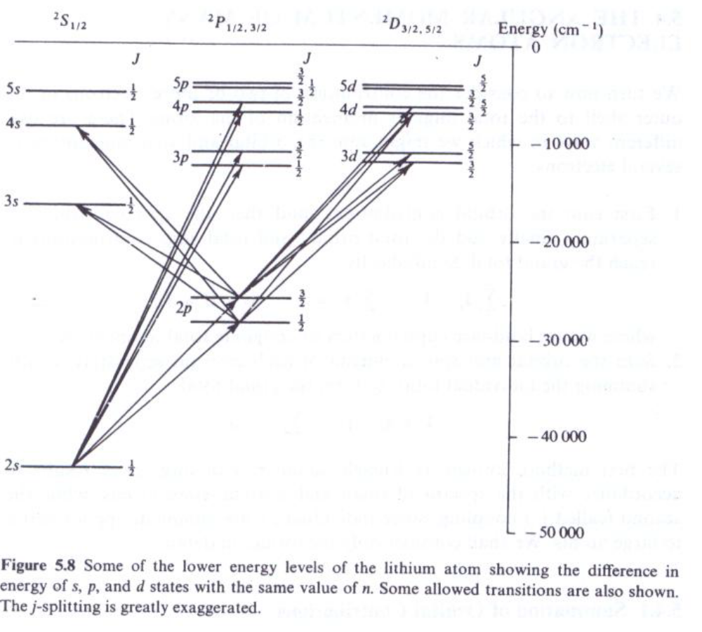
Electronic Spectroscopy of Atoms

Slide 35
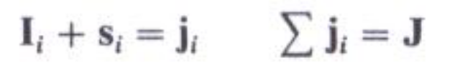
Electronic Spectroscopy of Atoms
■ The Angular Momentum of Many Electron Atoms:
We turn now to consider the contribution of two or more electrons in the outer shell to the total angular momentum of the atom. There are two different ways in which we might sum the orbital and spin momentum of several electrons:
1. First sum the orbital contributions, and then the spin contributions separately, finally add the total orbital and total spin contributions to reach the grand total. Symbolically:
2. Sum the orbital and spin momenta of each electron separately, finally summing the individual totals to form the grand total:

Slide 36
Electronic Spectroscopy of Atoms
■ The Angular Momentum of Many Electron Atoms:
The first method, known as Russell—Saunders coupling, gives results in accordance with the spectra of small and medium-sized atoms, while the second (called j, j coupling, since individual j's are summed) applies better to large atoms.

Slide 37
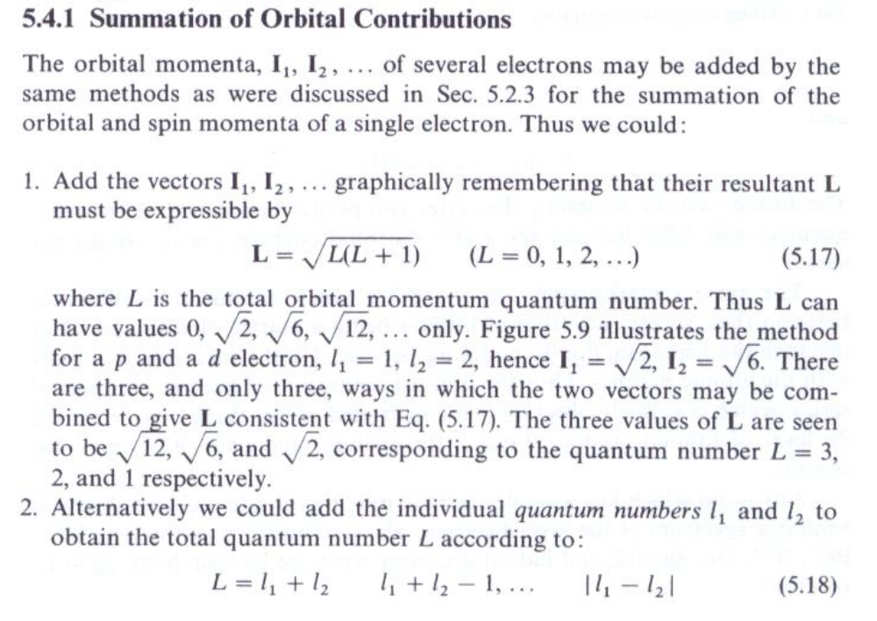
Electronic Spectroscopy of Atoms

Slide 38
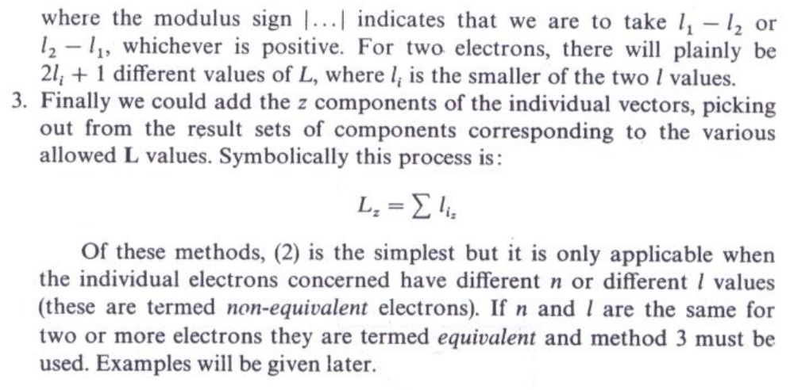
Electronic Spectroscopy of Atoms

Slide 39
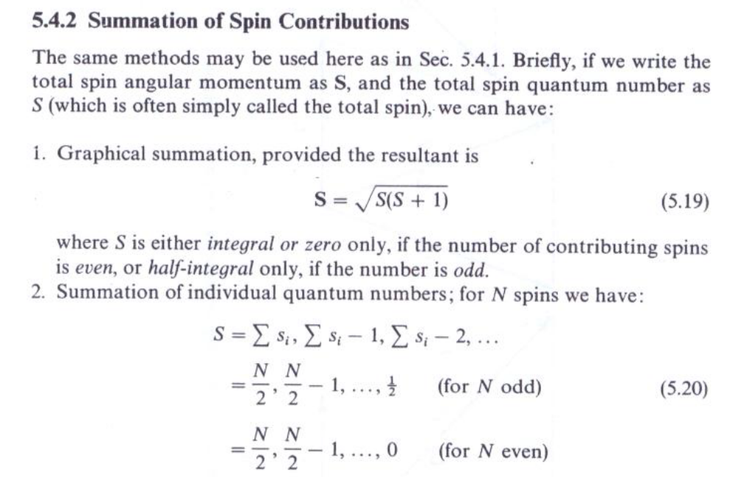
Electronic Spectroscopy of Atoms

Slide 40
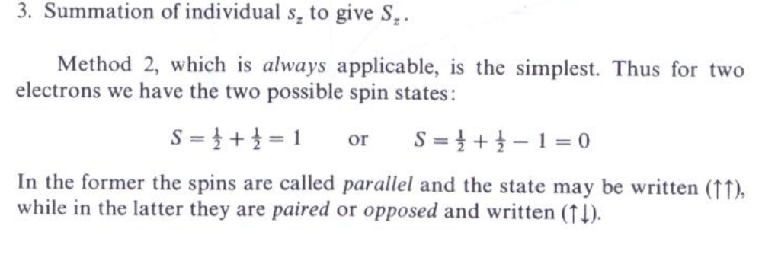
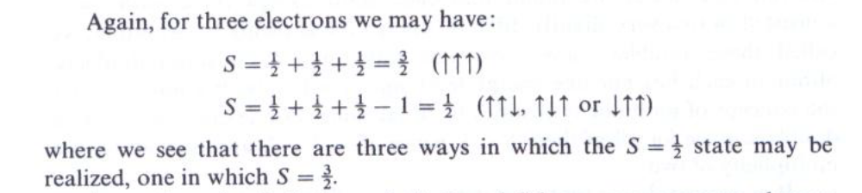
Electronic Spectroscopy of Atoms

Slide 41
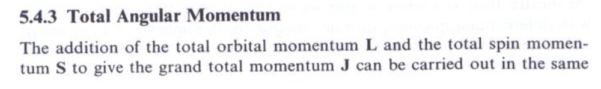
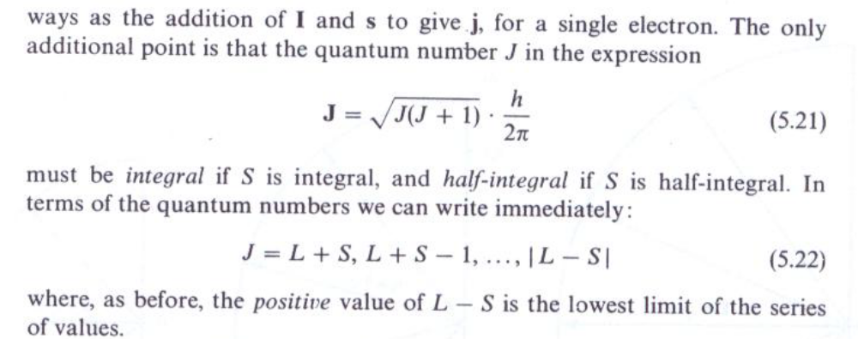
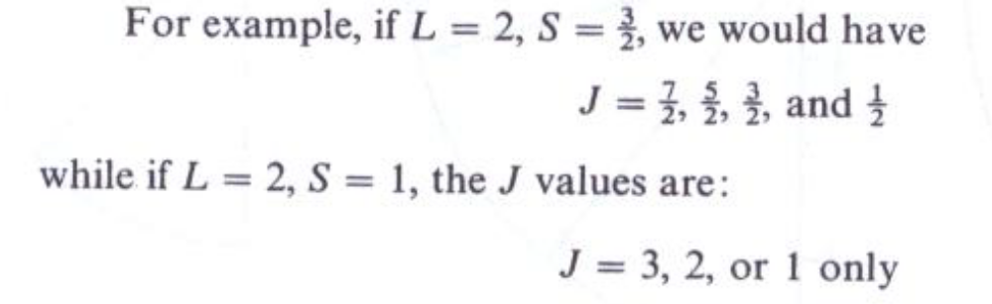
Electronic Spectroscopy of Atoms

Slide 42
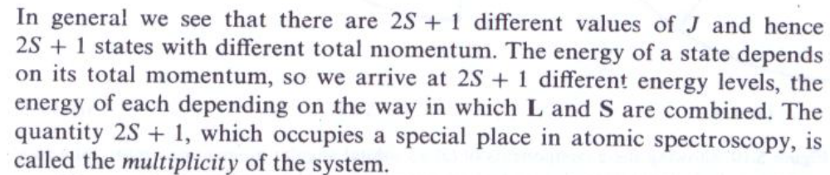
Electronic Spectroscopy of Atoms

Slide 43
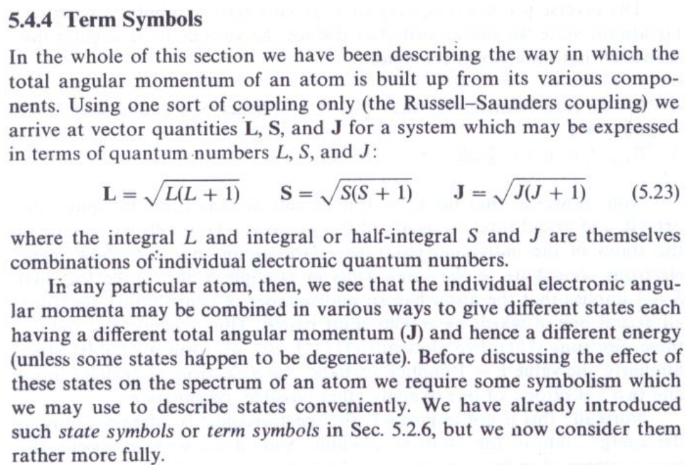
Electronic Spectroscopy of Atoms

Slide 44
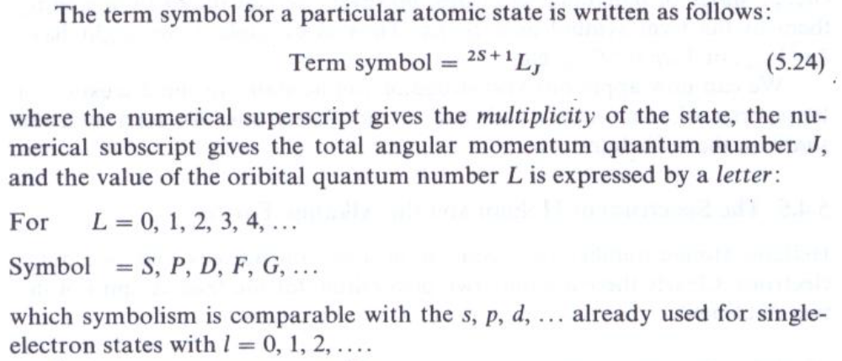
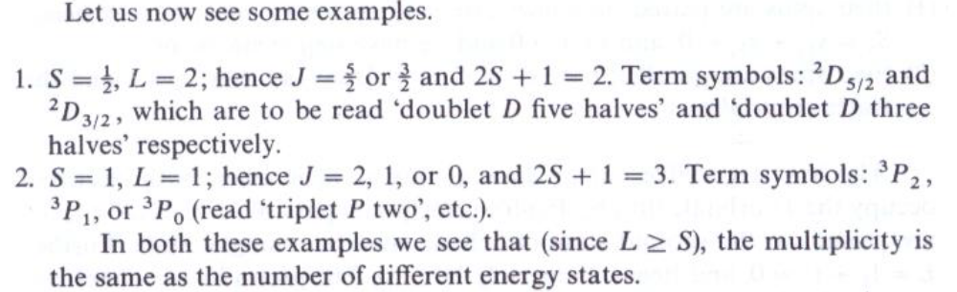
Electronic Spectroscopy of Atoms

Slide 45
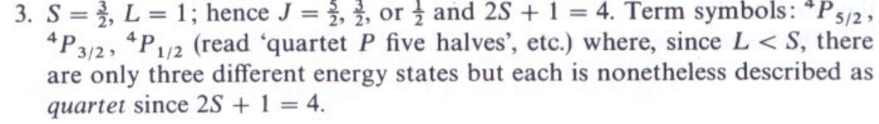
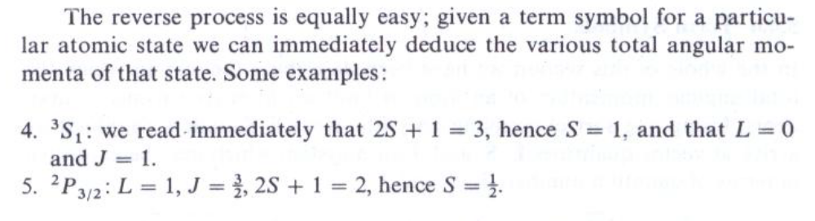
Electronic Spectroscopy of Atoms

Slide 46
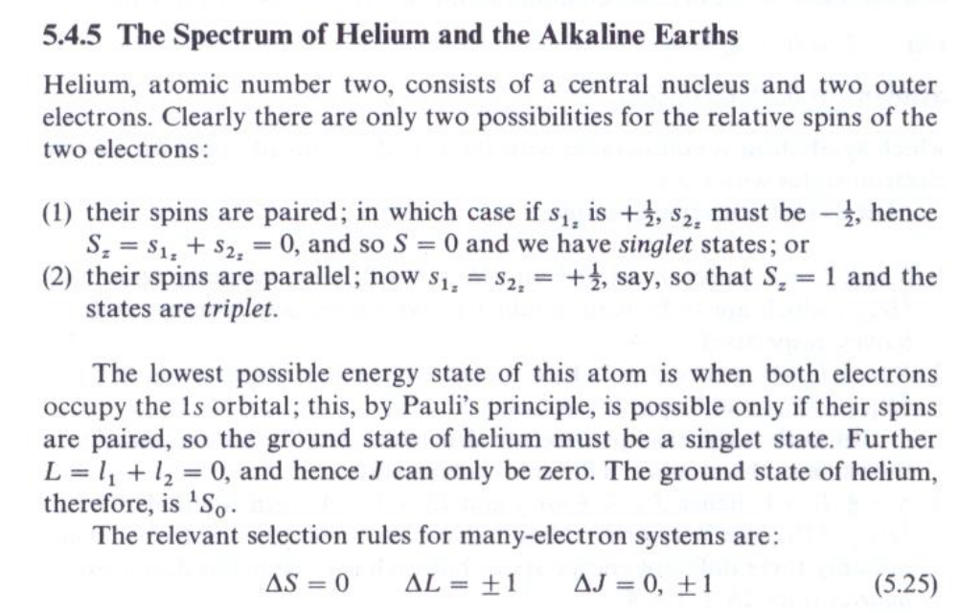
Electronic Spectroscopy of Atoms

Slide 47
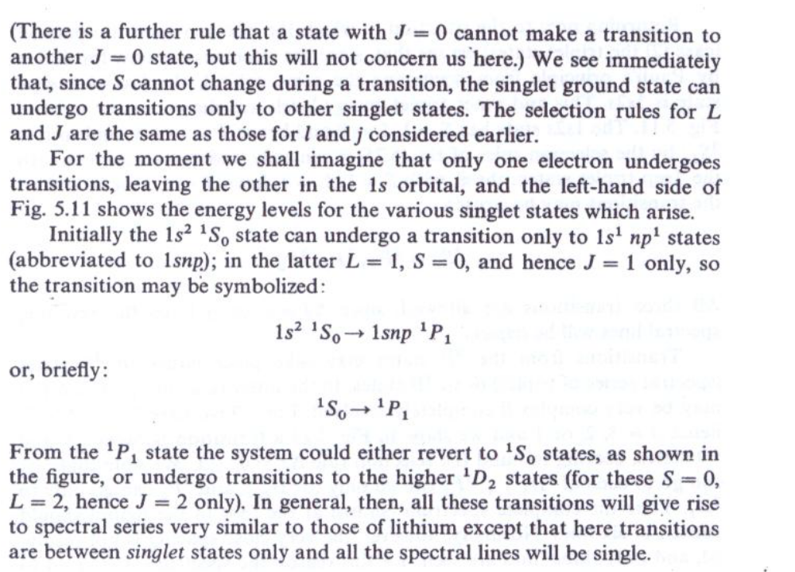
Electronic Spectroscopy of Atoms

Slide 48

Electronic Spectroscopy of Atoms

Slide 49

Electronic Spectroscopy of Atoms

Slide 50

Electronic Spectroscopy of Atoms

