Slide 1




HopsFS: Scaling Hierarchical File System Metadata Using NewSQL Databases
Salman Niazi¹, Mahmoud Ismail¹,
Seif Haridi¹, Jim Dowling¹, Steffen Grohsschmiedt², Mikael Ronström³
1. KTH - Royal Institute of Technology, 2. Spotify AB, 3. Oracle

Slide 2

>1 million ops/sec Hadoop compatible distributed hierarchical file system that stores billions of files.
H psFS
Notes:
HopsFS is all about scalability

Slide 3
Motivation

Slide 4
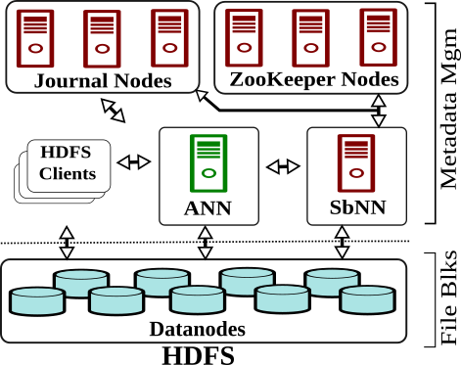
Hadoop Distributed File System

Slide 5

Hadoop Distributed File System

Slide 6

Hadoop Distributed File System

Slide 7
Hadoop Distributed File System

Slide 8
Hadoop Distributed File System

Slide 9
Hadoop Distributed File System

Slide 10
Hadoop Distributed File System

Slide 11
HDFS’ Namenode Limitations
Limited namespace
Namenode stores metadata on a JVM Heap
Limited concurrency
Strong consistency for metadata operations are guaranteed using a single global lock (single-writer, multiple readers)
Notes:
Garbage collection pauses freeze metadata operations

Slide 12
Solution

Slide 13
Solution
Increased size of the namespace
Move the Namenode metadata off the JVM Heap and store the metadata in an in-memory distributed database
Multiple stateless Namenodes access and update the metadata in parallel
Improved concurrency model and locking mechanisms to support multiple concurrent read and write operations (multiple-writers, multiple-readers)

Slide 14
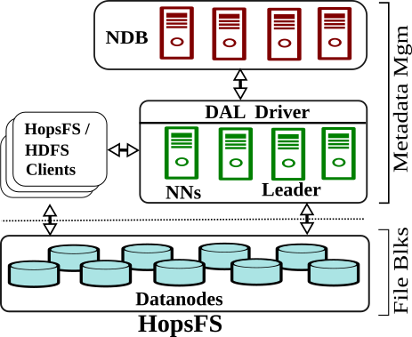
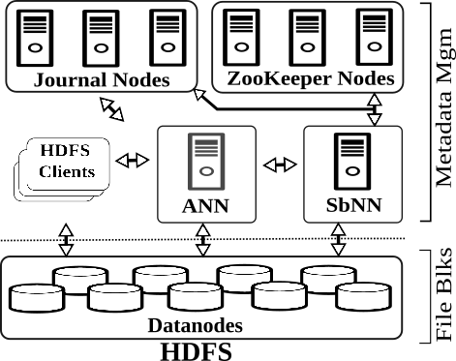
HopsFS System Architecture

Slide 15

HopsFS System Architecture

Slide 16
HopsFS System Architecture

Slide 17
HopsFS System Architecture

Slide 18
HopsFS System Architecture

Slide 19
NewSQL DB

Slide 20
MySQL Cluster: Network Database Engine (NDB)
Commodity Hardware
Scales to 48 database nodes
200 Million NoSQL Read Ops/Sec*
NewSQL (Relational) DB
Read Committed Transaction Isolation
Row-level Locking
User-defined partitioning
*https://www.mysql.com/why-mysql/benchmarks/mysql-cluster/

Slide 21
Metadata Partitioning

Slide 22
HopsFS Metadata and Metadata Partitioning
/
user
F1 F2 F3

Slide 23
HopsFS Metadata & Metadata Partitioning (contd.)
INode Table |  |  |  |  | Block Table |  |  |  | Replica Table
Inode_ID | Name | Parent_ID | ... |  | Block_ID | Inode_ID | ... |  | Inode_ID | Block_ID | DataNode_ID | ...
/
user
F1 F2 F3
Inode ID
Parent INode ID
Name
Size
Access Attributes
...

Slide 24
HopsFS Metadata & Metadata Partitioning (contd.)
INode Table |  |  |  |  | Block Table |  |  |  | Replica Table
Inode_ID | Name | Parent_ID | ... |  | Block_ID | Inode_ID | ... |  | Inode_ID | Block_ID | DataNode_ID | ...
/
user
F1 F2 F3
File INode to Blocks Mapping
Block Size
...

Slide 25
HopsFS Metadata & Metadata Partitioning (contd.)
INode Table |  |  |  |  | Block Table |  |  |  | Replica Table
Inode_ID | Name | Parent_ID | ... |  | Block_ID | Inode_ID | ... |  | Inode_ID | Block_ID | DataNode_ID | ...
/
user
F1 F2 F3
Location of blocks on Datanodes
...

Slide 26
HopsFS Metadata & Metadata Partitioning (contd.)
INode Table |  |  |  |  | Block Table |  |  |  | Replica Table
Inode_ID | Name | Parent_ID | ... |  | Block_ID | Inode_ID | ... |  | Inode_ID | Block_ID | DataNode_ID | ...
/
user
F1 F2 F3
MySQL Cluster
Partition 1 |  | Partition 2 |  | Partition 3 |  | Partition 4

Slide 27
HopsFS Metadata & Metadata Partitioning (contd.)
INode Table |  |  |  |  | Block Table |  |  |  | Replica Table
Inode_ID | Name | Parent_ID | ... |  | Block_ID | Inode_ID | ... |  | Inode_ID | Block_ID | DataNode_ID | ...
/
user
F1 F2 F3
MySQL Cluster
Partition 1 |  | Partition 2 |  | Partition 3 |  | Partition 4

Slide 28
HopsFS Metadata & Metadata Partitioning (contd.)
INode Table |  |  |  |  | Block Table |  |  |  | Replica Table
Inode_ID | Name | Parent_ID | ... |  | Block_ID | Inode_ID | ... |  | Inode_ID | Block_ID | DataNode_ID | ...
/
user
F1 F2 F3
MySQL Cluster
Partition 1 |  | Partition 2 |  | Partition 3 |  | Partition 4

Slide 29
HopsFS Metadata & Metadata Partitioning (contd.)
INode Table |  |  |  |  | Block Table |  |  |  | Replica Table
Inode_ID | Name | Parent_ID | ... |  | Block_ID | Inode_ID | ... |  | Inode_ID | Block_ID | DataNode_ID | ...
/
user
F1 F2 F3
MySQL Cluster
Partition 1 |  | Partition 2 |  | Partition 3 |  | Partition 4

Slide 30
HopsFS Metadata & Metadata Partitioning (contd.)
INode Table |  |  |  |  | Block Table |  |  |  | Replica Table
Inode_ID | Name | Parent_ID | ... |  | Block_ID | Inode_ID | ... |  | Inode_ID | Block_ID | DataNode_ID | ...
/
user
F1 F2 F3
All the tables except the INode table are partitioned by the Inode_ID
MySQL Cluster
Partition 1 |  | Partition 2 |  | Partition 3 |  | Partition 4

Slide 31
HopsFS Metadata & Metadata Partitioning (contd.)
INode Table |  |  |  |  | Block Table |  |  |  | Replica Table
Inode_ID | Name | Parent_ID | ... |  | Block_ID | Inode_ID | ... |  | Inode_ID | Block_ID | DataNode_ID | ...
/
user
F1 F2 F3
The INode table is partitioned using the Parent_ID of an INode
MySQL Cluster
Partition 1 |  | Partition 2 |  | Partition 3 |  | Partition 4

Slide 32
HopsFS Metadata & Metadata Partitioning (contd.)
INode Table |  |  |  |  | Block Table |  |  |  | Replica Table
Inode_ID | Name | Parent_ID | ... |  | Block_ID | Inode_ID | ... |  | Inode_ID | Block_ID | DataNode_ID | ...
/
user
F1 F2 F3
MySQL Cluster
Partition 1 |  | Partition 2 |  | Partition 3 |  | Partition 4

Slide 33
HopsFS Metadata & Metadata Partitioning (contd.)
INode Table |  |  |  |  | Block Table |  |  |  | Replica Table
Inode_ID | Name | Parent_ID | ... |  | Block_ID | Inode_ID | ... |  | Inode_ID | Block_ID | DataNode_ID | ...
1 | / | 0
/
user
F1 F2 F3
MySQL Cluster
Partition 1 |  | Partition 2 |  | Partition 3 |  | Partition 4

Slide 34
HopsFS Metadata & Metadata Partitioning (contd.)
INode Table |  |  |  |  | Block Table |  |  |  | Replica Table
Inode_ID | Name | Parent_ID | ... |  | Block_ID | Inode_ID | ... |  | Inode_ID | Block_ID | DataNode_ID | ...
1 | / | 0
/
user
F1 F2 F3
MySQL Cluster
Partition 1 |  | Partition 2 |  | Partition 3 |  | Partition 4
/

Slide 35
HopsFS Metadata & Metadata Partitioning (contd.)
INode Table |  |  |  |  | Block Table |  |  |  | Replica Table
Inode_ID | Name | Parent_ID | ... |  | Block_ID | Inode_ID | ... |  | Inode_ID | Block_ID | DataNode_ID | ...
1 | / | 0
2 | user | 1
/
user
F1 F2 F3
MySQL Cluster
Partition 1 |  | Partition 2 |  | Partition 3 |  | Partition 4
/

Slide 36
HopsFS Metadata & Metadata Partitioning (contd.)
INode Table |  |  |  |  | Block Table |  |  |  | Replica Table
Inode_ID | Name | Parent_ID | ... |  | Block_ID | Inode_ID | ... |  | Inode_ID | Block_ID | DataNode_ID | ...
1 | / | 0
2 | user | 1
/
user
F1 F2 F3
MySQL Cluster
Partition 1 |  | Partition 2 |  | Partition 3 |  | Partition 4
/ |  | user

Slide 37
HopsFS Metadata & Metadata Partitioning (contd.)
INode Table |  |  |  |  | Block Table |  |  |  | Replica Table
Inode_ID | Name | Parent_ID | ... |  | Block_ID | Inode_ID | ... |  | Inode_ID | Block_ID | DataNode_ID | ...
1 | / | 0
2 | user | 1
3 | F1 | 2
4 | F2 | 2
5 | F3 | 2
/
user
F1 F2 F3
MySQL Cluster
Partition 1 |  | Partition 2 |  | Partition 3 |  | Partition 4
/ |  | user

Slide 38
HopsFS Metadata & Metadata Partitioning (contd.)
INode Table |  |  |  |  | Block Table |  |  |  | Replica Table
Inode_ID | Name | Parent_ID | ... |  | Block_ID | Inode_ID | ... |  | Inode_ID | Block_ID | DataNode_ID | ...
1 | / | 0
2 | user | 1
3 | F1 | 2
4 | F2 | 2
5 | F3 | 2
/
user
F1 F2 F3
MySQL Cluster
Partition 1 |  | Partition 2 |  | Partition 3 |  | Partition 4
/ |  | user |  | F1
 |  |  |  | F2
 |  |  |  | F3

Slide 39
HopsFS Metadata & Metadata Partitioning (contd.)
INode Table |  |  |  |  | Block Table |  |  |  | Replica Table
Inode_ID | Name | Parent_ID | ... |  | Inode_ID | Block_ID | ... |  | Inode_ID | Block_ID | DataNode_ID | ...
1 | / | 0 |  |  | 3 | 1
2 | user | 1 |  |  | 3 | 2
3 | F1 | 2 |  |  | 3 | 3
4 | F2 | 2
5 | F3 | 2
/
user
F1 F2 F3
MySQL Cluster
Partition 1 |  | Partition 2 |  | Partition 3 |  | Partition 4
/ |  | user |  | F1
 |  |  |  | F2
 |  |  |  | F3

Slide 40
HopsFS Metadata & Metadata Partitioning (contd.)
INode Table |  |  |  |  | Block Table |  |  |  | Replica Table
Inode_ID | Name | Parent_ID | ... |  | Inode_ID | Block_ID | ... |  | Inode_ID | Block_ID | DataNode_ID | ...
1 | / | 0 |  |  | 3 | 1 |  |  | 3 | 1 | 1
2 | user | 1 |  |  | 3 | 2 |  |  | 3 | 1 | 2
3 | F1 | 2 |  |  | 3 | 3 |  |  | 3 | 1 | 3
4 | F2 | 2 |  |  |  |  |  |  | 3 | 2 | 4
5 | F3 | 2 |  |  |  |  |  |  | 3 | 2 | 5
 |  |  |  |  |  |  |  |  | 3 | ... | ...
/
user
F1 F2 F3
MySQL Cluster
Partition 1 |  | Partition 2 |  | Partition 3 |  | Partition 4
/ |  | user |  | F1
 |  |  |  | F2
 |  |  |  | F3

Slide 41
HopsFS Metadata & Metadata Partitioning (contd.)
INode Table |  |  |  |  | Block Table |  |  |  | Replica Table
Inode_ID | Name | Parent_ID | ... |  | Inode_ID | Block_ID | ... |  | Inode_ID | Block_ID | DataNode_ID | ...
1 | / | 0 |  |  | 3 | 1 |  |  | 3 | 1 | 1
2 | user | 1 |  |  | 3 | 2 |  |  | 3 | 1 | 2
3 | F1 | 2 |  |  | 3 | 3 |  |  | 3 | 1 | 3
4 | F2 | 2 |  |  |  |  |  |  | 3 | 2 | 4
5 | F3 | 2 |  |  |  |  |  |  | 3 | 2 | 5
 |  |  |  |  |  |  |  |  | 3 | ... | ...
/
user
F1 F2 F3
MySQL Cluster
Partition 1 |  | Partition 2 |  | Partition 3 |  | Partition 4
/ |  | user |  | F1
 |  |  |  | F2
 |  |  |  | F3

Slide 42
HopsFS Metadata & Metadata Partitioning (contd.)
INode Table |  |  |  |  | Block Table |  |  |  | Replica Table
Inode_ID | Name | Parent_ID | ... |  | Inode_ID | Block_ID | ... |  | Inode_ID | Block_ID | DataNode_ID | ...
1 | / | 0 |  |  | 3 | 1 |  |  | 3 | 1 | 1
2 | user | 1 |  |  | 3 | 2 |  |  | 3 | 1 | 2
3 | F1 | 2 |  |  | 3 | 3 |  |  | 3 | 1 | 3
4 | F2 | 2 |  |  |  |  |  |  | 3 | 2 | 4
5 | F3 | 2 |  |  |  |  |  |  | 3 | 2 | 5
 |  |  |  |  |  |  |  |  | 3 | ... | ...
/
user
F1 F2 F3
MySQL Cluster
Partition 1 |  | Partition 2 |  | Partition 3 |  | Partition 4
/ |  | user |  | F1 |  | [{3,1},{3,2},{3,3}
 |  |  |  | F2 |  | ],[{3,1,1},{3,1,2},
 |  |  |  | F3 |  | {3,1,3},{3,2,4}
 |  |  |  |  |  | …{3,3,9}]

Slide 43
HopsFS Metadata & Metadata Partitioning (contd.)
INode Table |  |  |  |  | Block Table |  |  |  | Replica Table
Inode_ID | Name | Parent_ID | ... |  | Inode_ID | Block_ID | ... |  | Inode_ID | Block_ID | DataNode_ID | ...
1 | / | 0 |  |  | 3 | 1 |  |  | 3 | 1 | 1
2 | user | 1 |  |  | 3 | 2 |  |  | 3 | 1 | 2
3 | F1 | 2 |  |  | 3 | 3 |  |  | 3 | 1 | 3
4 | F2 | 2 |  |  |  |  |  |  | 3 | 2 | 4
5 | F3 | 2 |  |  |  |  |  |  | 3 | 2 | 5
 |  |  |  |  |  |  |  |  | 3 | ... | ...
/
user
F1 F2 F3
$> ls /user/*
MySQL Cluster
Partition 1 |  | Partition 2 |  | Partition 3 |  | Partition 4
/ |  | user |  | F1 |  | [{3,1},{3,2},{3,3}
 |  |  |  | F2 |  | ],[{3,1,1},{3,1,2},
 |  |  |  | F3 |  | {3,1,3},{3,2,4}
 |  |  |  |  |  | …{3,3,9}]

Slide 44
HopsFS Metadata & Metadata Partitioning (contd.)
INode Table |  |  |  |  | Block Table |  |  |  | Replica Table
Inode_ID | Name | Parent_ID | ... |  | Inode_ID | Block_ID | ... |  | Inode_ID | Block_ID | DataNode_ID | ...
1 | / | 0 |  |  | 3 | 1 |  |  | 3 | 1 | 1
2 | user | 1 |  |  | 3 | 2 |  |  | 3 | 1 | 2
3 | F1 | 2 |  |  | 3 | 3 |  |  | 3 | 1 | 3
4 | F2 | 2 |  |  |  |  |  |  | 3 | 2 | 4
5 | F3 | 2 |  |  |  |  |  |  | 3 | 2 | 5
 |  |  |  |  |  |  |  |  | 3 | ... | ...
/
user
F1 F2 F3
$> cat /user/F1
MySQL Cluster
Partition 1 |  | Partition 2 |  | Partition 3 |  | Partition 4
/ |  | user |  | F1 |  | [{3,1},{3,2},{3,3}
 |  |  |  | F2 |  | ],[{3,1,1},{3,1,2},
 |  |  |  | F3 |  | {3,1,3},{3,2,4}
 |  |  |  |  |  | …{3,3,9}]

Slide 45
Transaction Isolation

Slide 46
Transaction Isolation Levels
MySQL Cluster Network Database Engine only supports Read-Committed Transaction Isolation Level
Isolation level | Dirty reads | Non-repeatable reads | Phantoms
Read Uncommitted | may occur | may occur | may occur
Read Committed | - | may occur | may occur
Repeatable Read | - | - | may occur
Serializable | - | - | -

Slide 47
Read Committed Transaction Isolation
Client 1 Client 2
/
Touch /user/F4
/
Touch /user/F4
user
user
F1 F2 F3
F1 F2 F3

Slide 48
Read Committed Transaction Isolation
Client 1 Client 2
/
Start Transaction
Metadata Read
/
/
Start Transaction
Metadata Read
/
user
user
F1 F2 F3
F1 F2 F3

Slide 49
Read Committed Transaction Isolation
Client 1 Client 2
/
Start Transaction
Metadata Read
/
user
/
Start Transaction
Metadata Read
/
user
user
user
F1 F2 F3
F1 F2 F3

Slide 50
Read Committed Transaction Isolation
Client 1 Client 2
/
Start Transaction
Metadata Read
/
user
F4 (Does not exist)
/
Start Transaction
Metadata Read
/
user
F4 (Does not exist)
user
user
F1 F2 F3
F1 F2 F3

Slide 51
Read Committed Transaction Isolation
Client 1 Client 2
/
/
Start Transaction
Metadata Read
/
User
F4 (Does not exists)
New Metadata
F4
Commit Transaction
Start Transaction
Metadata Read
/
User
F4 (Does not exists)
New Metadata
F4
Commit Transaction
user
user
F1 F2 F3 F4
F1 F2 F3 F4

Slide 52
Read Committed Transaction Isolation
Use row level locking to serialize conflicting file operation

Slide 53
Read Committed Transaction Isolation With Locking
Client 1 Client 2
/
Start Transaction
Metadata Read
/
/
Start Transaction
Metadata Read
/
user
user
F1 F2 F3
F1 F2 F3

Slide 54
Read Committed Transaction Isolation With Locking
Client 1 Client 2
/
Start Transaction
Metadata Read
/
Exclusive Lock
user
/
Start Transaction
Metadata Read
/
Exclusive Lock
user
user
user
F1 F2 F3
F1 F2 F3

Slide 55


Read Committed Transaction Isolation With Locking
Client 1 Client 2
/
Start Transaction
Metadata Read
/
Exclusive Lock
user
/
Start Transaction
Metadata Read
/
Exclusive Lock
user
user
user
F1 F2 F3
F1 F2 F3

Slide 56
Read Committed Transaction Isolation With Locking
Client 1 Client 2
/
Start Transaction
Metadata Read
/
Exclusive Lock
User
F4 (Does Not Exist)
New Metadata
F4
Commit Transaction
/
Start Transaction
Metadata Read
/
Exclusive Lock
user
user
user
F1 F2 F3 F4
F1 F2 F3

Slide 57
Read Committed Transaction Isolation With Locking
Client 1 Client 2
/
Start Transaction
Metadata Read
/
Exclusive Lock
User
F4 (Exists)
Abort Transaction
user
F1 F2 F3 F4

Slide 58
Fine Grain Locking & Transactional Operations

Slide 59
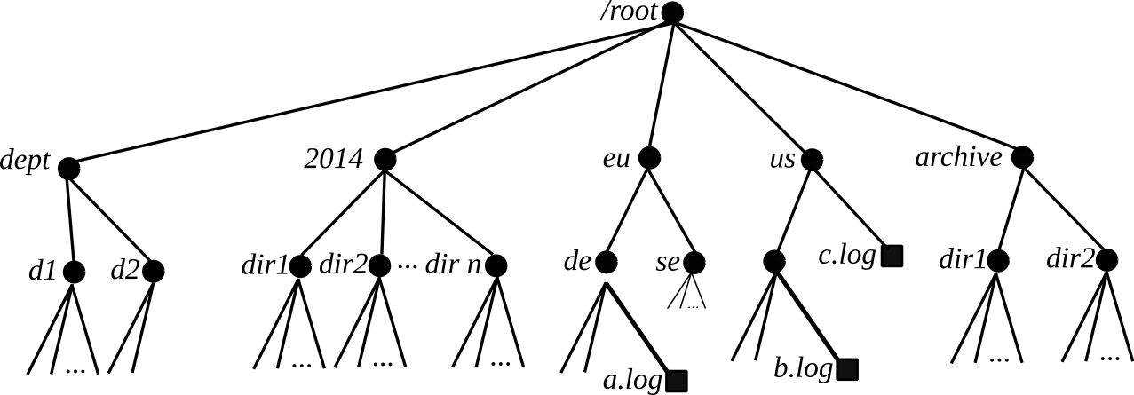
Metadata Locking

Slide 60
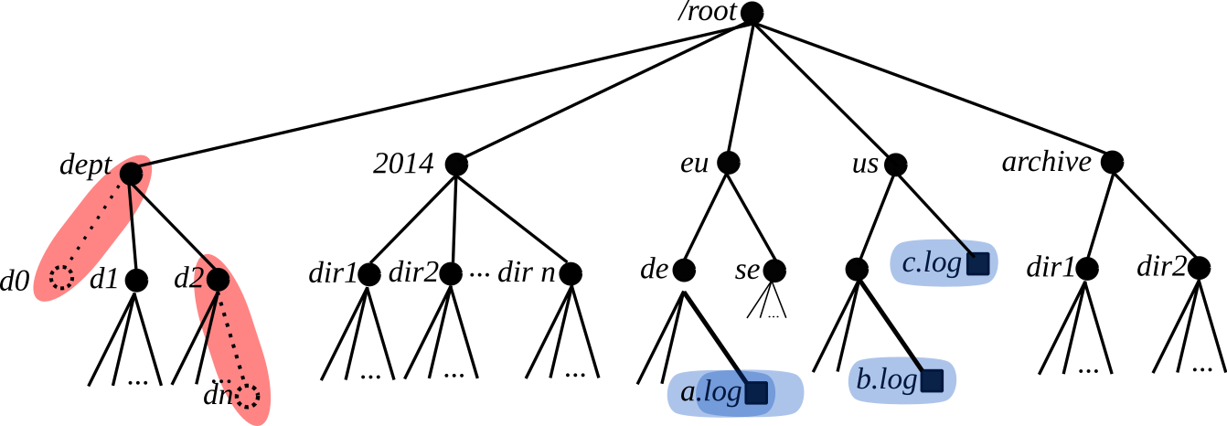
Metadata Locking (contd.)
Exclusive Lock
Shared Lock
Notes:
The ramification of some directory operations, such as, rename and delete, can inconsistencies or failure of file system operations on the same subtree

Slide 61
Subtree Operations

Slide 62
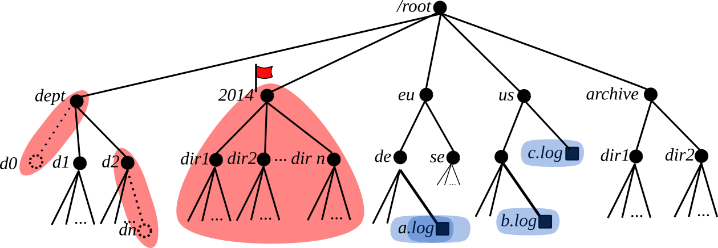
Metadata Locking (contd.)
Exclusive Lock
Shared Lock
Subtree Lock

Slide 63
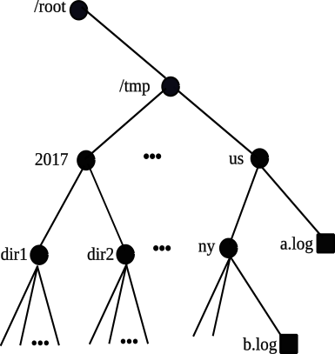
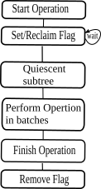
Subtree Locking
Subtree operation
Stages

Slide 64
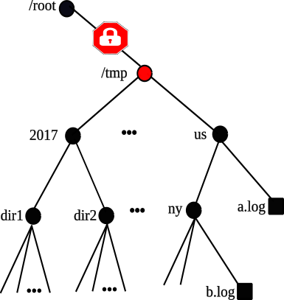
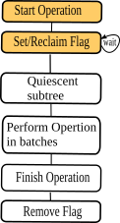
Subtree Locking (contd.)
Subtree operation
Stages
Subtree Locking
Progresses
Downwards

Slide 65
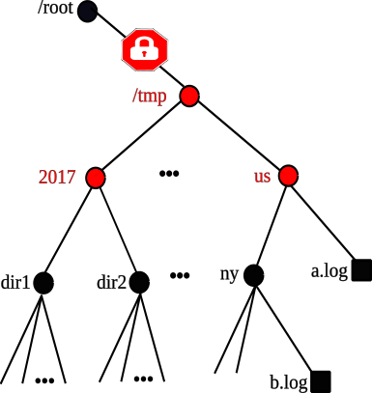
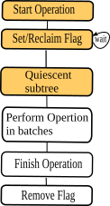
Subtree Locking (contd.)
Subtree operation
Stages
Subtree Locking
Progresses
Downwards

Slide 66
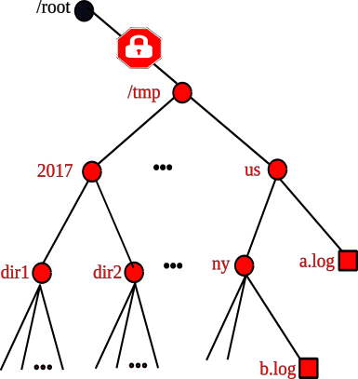
Subtree Locking (contd.)
Subtree operation
Stages
Subtree Locking
Progresses
Downwards

Slide 67
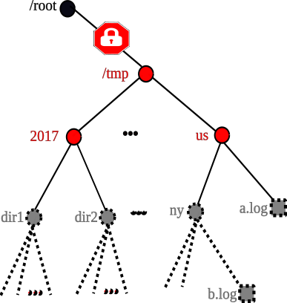
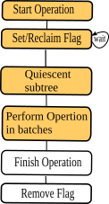
Subtree Locking (contd.)
Subtree operation
Stages
Delete
Progresses
Upwards

Slide 68
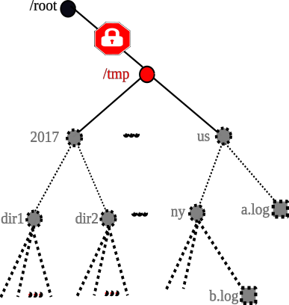
Subtree Locking (contd.)
Subtree operation
Stages
Delete
Progresses
Upwards

Slide 69
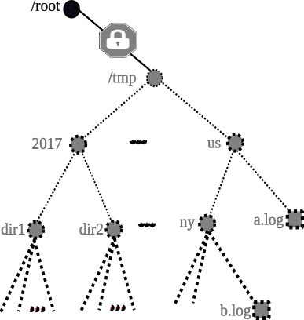
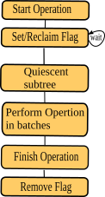
Subtree Locking (contd.)
Subtree operation
Stages
Delete
Progresses
Upwards

Slide 70
Failures during Subtree Operations
All subtree operations are implemented in such a way that if the operations fail halfway, then the namespace is not left in an inconsistent state.
If the NameNode executing the operation failed, the next NameNode to access the root of the subtree will reclaim the subtree lock (as the old NameNode will be marked as dead by the group membership service)

Slide 71
Evaluation

Slide 72
Evaluation
On Premise
Dual Intel® Xeon® E5-2620 v3 @ 2.40GHz,
256 GB RAM, 4 TB Disks
10 GbE
0.1 ms ping latency between nodes

Slide 73
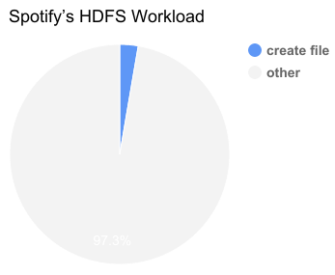
Evaluation
On Premise
Dual Intel® Xeon® E5-2620 v3 @2.40GHz
256 GB RAM, 4 TB Disks
10 GbE
0.1 ms ping latency between nodes

Slide 74
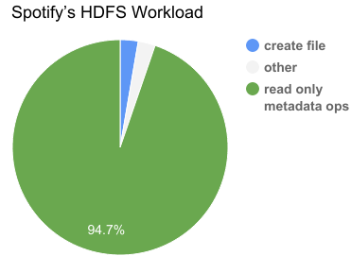
Evaluation
On Premise
Dual Intel® Xeon® E5-2620 v3 @2.40GHz
256 GB RAM, 4 TB Disks
10 GbE
0.1 ms ping latency between nodes

Slide 75
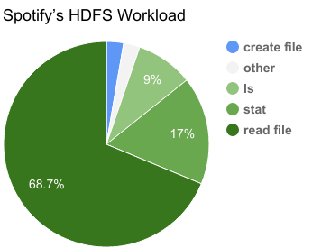
Evaluation
On Premise
Dual Intel® Xeon® E5-2620 v3 @2.40GHz
256 GB RAM, 4 TB Disks
10 GbE
0.1 ms ping latency between nodes

Slide 76
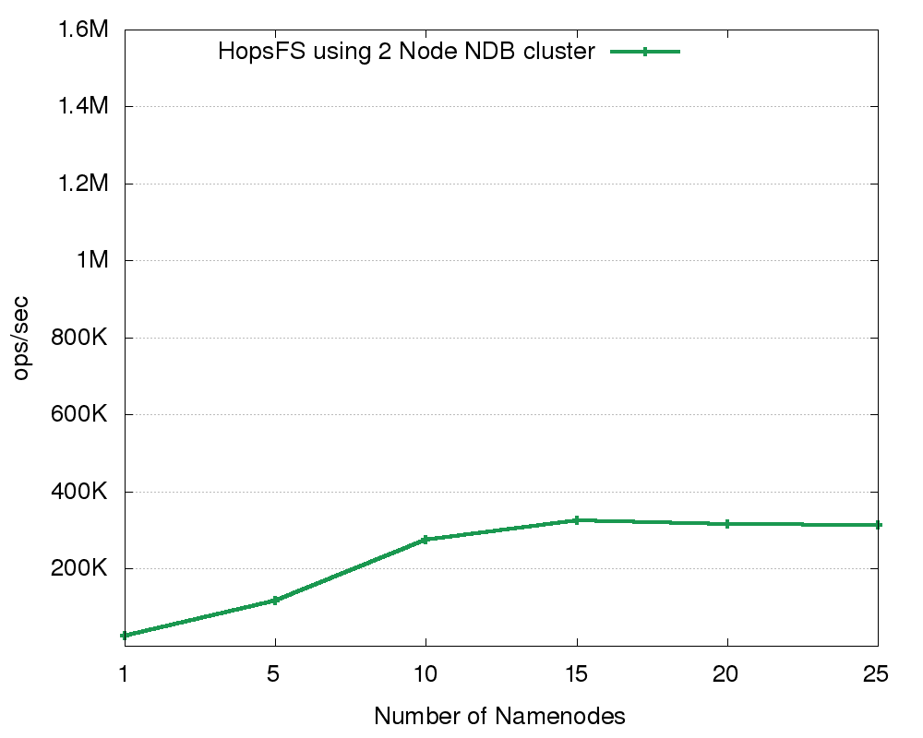
Evaluation: Industrial Workload

Slide 77
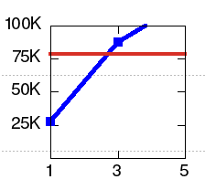
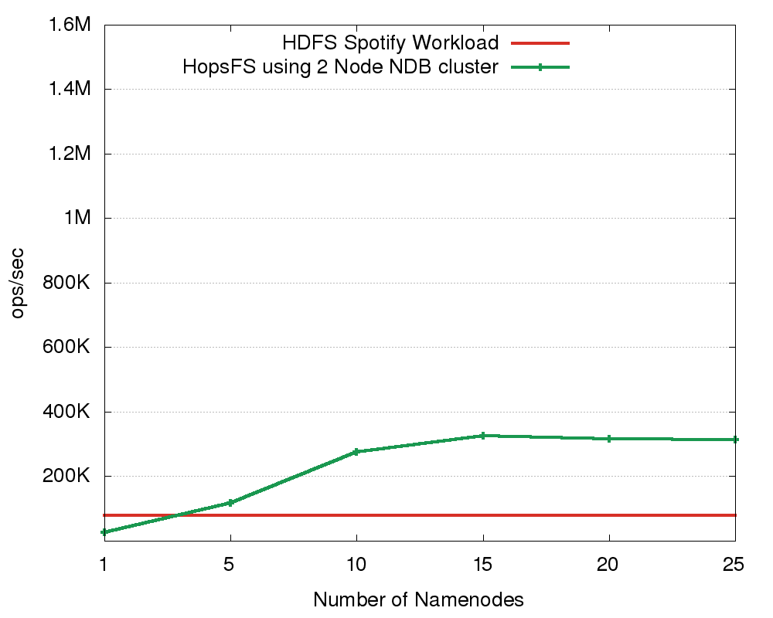
Evaluation: Industrial Workload
HopsFS outperforms with equivalent hardware: HA-HDFS with Five Servers
1 Active Namenode
1 Standby NameNode
3 Servers
Journal Nodes
ZooKeeper Nodes

Slide 78
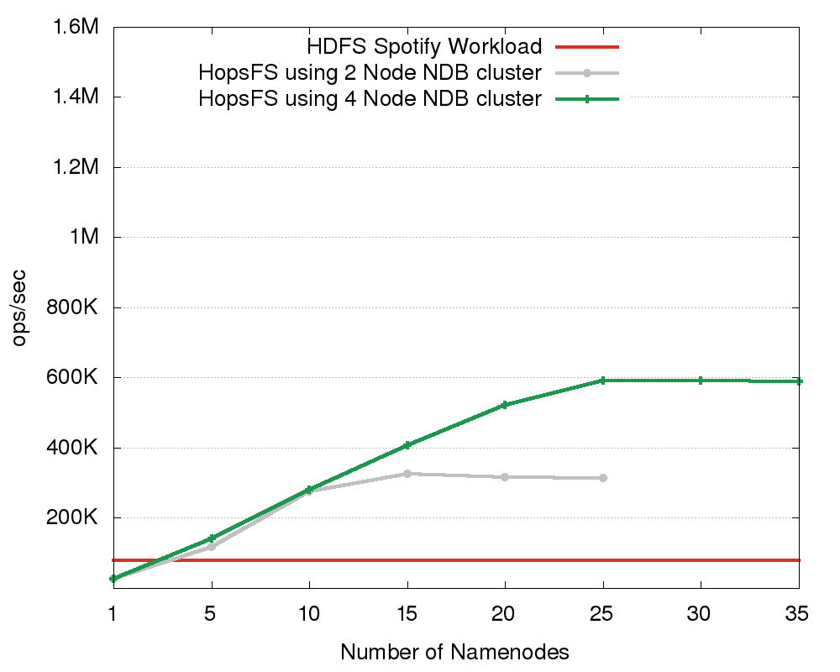
Evaluation: Industrial Workload (contd.)

Slide 79
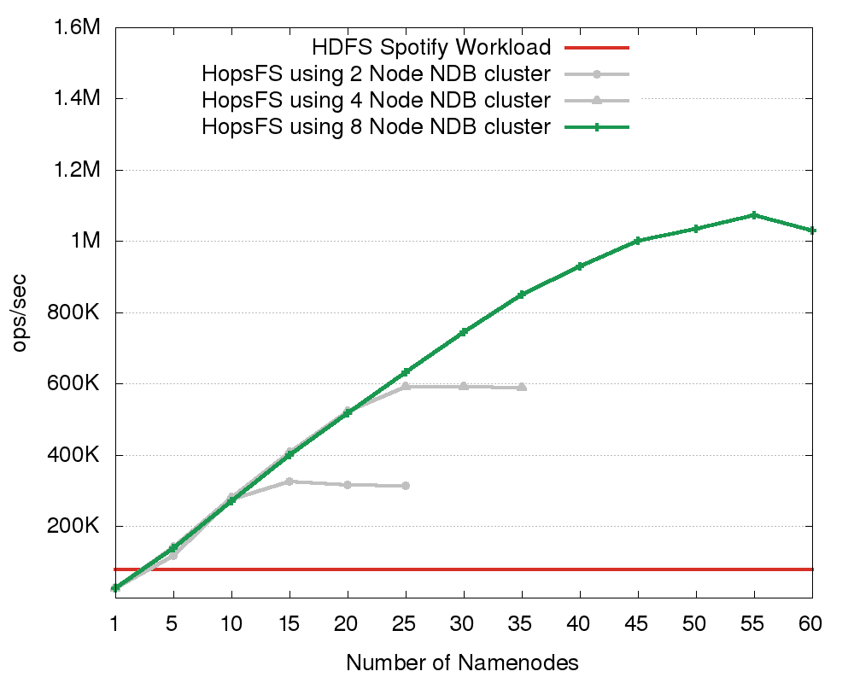
Evaluation: Industrial Workload (contd.)

Slide 80
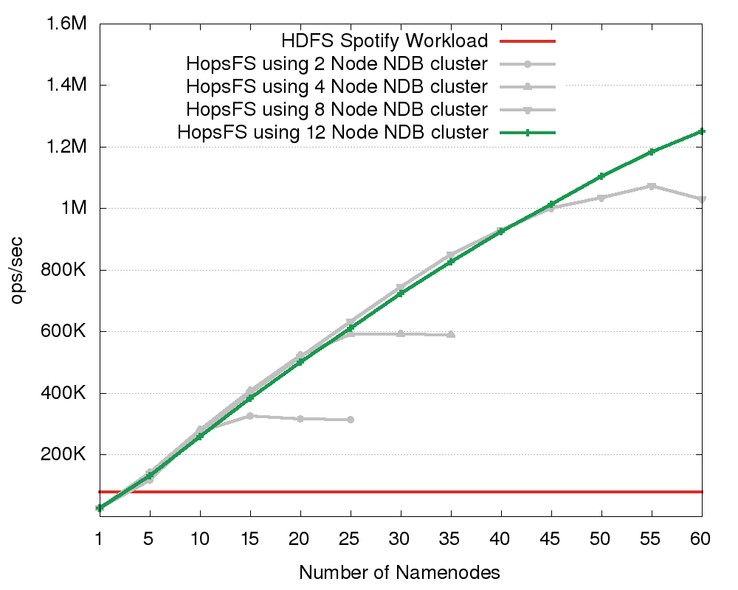
Evaluation: Industrial Workload (contd.)
Notes:
12-ndbds is a slightly lower performance that 8-ndbds, as we still have a small number of scans that don’t scale as well for larger numbers of ndbds.

Slide 81
Evaluation: Industrial Workload (contd.)
16X the performance of HDFS.
Further scaling possible with more hardware

Slide 82
Write Intensive workloads
Workloads | HopsFS ops/sec | HDFS ops/sec | Scaling Factor
Synthetic Workload (5.0% File Writes) | 1.19 M | 53.6 K | 22
Synthetic Workload (10% File Writes) | 1.04 M | 35.2 K | 30
Synthetic Workload (20% File Writes) | 0.748 M | 19.9 K | 37
Scalability of HopsFS and HDFS for write intensive workloads

Slide 83
Write Intensive workloads
Workloads | HopsFS ops/sec | HDFS ops/sec | Scaling Factor
Synthetic Workload (5.0% File Writes) | 1.19 M | 53.6 K | 22
Synthetic Workload (10% File Writes) | 1.04 M | 35.2 K | 30
Synthetic Workload (20% File Writes) | 0.748 M | 19.9 K | 37
Scalability of HopsFS and HDFS for write intensive workloads

Slide 84
Metadata Scalability
HDFS Metadata 200 GB → Max 500 million files/directories

Slide 85
Metadata Scalability
HDFS Metadata 200 GB → Max 500 million files/directories
HopsFS Metadata 24 TB → Max 17 Billion files/directories
37 times more files than HDFS

Slide 86
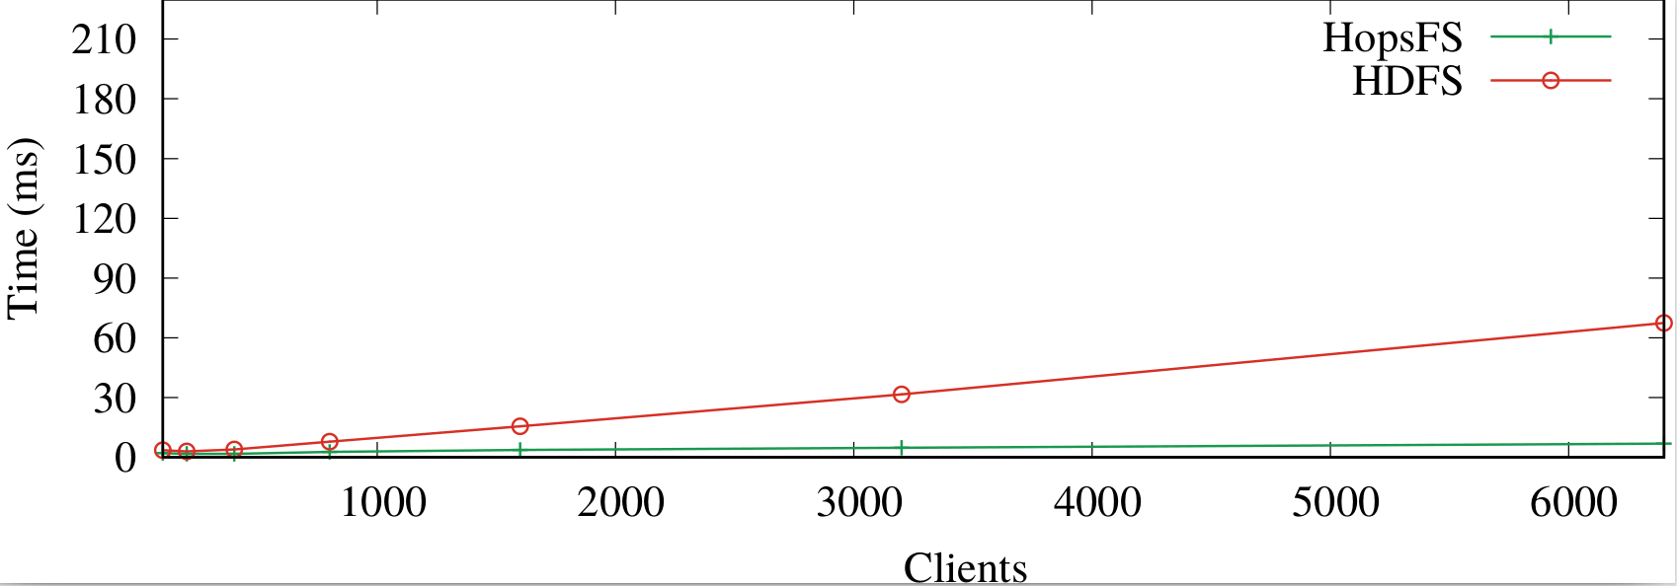
Operational Latency
File System Clients
No of Clients | HopsFS Latency | HDFS Latency
50 | 3.0 | 3.1

Slide 87
Operational Latency
File System Clients
No of Clients | HopsFS Latency | HDFS Latency
50 | 3.0 | 3.1
1500 | 3.7 | 15.5

Slide 88
Operational Latency
File System Clients
No of Clients | HopsFS Latency | HDFS Latency
50 | 3.0 | 3.1
1500 | 3.7 | 15.5
6500 | 6.8 | 67.4

Slide 89
Operational Latency
File System Clients
For 6500 clients HopsFS has 10 times lower latency than HDFS
No of Clients | HopsFS Latency | HDFS Latency
50 | 3.0 | 3.1
1500 | 3.7 | 15.5
6500 | 6.8 | 67.4

Slide 90

Production-quality distributed hierarchical file system with transactional distributed metadata
HopsFS has 16X-37X the throughput of HDFS, with even higher throughput possible with more hardware
Conclusion
HopsFS
HDFS
Notes:
HopsFS is all about scalability

Slide 91



Questions
http://www.hops.io
http://github.com/hopshadoop
@hopshadoop

Slide 92
Backup Slides

Slide 93
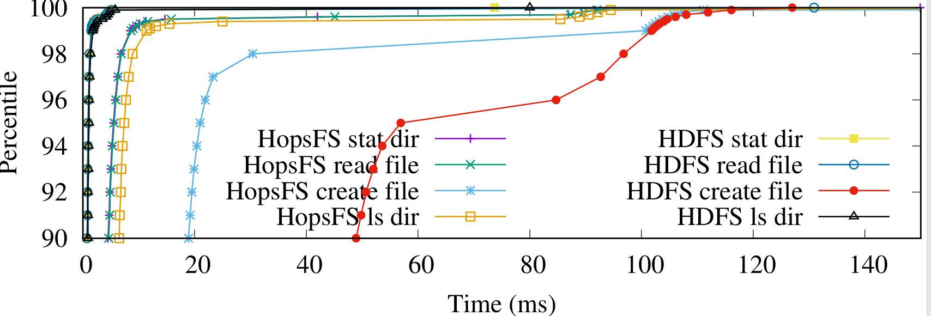
Operational Latency
Operation | HopsFS(ms) | HDFS(ms)
Create File | 100.8 | 101.8
Read File | 8.6 | 1.5
ls dir | 11.4 | 0.9
stat | 8.5 | 1.5
99th Percentiles

Slide 94
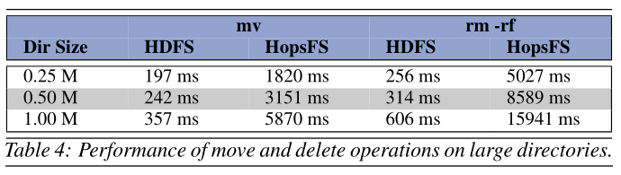
Subtree operations

Slide 95
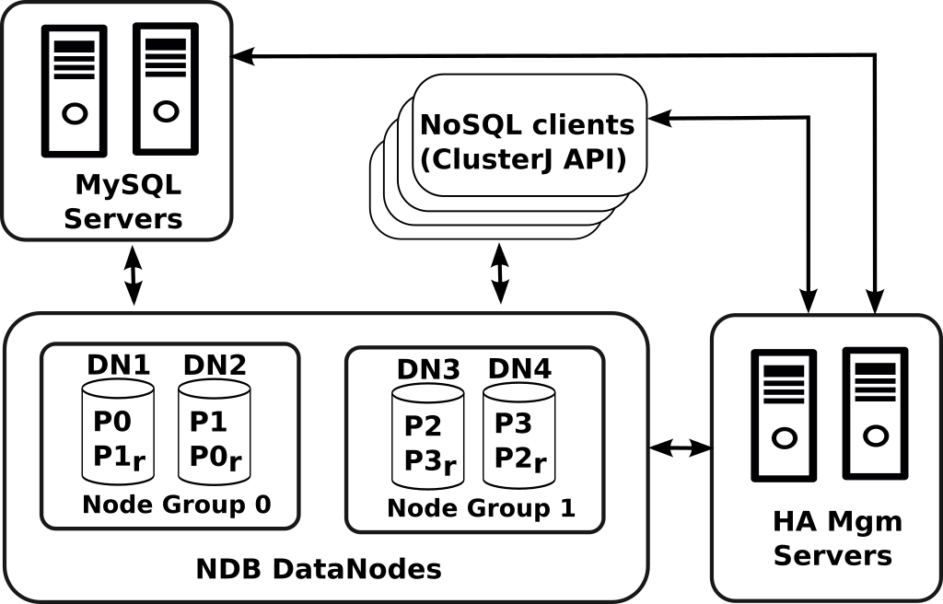
NDB Architecture
A Global Checkpoint occurs every few seconds, when transactions for all nodes are synchronized and the redo-log is flushed to disk.

Slide 96
Transaction Isolation Levels, Read Phenomena
Isolation level | Dirty reads | Non-repeatable reads | Phantoms
Read Uncommitted | may occur | may occur | may occur
Read Committed | - | may occur | may occur
Repeatable Read | - | - | may occur
Serializable | - | - | -

Slide 97
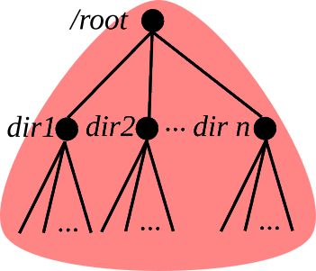
HDFS Namespace Locking Mechanism
Multi-reader, single-writer concurrency semantics

Slide 98
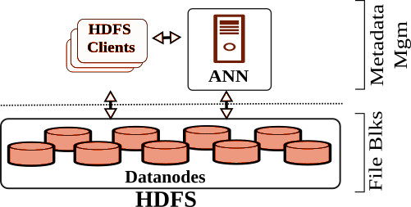
Hadoop Distributed File System

Slide 99
Hadoop Distributed File System

Slide 100
Hadoop Distributed File System

Slide 101
Hadoop Distributed File System

Slide 102
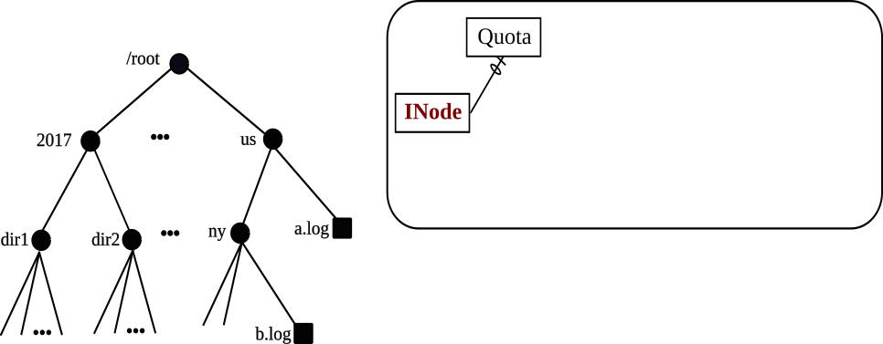
HopsFS Metadata
Database Entity Relationship Diagram

Slide 103
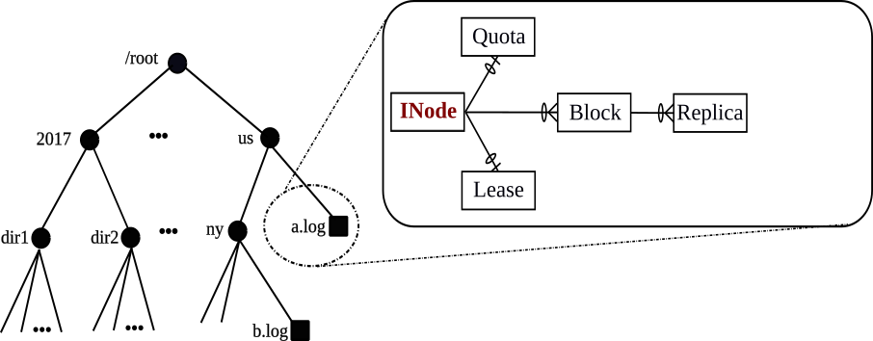
HopsFS Metadata
Database Entity Relationship Diagram

Slide 104
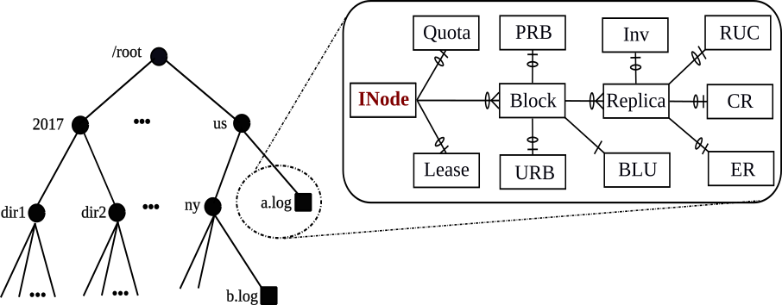
HopsFS Metadata
Database Entity Relationship Diagram

Slide 105
MySQL Cluster Network Database Engine (NDB)
NewSQL (Relational) DB
User-defined partitioning
Row-level Locking
Distribution-aware transactions
Partition-pruned Index Scans
Batched Primary Key Operations
Commodity Hardware
Scales to 48 database nodes
In-memory, but supports on-disk columns
SQL API
C++/Java Native API
C++ Event API

Slide 106
MySQL Cluster
Network Database Engine (NDB)
Real Time, 2-Phase Commit
Transaction Coordinator Failure detection in 6 seconds**
Transparent Transaction Coordinator failover
Transaction participant failure detection in 1.2 seconds**
(Aborted transactions are retried by HopsFS)
High Performance*
200 Million NoSQL Ops/Sec
2.5 Million SQL Ops/Sec
*https://www.mysql.com/why-mysql/benchmarks/mysql-cluster/
**Configuration used by HopsFS

Slide 107
INode Table |  |  |  |  | Block Table |  |  |  | Replica Table
Inode_ID | Name | Parent_ID | ... |  | Block_ID | Inode_ID | ... |  | Inode_ID | Block_ID | DataNode_ID | ...
/
user
F1 F2 F3
MySQL Cluster
Partition 1 |  | Partition 2 |  | Partition 3 |  | Partition 4

Slide 108
Failures during Subtree Operations
All subtree operations are implemented in such a way that if the operations fail halfway, then the namespace is not left in an inconsistent state.
If the NameNode executing the operation failed, the next NameNode to access the root of the subtree will reclaim the subtree lock (as the old NameNode will be marked as dead by the group membership service)

Slide 109
/
Start Transaction
Metadata Read
/
user
F4 (Does not exist)
/
Start Transaction
Metadata Read
/
/user
F4 (Does not exist)
user
user
F1 F2 F3
F1 F2 F3
/
/
Start Transaction
Metadata Read
/
user
New Metadata
F4
Commit Transaction
Start Transaction
Metadata Read
/
user
New Metadata
F4
Commit Transaction
user
user
F1 F2 F3
F1 F2 F3

Slide 110
Read Committed Transaction With Locking
/
Start Transaction
Metadata Read
/
Exclusive Lock
user
/
Start Transaction
Metadata Read
/
Exclusive Lock
user
user
user
F1 F2 F3
F1 F2 F3
/
Start Transaction
Metadata Read
/
Exclusive Lock
user
New Metadata
F4
Commit Transaction
user
F1 F2 F3 F4
/
Start Transaction
Metadata Read
/
Exclusive Lock
user
user
F1 F2 F3 F4

Slide 111
Read Committed Transaction With Locking
/
Start Transaction
Metadata Read
/
Exclusive Lock
user
/
Start Transaction
Metadata Read
/
Exclusive Lock
user
user
user
F1 F2 F3
F1 F2 F3
/
Start Transaction
Metadata Read
/
Exclusive Lock
user
New Metadata
F4
Commit Transaction
user
F1 F2 F3 F4
/
Start Transaction
Metadata Read
/
Exclusive Lock
user
user
F1 F2 F3 F4

Slide 112
HopsFS Transactional Operations
$> cat /user/F1
1. Get hints from the inodes hint cache
2. Set partition key hint for the transaction
BEGIN TRANSACTION
LOCK PHASE:
3. Using the inode hints, batch read all inodes
up to the penultimate inode in the path
4. If (cache miss || invalid path component) then
recursively resolve the path & update the cache
5. Lock and read the last inode
6. Read Lease, Quota, Blocks, Replica, URB, PRB, RUC,
CR, ER, Inv using partition pruned index scans
EXECUTE PHASE:
7. Process the data stored in the transaction cache
UPDATE PHASE:
8. Transfer the changes to database in batches
COMMIT/ABORT TRANSACTION
MySQL Cluster
Partition 1 |  | Partition 2 |  | Partition 3 |  | Partition 4
/ |  | user |  | F1 |  | [{3,1},{3,2},{3,3}
 |  |  |  | F2 |  | ],[{3,1,1},{3,1,2},
 |  |  |  | F3 |  | {3,1,3},{3,2,4}
 |  |  |  |  |  | …{3,3,9}]

Slide 113
HopsFS Transactional Operations
$> cat /user/F1
1. Get hints from the inodes hint cache
2. Set partition key hint for the transaction
BEGIN TRANSACTION
LOCK PHASE:
3. Using the inode hints, batch read all inodes
up to the penultimate inode in the path
4. If (cache miss || invalid path component) then
recursively resolve the path & update the cache
5. Lock and read the last inode
6. Read Lease, Quota, Blocks, Replica, URB, PRB, RUC,
CR, ER, Inv using partition pruned index scans
EXECUTE PHASE:
7. Process the data stored in the transaction cache
UPDATE PHASE:
8. Transfer the changes to database in batches
COMMIT/ABORT TRANSACTION
MySQL Cluster
Partition 1 |  | Partition 2 |  | Partition 3 |  | Partition 4
/ |  | user |  | F1 |  | [{3,1},{3,2},{3,3}
 |  |  |  | F2 |  | ],[{3,1,1},{3,1,2},
 |  |  |  | F3 |  | {3,1,3},{3,2,4}
 |  |  |  |  |  | …{3,3,9}]

Slide 114
HopsFS Transactional Operations
$> cat /user/F1
1. Get hints from the inodes hint cache
2. Set partition key hint for the transaction
BEGIN TRANSACTION
LOCK PHASE:
3. Using the inode hints, batch read all inodes
up to the penultimate inode in the path
4. If (cache miss || invalid path component) then
recursively resolve the path & update the cache
5. Lock and read the last inode
6. Read Lease, Quota, Blocks, Replica, URB, PRB, RUC,
CR, ER, Inv using partition pruned index scans
EXECUTE PHASE:
7. Process the data stored in the transaction cache
UPDATE PHASE:
8. Transfer the changes to database in batches
COMMIT/ABORT TRANSACTION
MySQL Cluster
Partition 1 |  | Partition 2 |  | Partition 3 |  | Partition 4
/ |  | user |  | F1 |  | [{3,1},{3,2},{3,3}
 |  |  |  | F2 |  | ],[{3,1,1},{3,1,2},
 |  |  |  | F3 |  | {3,1,3},{3,2,4}
 |  |  |  |  |  | …{3,3,9}]

Slide 115
HopsFS Transactional Operations
$> cat /user/F1
1. Get hints from the inodes hint cache
2. Set partition key hint for the transaction
BEGIN TRANSACTION
LOCK PHASE:
3. Using the inode hints, batch read all inodes
up to the penultimate inode in the path
4. If (cache miss || invalid path component) then
recursively resolve the path & update the cache
5. Lock and read the last inode
6. Read Lease, Quota, Blocks, Replica, URB, PRB, RUC,
CR, ER, Inv using partition pruned index scans
EXECUTE PHASE:
7. Process the data stored in the transaction cache
UPDATE PHASE:
8. Transfer the changes to database in batches
COMMIT/ABORT TRANSACTION
MySQL Cluster
Partition 1 |  | Partition 2 |  | Partition 3 |  | Partition 4
/ |  | user |  | F1 |  | [{3,1},{3,2},{3,3}
 |  |  |  | F2 |  | ],[{3,1,1},{3,1,2},
 |  |  |  | F3 |  | {3,1,3},{3,2,4}
 |  |  |  |  |  | …{3,3,9}]

Slide 116
HopsFS Transactional Operations
$> cat /user/F1
1. Get hints from the inodes hint cache
2. Set partition key hint for the transaction
BEGIN TRANSACTION
LOCK PHASE:
3. Using the inode hints, batch read all inodes
up to the penultimate inode in the path
4. If (cache miss || invalid path component) then
recursively resolve the path & update the cache
5. Lock and read the last inode
6. Read Lease, Quota, Blocks, Replica, URB, PRB, RUC,
CR, ER, Inv using partition pruned index scans
EXECUTE PHASE:
7. Process the data stored in the transaction cache
UPDATE PHASE:
8. Transfer the changes to database in batches
COMMIT/ABORT TRANSACTION
MySQL Cluster
Partition 1 |  | Partition 2 |  | Partition 3 |  | Partition 4
/ |  | user |  | F1 |  | [{3,1},{3,2},{3,3}
 |  |  |  | F2 |  | ],[{3,1,1},{3,1,2},
 |  |  |  | F3 |  | {3,1,3},{3,2,4}
 |  |  |  |  |  | …{3,3,9}]

Slide 117
HopsFS Transactional Operations
$> cat /user/F1
1. Get hints from the inodes hint cache
2. Set partition key hint for the transaction
BEGIN TRANSACTION
LOCK PHASE:
3. Using the inode hints, batch read all inodes
up to the penultimate inode in the path
4. If (cache miss || invalid path component) then
recursively resolve the path & update the cache
5. Lock and read the last inode
6. Read Lease, Quota, Blocks, Replica, URB, PRB, RUC,
CR, ER, Inv using partition pruned index scans
EXECUTE PHASE:
7. Process the data stored in the transaction cache
UPDATE PHASE:
8. Transfer the changes to database in batches
COMMIT/ABORT TRANSACTION
MySQL Cluster
Partition 1 |  | Partition 2 |  | Partition 3 |  | Partition 4
/ |  | user |  | F1 |  | [{3,1},{3,2},{3,3}
 |  |  |  | F2 |  | ],[{3,1,1},{3,1,2},
 |  |  |  | F3 |  | {3,1,3},{3,2,4}
 |  |  |  |  |  | …{3,3,9}]

Slide 118
HopsFS Transactional Operations
$> cat /user/F1
1. Get hints from the inodes hint cache
2. Set partition key hint for the transaction
BEGIN TRANSACTION
LOCK PHASE:
3. Using the inode hints, batch read all inodes
up to the penultimate inode in the path
4. If (cache miss || invalid path component) then
recursively resolve the path & update the cache
5. Lock and read the last inode
6. Read Lease, Quota, Blocks, Replica, URB, PRB, RUC,
CR, ER, Inv using partition pruned index scans
EXECUTE PHASE:
7. Process the data stored in the transaction cache
UPDATE PHASE:
8. Transfer the changes to database in batches
COMMIT/ABORT TRANSACTION
MySQL Cluster
Partition 1 |  | Partition 2 |  | Partition 3 |  | Partition 4
/ |  | user |  | F1 |  | [{3,1},{3,2},{3,3}
 |  |  |  | F2 |  | ],[{3,1,1},{3,1,2},
 |  |  |  | F3 |  | {3,1,3},{3,2,4}
 |  |  |  |  |  | …{3,3,9}]

Slide 119
HopsFS Transactional Operations
$> cat /user/F1
1. Get hints from the inodes hint cache
2. Set partition key hint for the transaction
BEGIN TRANSACTION
LOCK PHASE:
3. Using the inode hints, batch read all inodes
up to the penultimate inode in the path
4. If (cache miss || invalid path component) then
recursively resolve the path & update the cache
5. Lock and read the last inode
6. Read Lease, Quota, Blocks, Replica, URB, PRB, RUC,
CR, ER, Inv using partition pruned index scans
EXECUTE PHASE:
7. Process the data stored in the transaction cache
UPDATE PHASE:
8. Transfer the changes to database in batches
COMMIT/ABORT TRANSACTION
MySQL Cluster
Partition 1 |  | Partition 2 |  | Partition 3 |  | Partition 4
/ |  | user |  | F1 |  | [{3,1},{3,2},{3,3}
 |  |  |  | F2 |  | ],[{3,1,1},{3,1,2},
 |  |  |  | F3 |  | {3,1,3},{3,2,4}
 |  |  |  |  |  | …{3,3,9}]

