Slide 1
Usurp: Distributed NAT Traversal for Overlay Networks
Salman Niazi, Jim Dowling
salman,jdowling@sics.se
Swedish Institute of Computer Science

Slide 2
Usurp
A NAT-aware message routing service, implemented as an overlay network.
Nodes primarily use structured overlay network (SON) IDs as network endpoints.
Build NAT-traversing P2P applications!
Peer-to-Peer (P2P) apps are layered over Usurp middleware so that they both traverse NATs and can make NAT-aware connection decisions.

Slide 3

Client-Server NAT Infrastructure
NAT Type
Indentification
Message
Relaying
Hole-Punching
for UDP
STUN
Servers
TURN
Servers
Rendezvous
Servers
Stateless
2 Public IPs
Stateful
High B/W
Stateful
Low Latency
P2P Network
Requires additional addressing/routing support to enable communication with private nodes!
Notes:
Stun servers are stateless.
Challenges:
Stun servers require 2 public IP addresses.
Turn and Rendezvous servers are stateful. Needs lots of them as the system scales.

Slide 4
Distributed NAT Infrastructure
Public Nodes have an Open IP address or support the UPnP IGD profile.
SON of Public Nodes
Addressing/Routing,
STUN,
TURN,
Rendezvous services
P2P Network
Private Nodes are behind NATs/firewalls and become clients of public nodes.

Slide 5
background on nats

Slide 6


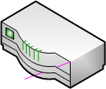
NAT Devices
NAT devices differ in many application-observable aspects.
NAT port mappings,
Trafﬁc ﬁltering,
NAT binding timeouts,
ICMP handling,
Queuing,
Hair pinning,
Buffer sizes
192.168.1.1
78.229.32.1
Internet
192.168.1.121
192.168.1.54
IETF NAT Behavioral Requirements standards not adopted yet by manufacturers.
Notes:
NAT Gateways allow the use of many private IP addresses behind a single public IP address
Solve the IP shortage problem
Using NATs doesn’t affect clients in client-server Internet services
HTTP, SMTP, IMAP, SSH, FTP, DNS, etc
NAT Gateways present a connectivity problem for Peer-to-Peer (P2P) apps
Only 20-40% of nodes are public nodes in existing systems.
Active Queue Management (vs Drop tail behaviour)
NAT behaviour is vendor-specific, but several common behaviours:
NATs create transient mappings between private (ip:port) and public (ip:port) bindings.
NATs exhibit differing packet filtering rules when mapping from public to private address space.
NAT has at least 2 Network Interfaces: private network interface, public network interface.
You can also have multi-layer NATs, Corporate NATs (many public network interfaces).
There is no standard for NAT behaviour, although there are now recommended behaviours:
IETF Network Address Translation (NAT) Behavioral Requirements for Unicast UDP
NAT Behavioral Requirements for ICMP
NAT behaviour is vendor-specific, but several common behaviours:
NATs create transient mappings between private (ip:port) and public (ip:port) bindings.
NATs exhibit differing packet filtering rules when mapping from public to private address space.

Slide 7
USURP

Slide 8
Usurp Component Architecture
Both Public & Private Nodes
Public Nodes
Only
Notes:
Also have a Bootstrap Client here!

Slide 9
NAT type identification using DISTRIBUTED STUN

Slide 10
NAT Type Classification
We use the BEHAVE RFC [1].
Defines NAT behaviour as a set of policies:
Port Allocation
Port Mapping
Port Filtering
NAT Binding Timeout
X
Symmetric
Port-Restricted
Partial-Cone
Full-Cone

Slide 11
NAT Port Allocation Policy
NAT with Public IP = 124.29.31.1
Source IP:port
NAT Port
Destination IP:port
Port Allocation Policy
192.168.1.12:4983
4983
134.229.81.12:8888
Preservation
192.168.1.12:4983
56000
121.85.141.13:6543
Contiguity
192.168.1.12:4983
54832
184.121.54.83:1234
Random
Preservation
Contiguity
Random
:54832
:56000
:4983
192.168.1.12:4983
134.22.81.12:8888
184.121.54.83:1234
121.85.141.13:6543
56000 +∆
Notes:
When a packet is sent out from a certain private endpoint of a node behind a gateway
to some public endpoint, a rule in the NAT table is created.
Symmetric NATs sometimes have a random port allocation policy.

Slide 12
Port Mapping Policy
Source IP:port
NAT Port
Destination IP:port
192.168.1.12:4983
4983
134.22.81.12:8888
134.22.81.12:6543
184.121.54.8:1234
Endpoint Independent Mapping
(Preservation)
Source IP:port
NAT Port
Destination IP:port
192.168.1.12:4983
56000
134.22.81.12:8888
134.22.81.12:6543
Host Dependent Mapping
(Contiguity)
192.168.1.12:4983
56001
184.121.54.8:1234
Source IP:port
NAT Port
Destination IP:port
192.168.1.12:4983
13545
134.22.81.12:8888
Port Dependent Mapping
(Random)
192.168.1.12:4983
45352
134.22.81.12:6543
192.168.1.12:4983
6957
184.121.54.8:1234

Slide 13
NAT Port Filtering Policy
Port Filtering Policy
Source IP:port
NAT Port
Destination IP:port
EI
HD
PD
Incoming Packet
192.168.1.12:4983
4983
134.229.81.12:8888
Y
Y
Y
134.229.81.12:8888
Y
Y
N
134.229.81.12:7856
Y
N
N
85.185.241.13:6543
134.22.81.12:8888
134.22.81.12:7856
192.168.1.12:4983
85.185.241.13:6543
EI =Endpoint Independent; HD=Host Dependent; PD=Port Dependent
Notes:
Symmetric NATs often have a port-dependent filtering policy.
Port-Restricted NATs often have a port-dependent filtering policy.
Partial-Cone NATs have a host-dependent filtering policy.
Full-Cone NATs have an endpoint-independent filtering policy.
Symmetric = {<EI Filt, Random}
Full-Cone = {EI, Random}
Partial-Cone
Port-Restricted Cone

Slide 14
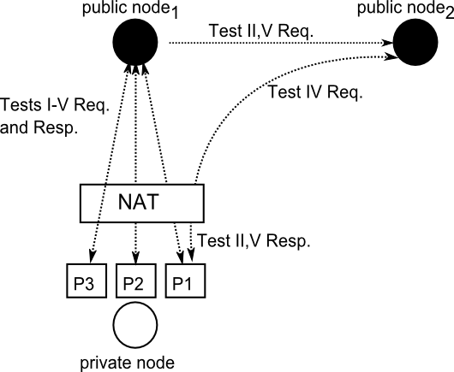
Distributed STUN
Identifies the NAT Type:
Mapping, Port Allocation and Filtering Polices & Binding Timeout
Notes:
Can re-run this protocol during application lifetime if one has a NAT that changes its type: e.g., corporate NATs

Slide 15
ADDRESSING, ROUTING and connection establishment

Slide 16
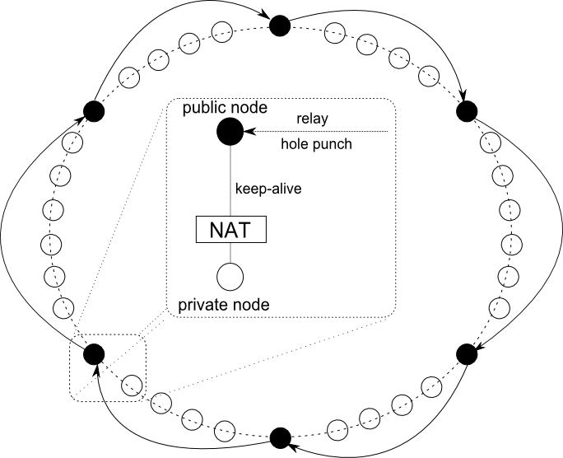
SON for Addressing and Routing
Successor-list replication can be used so that private nodes have several parents
Parent failure identified using private->public node heartbeats & p-stabilization.
Notes:
If you are using successor-list replication, and periodic stabilization identifies a dead node, you may be a parent of the failed node, and inform it that its parent has died.
A child then has to find a new parent – successor list replication is used for this.

Slide 17

Node Descriptors
SON key is used to connect to nodes
NAT type contains:
Mapping, Allocation, Filtering Policies
IP Endpoints
Single endpoint for public nodes
Multiple Parent Endpoints for private nodes
Timestamp for descriptor creation
Notes:
IP header = 20 Bytes
UDP header = 8 bytes
Usurp header (public node) = 35 bytes
Usurp header (private node, 3 parents) = 47 bytes

Slide 18
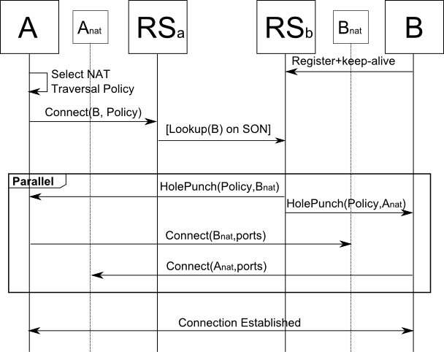
Connection Establishment
Parallelize connection attempts to private nodes by connecting to all its parents concurrently.
Notes:
Parallelized connection attempts is like parallel lookups on Kademlia.

Slide 19
NAT Hole Punching Strategies
Connection reversal
From public node to a private node
Simple Hole-Punching
Endpoint-Independent mapping or filtering
Port-prediction using Contiguity
Port-prediction using Preservation

Slide 20
NAT-Aware Connections
It is the combination of NAT types of 2 nodes that is important when connecting two nodes behind NATs [2].
B’s Parent
1. Bind port X and Connect(B, Policy)
2. Response: B’s NAT IP
2. Connect(A’s NAT IP/port)
3. Send msg to random port
at B’s NAT IP addr
4. Connect sent to port X on A’s NAT
A
B
HD Mapping, Preservation, PD Filter
PD Mapping, Random, PD Filter
Notes:
Rule-of-Thumb:
If a connection is initiated by a less restrictive NAT to a more restrictive NAT, the more restrictive NAT performs the hole punching

Slide 21
EXPERIMENTS

Slide 22
Experimental Evaluation
Evaluate performance of a Peer Sampling Service (Cyclon) in the presence of NATs.
Compare behaviour and performance of:
Baseline Cyclon (no NATs)
Cyclon (with NATs)
Cyclon over Usurp.
Message-level simulator using Kompics.
NAT emulator that emulates mapping, port allocation and filtering policies.

Slide 23
Cyclon Layered on Usurp

Slide 24
Experimental Setup
Ratio public to private nodes is set to 1:4
Percentages of NAT types are taken from [2].
Rule binding expiration time
Randomly chosen from {30, 60, 90, 120, 150, 180 sec}
Simulate multiple nodes behind a NAT.
Network size 1024 nodes.
Constant node arrival rate of 500ms.
Latencies modelled using the King Data Set [3]
Results average of 30 runs

Slide 25
Experiment Setup
Chord parameters
successor stabilization of 2 seconds
finger stabilization 3 seconds
Cyclon parameters
Cycle period 10 seconds
View size 15
Shuffle Length 5

Slide 26
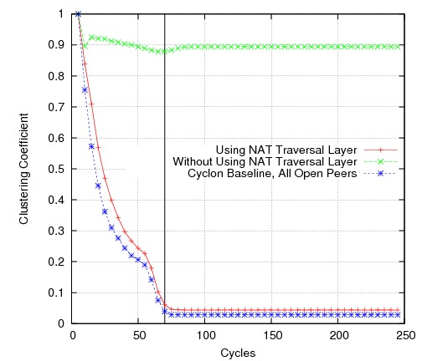
Clustering Coefficient

Slide 27
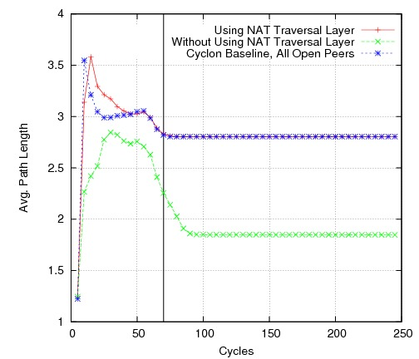
Average Path Length

Slide 28
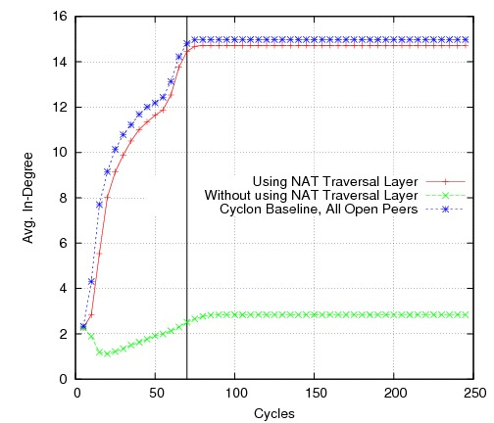
Average In-Degree

Slide 29
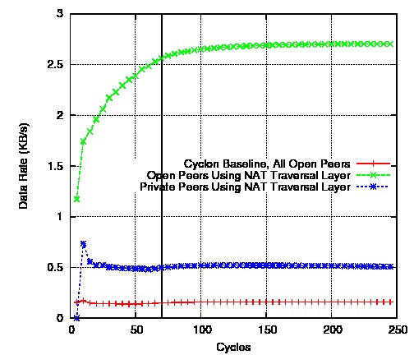
Usurp Overhead vs Time

Slide 30
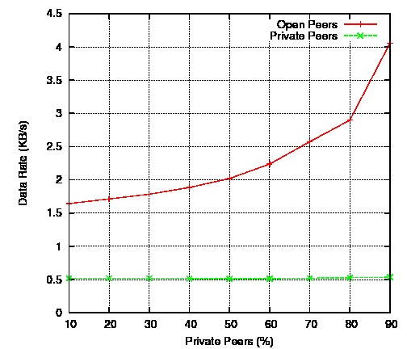
Overhead vs % Private Nodes

Slide 31
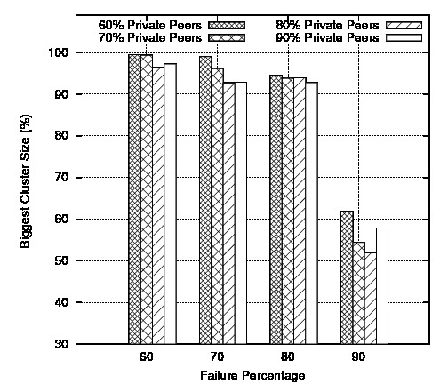
Massive Failure

Slide 32
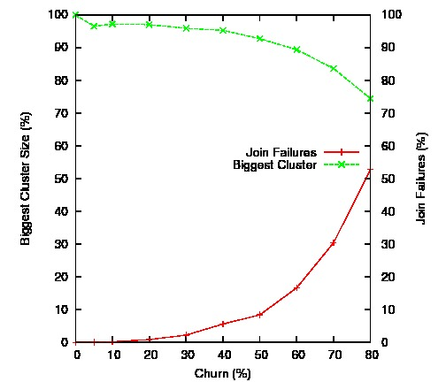
Churn: Percent failures/cycle
Notes:
How churn affects the SON
Join failures == failures of nodes to join the SON

Slide 33
Conclusions and Future Work
Presented a fully distributed message routing infrastructure for IP networks with NATs
P2P applications can be layered on Usurp.
Validated Usurp using a PSS
Acceptable overhead on public nodes for small networks
Working on integration of a SON that supports sub-second lookups

Slide 34
References
[1] BEHAVE RFC, Audet, F., Jennings, C.: Network address translation (nat) behavioral requirements for unicast udp (2007) IETF
[2] Roverso et al., Natcracker: Nat combinations matter, ICCC, 2009.
[3] Gummadi, K.P. et al, King: Estimating latency between arbitrary internet end hosts. In SIGCOMM Internet Measurement Workshop (2002)

