Slide 1

Leader Election Using NewSQL Database Systems
Salman Niazi, Mahmoud Ismail, Gautier Berthou and Jim Dowling

Slide 2
Content
Problem
Solution
Evaluation

Slide 3

Leader Election

Slide 4
Leader Election
Synchronous Systems
Asynchronous Systems
Eventually synchronous Systems

Slide 5
Leader Election (Eventually Synchronous System)

Slide 6

Problem
Multiple leaders
conflicting decisions
data corruption
all hell can break loose

Slide 7
Unique Leader Election
Essentially an agreement problem
Paxos
Hard to understand
Does not perform well for hundreds of servers
Total order atomic broadcast
Implementation ?

Slide 8

Leader Election
Out of the box solutions
Zookeeper, Chubby
Problems
Another service to maintain

Slide 9
A Typical Internet Application
Service A
Instance 1
Service B
Instance 1
Service C
Instance 1
Service D
Instance 1
Coordination Service
Service D
Instance 2
Service C
Instance 2
Service B
Instance 2
Service A
Instance 2
HA Database
(NewSQL DBs)
Leader Election Service

Slide 10
Thats not new?
Shared memory based LE
Guerraoui, R., Raynal, M.: A Leader Election Protocol for Eventually Synchronous Shared Memory Systems, pp. 75–80. IEEE Computer Society, Alamitos (2006)
Fernandez, A., Jimenez, E., Raynal, M.: Electing an eventual leader in an asynchronous shared memory system. In: Dependable Systems and Networks, DSN 2007, pp. 399–408 (June 2007)
Using 2PC Transaction
No existing work using 2PC Transaction
Some work using compare & swap primitives
Afek, Y., Stupp, G.: Optima Time-Space Tradeoff for Shared Memory Leader Election. Journal Algorithms 25(1): 95-117 (1997)
Serializable Transaction Isolation

Slide 11
Why NewSQL DB?
Relational Databases
Failures are considered to be rare
DB is unavailable until standby takes over
NewSQL
Are built to handle frequent node failures
There is no pause in DB service if a datanode fails
When a datanode fails the transactions can be quickly re-tried on other datanodes.

Slide 12
Problems with NewSQL
Many of the NewSQL DBs does not support Serializable Transaction
Poor scalability of serializable transactions especially in distributed environment

Slide 13
Contribution
Scalable leader election using NewSQL as shared memory
Majority of process uses weaker Tx isolation level than serializable Tx isolation level
Serialize only if needed -- > Greater Scalability
Combining 2PC and lease mechanism to ensure single leader at any given time
Transaction isolation using row level locking
Portable to many NewSQL Systems

Slide 14
Solution
Consists of two registers
Vars, Descriptors
Runs in rounds
In each round
Start Tx
Read all descriptors and variables
Save to local history
Update counter
if smallest Id
become leader, kick out dead processes and acquire a lease
Commit Tx

Slide 15
Solution
Vars Reg Descriptors Reg
MaxId: 3, RD: 2000ms, Evict Flag
P₀ ( Counter: 10, IP: … )
P₁ ( Counter: 11, IP: … )
P₂ ( Counter: 10, IP: … )
P₃ ( Counter: 12, IP: … )

Slide 16
Solution ( Periodic Counter Update)
Vars Reg Descriptors Reg
MaxId: 3, RD: 2000ms, Evict Flag
P₀ ( Counter: 11, IP: … )
P₁ ( Counter: 12, IP: … )
P₂ ( Counter: 11, IP: … )
P₃ ( Counter: 13, IP: … )

Slide 17
Solution (Join)
Vars Reg Descriptors Reg
MaxId: 4, RD: 2000ms, Evict Flag
P₀ ( Counter: 11, IP: … )
P₁ ( Counter: 12, IP: … )
P₂ ( Counter: 11, IP: … )
P₃ ( Counter: 13, IP: … )
P₄ ( Counter: 1, IP: … )

Slide 18
Solution (Non - Leader Failure)
Vars Reg Descriptors Reg
MaxId: 4, RD: 2000ms, Evict Flag
P₀ ( Counter: 11, IP: … )
P₁ ( Counter: 12, IP: … )
P₂ ( Counter: 11, IP: … )
P₃ ( Counter: 13, IP: … )
P₄ ( Counter: 1, IP: … )

Slide 19
Solution (Non - Leader Failure)
Vars Reg Descriptors Reg
MaxId: 4, RD: 2000ms, Evict Flag
P₀ ( Counter: 12, IP: … )
P₁ ( Counter: 12, IP: … )
P₂ ( Counter: 12, IP: … )
P₃ ( Counter: 14, IP: … )
P₄ ( Counter: 2, IP: … )

Slide 20
Solution (Non - Leader Failure)
Vars Reg Descriptors Reg
MaxId: 4, RD: 2000ms, Evict Flag
P₀ ( Counter: 13, IP: … )
P₁ ( Counter: 12, IP: … )
P₂ ( Counter: 13, IP: … )
P₃ ( Counter: 15, IP: … )
P₄ ( Counter: 3, IP: … )

Slide 21
Solution (Non - Leader Failure)
Vars Reg Descriptors Reg
MaxId: 4, RD: 2000ms, Evict Flag
P₀ ( Counter: 14, IP: … )
P₂ ( Counter: 14, IP: … )
P₃ ( Counter: 16, IP: … )
P₄ ( Counter: 4, IP: … )

Slide 22

Solution (Leader Failure)
Vars Reg Descriptors Reg
MaxId: 4, RD: 2000ms, Evict Flag
P₀ ( Counter: 14, IP: … )
P₂ ( Counter: 14, IP: … )
P₃ ( Counter: 16, IP: … )
P₄ ( Counter: 4, IP: … )
3.5 Sec left
Leader Process P₀

Slide 23
Solution (Leader Failure)
Vars Reg Descriptors Reg
MaxId: 4, RD: 2000ms, Evict Flag
P₀ ( Counter: 14, IP: … )
P₂ ( Counter: 14, IP: … )
P₃ ( Counter: 16, IP: … )
P₄ ( Counter: 4, IP: … )
3.5 Sec left
Leader Process P₀

Slide 24
Solution (Leader Failure)
Vars Reg Descriptors Reg
MaxId: 4, RD: 2000ms, Evict Flag
P₀ ( Counter: 14, IP: … )
P₂ ( Counter: 15, IP: … )
P₃ ( Counter: 17, IP: … )
P₄ ( Counter: 5, IP: … )
1.5 Sec left
Leader Process P₀

Slide 25
Solution (Leader Failure)
Vars Reg Descriptors Reg
MaxId: 4, RD: 2000ms, Evict Flag
P₀ ( Counter: 14, IP: … )
P₂ ( Counter: 16, IP: … )
P₃ ( Counter: 18, IP: … )
P₄ ( Counter: 6, IP: … )
lease expired
Leader Process: No Leader

Slide 26
Solution (Leader Failure)
Vars Reg Descriptors Reg
MaxId: 4, RD: 2000ms, Evict Flag
P₂ ( Counter: 17, IP: … )
P₃ ( Counter: 19, IP: … )
P₄ ( Counter: 7, IP: … )
Leader Process P₂

Slide 27
Solution (Re-Join)
Vars Reg Descriptors Reg
MaxId: 5, RD: 2000ms, Evict Flag
P₂ ( Counter: 17, IP: … )
P₃ ( Counter: 19, IP: … )
P₄ ( Counter: 7, IP: … )
P₅ ( Counter: 1, IP: … )

Slide 28
Transaction Isolation
Two groups of processes
Group A
Process that only update their counters
Majority of the processes
Group B
Leader Process
Process contending to become leader
New Processes
Relatively very few processes
No Serialization Needed
Serialize All Transactions

Slide 29
How Transactions are Isolated
Group A ( No Serialization Required)
Group B ( Serialization Required)
Vars Register
Vars Register

Slide 30
Experiments
NewSQL Setup
6 Node MySQL Cluster
6-core AMD Opteron 2.6 GHz, 32GB RAM
ZooKeeper Setup
3 Node Quorum
6-core AMD Opteron 2.6 GHz, 32GB RAM
Clients
12-core Intel Xeon 2.8 GHz, 40 GB RAM
Network
1 Gbit Switch, 0.2 ms pings

Slide 31
Experiments
Start N processes
Kill Leader, and start a new process
Measure time taken to elect new leader
Go to 2.

Slide 32
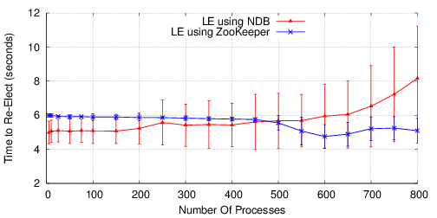
Evaluation ( Fail over time )

Slide 33
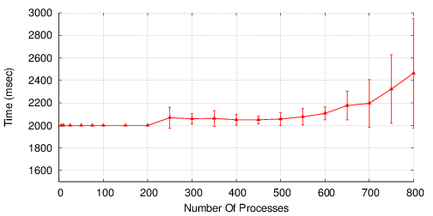
Evaluation ( Counter update duration )

Slide 34
Recent Related Work
Microsoft’s Project Orleans: Distributed Virtual Actors for Programmability and Scalability.
Uses Azure Table service for Membership Mgm
http://research.microsoft.com/en-US/people/philbe/disckeyotephilbefinal.pdf
Beast Master: Coordination Server built on top of FoundationDB
Status: Under Development
https://news.ycombinator.com/item?id=6366665

Slide 35
Questions

Slide 36
LE Properties
Integrity: there should never be more than one leader in the system.
Termination: a correct process eventually becomes a leader.
Termination: all invocations of the primitive getLeader() invoked by a correct process should return the leader’s id

Slide 37
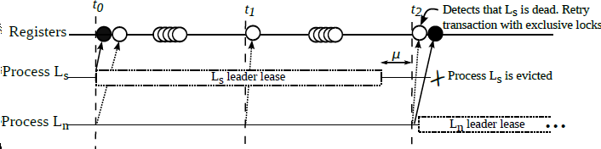
Integrity
there should never be more than one leader in the system.

Slide 38
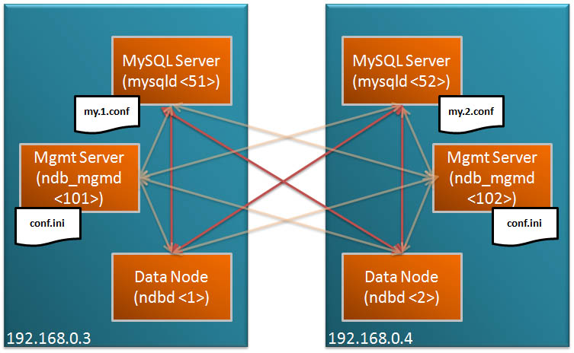
MySQL Cluster Sample HA Setup

