Slide 1

Post-Harvest Loss Reduction Advisor using GenAI
Leveraging Generative AI, RAG & Regional Language Support
for Smart Agricultural Decision-Making
Team A15 | Prasanna Anagal • Sahana R • Rachana Rane • Vindhya Hegde
01fe23bcs097 • 01fe23bcs138 • 01fe23bcs150 • 01fe23bcs160 | Domain 3: Agriculture & Rural AI

Slide 2
Problem Statement
Why Farmers Lose Crops
Consequences
Poor storage practices & facilities
No knowledge of government schemes
Limited access to weather forecasts
Language barriers to technical info
Lack of personalised advisories
~16% post-harvest food grain loss
Reduced crop quality & shelf life
Severe financial losses to farmers
Large-scale food wastage
Inefficient supply chain management
🌾 Harvest
📦 Improper Storage
🐛 Crop Loss
💸 Reduced Income

Slide 3
Why This System is Needed
Aspect | Traditional Method | AI-Powered System
Information Access | Scattered, hard to find | Centralised, instant
Language Support | English only | English + regional languages
Personalisation | Generic advice | Crop & region specific
Scheme Awareness | Farmer must search manually | Auto-checked eligibility
Storage Guidance | Word of mouth | Data-driven AI advisory
Report Generation | Not available | Downloadable DOCX

Slide 4






Project Objectives
Crop-Specific Storage Recommendations
Weather-Aware Storage Risk Prediction
Government Scheme Eligibility Check
Multilingual Natural Language Queries
Downloadable Advisory Reports (DOCX)
Reduced Post-Harvest Losses

Slide 5
Proposed Solution Overview
System Components
System Capabilities
Generative AI (Groq LLM)
RAG – Retrieval-Augmented Generation
ChromaDB Vector Database
IndicTrans2 Translation Engine
python-docx Report Generator
Streamlit Web Interface
Understand farmer queries in natural language
Generate personalised management plans
Respond in Kannada or English
Export advisory as DOCX report
Check government scheme eligibility

Slide 6
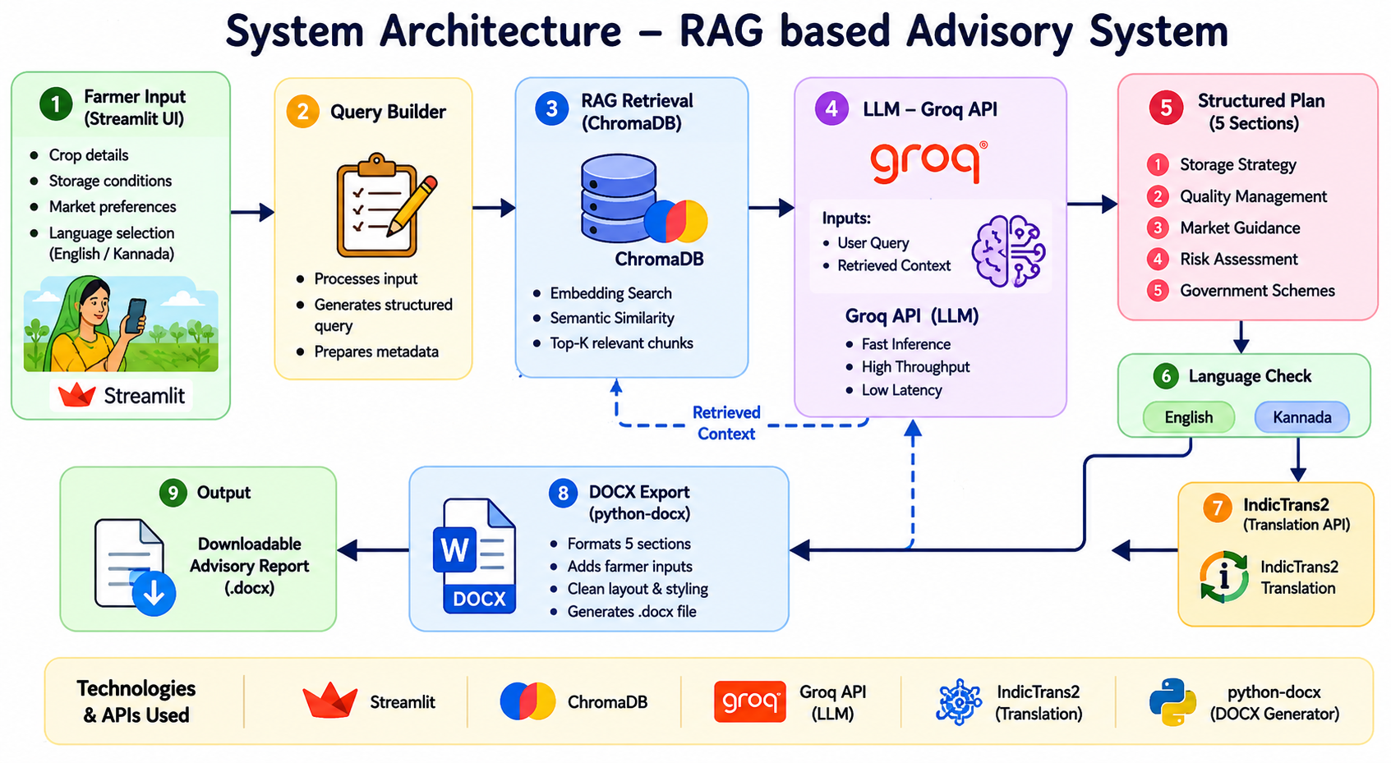
System Architecture
Farmer (Streamlit UI)

Slide 7
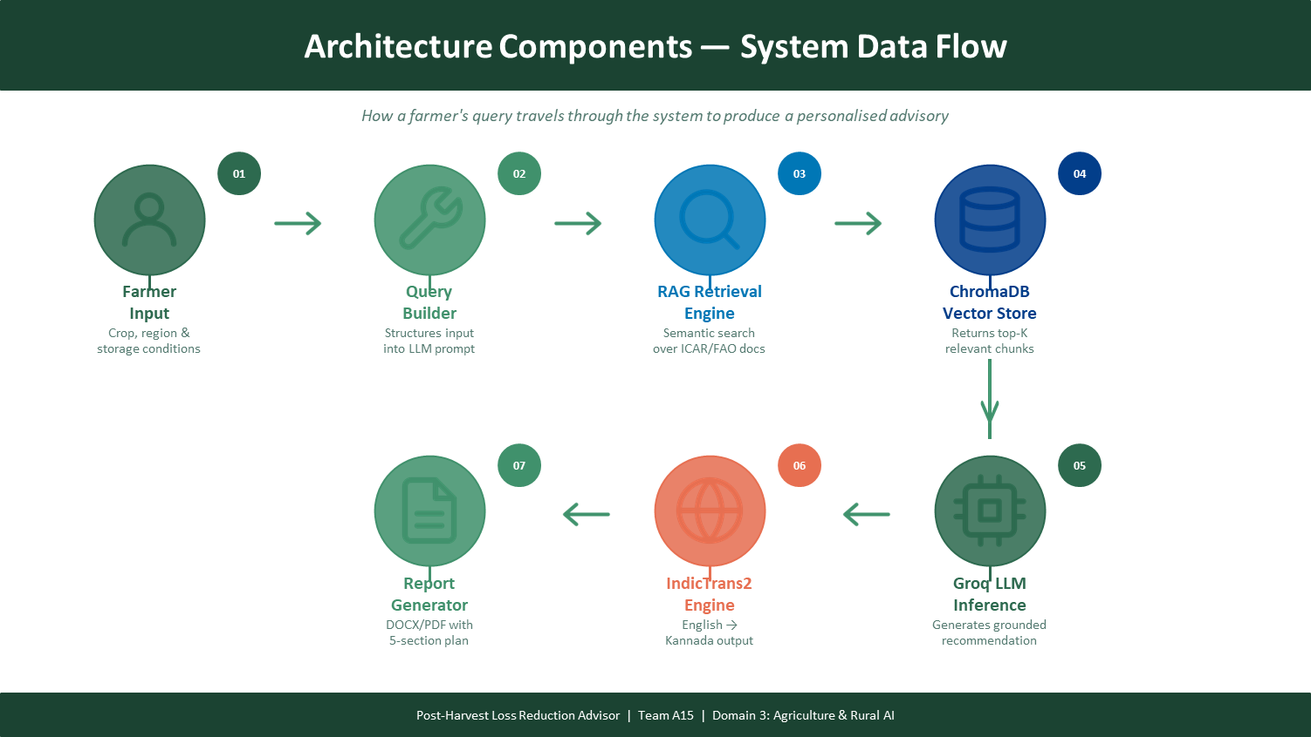

Slide 8
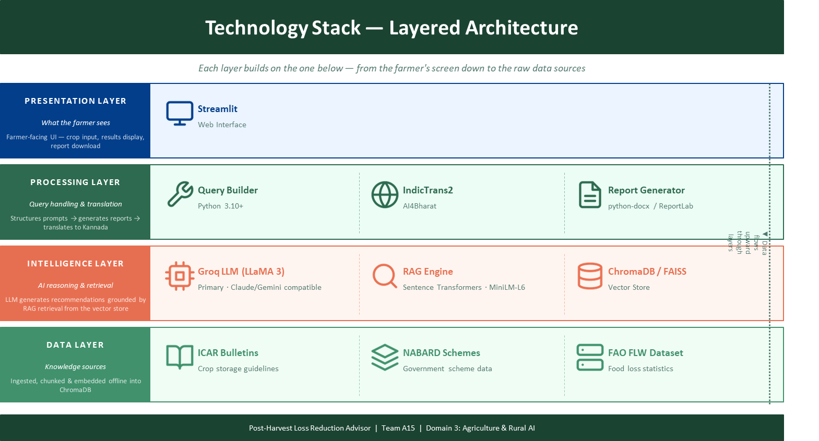

Slide 9
Implementation Flow
01 Farmer Enters details
06 Groq LLM Inference
02 Structured Query Format
07 Structured Recommendation
03 Embedding Generation
08 Translation (if Kannada)
04 Similarity Search (ChromaDB)
09 Report Generation
05 Relevant Docs Retrieved
10 Final Response to Farmer

Slide 10
RAG Workflow — Retrieval-Augmented Generation
OFFLINE: Knowledge Ingestion Pipeline
Document Collection
(ICAR, NABARD, FAO)
Data Cleaning
& Pre-processing
Text Chunking
(500 tokens)
Embedding
Generation
ChromaDB
Storage
ONLINE: Query-Time Retrieval & Generation Pipeline
Farmer
Query Input
Query
Embedding
Similarity Search
in ChromaDB
Top-K Chunks
Retrieved
Context +
Prompt Injection
Groq LLM
Generation
Final
Response
Why RAG? Without RAG, the LLM gives generic answers and may hallucinate crop-specific facts. RAG grounds the output in real ICAR bulletins, NABARD scheme data, and FAO loss statistics making every recommendation factual, localised, and trustworthy.

Slide 11






Key Features of the System
Smart Crop Storage Guidance
Weather-Aware Recommendations
Govt. Scheme Suggestions
Market Insights
Tailored storage recommendations by crop type, quantity & region
Uses IMD forecast data to flag humidity/temperature storage risks
Automatic NABARD/AMIF warehouse eligibility check per farmer profile
Recommends optimal selling windows based on commodity price trends
Multilingual Support
Downloadable Reports
Pest Risk Calendar
AI Query Answering
Full Kannada ↔ English switching powered by IndicTrans2
5-section DOCX advisory + pest calendar + scheme eligibility export
Region- and crop-specific pest risk window calendar from ICAR data
Open-ended farmer Q&A powered by Groq LLM with RAG grounding

Slide 12
Benefits & Impact
🌾 For Farmers
🏗 For Agriculture Sector
Reduced post-harvest crop loss
Better informed storage decisions
Access to government scheme benefits
Higher profitability per season
Guidance in their native language
Mobile-friendly downloadable reports
Reduced national food wastage
Better supply chain efficiency
Improved knowledge dissemination
Regional language AI accessibility
Data-driven policy planning support
Scalable to any Indian state/crop
India loses ~16% food grain post-harvest | Target: Reduce to <8% | Impact: Millions of farming households

Slide 13
Future Enhancements & Roadmap
Phase 1
(Current)
Phase 2
(3–6 months)
Phase 3
(6–12 months)
Phase 4
(12+ months)
Streamlit Web App
RAG + Groq LLM
DOCX Report
Kannada Support
Voice-based interaction
Mobile application (PWA)
More regional languages
WhatsApp chatbot
IoT sensor integration
Real-time market pricing
AI storage risk scoring
Offline mode support
Pan-India deployment
State govt. integration
Predictive yield models
Satellite imagery analysis

Slide 14
Conclusion
This system empowers Indian farmers with AI-driven, personalised post-harvest advisory in their native language — tackling the 16% crop loss problem through intelligent storage guidance, pest risk awareness, government scheme access, and downloadable report generation.

Slide 15
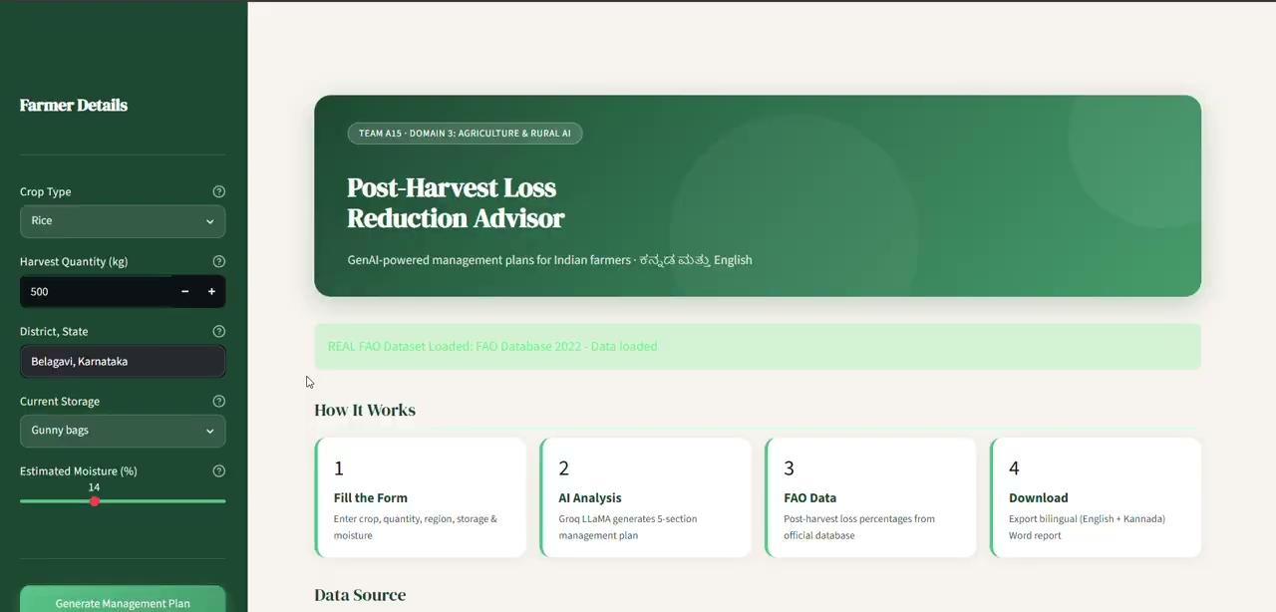
Demo

Slide 16
Thank You
Questions & Discussion
Team A15 | Prasanna Anagal • Sahana R • Rachana Rane • Vindhya Hegde
Domain 3: Agriculture & Rural AI | Post-Harvest Loss Reduction Advisor using GenAI
"Empowering farmers with AI — from harvest to storage, in their language."

