Slide 1
CLINICAL TRIAL ELIGIBILITY SCREENER USING NLP
GUIDE:
DR. GURUPRASAD KONNURMATH
GENAI

Slide 2
TEAM DETAILS
TEAM NO: A13
SLNO | NAME | ROLL NO | USN
1 | Manjunath S M | 152 | 01FE23BCS248
2 | Sanmati U Shinganmakki | 141 | 01FE23BCS290
3 | Nishita P Jahagirdar | 148 | 01FE23BCS123
4 | Spoorthi L C | 162 | 01FE23BCS255
2

Slide 3
PROBLEM STATEMENT
Matching patients to clinical trials requires parsing complex inclusion/exclusion criteria written in dense medical prose. Build a GenAl system that takes a patient's EHR summary and a set of clinical trial eligibility criteria, and produces a structured eligibility report with criterion-level match/no-match decisions and rationale.
Problem
Matching patients to clinical trials is difficult because:
Trial eligibility criteria written in complex medical language.
Manual screening takes time.
Human errors during matching.
Clinicians must compare large EHR records with lengthy trial protocols.
Proposed Solution
Develop an AI-powered system that:
Reads Patient EHR data
Reads Clinical Trial Criteria
Automatically evaluates eligibility
Generates detailed decision reports
3

Slide 4
OBJECTIVES
Extract patient information from EHR
Parse inclusion and exclusion criteria
Match eligible patients for clinical trials using NLP
Generate criterion-level decisions
Export professional reports in DOCX format
4

Slide 5
SYSTEM ARCHITECTURE
Key Modules
Presentation Layer: Streamlit UI for EHR & Trial upload
Data Processing Layer: OCR, NLP preprocessing, feature extraction
Intelligence Layer: Gemini LLM for eligibility analysis and rationale generation
Decision Engine: Match / No Match / Uncertain classification
Output Layer: Eligibility report and DOCX export
5

Slide 6
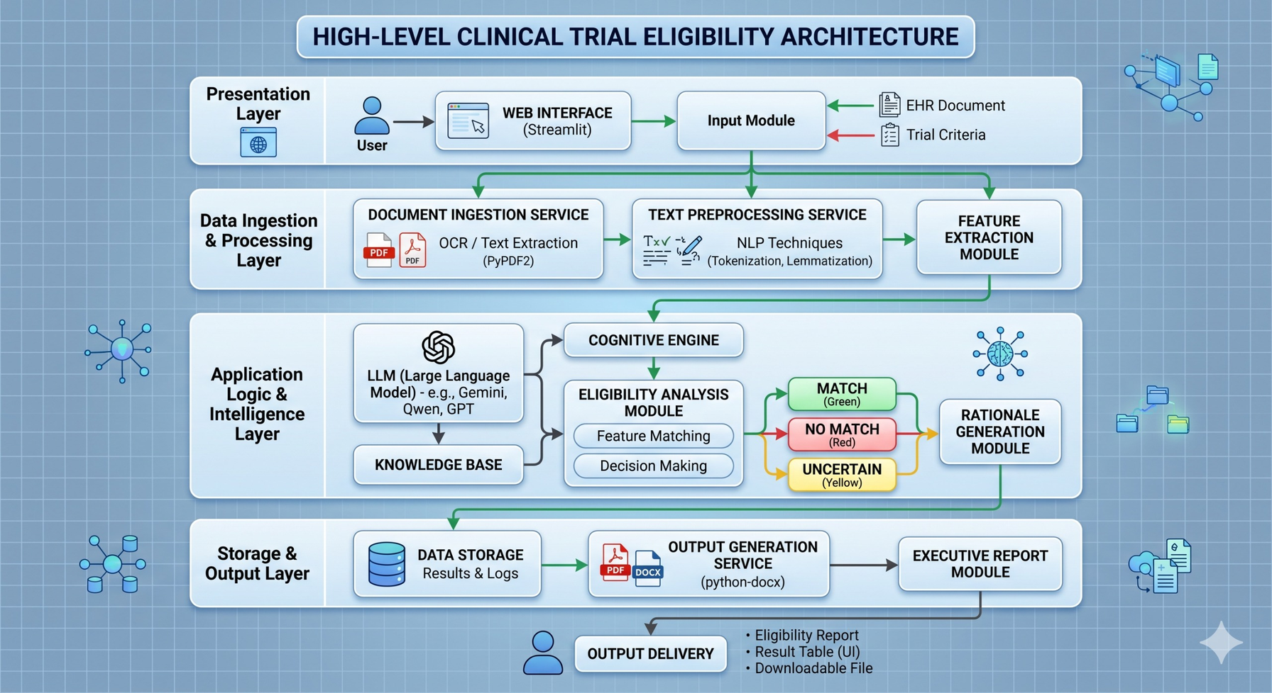
SYSTEM ARCHITECTURE
Fig 1: patient EHR and trial criteria flow through four layers — input, processing, AI analysis, and report generation.
5

Slide 7
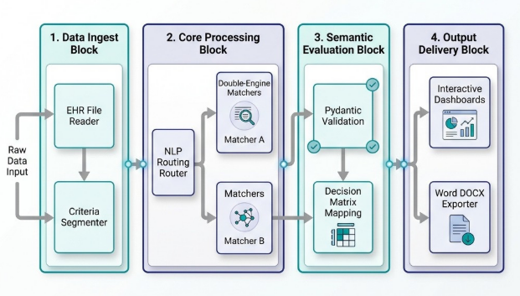
OVERALL WORKFLOW
Workflow Stages
Data Ingestion
Core Processing
Semantic Evaluation
Output Delivery
The workflow transforms raw medical documents into structured eligibility reports.
Fig 2: pipeline converting raw medical data into validated eligibility decisions and downloadable reports.
7

Slide 8
CORE MODULES
Patient EHR Reader
Criteria Segmenter
NLP Router
Double Engine Matcher
Gemini AI Engine
Pydantic Validator
8

Slide 9
ELIGIBILITY DECISION LOGIC
Inclusion Analysis:
Patient must satisfy required inclusion rules.
Exclusion Analysis:
Checks disqualifying conditions.
Decision Matrix:
Condition | Result
All Inclusion Met | Eligible
Any Exclusion Match | Ineligible
Missing Information | Uncertain
9

Slide 10
TECHNOLOGY STACK
Python
Streamlit
Google Gemini 1.5 Pro
LangChain
Pydantic
Pandas
PyPDF2
python-docx
10

Slide 11
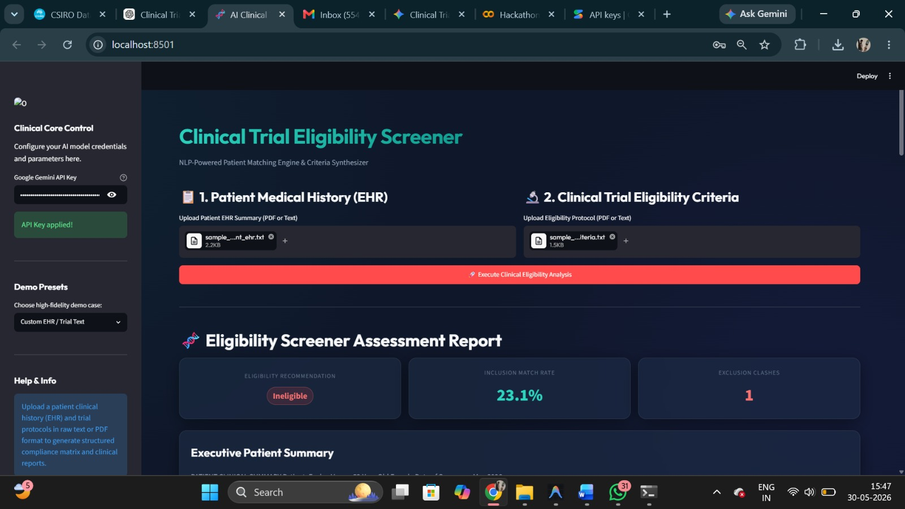
SYSTEM DEMO
Fig 3.1: Demo f UI
11

Slide 12
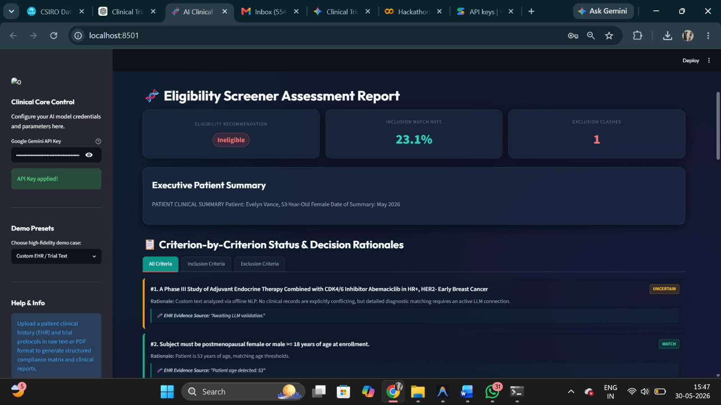
SYSTEM DEMO
Fig 3.2: Demo f UI
12

Slide 13
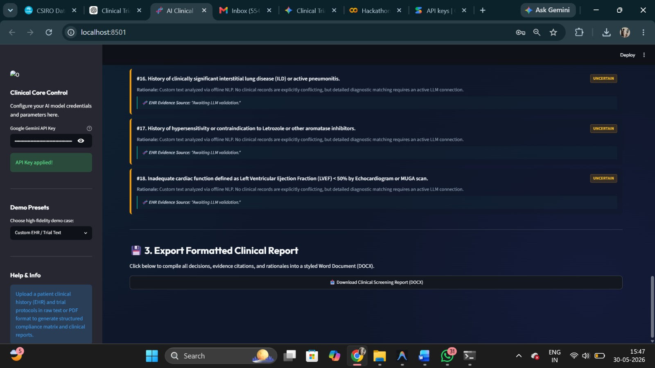
SYSTEM DEMO
Fig 3.3: Demo f UI
13

Slide 14
THANK YOU
14

