Slide 1
Factorization Meets the Neighborhood: a Multifaceted Collaborative Filtering Model
Lee Yoonho

Slide 2
Background
CF(collaborative filtering)
Analyzes past transaction to identify user –product connection
(+) domain knowledge not required
(+) no need for extensive data collection
(-) cold start
Explicit feedback
Explicit input by user (Ex : rating)
Sparse matrix
Implicit feedback
User behavior indirectly reflecting opinion (Ex : search, )
Dense matrix

Slide 3




Neighborhood Model
Baseline estimate :
Neighborhood Model
Relationship between users or items
(+) intuitive & explainable prediction
(-) not entire neighbors
(-) what if similar items are not rated?

Slide 4

Latent Factor Model
Latent Factor Model
Uncover latent factors that explains observing
Singular Value Decomposition (SVD)
Missing data -> overfitting
Attractive accuracy & scalability

Slide 5
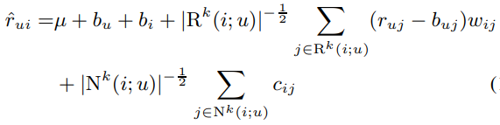
New Neighborhood Model
(+) implicit feedback
(+) global optimization
→ user’s opinion formed by both rated and not rated

Slide 6
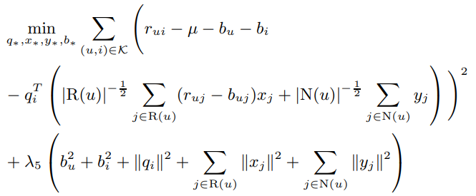
Assymmetric SVD
(+) New User
(+) Explainable
(+) Lower complexity
(+) implicit feedback

Slide 7
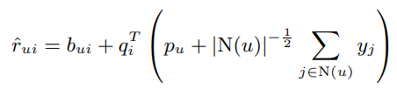
SVD++
(+) implicit feedback

Slide 8

Experiment
Dataset
Netflix dataset
100 million movie ratings (star : 1 ~ 5)
500,000 anonymous customers
Accuracy
Root mean square error(RMSE)

Slide 9
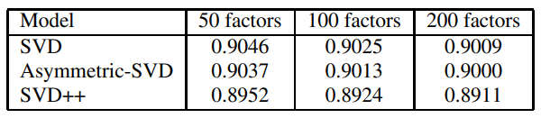
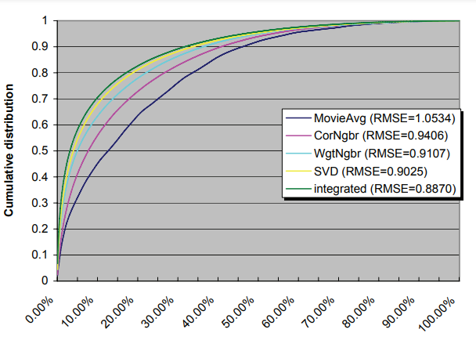
Experiment
Performance :
SVD++ > Asymmetric-SVD > SVD
MovieAvg : best movie
CorNgbr : neighborhood
WgtNgbr : weighted neighborhood

Slide 10

Questions?

Slide 11
Discussion
(+) global scope of neighborhood, (+) implicit data,
(+) used both latent factor model and neighborhood model
Experiment → No implicit data tested
Good for recommending item, but not for explanation behind it( ex : factors)
Pros and cons of domain-free property of CF
How to determine number of factors? (without domain knowledge)
No use of timestamp
Our project ?

