Slide 1
Restaurant Recommendation System fall 2018
Team Members:
Yi Liu
Manlun Song
Reporsitory: https://github.com/SoapLiu/RestaurantRecommendationSystem

Slide 2
Aim to do:
Restaurant recommendation system which can give back the top restaurant according to where you are and what you might like.
The system is built on Apache Spark with Scala to parse, clean, filter enormous data.

Slide 3
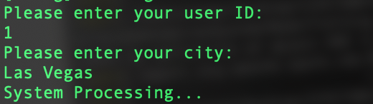
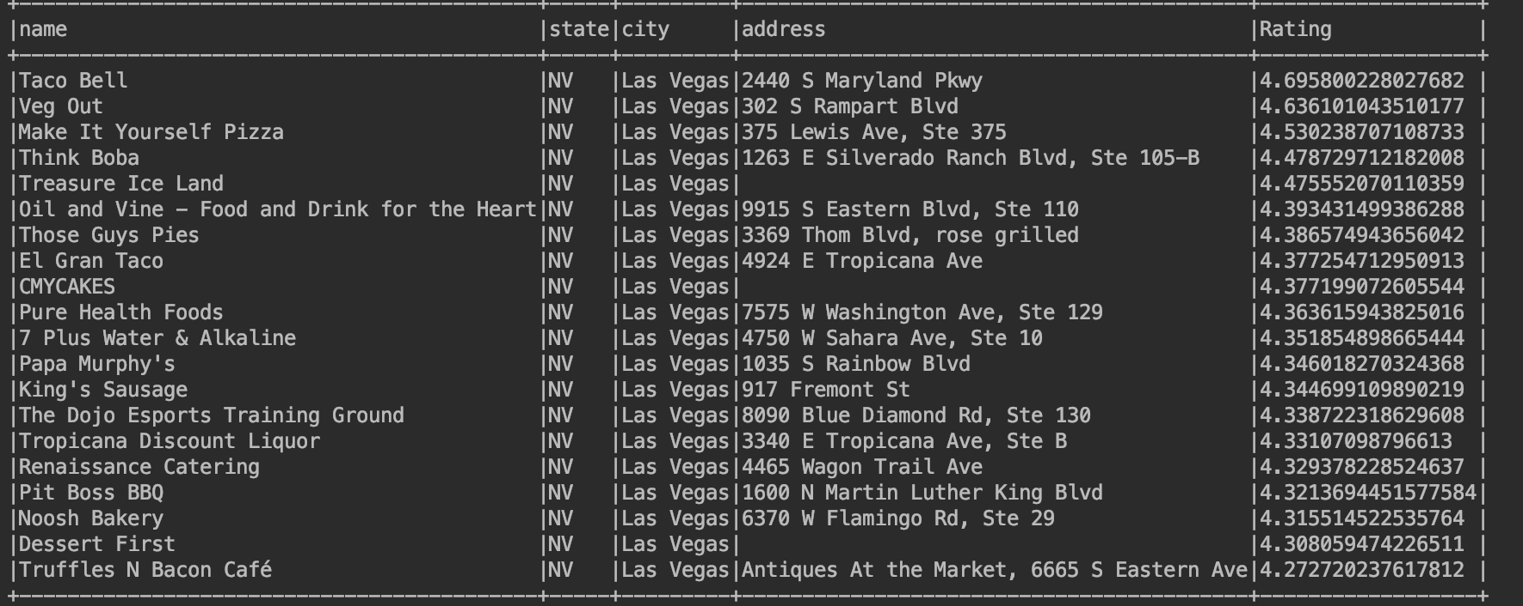
Use case
Users input user ID and location. Recommendation system returns the top near restaurants that you might thumbs up.

Slide 4
Data Source
Yelp Dataset :A trove of review, business, user and check-in data
Business(174 thousands): Basic information about every restaurant, including location, review counts, etc.
Review(5 million): review information includes user_id, restaurant_id, date, rating and review content.
User: user’s specific information.
https://www.kaggle.com/yelp-dataset/yelp-dataset

Slide 5
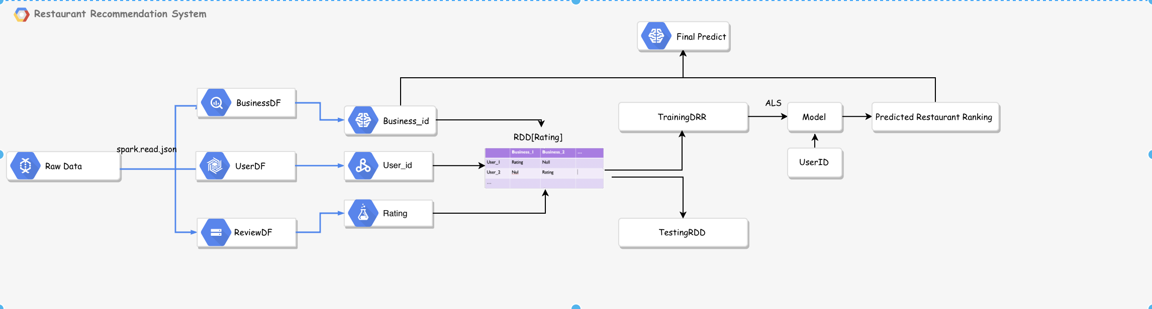
Work Flow
Notes:
Roughly talking about the work flow: 1. We parse the json file, and transform their structure into dataframe. 2.And then we ingest business id, user id, Rating, these are what we need to build an rating matrix; 3. Next Step, we use those 3 kind of data to build RDD. And split those data into two part: 80% of those are used to train ALS model, to used for prediction, in an other word. The rest 20% are used for evaluating the model . 4. According to what user keys in, his id and location, to filter the relevant restaurant and give them back to user.

Slide 6
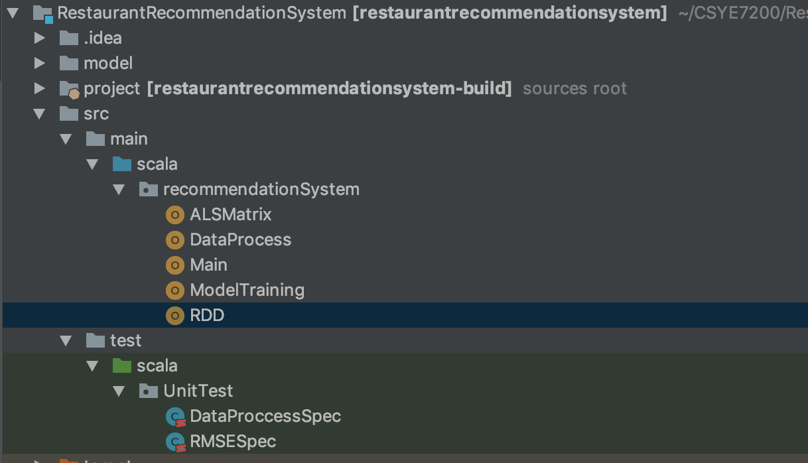
Project structure
Notes:
This is our project structure. I’ll explain each part of them in the next. slides

Slide 7
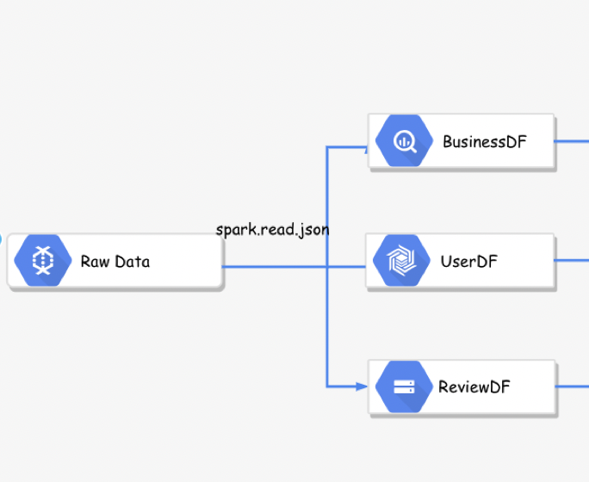
Methodology
DataPreprocess.scala:
Parse Json file, get raw data (Spark.read.json)
Selet the data that we need, including type of restaurant, address,ect
Get 3 DataFrames: Business DataFrame, User DataFrame, and Rating DataFrame.
Notes:
At first, we process the raw data. We use Spark.read.json to read and parse json file. It transfor json file into dataframe. There are 3 Json files, so we get 3 dataframe: BusinessDF, UserDF and Review dataFrames. Each dataframe includes specific information of each part. Such as name, address and categary in business DF.

Slide 8
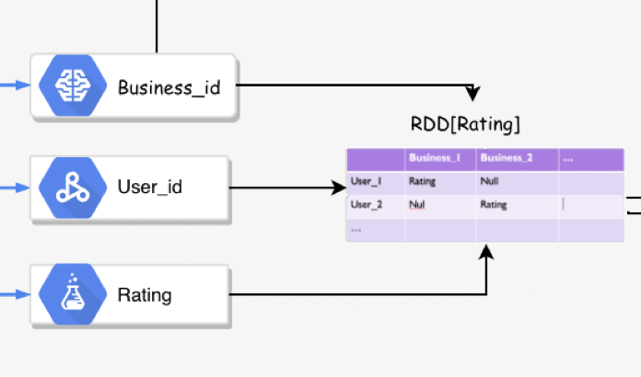
Methodology
RDD.scala:
Select business_id from Business DataFrame, user_id from User DataFrame, Rating from Rating DataFrame
Structure an Rating RDD. This RDD is splited into two part: Trainingdata RDD is used to train ALS model. And the rest is used to evaluate.
Notes:
And then, we transform dataframs into RDD, which will be used in the next training model part. We ingest business_id, User_id and Rating from thoes previous dataframes. And the user ratings on restaurants are represented as a matrix, user-restaurant rating matrix

Slide 9
Methodology
RDD[Rating] → User-Restaurant Matrix
 | Restaurnt_1 | Restaurant_2 | …
User_1 | 4.0 | Null
User_2 | Null | 3.5
… |  |  | …
Notes:
where a cell represents ratings for a particular Restaurant by a user . There might be some Empty rating. The empty cells represent the restaurant user is not aware of or hasn’t tasted, what we are going to do is to predict the missing rating, to fill the empty cell

Slide 10
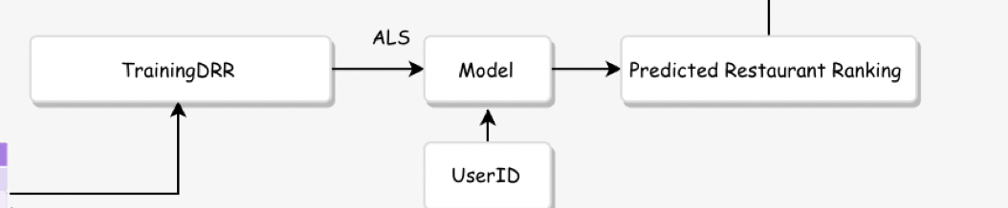
Methodology
ALSMatrix Model Training:
org.apache.spark.mllib.recommendation.{ALS, MatrixFactorizationModel, Rating}
Modify parameters to optimize the model. Then select and deploy the best model. Best model will be saved to local, in order to make next prediction.
Best model is deployed to make prediction and rank all restaurants.
Notes:
The tool of predicting the missing rating is ALS Matrix Model. Spark MLlib uses Alternate Least Squares (ALS) to make a prediction. ALS use a preference of other users who have the similar interests to predicts restaurants of any user’s unkonwn interests. In our project, it is used to predict the rating that user might give to particular restaurant.
Als will give back a model of predicts.
In this process, We modify the training parameter sets to get several models, and calculate RMSE with testingdata RDD to evaluate them and select the best one.

Slide 11
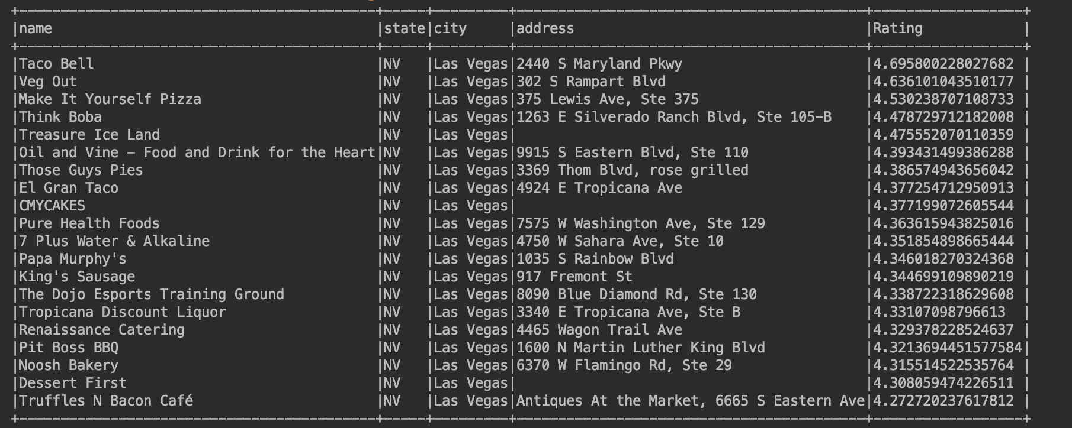
Methodology
Filter relevant restaurants:
Come back to business Dataframe. Filter restaurant using location that user keys in.
Order these restaurants according to the rank we got from the previous step.
Notes:
In the end, Come back to business Dataframe. Filter restaurants using location that user keys in, and give back the rank of these restaurant in this location.

Slide 12
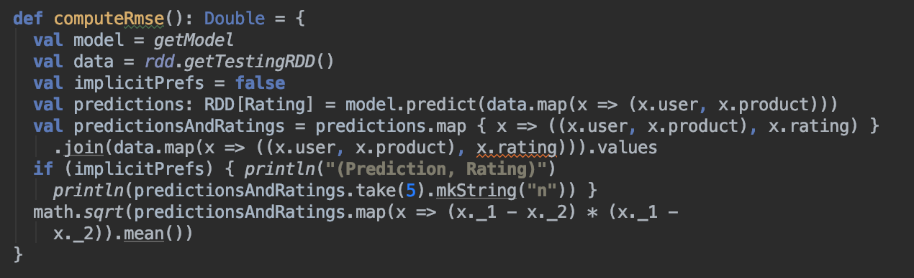

Acceptance criteria
RMSE:
In order to verify the quality of the model, Root Mean Squared Error (RMSE) is used to measure the difference between values predicted by a model and the values actually observed. The smaller the calculated error, the better the model. In order to test the quality of the model, the test data is used.
RMSE <1
Notes:
when the RMSE < 1 , we can verify the quality of this model

Slide 13
Milestone:
11.11 - 11.18: Source data and understand relevant algorithm
11.19 - 11.26: Parsing data using Spark and Scala from dataset
11.27 - 12.2: Build an ALS user product matrix and make predictions
12.9 - 12.13: Testing and prepare for presentation

