Slide 1


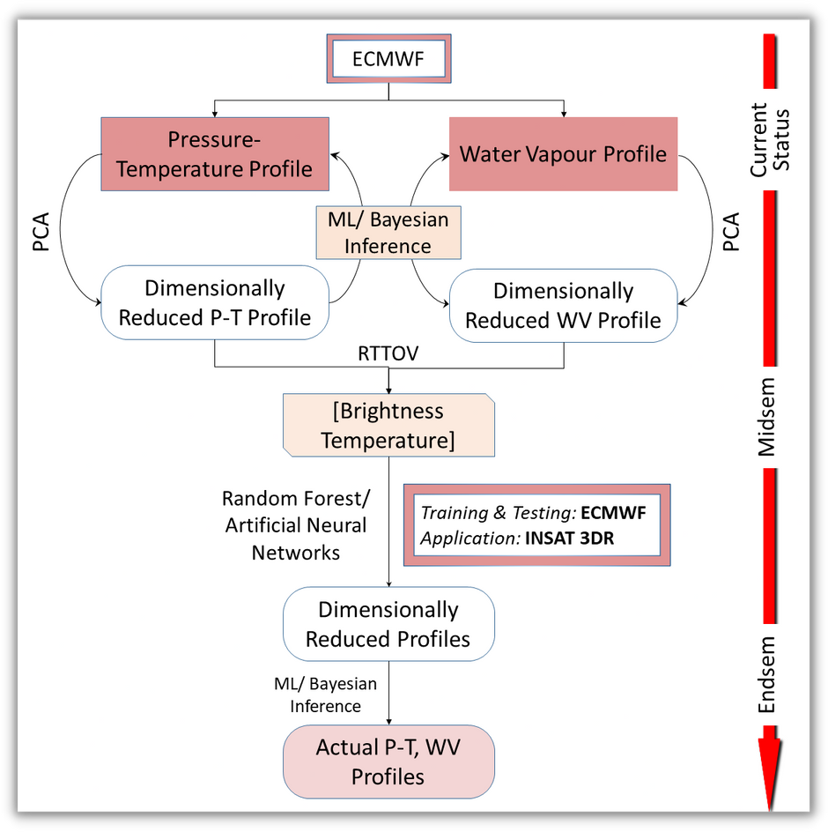




Retrieving Pressure-Temperature and Water Vapour Profiles in Earth’s Atmosphere from INSAT 3DR data using Machine Learning
Fida Salim, Soumik Bhattacharyya (Group 20)
In Supervision of Dr. Subhankar Mishra and Dr. Jayesh M. Goyal
Idea:
Due to lack of instruments to measure actual sea surface temperature, brightness temperature(s) (BT) from satellite data is used as a proxy in practice. In this project we will use a radiative transfer model (RTTOV) to get the BT from available pressure temperature (P-T) and water vapor (WV) profiles and develop a machine learning algorithm to backtrace those profiles from BT obtained by INSAT 3DR satellite images.
Dataset:
25000 P-T and WV Profiles from ECMWF;
INSAT 3D sounder images produced in every 30 minutes
Expected Results :
Dimensionally reduced P-T or WV profiles to get BT within affordable tolerance;
P-T and WV profiles predicted from Satellite BT

Slide 2









Relevant Paper
Lasota, E. Comparison of different machine learning approaches for tropospheric profiling based on COSMIC-2 data. Earth Planets Space 73, 221 (2021). https://doi.org/10.1186/s40623-021-01548-4
Stephens, G. L. (1990). On the Relationship between Water Vapor over the Oceans and Sea Surface Temperature, Journal of Climate, 3(6), 634-645.n.
Jindal, P et al. Total column ozone retrieval using INSAT-3D sounder in the tropics: A simulation study. J Earth Syst Sci 123, 1265–1271 (2014). https://doi.org/10.1007/s12040-014-0477-1
Midway Target and Work Division
Data Collection and preprocessing (Combined)
1
2
Feature selection in P-T profile using dimensionality reduction algorithm
(Soumik).
Baseline
3
Feature selection in W-V profile using dimensionality reduction algorithm
(Fida).
PCA for dimensionality
reduction
of P-T and
WV profile.
Random forest and ANN will be used for retrieving P-T and WV profile from BT
Learn about Neural Network and implement an ANN model as initial stage. (Combined)
4
5
Project Report (Combined)

