Slide 1
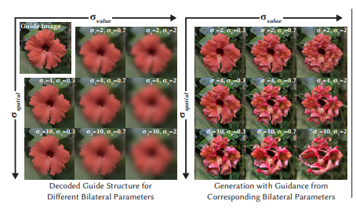
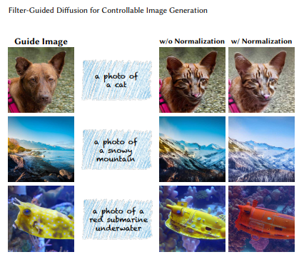
Filter-Guided Diffusion for Controllable Image Generation
What is the problem?
What has been done earlier?
"Filter-Guided Diffusion for Controllable Image Generation" addresses the issue of generating high-quality images while maintaining control over specific attributes. The authors propose a novel diffusion model that incorporates learned filters to guide the generation process, allowing for precise manipulation of desired features. This approach improves the controllability and quality of generated images compared to existing methods.
Earlier research in Filter-Guided Diffusion for Controllable Image Generation uses a filter to guide the diffusion process, allowing users to specify desired features in the output image. The filter is learned from a small set of reference images, and it is used to modulate the diffusion process at each step. This approach enables the generation of images with precise control over their content and style.
Saswat Jagannath Mishra,B421044

Slide 2
What are the remaining challenges?
What novel solution proposed by the authors to solve the problem?
1. Fine-Grained Control:
Precise Attribute Manipulation: While these models can control certain high-level attributes, achieving precise control over finer-grained details like object poses, textures, or lighting conditions remains challenging.
Consistent Control: Ensuring that the desired changes are applied consistently across different parts of the image or across multiple generations is often difficult.
2. Generalization:
New Attributes: Extending the model's ability to control attributes that were not encountered during training can be problematic.
Domain Shifts: Adapting the model to new domains or styles without retraining on a large amount of data is a significant challenge.
3. Efficiency:
Computational Cost: Generating high-quality images with fine-grained control can be computationally expensive, limiting their practical applications.
Sampling Speed: Improving the speed of the sampling process is essential for real-time or interactive applications.
4. Quality and Realism:
Artifact Reduction: Reducing artifacts and noise in the generated images, especially when performing complex manipulations, remains an ongoing challenge.
Photorealism: Achieving photorealistic quality, particularly for complex scenes or objects, is still a demanding task.
Finer Control: FGD introduces a new mechanism to control the generation process by applying filters to the guidance signal. This enables more precise control over the frequency content and strength of the guidance, leading to more accurate and visually appealing results.
Efficiency: FGD is computationally efficient, as it relies on fast filtering operations rather than complex neural network architectures. This makes it practical for real-time applications and large-scale image generation tasks.
Flexibility: FGD is compatible with various sampling methods, allowing users to choose the best approach for their specific needs. This flexibility makes it applicable to a wide range of image generation scenarios.
Improved Quality: FGD consistently outperforms existing methods in terms of structural and semantic metrics, demonstrating its ability to generate high-quality images with better control over their content.
Saswat Jagannath Mishra,B421044

