Slide 1
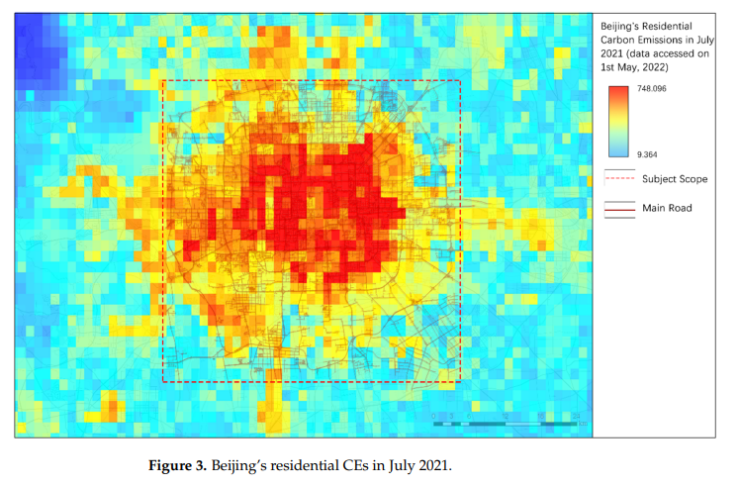
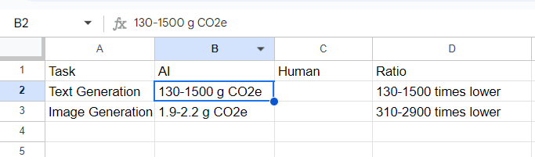
AI-Driven Exploration of climate change
What is the problem?
What has been done earlier?
The project aim is to use AI-driven computer vision to detect and suggest ways to reduce carbon emissions, particularly through optimization of traffic flow and reducing vehicle congestion to tackle the problem of climate change.
Earlier research in AI-Driven Exploration of climate change in carbon emission footprint focused on the idea that AI language models can be more efficient than humans in creative tasks like writing and image generation, resulting in a significantly lower carbon footprint. This is because training large language models can be very energy-intensive. However, smaller AI models can be used for simpler tasks and can be more energy-efficient.
Saswat Jagannath Mishra,B421044

Slide 2
What are the remaining challenges?
What novel solution proposed by the authors to solve the problem?
Data Quality and Availability:
Insufficient Data: Many regions lack sufficient high-quality data for training AI models.
Data Bias: Bias in training data can lead to biased and inaccurate predictions.
2. Computational Complexity:
Resource-Intensive: Large-scale AI models require significant computational resources, which can be environmentally costly.
3. Model Interpretability:
Black Box Problem: Understanding how AI models reach their conclusions is crucial for decision-making, but it can be challenging.
4. Scalability and Generalizability:
Domain-Specific: AI models may be overfitted to specific regions or conditions, limiting their generalizability.
5. Ethical Considerations:
Privacy Concerns: Data collection and usage must adhere to strict privacy regulations.
1.Data Augmentation and Synthesis:
Generating New Data: Creating synthetic data can supplement real-world data, improving model performance.
Data Quality Enhancement: Techniques like image enhancement and noise reduction can improve data quality.
2.Efficient Model Architectures:
Lightweight Models: Developing smaller, more efficient models can reduce computational costs.
Transfer Learning: Leveraging pre-trained models can accelerate training and reduce resource requirements.
3.Explainable AI:
Feature Importance Analysis: Identifying the most influential features can help understand model decisions.
Visualization Techniques: Visualizing model outputs can make them more interpretable.
4.Domain Adaptation:
Transferring Knowledge: Adapting models to new domains can improve their generalizability.
Domain-Specific Features: Incorporating domain-specific features can enhance model performance.
5.Ethical Frameworks:
Privacy-Preserving Techniques: Using techniques like differential privacy to protect sensitive data.
Saswat Jagannath Mishra,B421044

