Slide 1
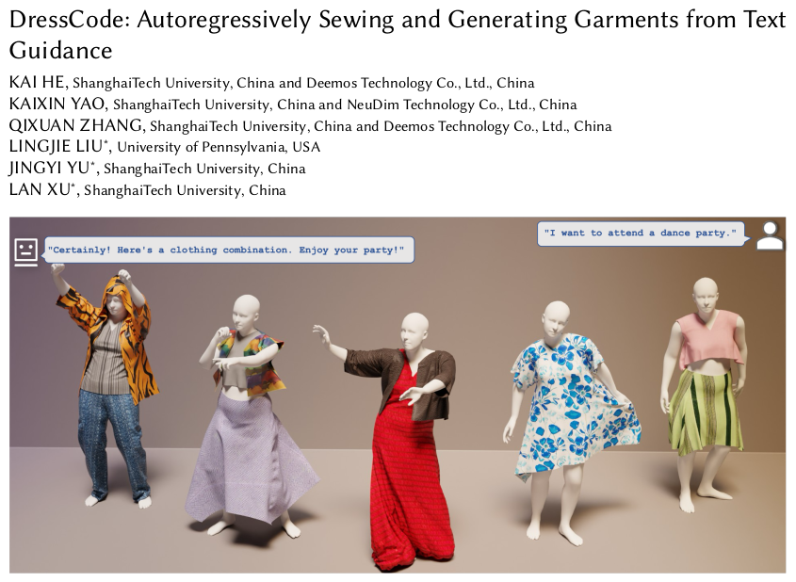
Presented By Baibhav Kumar (B421016)

Slide 2
Early Work and Requirements
What has been done till now?
Representing garments through Meshes or Neural Fields
Topology Limitations
Draping Limitations
Point cloud representation
Suitable to represent geometry but cannot represent textures.
Requirements
CG-friendly garment generation using Sewing Patterns.
Vivid generation through desired textures and Physically Based Materials.
Handling generation through more natural language interactions.

Slide 3
DressCode : The New Paradigm
DressCode is a novel framework that empowers users to create customized 3D garments simply by describing them with text.
Input: Natural language text prompts describing the garment's shape, style, and desired texture.
Two Key Components:
SewingGPT: A GPT-based architecture specifically trained to generate sewing patterns from text. SewingGPT outputs the garment's blueprint, detailing how different fabric panels are connected and arranged.
Fine-tuned Stable Diffusion: A tailored version of the powerful Stable Diffusion model, trained on a dataset of PBR textures. Given text descriptions, this component generates realistic fabric textures to apply to the generated garment.
Output: High-quality, CG-ready 3D garments that can be seamlessly integrated into existing digital fashion pipelines for animation, rendering, and further editing.

Slide 4
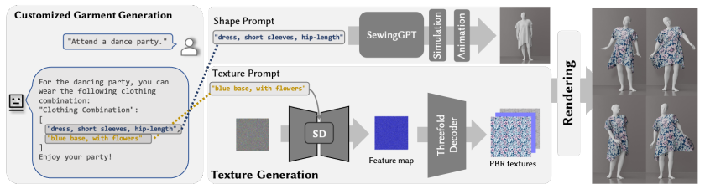

Slide 5
Achievements and Limitations
Achievements
Highest CLIP Score of 0.327 in its category.
PBR Texture, Texture Editing, Draping available.
Least runtime of ~4s compared to competing models.
Limitations
Expand the dataset with more diverse and wider garments.
Increase modality.
Potential ethical concerns.

