Slide 1
LIMAP - Global Mapper 3D Line Mapping Revisited
What is the problem?
3D line-based reconstruction methods are far less developed compared to point-based methods. Although line segments offer strong geometric cues and can efficiently represent the overall scene structure, particularly in urban and indoor environments, the available methods for reconstructing 3D lines from multiple views are not robust. Specifically, existing methods struggle with line triangulation (converting 2D line segments into 3D structures) and do not integrate well with point-based systems. This limitation prevents lines from being effectively used in various applications like visual localization and bundle adjustment.
What has been done earlier?
Earlier works have mainly focused on keypoint-based reconstruction methods, such as Structure-from-Motion (SfM), which are efficient at creating 3D point clouds from multi-view images. These methods rely on identifying and matching keypoints (small, detailed features) across images to reconstruct scenes. Line-based methods, though potentially powerful, have not been fully explored due to issues with line triangulation and tracking. Some line-based techniques have been proposed, but they often rely on simplified settings or struggle with the complexities of real-world scenes. Previous methods have also not fully leveraged the structural information that line segments can provide.
Sai Simran Patro,B421043

Slide 2
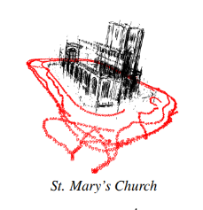
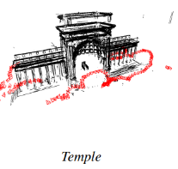
What are the remaining challenges? What novel solution proposed by the authors to solve the problem?
Degeneracy in line triangulation: Current methods struggle to accurately transform 2D line segments into 3D, especially under certain viewing conditions (e.g., when lines are nearly parallel to the camera).
Robust scoring and track-building: There is a lack of effective techniques for reliably tracking line segments across multiple frames and scoring them to ensure high accuracy in complex scenes.
Poor integration with point-based methods: Point-based 3D reconstruction techniques are widely used, but existing line-based methods do not integrate well with these approaches.
Utilization of structural priors: Important structural information such as parallelism, orthogonality, and line coincidence has not been fully incorporated into line-based methods, reducing their potential accuracy.
The authors propose LIMAP, a library for robust and efficient 3D line mapping
Revisiting and solving line triangulation issues,
New techniques for scoring and track-building line segments,
Exploiting structural priors like line coincidence and parallelism,
Seamless integration with point-based SfM methods, improving line accuracy
using point clouds.
Sai Simran Patro,B421043

