Slide 1


INFRAPOD
Technologies

Slide 3
INFRAPOD
Technologies

Slide 5



Networking
Backup

Slide 6
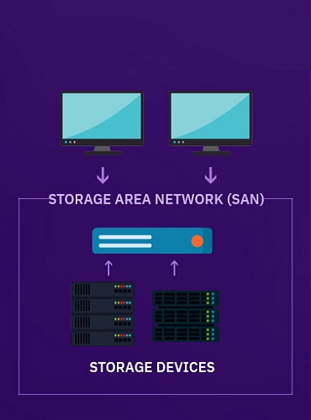





Slide 7





Slide 8





Slide 9


SatyaCodes
Design. Code. Deploy

Slide 10


https://www12.lunapic.com/editor/?action=save
INFRAPOD
Technologies

