Slide 1
Burn-Out Bot
Ty Pavia & Saran Lendzian
ART 4201: New Media Robotics – Fall 2022
Final Project Idea Presentation

Slide 2
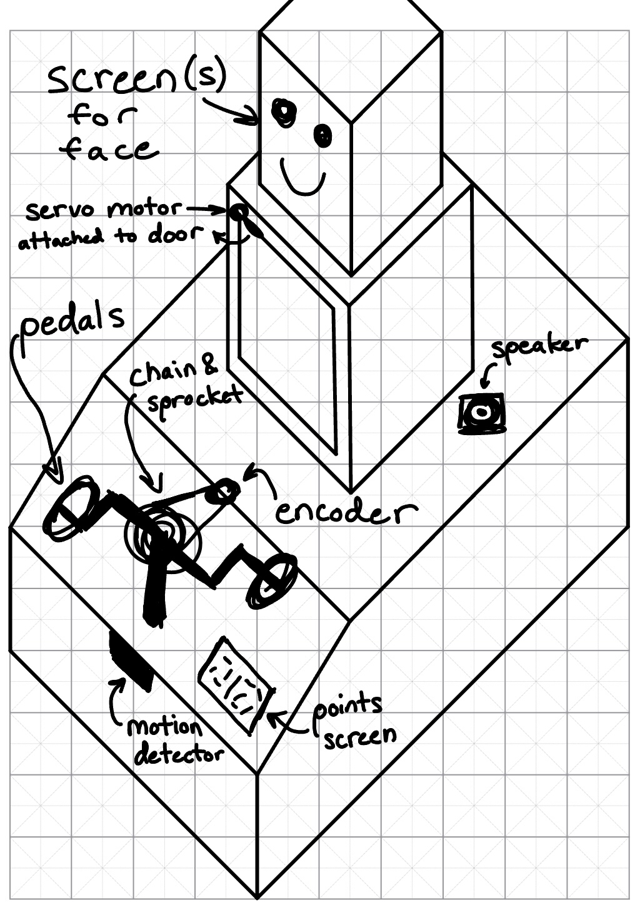

Slide 3
Robot face reacts when it "sees" a person come near
😐
😄

Slide 4
As one continues to move the pedals,
Points go up
Positive reinforcement from the speaker
Either words or positive feedback sounds

Slide 5
As one continues to move the pedals,
Robot Face:
😄
🥺
😢

Slide 6
As one continues to move the pedals,
Torso casing swings open -- underneath any mechanical facade we are forced into, we are still human.
😢
Human organs
(heart)

Slide 7
As one continues to move the pedals,
Soon, the door closes again, and the process continues
😢

